Slide 1
Process of identifying and selecting IS development projects
-Nishan Yonjan

Slide 2
It consists of three primary activities:.
Identifying potential development projects
Classifying and ranking projects,
Selecting projects for development

Slide 3
Identifying potential development projects
Organizations vary as to how they identify projects. This process can be performed by:
Key member of top management
Steering committee with managers having an interest in systems
User department unit
The development group
They all do is decide which project to submit.

Slide 4
Top Management
Steering Committee
User Department
Development Group
Selection Methods for identifying potential development projects

Slide 5
Each identification method has strengths and weaknesses.
Projects identified by top management have a strategic focus.
Projects identified by steering committees have a cross-functional focus.
Projects identified by user department have a narrow nonstrategic focus.
The development group identifies projects based on the ease with which existing hardware and systems will integrate with the proposed project.
Other factors, such as project cost, duration, complexity, and risk, also influence the people who identify a project. Table below summarizes the characteristics of each selection method.

Slide 6
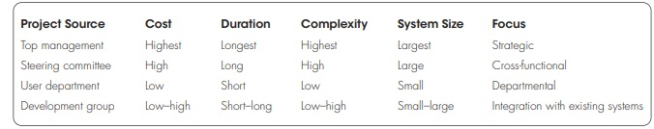
Characteristics of Methods for making IS identification and Selection Decision

Slide 7
Classifying and Ranking Projects
Evaluating the merit of potential projects is the second major activity.
Can be performed by top managers, a steering committee, user department, or the development group.
The criteria used to assign the merit of a given project can vary based on the size of the organization.
If, for example, an organization uses a steering committee, it may choose month or quarter of year to review projects and use a wide variety of evaluation criteria.

Slide 8
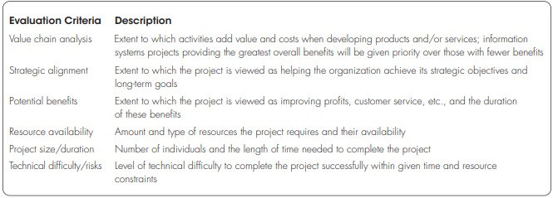
Possible evaluation criteria when classifying and ranking projects

Slide 9
Selecting IS Development Projects
The selection of projects is the final activity in the project identification and selection phase.
The short- and long-term projects most likely to achieve business objectives are considered.
As business conditions change over time, the relative importance of any single project may substantially change.
Thus, the identification and selection of projects is an important and ongoing activity.

Slide 10
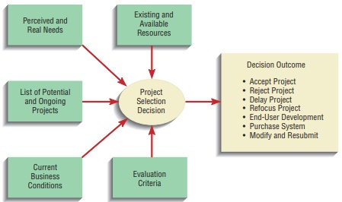
Project selection decision must consider numerous factors and can have numerous outcomes

Slide 11
This decision-making process can lead to numerous outcomes.
Projects can be accepted or rejected.
Acceptance of a project usually means that funding to conduct the next project has been approved.
Rejection means that the project will no longer be considered for development.
However, projects may also be conditionally accepted; projects may be accepted pending the approval or availability of needed resources..
Finally, the requesters of a project may be asked to modify and resubmit their request after making suggested changes or clarifications.

Slide 12
Deliverables and Outcomes
The outcome from the project identification and selection phase is a schedule of specific IS development projects.
The projects move into the second activity i.e project initiation and planning.
An outcome of this activity is the assurance that people in the organization gave careful consideration to project selection and clearly understood how each project could help the organization reach its objectives.

Slide 13
Because of the principle of incremental commitment, a selected project may or may not be turned into working software.
Incremental commitment: A strategy in system analysis and design in which the project is reviewed after each phase and continuation of the project is justified in each of these reviews.
This will determine whether the business conditions have changed or whether a more detailed understanding of a system’s costs, benefits, and risks would suggest that the project is not as worthy as previously thought

Slide 14
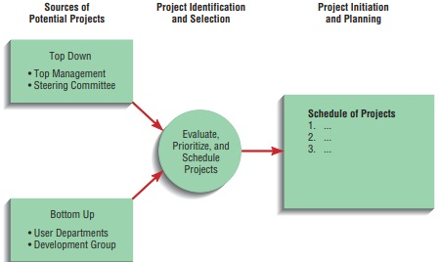
Is development projects come from both top-down and bottom-up initiatives

