Slide 1

CouchDB
Presented By
Team 9:
Donita Almeida
Dhiraj Gurnani
George Zachariah
Ritika Shetty
Saina Patel

Slide 2
Introduction
Why CouchDB ?
Powerful data processing using the built-in query engine
Modular & Scalable design
User friendly

Slide 3
Features
A NoSQL database
Uses JSON for documents
Uses JavaScript for MapReduce indexes
Uses HTTP for it’s API
Documents can have attachments

Slide 4
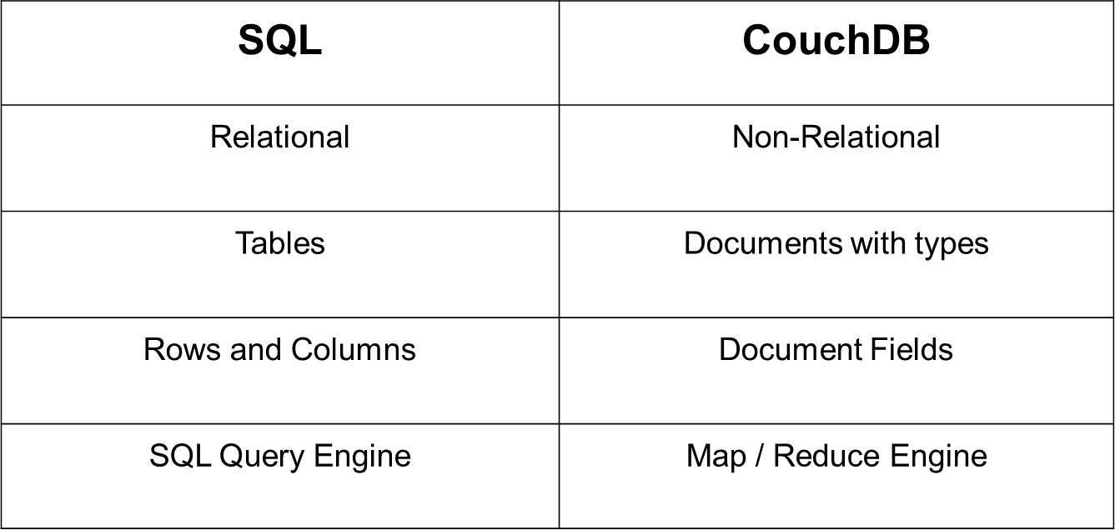
SQL vs CouchDB

Slide 5
CouchDB Core API (Command Line Utility )
Server API
Database API
Document API
Replication API

Slide 6
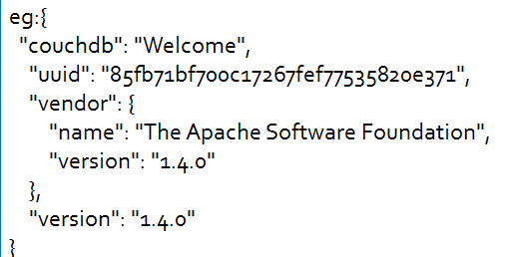
Server API (Access via CURL)
5984 is the port where Couch DB server runs
curl http://127.0.0.1:5984/
This returns the database information

Slide 7
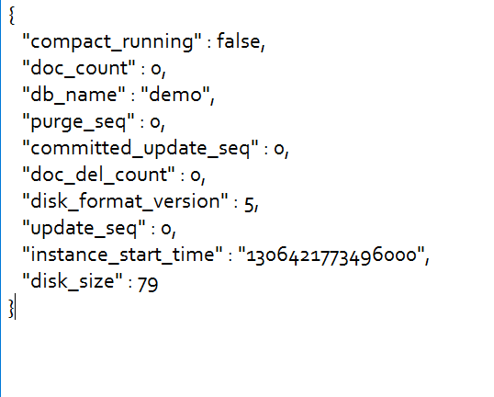
Database API
curl -X GET http://127.0.0.1:5984/demo (To obtain the database information of database demo)
Result eg:

Slide 8
Database API (Contd..)
curl -X PUT http://127.0.0.1:5984/baseball
creates a database with the name baseball (database names should be unique)
curl -X DELETE http://127.0.0.1:5984/baseball

Slide 9
Document API via CURL
curl -X PUT http://127.0.0.1:5984/albums
curl -X PUT http://127.0.0.1:5984/albums/1000 -d '{"title":"Abbey Road","artist":"The Beatles"} ‘
Uuids curl -X GET http://127.0.0.1:5984/_uuids
curl -X GET http://127.0.0.1:5984/albums/1000

Slide 10
Document API (Contd..)
_rev - If you want to update or delete a document, CouchDB expects you to include the _rev field of the revision you wish to change
curl -X PUT http://127.0.0.1:5984/albums/1000 -d '{"_rev":"1-42c7396a84eaf1728cdbf08415a09a41","title":"Abbey Road", "artist":"The Beatles","year":"1969"}'

Slide 11
Replication API via curl
Command to replicate a Database :
curl -vX POST http://127.0.0.1:5984/ _replicate \ -d '{"source":"albums","target": "albums_replica"}'

