Slide 1

CouchDB
Presented By
Team 9:
Donita Almeida
Dhiraj Gurnani
George Zachariah
Ritika Shetty
Saina Patel

Slide 2
Introduction
Why CouchDB ?
High availability is important
Eventually consistent
Powerful data processing using the built-in query engine
Modular & Scalable design
User friendly

Slide 3
Features
A NoSQL database
Uses JSON for documents
Uses JavaScript for MapReduce indexes
Uses HTTP for it’s API
Documents can have attachments
Incremental peer-peer replication

Slide 4
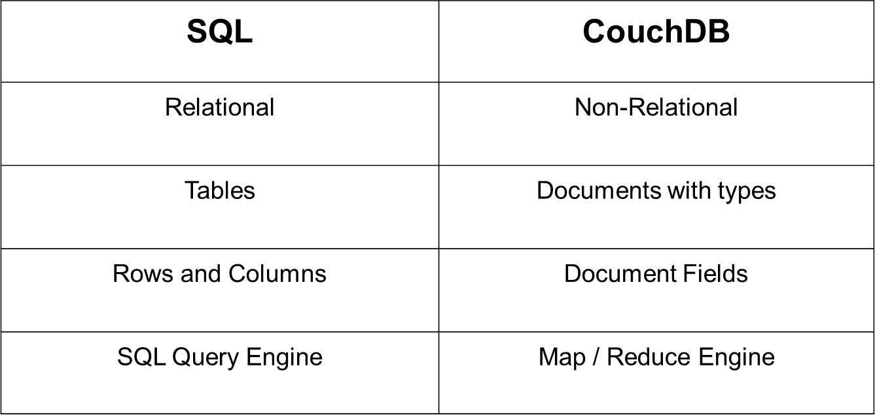
SQL vs CouchDB

Slide 5
CouchDB Core API (Command Line Utility )
Server API
Database API
Document API
Replication API

Slide 6
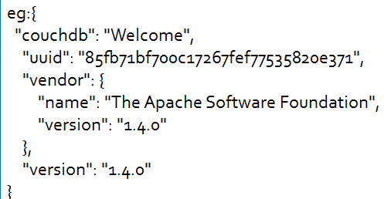
Server API (Access via CURL)
CouchDB runs on port 5984
curl -X GET http://127.0.0.1:5984/
returns the server information

Slide 7
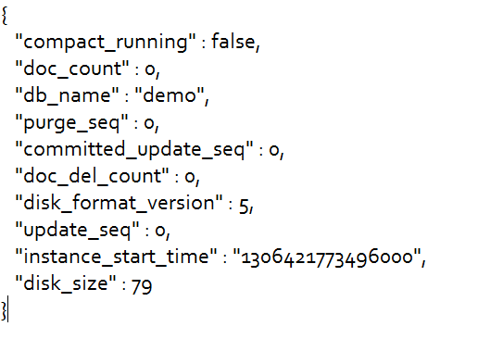
Database API
curl -X GET http://127.0.0.1:5984/demo
Returns the information about database demo

Slide 8
Database API (Contd..)
Create a database
curl -X PUT http://127.0.0.1:5984/baseball
Delete a database
curl -X DELETE http://127.0.0.1:5984/baseball

Slide 9
Document API via CURL
curl -X PUT http://127.0.0.1:5984/albums
Create a document
curl -X PUT http://127.0.0.1:5984/albums/1000 -d '{"title":"Abbey Road","artist":"The Beatles"} ‘
Retrieve a document
curl -X GET http://127.0.0.1:5984/albums/1000

Slide 10
Document API (Contd..)
_rev - If you want to update or delete a document, CouchDB expects you to include the _rev field of the revision you wish to change
curl -X PUT http://127.0.0.1:5984/albums/1000 -d '{"_rev":"1-42c7396a84eaf1728cdbf08415a09a41","title":"Abbey Road", "artist":"The Beatles","year":"1969"}'

Slide 12
Replication API via curl
Command to replicate a Database :
curl –vX POST http://127.0.0.1:5984/ _replicate \ -d '{"source":"albums","target": "albums_replica"}'

Slide 13
CouchDB Conflict Resolution
How does CouchDB’s replication system deal with conflicts?
Flags the affected document with a special attribute "_conflicts": true
Determines which of the changes will be stored as the latest revision (winning revision).
The loosing revision gets stored as the previous revision

Slide 14
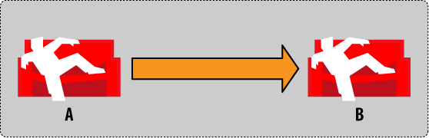
CouchDB Conflict Resolution
1. We have two CouchDB databases A and B, and we are replicating from A to B.

Slide 15
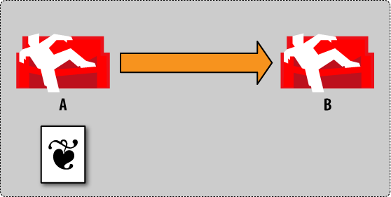
2. We create a document in database A. Database B won’t know about the new document for now.

Slide 16
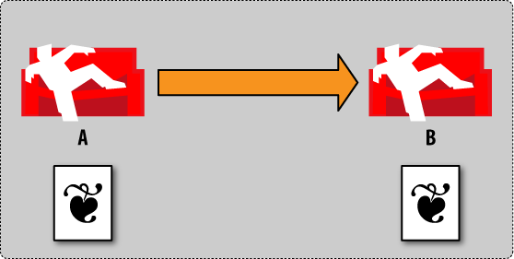
3. We now trigger replication and tell it to use database A as the source and database B as the target

Slide 17
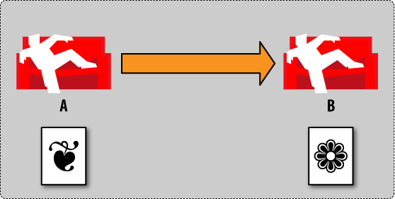
4. Now we go to database B and update the document.
Upon change, CouchDB generates a new revision for us.

Slide 18
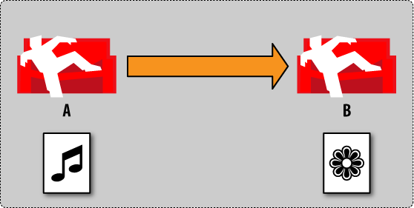
5. Now we make a change to our document in database A by changing some other values.
There are two different revisions of that same document in each database.

Slide 19
6. Now we trigger replication again from database A to database B as before

Slide 20
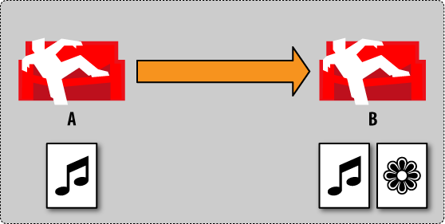
7. When replicating two different revisions are detected for the same document, and it creates a conflict .

Slide 21
8. Finally, we tell CouchDB which version we want as the latest revision by resolving the conflict.
Now both databases have the same data.

Slide 22
Couch DB Views
Why views?
No tables and collection.
So views
View server execute functions
Map – used to display a view
Reduce(optional) – which is used to create a sorted view

Slide 23
Example Database
{
"_id": "album1",
"artist": "Megadeth",
"title": "Endgame",
"year": 2010
}
{
"_id": "album2",
"artist": "Slayer",
"title":"World Painted Blood",
"year":2009
}
{
"_id": "album3",
"artist": "Arcturus",
"title": "Sideshow Symphonies",
"year": 2005
}

Slide 24
{
"_id": "album4",
"artist": "Pantera",
"title": "Reinventing the Steel",
"year": 2009
}
{
"_id": "album5",
"artist": "Slayer",
"title": "South of Heaven",
"year": 2009
}

Slide 25
Map and Reduce functions
"_id": "_design/foobar",
"language": "javascript",
"views": {
"by_year": {
"map": "function(doc) {
if (doc.year) {
emit(doc.year, 1);
}
}",
"reduce": "function(keys, values, rereduce) {
return sum(values);
}"
}
}
}

Slide 26
$ curl http://localhost:5984/albums/_design/foobar/_view/by_year
{
"update_seq": 6,
"rows": [
{"key": null, "value": 5}
]
}

Slide 27
$ curl http://localhost:5984/albums/_design/foobar/_view/by_year?group=true
{
"update_seq": 6,
"rows": [
{"key": 2005, "value": 1},
{"key": 2009, "value": 3},
{"key": 2010, "value": 1}
]
}
$ curl 'http://localhost:5984/albums/_design/foobar/_view/by_year? group=true&startkey=2009&endkey=2010'
{
"update_seq": 6,
"rows": [
{"key": 2009, "value": 3},
{"key": 2010, "value": 1}
]
}

Slide 28
$ curl \ http://localhost:5984/albums/_design/foobar/_view/by_year?reduce=false
{
"update_seq":6,
"rows": [
{"id": "album3", "key": 2005, "value": 1},
{"id": "album2", "key": 2009, "value": 1},
{"id": "album4", "key": 2009, "value": 1},
{"id": "album5", "key": 2009, "value": 1},
{"id": "album1", "key": 2010, "value": 1}
]
}

Slide 29
Limitations
Temporary views on large datasets are very slow.
Replication of large databases may fail
Documents are quite large as the data is represented using “JSON” format
"Only" eventual consistency.
Couch maintains a different document for every update you make this fills up your hard disk fast

Slide 30
Compaction
DB/view files are written in append mode
Will continue to grow indefinitely
A DB or View compaction operation can be triggered
curl -X POST http://127.0.0.1:5984/albums/compact
curl -X POST http://127.0.0.1:5984/albums/_design/view

Slide 31
What Compaction does?
i. Creates a new file
ii. Traverses the DB or View B-Tree and lookups the most recent data pointed by each node
iii. Writes that most recent data to the new file
iv. deletes the original file and renames the compacted file to the original DB/View file name.

Slide 32
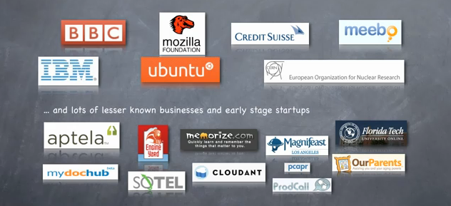
Who uses CouchDB?

Slide 33
Thank You

