Slide 1

PROJECT PRESENTATION
MIRA
Memory, Intelligence, Recall, Assistant
Your Personal Knowledge Assistant
TEAM
DCoders
Dhiraj Karangale
Vedang Joshi
GITHUB REPOSITORY
PROJECT DEMO
View Source Code
Watch Demo on YouTube
DCoders | MIRA

Slide 2
THE PROBLEM
Your Digital Life Has No Memory
Everyday information is everywhere, but useful context is missing.
01
02
03
Lost Information
Repeating Context
Fragmented Digital Life
Notes, files and useful details get scattered across apps.
Users repeatedly explain their projects and preferences to AI.
Work, browsing and conversations remain disconnected.
04
05
Forgotten Tasks & Ideas
Privacy Concerns
Important ideas and pending tasks are easily overlooked.
Users want helpful AI without exposing their entire digital history.
The result: lost time, repeated effort and disconnected context.
DCoders | MIRA

Slide 3
THE SOLUTION
Meet MIRA
Your Personal Knowledge Assistant
MIRA is a personal AI assistant that remembers your digital activity, retrieves relevant information, and uses that context to help you continue your work.
CAPTURE
→
REMEMBER
→
RECALL
→
ASSIST
HOW MIRA SOLVES THE PROBLEMS
01
02
03
Searchable Memory
Smarter AI Chat
Unified Recall
Find notes, files and useful details from one searchable knowledge base.
Get answers informed by relevant details from previous activities.
Bring captured activity and stored information together.
04
05
Daily Briefings & Planning
Privacy-First Design
Surface useful information and support everyday planning.
Keep personal memory local while sharing selected context with cloud AI.
DCoders | MIRA

Slide 4
MIRA CAPABILITIES
Beyond Memory: Your Everyday AI Assistant
One assistant for conversations, planning, awareness and privacy.
01
02
Natural Interaction
Daily Intelligence
Talk to MIRA or type instructions and questions.
Make everyday decisions and planning easier.
Text-based chat
Conversational AI replies
Context-aware assistance
Daily suggestions
Day planning
Weekend planning
03
04
Live Awareness
Privacy & Security
Stay informed about conditions and events around you.
Keep personal information under user control.
Weather forecasts + suggestions
Nearby and regional news
National headlines
Local data storage
Encryption and access protection
Selective context sharing
One assistant. Connected context. More informed everyday decisions.
DCoders | MIRA

Slide 5
UNDER THE HOOD
MIRA Technical Architecture
Six core services connected through APIs and asynchronous event streams.
CLIENT
ENGINE
MEMORY
Desktop interface for chat, voice, memory search and privacy controls. Sends requests and displays AI responses.
Coordinates AI workflows, retrieves context, builds prompts, runs models and returns responses. Supports speech-to-text.
Filters duplicate screen frames, extracts text using OCR, creates searchable memory and retrieves relevant context.
React + TypeScript | Tauri 2
Python | FastAPI | LLM providers
Python | OpenCV | Tesseract | Qdrant
OPERATOR
VAULT
MESSAGE BROKER
Captures desktop screens and app metadata under privacy controls. Sends capture jobs and removes temporary screenshots after processing.
Manages configuration, credentials, user profiles, chat history and encrypted audit records.
Routes asynchronous jobs between services. Redis Streams provides consumer groups, acknowledgments and recovery tracking.
Rust | Tokio | Native capture
FastAPI | SQLite | PyNaCl | OS keyring
FastAPI | Redis Streams
HOW DATA FLOWS
CAPTURE & INDEX
Operator
→
Broker
→
Memory / OCR
→
Engine
→
Qdrant
QUESTION & RESPONSE
Client
→
Engine
→
Memory / Qdrant
→
AI Model
→
Response
VAULT: Configuration and encrypted records | Scripts: Service startup and health checks
DCoders | MIRA

Slide 6
WHAT'S NEXT
Future Scope & Roadmap
From personal memory to a private, proactive AI that works across your digital life.
01
02
03
On-Device AI & Privacy
System & Voice Automation
Browser & Web Agent
Run AI locally while protecting personal data.
Control the computer using natural commands.
Automate everyday work across the web.
Small models run locally
Private cloud for heavy tasks only
Minimum context or embeddings shared; never raw personal data
Operate apps, files and system settings
Execute authorized terminal workflows
Confirm sensitive actions with the user
Manage email and online workflows
Research topics and discover videos
Complete web tasks with user approval
04
05
06
Career & Learning Agent
Personal Recommendations
Connected Ecosystem & Sync
Support career growth and job opportunities.
Learn preferences to suggest relevant content.
Connect tools and synchronize personal memory.
Discover jobs and match user skills
Prepare resumes and track applications
Recommend courses and career development paths
Recommend movies, music and sports
Discover relevant videos and interests
Adapt suggestions to personal preferences
Encrypted peer-to-peer device sync
MCP-based tools and service integrations
Extend MIRA with community-built skills
ROADMAP: Local AI → System Automation → Web Agent → Career Growth → Personal Intelligence → Connected Ecosystem
DCoders | MIRA

Slide 7
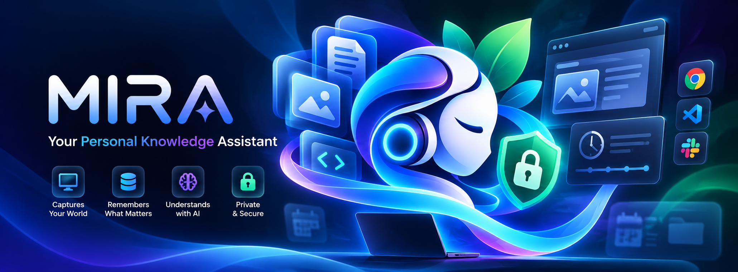
THANK YOU
DCoders | Dhiraj Karangale | Vedang Joshi
GitHub: github.com/DhirajKarangale/Mira
YouTube: Watch MIRA Demo

