Slide 1
Dynamic Sampling for N-Link Chain Using Workspace Segmentation
Dhiraj Kumar Rouniyar
Dhrumil Kotadia

Slide 2
Overview
Recap
Maps, Sampling Methods and Metric
Flow
Learning
Results
Future Work

Slide 3
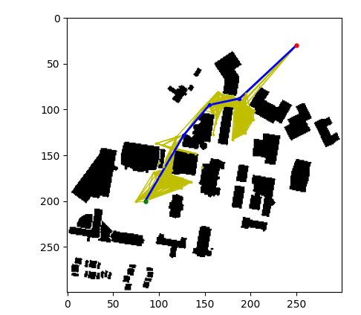
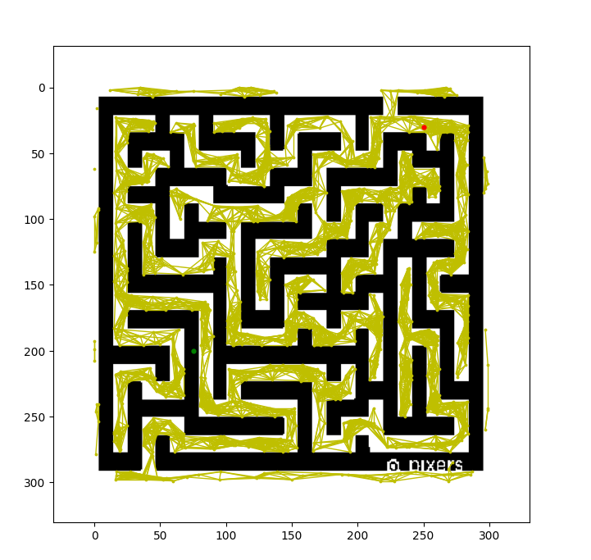
Recap
Notes:
Title of Slide

Slide 4
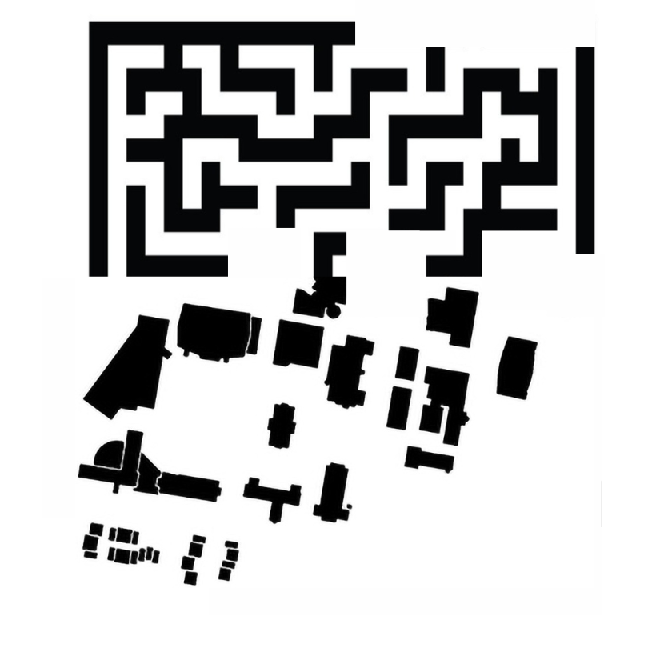
Recap
Notes:
Title of Slide

Slide 5










Maps
Notes:
Title of Slide

Slide 6
Sampling Methods and Metric
Uniform Random Sampling
Gaussian Sampling
Bridge Sampling
Custom Chain Sampling
Number of Nodes

Slide 7
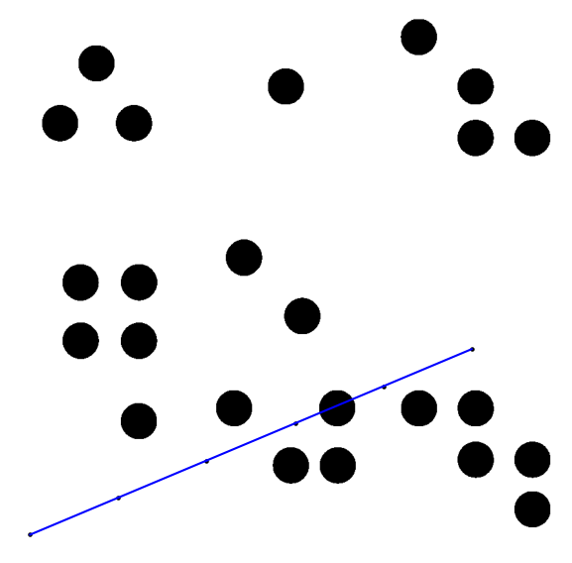
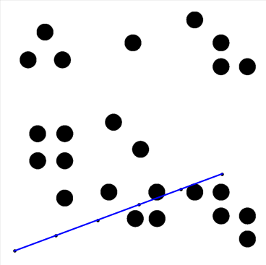
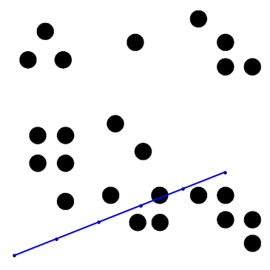
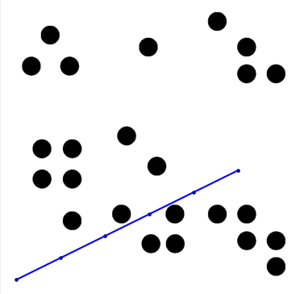
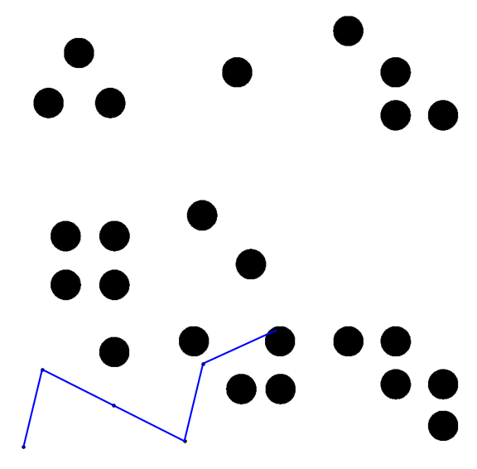
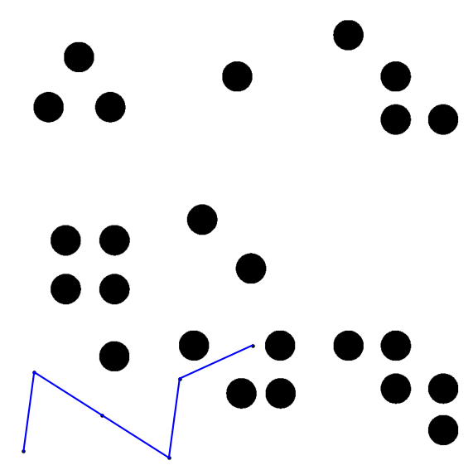
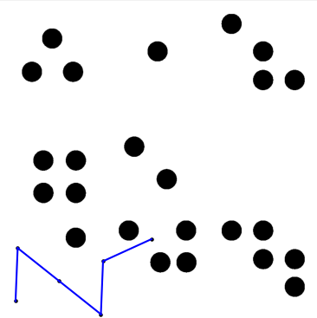
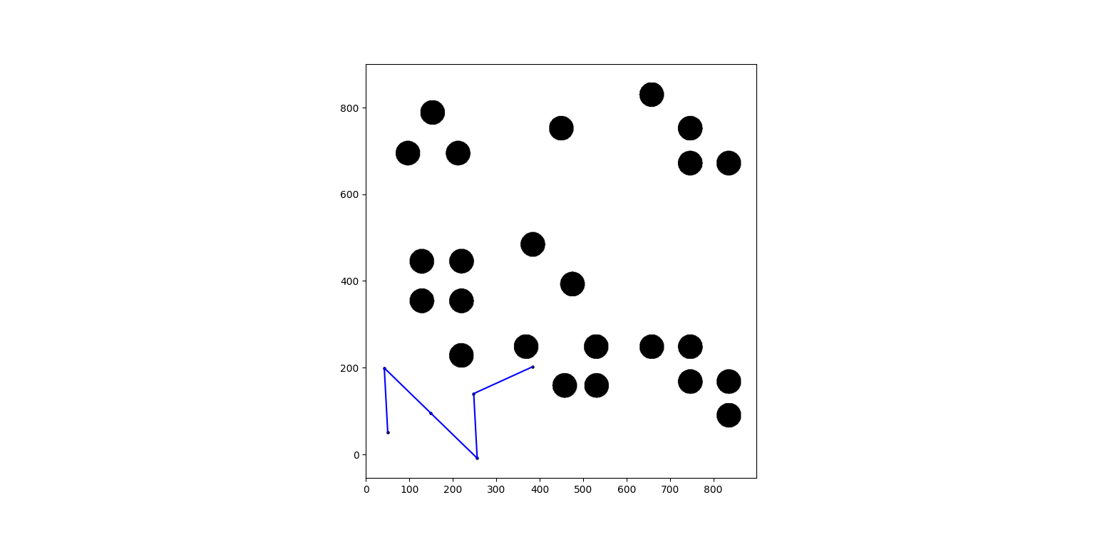
Custom Chain Sampling

Slide 8
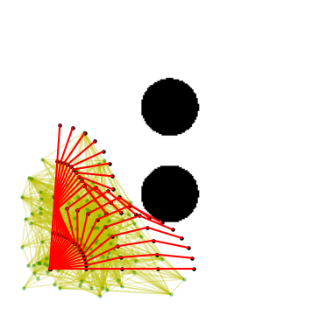
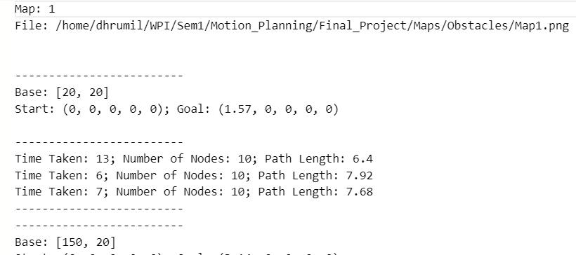
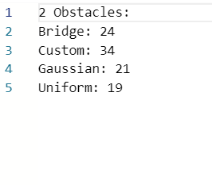
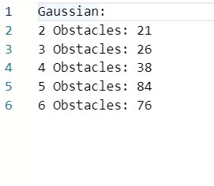
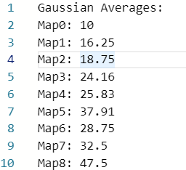
Flow

Slide 9
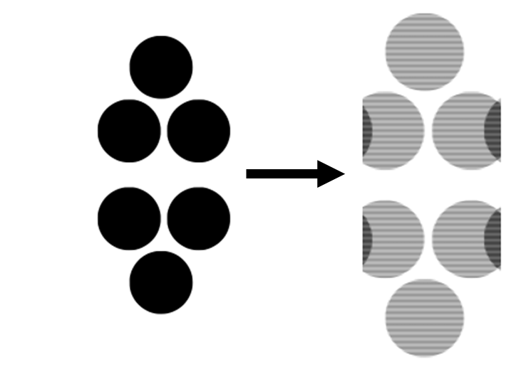
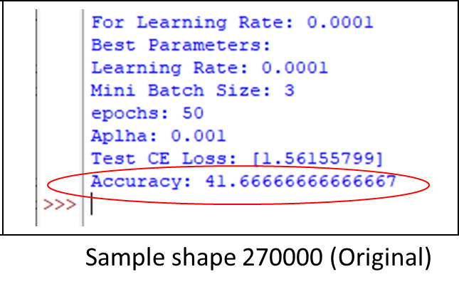
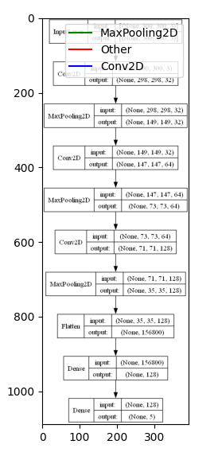

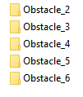
Model Learning
Softmax Regression
Feature loss_ dataset reshaping
Low Test Accuracy
Convolutional Neural Network (CNN)
Major Challenges
Model parameters Tensorflow
target_size=(300, 300),
batch_size=1,
class_mode='categorical‘
optimizer=‘adam’
loss='categorical_crossentropy'
Dataset
Image size: 300 x 300
Train set: 40 maps
Test set: 10 maps

Slide 10
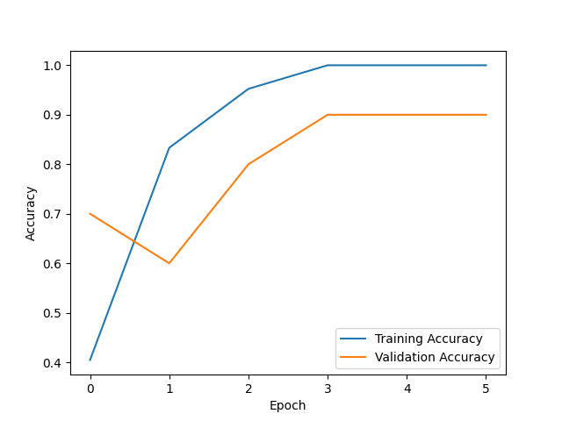
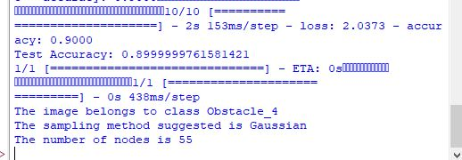
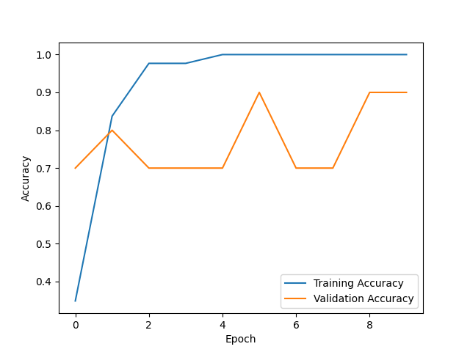
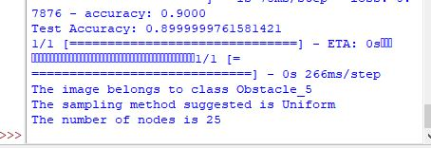

Model Results

Slide 11
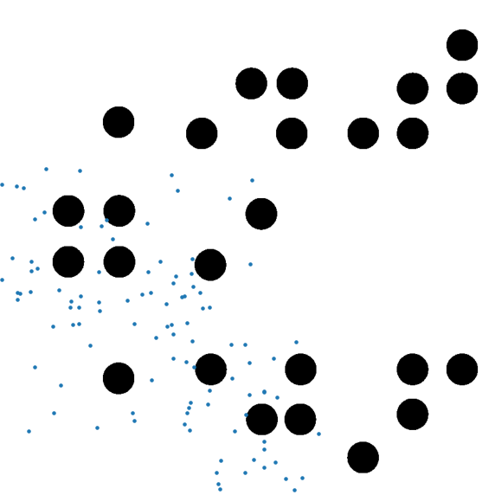
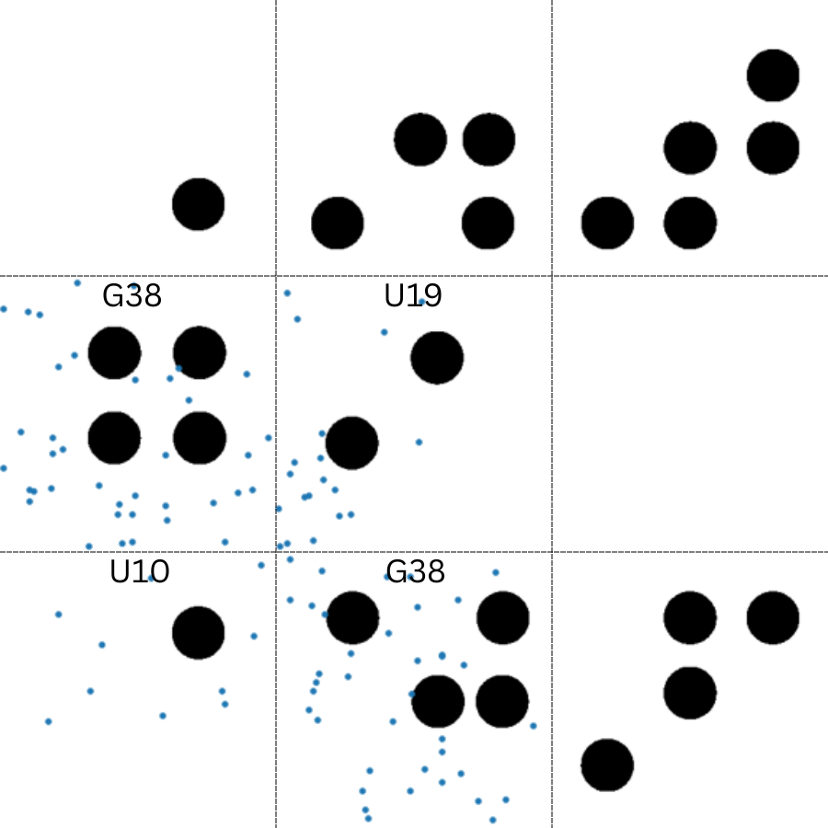
Results
Notes:
Title of Slide

Slide 12
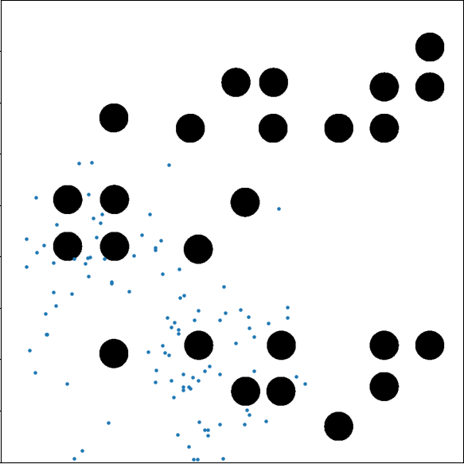
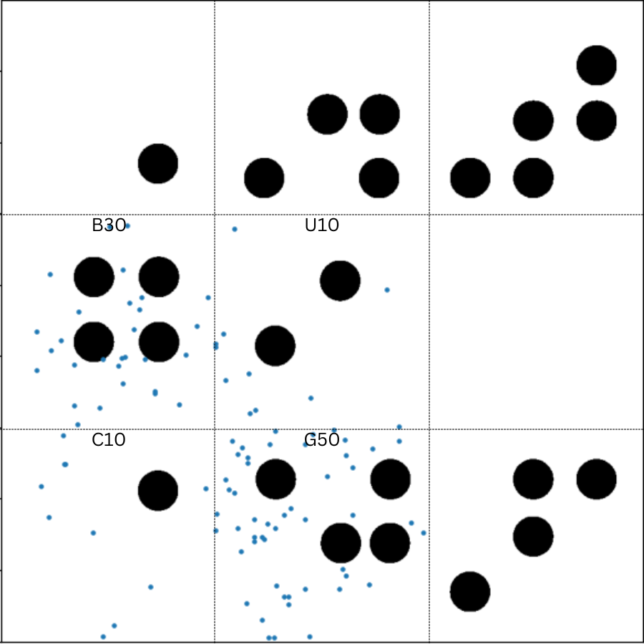
Results
Notes:
Title of Slide

Slide 13
Improvements / Future Work
Data
Metric
Disjoint Process
Sampling Methods
Dataset preparation for model

Slide 14
Thank You

