Slide 1
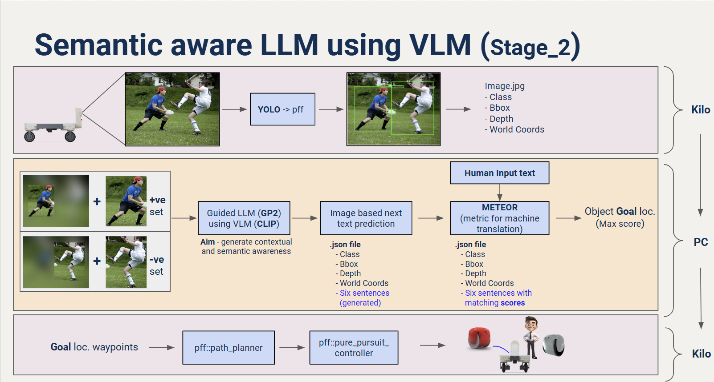
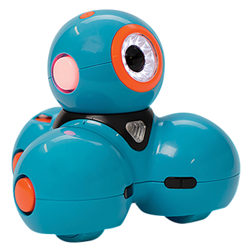

Overall Pipeline_Semantic awareness using LLM with VLM
Bot
Bot

Slide 2
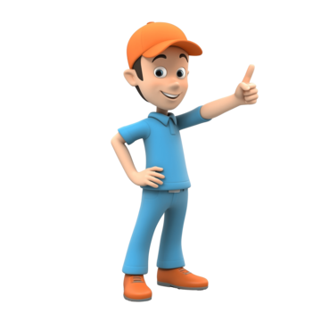
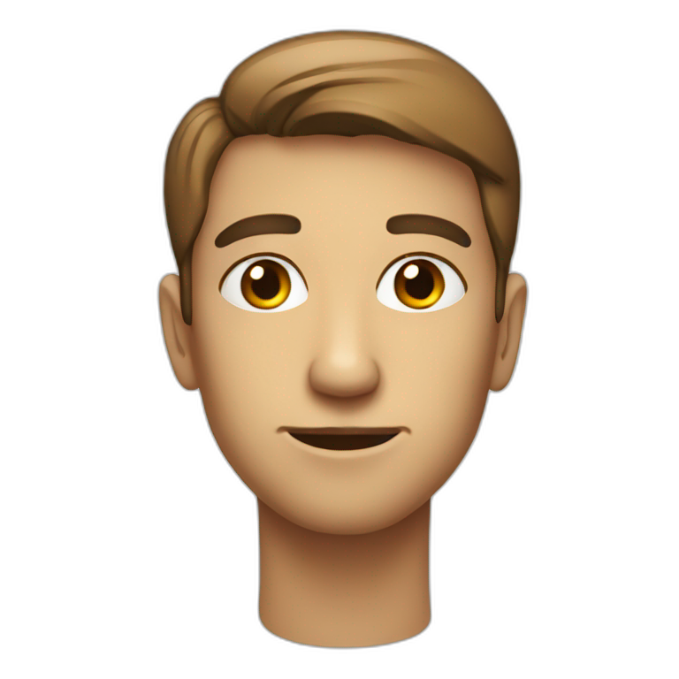

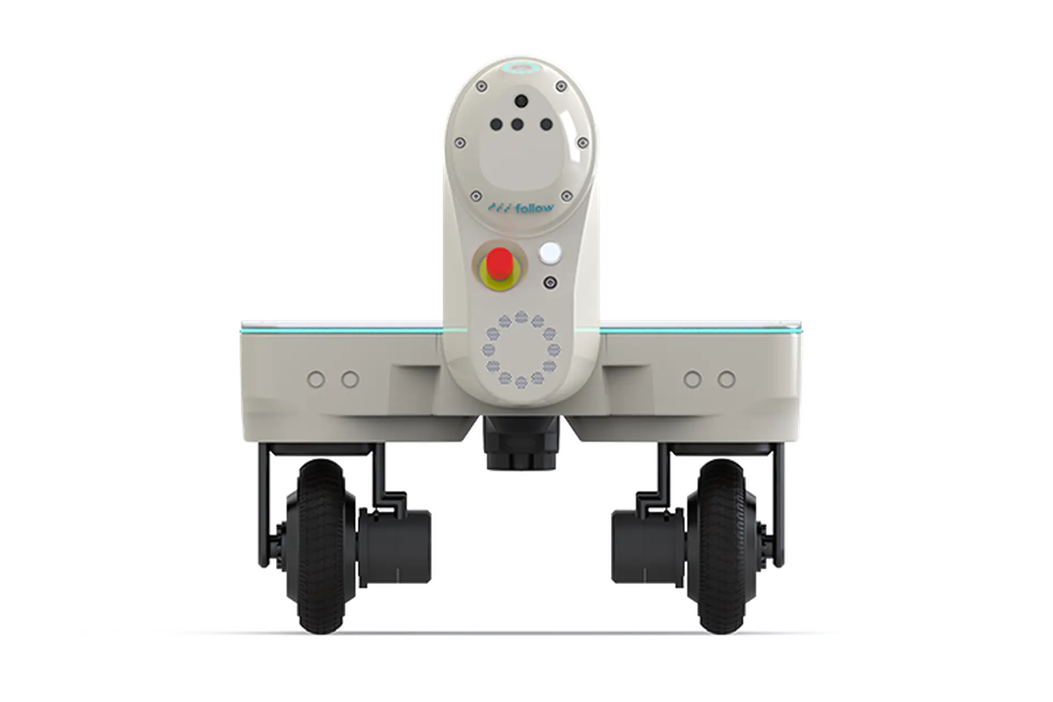

Advanced Use Cases:
GUI
No worries, I know where to go, thanks to guided VLM model.
Go to person wearing a blue shirt,
orange cap and blue pant
I reached to Coordinates: x,y,z
That’s tough one, also I don’t have that object in my map
GUI
Go to person wearing a red tie,
gray pants and black shoes
I reached to Coordinates: x,y,z
Notes:
Get the semantic map information to go to a location

