Slide 1
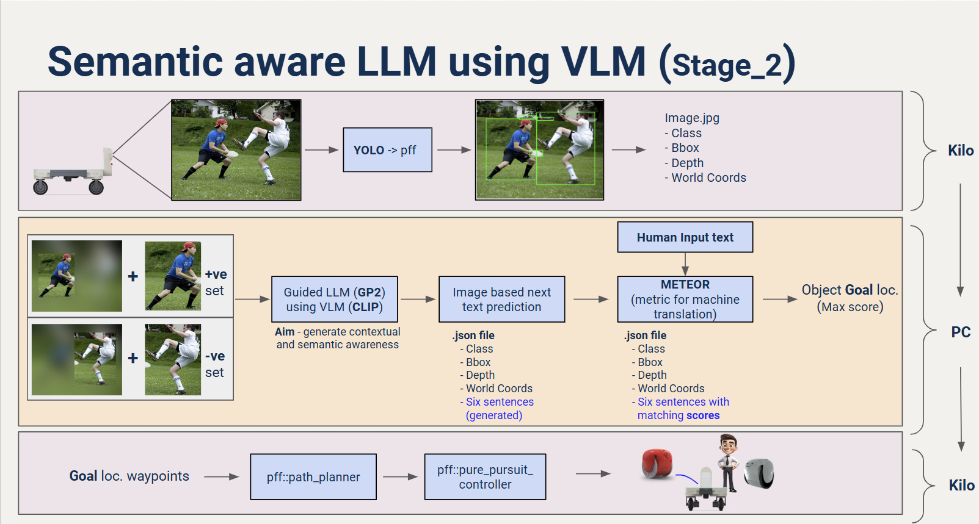
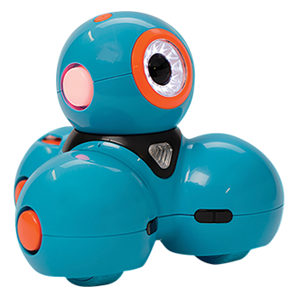

Overall Pipeline_Semantic awareness using LLM with VLM
Bot
Bot

Slide 2
API-Driven Cloud Pipeline
This pipeline integrates a finetuned GPT LLM with VLM-based inference for semantic awareness, processing YOLO-detected indoor & outdoor objects. The pipeline is scalable, leveraging AWS services, containerization and JSON serialization for efficient storage, indexing, and retrieval.
Steps:
-YOLO runs on bot for object detection.
-Bot sends image & metadata to AWS S3.
-AWS Lambda processes data using VLM (CLIP/BLIP-2) & LLM.
-FAISS (vector search) handles efficient retrieval (match code METEOR here):
-either from Database 1 (LLM/VLM output) for unknown environments
-or from Database 2 (semantic segmentation output) for known environments.
-Goal coordinate (file.txt) sent back to bot via AWS IoT Core.
-ROS reads (file.txt) & navigates the bot accordingly.
The above can be nicely performed using API like FastAPI.
-> API for Human Query → Cloud-Based Retrieval
Tools: FastAPI (for API), AWS Lambda (already have a container), FAISS (vector search)
•User types a text query (e.g., "Find the red chair").
•API receives the query & cause the start of whole process like embeddings of images, multi-modal LLM/VLM inferencing, saving generated sentences as embeddings FAISS,
•It searches FAISS (stored LLM descriptions) for the closest match.
•API returns the best-matching object + coordinates.

Slide 3



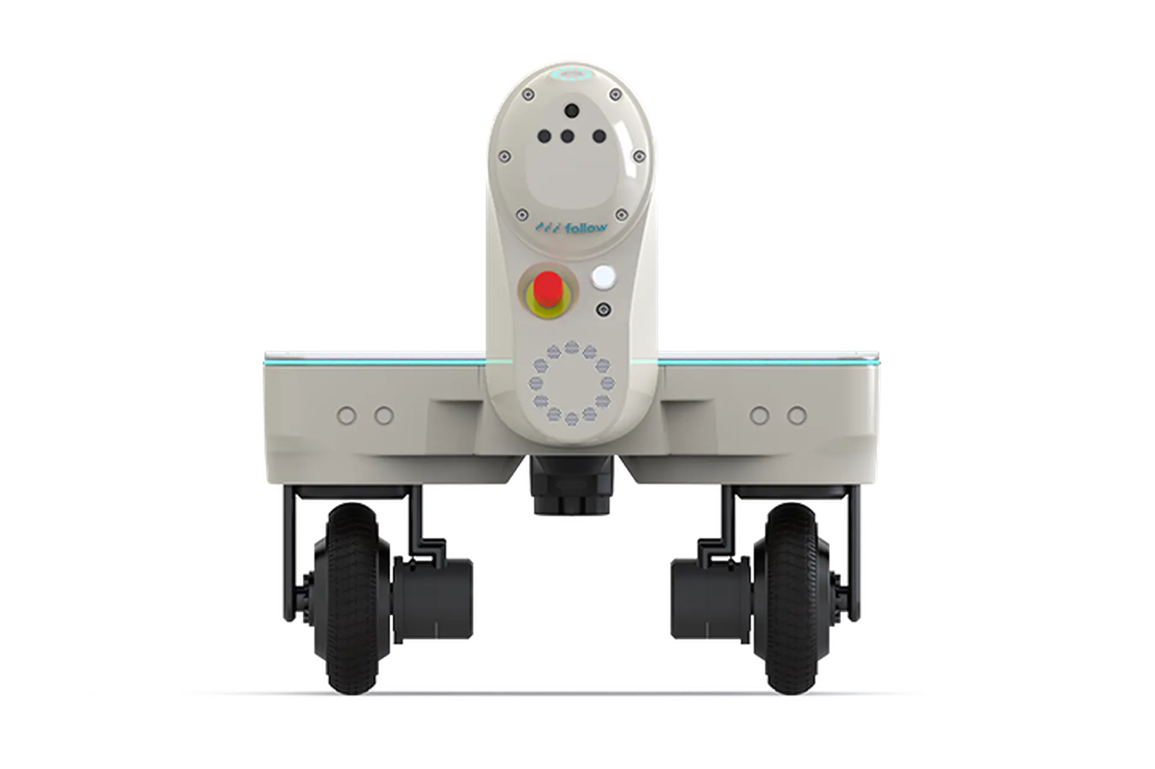

Advanced Use Cases:
GUI
No worries, I know where to go, thanks to guided VLM model.
Go to person wearing a blue shirt,
orange cap and blue pant
I reached to Coordinates: x,y,z
That’s tough one, also I don’t have that object in my map
GUI
Go to person wearing a red tie,
gray pants and black shoes
I reached to Coordinates: x,y,z
Notes:
Get the semantic map information to go to a location

Slide 4
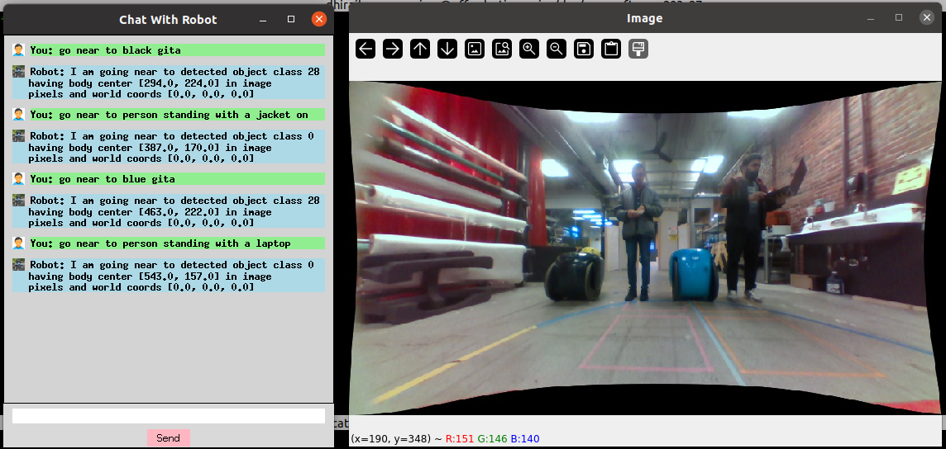
Multi attribute detection:
Notes:
Get the semantic map information to go to a location

Slide 5
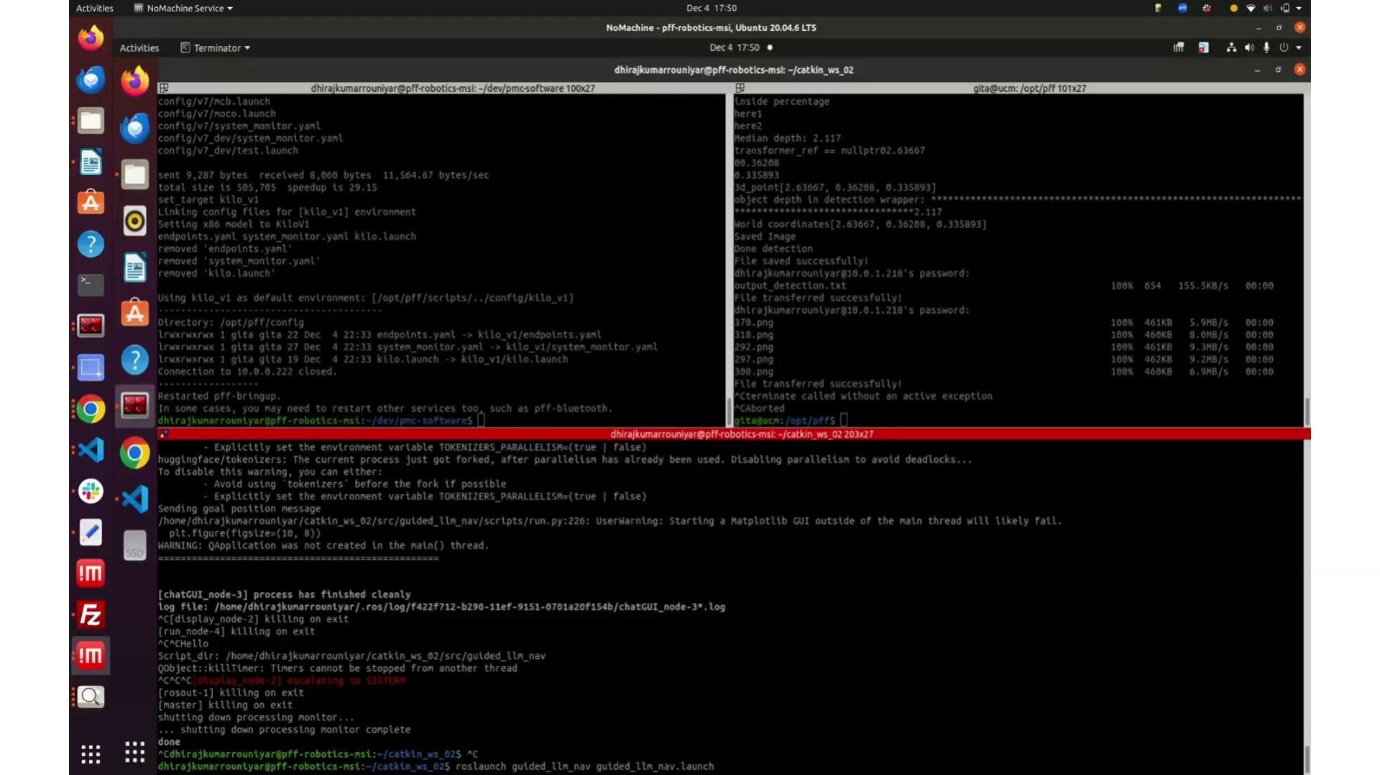
Multi attribute detection and Path traverse:
Notes:
Get the semantic map information to go to a location

