Slide 1

Gen Coder’s
Creating an AI-Powered
Banking Chatbot with WatsonX

Slide 2


Introduction to Chatbots

Slide 3
WatsonX Overview

Slide 4
Problem Statement

Slide 5
Solution

Slide 6
Solution

Slide 7
Data Gathering Building the Chatbot Training the Chatbot Deployment

Slide 8
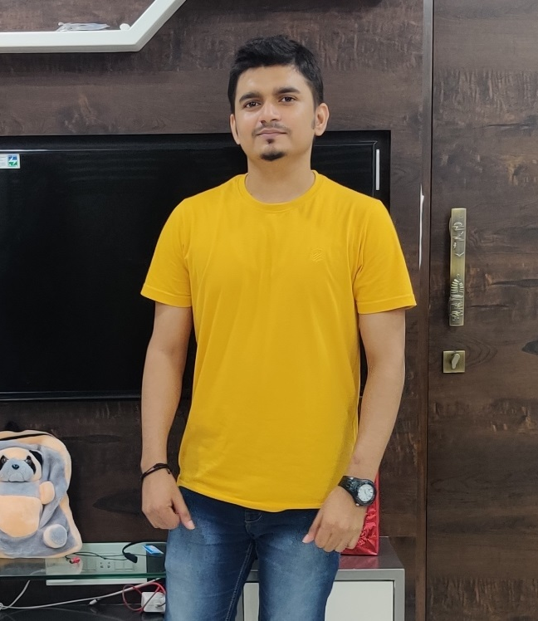


team
Dhiraj Singh
Gaurav Pawar
Aniketh SP

Slide 9

Thank you

