Slide 1

A Presentation on “ Design and Development of Robot based System For Precision Farming”
Prepared by:
Ms. Ghule Sakshi Balasaheb (Roll No. 4119)
Mr. Warke Dhiraj Shailesh (Roll No. 4184)
Ms. Zanzurne Radhika Bhaurav (Roll No. 4185)
Mr. Zope Dipesh Sudhir (Roll No. 4186)
Under the Guidance of:
Prof. M . S .Gadakh
Department Of Electrical Engineering
Amrutvahini College of Engineering, Sangamner

Slide 2
Content -
Problem statement
Motivation Of project
Problem Statement
Objective
scope
Literature Survey
System Development
Advantages
Application
Project Plane
References

Slide 3
Problem Statement
Agriculture is a very important sector in Indian economy. Most of the livelihood in India depends on agriculture. As the knowledge based farm labours are less, the requirement for them is high and their wages are increasing. Traditionally farming is done by human being with the help of bullock carts, tractors and tillers etc. The main problem in agricultural field include lack of labor availability, lack of knowledge regarding soil testing, increase in labor wages, wastage of seeds and more wastage in water. The idea of applying robotics technology in the field of agriculture is very new. In agriculture, the opportunity for robot-enhanced productivity is more and the robots are appearing on farms in various guises and in increasing numbers.
’.

Slide 4
Motivation of project
The agriculture has always been the backbone of India’s sustained growth. As the population of India continues to grow, the demand for production will also grows. Hence, there is a great need for multiple cropping in the farms and this in turn requires efficient and time saving machines. The paper discusses the modern way agriculture which will be helpful for the agriculture industry to move towards mechanization

Slide 5
Objectives of Project
To build a battery operated smart agricultural robot for multipurpose farm activities.
System is totally operated on solar power.
The ground should be dug to the specified depth and the adequate amount of seeds has to be dispensed then it should level the mud after seeding operation.
It should be easy to operate and safe handling.
scope
The Robot Based System For Precision Farming used by the farmers for the purpose of automated seed sowing machine which has the ability to increase productivity.

Slide 6
Literature Survey
Author | Name | year | working
Vishnu Prakash K, Sathish Kumar V, Venkatesh P | “Design and fabrication of multipurpose agricultural robot”, | 2016 | This autonomous vehicle goes through the crop lines of Agricultural land and performs duties that are tiresome and/or unsafe to the farmers.
Ankit Singh, Abhishek Gupta, Akash Bhosale, Sumeet Poddar | “Agribot: An Agriculture Robot” | 2015 | This bot carries out primary functions like picking, harvesting, weeding, pruning, planting, grafting. They developed a robot to perform various activities in farm like cutting and picking.
Ms. Aditi D. Kokate, Prof. Priyanka D.Yadav | “Multipurpose Agricultural Robot” | 2017 | An automatic robot [5] capable of carrying out procedures like programmed seeding, irrigation, and fertilization. In addition, it provides manual as well as auto control.

Slide 7
Components:
Survey of Major Components of Project
Hardware components:
Microcontroller PIC 18F4520
Ultrasonic Sensor
Bluetooth Module (HC -05)
LED
Relay Module
L293 D Motor Driver
Alarm
Resistor
Capacitor
Sprayer

Slide 8
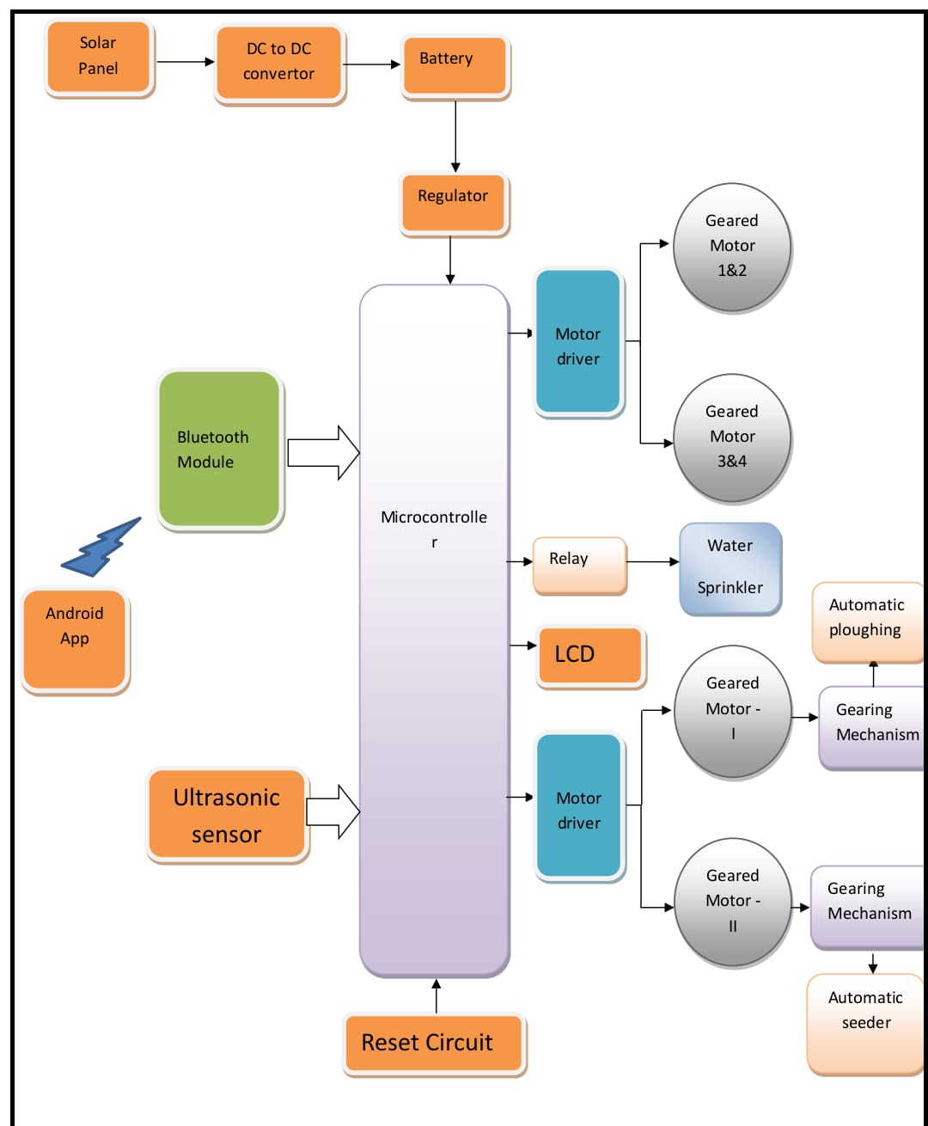
Block diagram

Slide 9
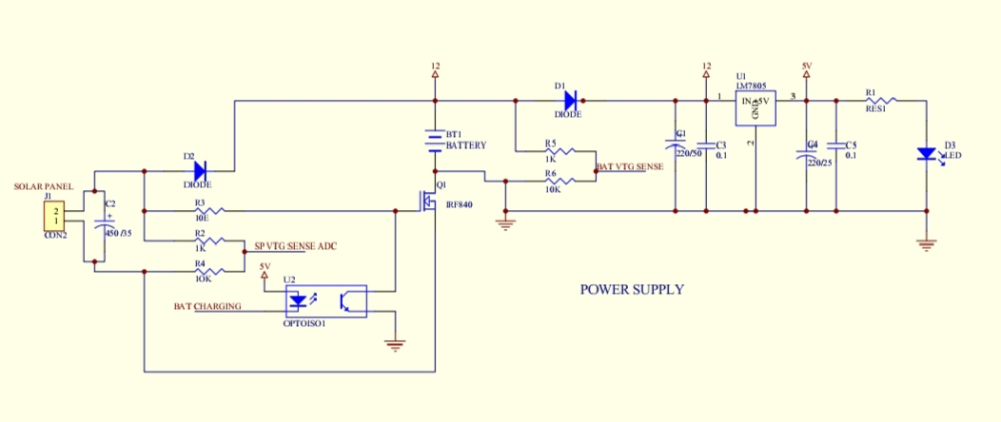
SOLAR CIRCUIT DIAGRAM:
Fig: Solar Circuit Diagram of controller

Slide 10
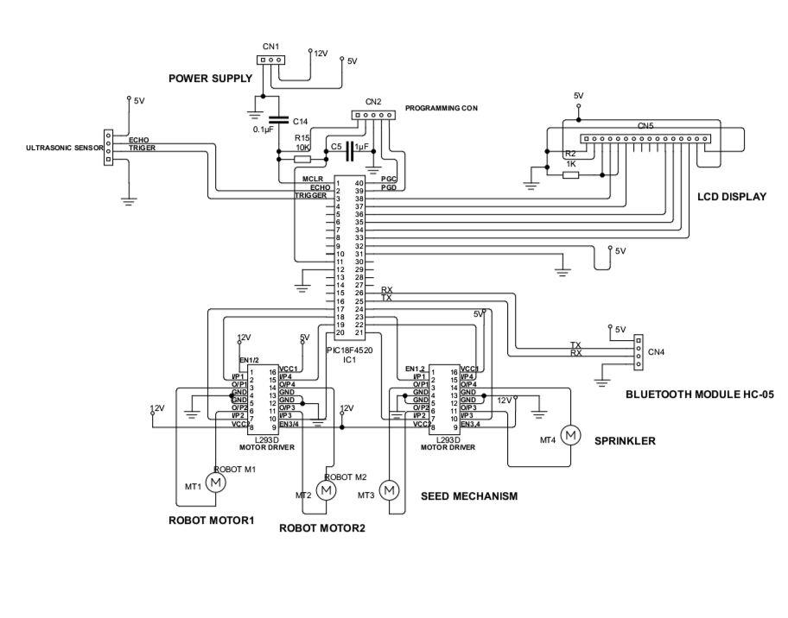
Fig: Circuit Diagram

Slide 11
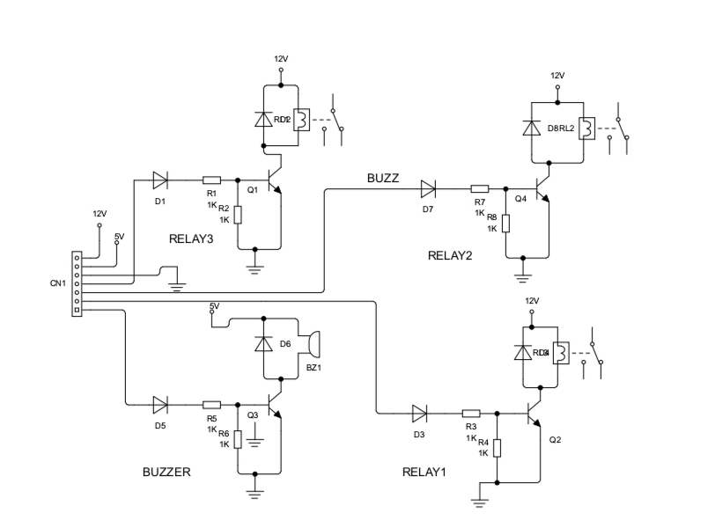
CIRCUIT DIAGRAM OF RELAY:

Slide 12
Continued…
Survey of Major Components of Project
Hardware components:
Microcontroller PIC 18F4520
Ultrasonic Sensor
Bluetooth Module (HC -05)
LED
Relay Module
L293 D Motor Driver
Alarm
Resistor
Capacitor
Sprayer

Slide 13
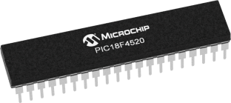
Explanation of Each Block / Hardware Element used in project
Microcontroller( PIC18f4520):
Features:
Operating Frequency: DC – 40 MHZ
Program Memory (Bytes): 32768
Program Memory (Instructions): 16384
Data Memory (Bytes): 1536
Data EEPROM Memory (Bytes): 256
Interrupt Sources: 20
I/O Ports: Ports A, B, C, D, E
Timers: 4
Capture/Compare/PWM Modules: 1
Enhanced Capture/Compare/PWM Modules: 1
Serial Communications: MSSP, Enhanced USART
10-Bit Analog-to-Digital Module: 13 Input Channels
Resets (and Delays): POR, BOR, RESET Instruction, Stack Full, Stack Underflow (PWRT, OST), MCLR (optional), WDT
Instruction Set: 75 Instructions, 83 with Extended Instruction Set Enabled
Packages: 40-Pin PDIP 44-Pin QFN 44-Pin TQF

Slide 14
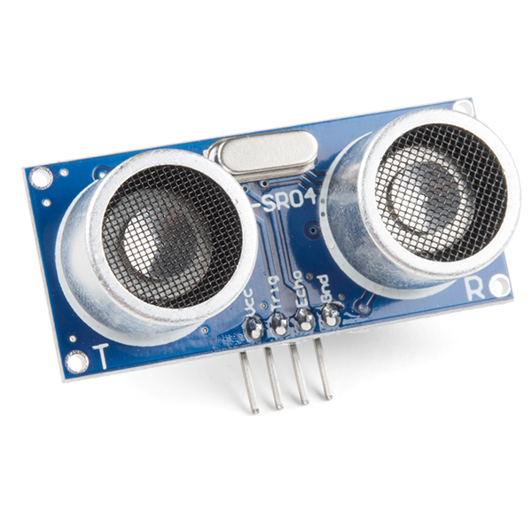
Ultrasonic sensor
Working Voltage | DC 5 V
Working Current | 15mA
Working Frequency | 40Hz
Max Range | 4m
Min Range | 2cm
Measuring Angle | 15 degree
Trigger Input Signal | 10uS TTL pulse
Echo Output Signal | Input TTL lever signal and the range in proportion
Dimension | 45*20*15mm

Slide 15
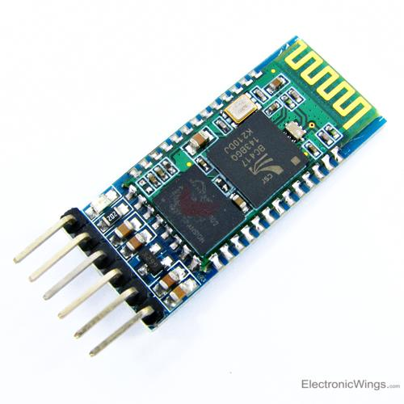
Bluetooth Module(HC05):
It is used for many applications like wireless headset, game controllers, wireless mouse, wireless keyboard and many more consumer applications.
It has range up to <100m which depends upon transmitter and receiver, atmosphere, geographic & urban conditions.

Slide 16
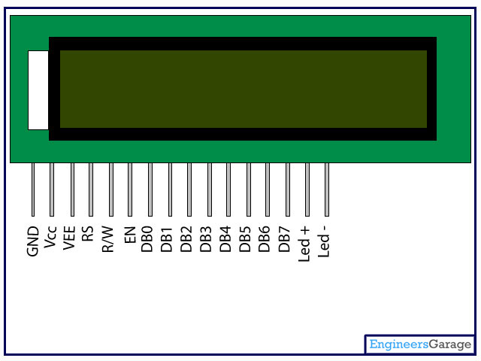
LCD Display:
LCD (Liquid Crystal Display) screen is an electronic display module and find a wide range of applications. A 16x2 LCD display is very basic module and is very commonly used in various devices and circuits. A 16x2 LCD means it can display 16 characters per line and there are 2 such lines. In this LCD each character is displayed in 5x7 pixel matrix. This LCD has two registers, namely, Command and Data.

Slide 17
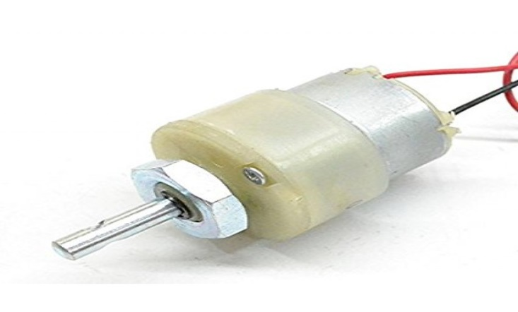
Dc Motor
Specification:
Nominal Voltage 6V.
Maximum Current 115mA.
Stall Torque 36 g.cm
Size 25*15*20
Weight 18g
Shaft Diameter 2mm
Torque 4kg.cm

Slide 18
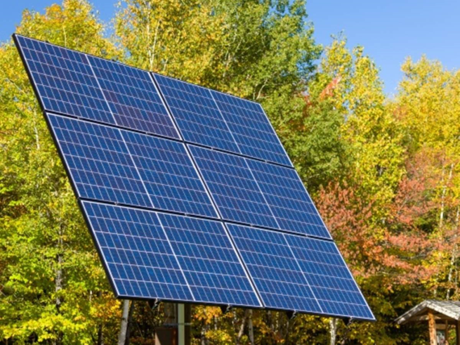
Solar panel
2. Additional Data
Number of cells 36 series
Dimensions 291*160*25mm
Net Weight 0.74Kgs/pc
Module Name LL-5w-12v
3. Cell Type
Polycrystalline silicon photovoltaic cells
Features:
1. Parameters
Nominal Peak Power 5W
Maximum Power Voltage (Vmp) 18.0V
Maximum Power Current (Imp) 0.28A
Short – Circuit Current(Isc) 0.32A
Open – Circuit Voltage(Voc) 21.5V
Optimized Cell Efficiency (%) 17.2%

Slide 19
Buzzer
Features
sealed: yes
operating power: 3-6V DC / 25mA
extremely compact, ultrathin construction
no electrical noise
low current consumption yet high sound pressure level
Specifications
tone type: single
operating voltage: 3-6V DC
rated voltage: 5V DC
current consumption: 25mA
osc. frequency: 3.2kHz

Slide 20
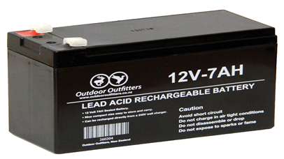
Battery :
General Features
Absorbent Glass Mat (AGM) technology for efficient gas recombination of up to 99% and freedom from electrolyte maintenance or water adding.
Not restricted for air transport-complies with IATA/ICAO Special Provision A67.
UL-recognized component.
Can be mounted in any orientation.
Computer designed lead, calcium tin alloy grid for high power density.
Long service life, float or cyclic applications.
Maintenance-free operation.
Low self-discharge.
Fig: 12V 7Ah Battery

Slide 21
Advantages
With the help of innovative seed sowing equipment the seed can feed into the soil continuously without any restriction while in flowing of seed.
reduces labour cost
Overall Cost for seed sowing process will be reduced
used for sowing different types of seeds.
Application
Seed sowing devices plays a wide role in Agriculture field.

Slide 22
References
Vishnu Prakash K, Sathish Kumar V, Venkatesh P, Chandran A, “Design and fabrication of multipurpose agricultural robot”, International Journal of Advanced Science and Engineering Research, Volume: 1, Issue: 1, June 2016, ISSN: 2455 9288
Ankit Singh, Abhishek Gupta, Akash Bhosale, Sumeet Poddar, “Agribot: An Agriculture Robot”, International Journal of Advanced Research in Computer and Communication Engineering Vol. 4, Issue 1, January 2015 ISSN (Online): 22781021 ISSN (Print): 2319-5940.
Mr.Sagar R. Chavan, Prof. Rahul D. Shelke, Prof. Shrinivas R. Zanwar, “Enhanced agriculture robotic system”, International journal of engineering sciences & research technology, ISSN: 2277-9655.
Nithin P V, Shivaprakash S, “Multipurpose agricultural robot”, International Journal of Engineering Research, ISSN: 2319- 6890)(online),2347-5013(print) Volume No.5 Issue: Special 6, pp: 1129 - 1254.
Ms. Aditi D. Kokate, Prof. Priyanka D.Yadav, “Multipurpose Agricultural Robot”, International Advanced Research Journal in Science, Engineering and Technology National Conference on Emerging trends in Electronics & Telecommunication Engineering (NCETETE 2017), ISSN (Online) 2393-8021 ISSN (Print) 2394- 1588.

Slide 23
Thank you…

