Slide 1


Helping Hand
Presented By –
Group Name : Kal-Yug
Parth Shah (001006181)
Yash Jain (001521876)
Ashwini Dharmarajan (002953107)

Slide 2
Problem Statement : Customers are found to spend a significant amount of time, attention, and energy on many applications in order to complete a single job. Additionally, having to launch multiple applications in order to complete a task can be unpleasant. Searching for each program is time-consuming, difficult, and tedious. FYI : According to a study, consumers squander 25% of their time looking for different websites to do their tasks.

Slide 3

Helping Hand
Proposed Solution :
The HELPING HAND Application's goal is to provide a single platform for people and service providers to connect. Forming a bridge between customers and service providers such that customers do not need to open many windows to complete tasks; instead, a single application is sufficient to meet the eight most important requirements. The application can be maintained by the organization's administrator, while the customer can operate on any domain, based on their needs.

Slide 4

Advantages :
Simplicity: Eliminate unnecessary design elements and have a single application easy to understand.
Navigability: Simple to navigate and straight forward so visitors can naturally access all elements.
Accessibility: Application will be compatible with all devices (mobile, tablet, etc.). Easy to access for all age groups.
Conventionality: Multiple services present in a with variety of operation within the same application .
User-friendly: Gathering responses for service provided from users to get the best results and improving the store functionalities.

Slide 5
Working
Consider the working in two parts
Admin Login
Customer Login
Application is meant for both the service provider (Admin) to make provide information of their services and to make changes as required.
While the end-user (customer) can benefit through the application and multiple services.

Slide 6

Working: Admin Login
An admin from any entity will have to sign-in in order to view the different functionalities. There are options to sign in and forgot password as well. All details are stores in the DB4O database in the application
Under each service the admin can perform CRUD operations and manage their services according to their convenience
Select the service to login from the seven available options.
Delivery
Grocery
Legal
Hotel
House Cleaning Services
Mental Care Therapy
Add customer details

Slide 7

Working: Customer Login
Customer can login, view his profile and can update his details if required.
They can shift move one from the page to another effortlessly. Submitting details, booking appointments, selecting changes, making payments etc can be done through a few clicks
The different pages a customer can view once he is logged in are –
Profile
Covid Care – Wellness Check
Legal Appointments
Grocery Ordering
House Cleaning Services
Therapy Session Appointments
Restaurant Orders
Viewing cart contents
Making payments

Slide 8
Roles System Admin is the administrator who can login and view roles and perform CRUD operation in each role.
Customer Profile – Create the profile and view all changes
Restaurant - Contains view hotel details and their managers
Grocery Store - Contains grocery store details and its managers
Therapist Sessions – Additions of therapist details are possible
Legal Assistance – Enter details such that appointments can be booked in the future
Cleaning Services – Enter employee details and perform edits
Delivery Services – Add employees and perform CRUD operations
Payment Details – Items can be bought directly if card details exists without using cart
Cart Items – View items and make payments

Slide 9

Enterprises
Hotel/Ordering
Hospital Services
Legal Services
Cleaning Services

Slide 10
Organizations
Person - Create profile such that all organizations and roles can be utilized sufficient
Grocery – Add and pick items to the cart, select according to needs
Therapist – Book sessions and mention any requirements
Legal Assistance – Confirm and book appointments with your lawyer
Cleaning Services – Pick time, place and area to be cleaned
Hotel – Place orders, and select items to view
Delivery – Multiple items can be viewed and request for a delivery
Cart – Add items according to your desire and analyze before payment
Payment – Make payments for all items and services in cart

Slide 11
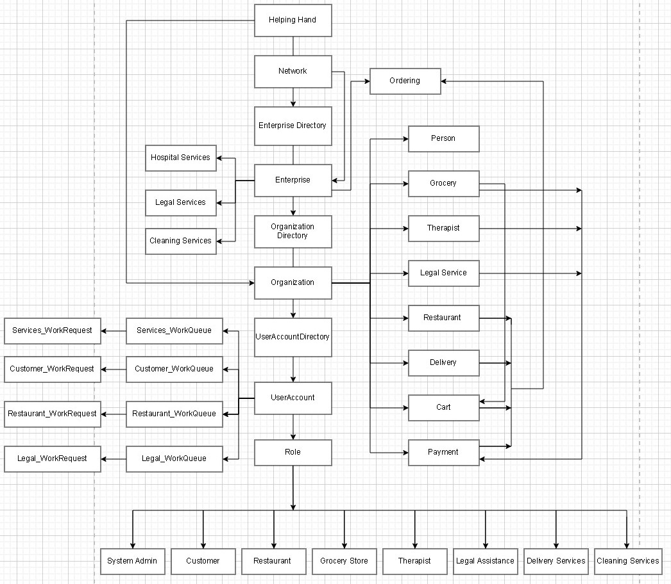
Flow Diagram

Slide 12
Screenshots

Slide 13
Usecases

Slide 14

THANK YOU

