Slide 1
Global Sports Footwear Market (2018–2026)
Data-Driven Insights for Pricing, Channels & Growth
Team name: TheD

Slide 2
Problem Framing & Strategic Mandate
Industry Context
Between 2018–2026, the global sports footwear market grew steadily due to:
Lifestyle shifts & fitness awareness
E-commerce expansion
Category diversification (Running, Lifestyle, Training, etc.)
However, increasing reliance on discounts (0–30%) has created:
Margin pressure
Brand dilution risk
Inconsistent geographic performance
CEO Mandate (2026–2029 Planning Cycle)
Provide a data-backed strategy to optimize:
Pricing & discount discipline
Online vs Retail channel investments
Objective: Drive sustainable growth without sacrificing profitability or customer satisfaction.
Geographic prioritization
Brand & category focus
Analytical Methodology & Scope
Dataset Overview (2018–2026)
Analytical Approach
Transaction-level analysis including:
Base Price, Discount %, Final Price
Units Sold & Revenue
Sales Channel (Online / Retail)
Country
Income Segment (Low / Middle / High)
Customer Satisfaction
I have performed:
Brand revenue & unit contribution analysis
Pricing power calculation (Revenue per discount intensity)
Discount band elasticity analysis (0–10%, 11–20%, 21–30%)
Channel AOV & discount dependency comparison
Geographic attractiveness evaluation
Income-based price realization analysis
Category growth trend assessment (2018–2026)

Slide 3
Analytical Dashboard

Slide 4
Core Insights Across Decision Areas
Brand Performance & Pricing Power
ASICS leads in total revenue
Nike demonstrates strongest pricing power
Revenue leadership ≠ discount intensity
Some brands rely heavily on promotions for volume
Insight: Pricing strength, not discounting, drives sustainable advantage.
Discount Strategy Effectiveness
10–20% band delivers optimal revenue-volume balance
20–30% discounts show diminishing marginal returns
Higher discounts do not significantly improve satisfaction
Conclusion: Smart discounting outperforms aggressive promotions.
Channel Strategy (Online vs Retail)
Retail generates higher revenue realization
Online drives broader volume reach
Retail appears less discount-dependent
Retail = Margin Stabilizer Online = Growth Accelerator
Category Strategy
Lifestyle & Training show stable long-term growth
Gym & Basketball display higher volatility
Category performance varies across countries
Categories act as either growth drivers or margin stabilizers.
Geographic & Income Segmentation
UAE exhibits strong premium demand
USA & UK provide stable revenue base
High-income consumers sustain higher realized prices
Premium strategy is market-specific, not universal.
Consumer Segmentation: Income-Driven Purchasing Behavior
High-Income Resilience: This segment demonstrates the highest price realization across premium brands, specifically Nike, which is identified as the High-Income favorite brand.
Pricing Power Leadership: Nike serves as the "Pricing Power Leader," maintaining superior value capture even within the high-income demographic.
Middle & Low-Income Sensitivity: These segments show lower price realization across most brands and share a preference for ASICS, the favorite brand for both Medium and Low-income consumers.
Dual Strategy Recommendation:
Premium Positioning: Protect margins for Nike and Reebok by limiting discounts, as high-income realized prices remain elevated.
Smart Value for Middle-Income: Utilize the identified 11–20% "Sweet Spot" for ASICS to maintain volume without sacrificing the brand’s stability in the middle-income segment.

Slide 5
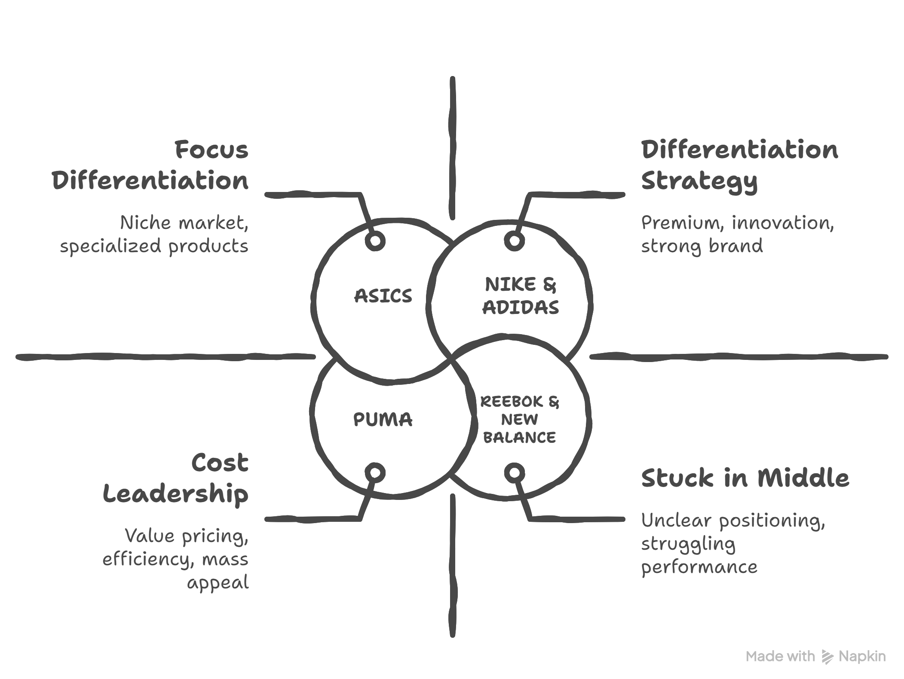
Strategic Framework Application
Framework #1: Porter's Generic Strategies
Understanding Competitive Strategy Types
What is Porter's Generic Strategies?
Michael Porter identified 3 sustainable competitive strategies:
Cost Leadership: Be the lowest cost producer in the industry while maintaining acceptable quality.
Differentiation: Offer unique value that customers are willing to pay a premium for.
Focus: Target a specific market niche with either cost or differentiation advantage
Key Principle: Companies must choose ONE clear strategy. Trying to pursue multiple strategies simultaneously leads to being "stuck in the middle" and results in underperformance.
Brands with clear positioning and pricing discipline (Nike, Adidas) sustain stronger margins and stability. Heavy discount reliance (Reebok) correlates with weaker competitive positioning.

Slide 6
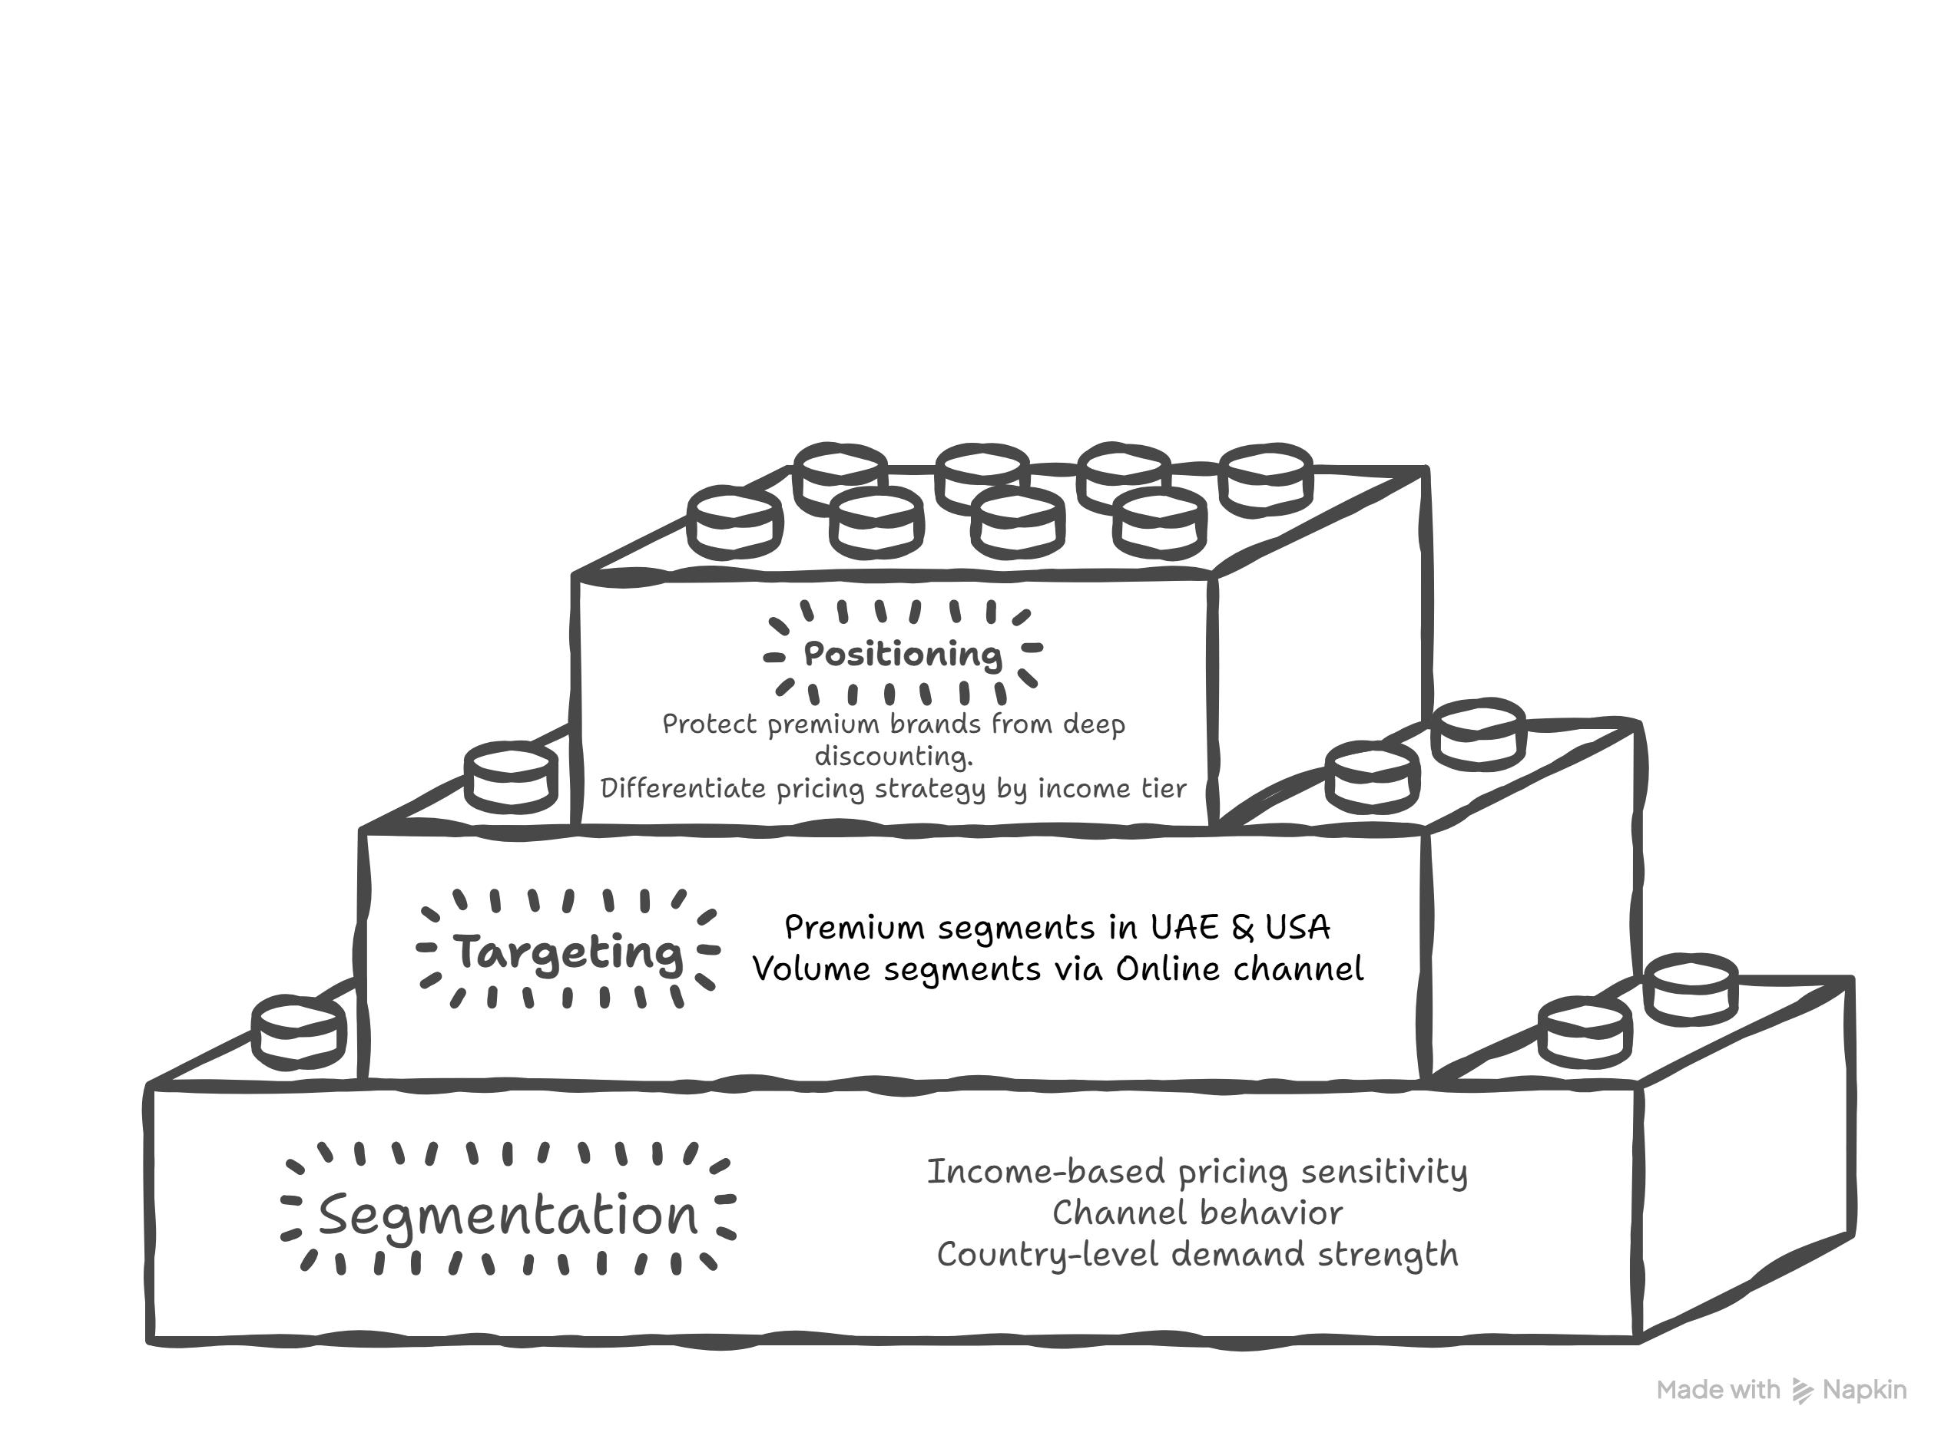
Strategic Framework Application
Framework #2: STP Framework
Segmentation → Targeting → Positioning Strategy
What is STP Framework?
STP is the foundation of modern marketing strategy:
S = Segment: Divide the total market into distinct groups with similar characteristics
T = Target: Evaluate segments and choose which ones to serve based on attractiveness and fit
P = Position: Create a unique value proposition that resonates with your target segments
Developed by Philip Kotler, STP ensures marketing resources are focused on the most valuable opportunities with clear differentiation.
STP-Based Strategic Positioning (Data-Driven)
Target Segment: High and Middle income consumers in USA and China markets
Category Focus: Running and Training footwear (highest revenue & pricing stability)
Positioning Strategy: Premium performance footwear with disciplined value optimization (11–20% strategic-discount band maximizes revenue without margin erosion)
Channel Priority: Online channel for premium conversion and higher average selling prices
Strategic Rationale: Data shows stronger price realization, lower discount sensitivity, and higher revenue contribution within these segments.
Resource Allocation Recommendation:
~70% investment focus toward:
High & Middle income segments
USA & China markets
Running & Training categories
Online channel expansion
Based on revenue contribution, pricing power, and growth stability trends(2018-2026).

Slide 7
Executive Summary
Strategic Pivot: Shifting from Promotional Volume to Margin-Led Value
Pricing & Profitability Optimization
Channel & Geographic Discipline
The "Pricing Power" Guardrail: Maintain a strict 5% discount cap for premium leaders like ASICS (our top-performing brand for High-Income segments) to preserve long-term pricing integrity.
Targeted Volume Activation: Standardize the 11–20% discount band as the primary lever for seasonal demand. This range maximizes volume without the sharp satisfaction drops seen at higher discount tiers.
Promotional De-escalation: Phased reduction of 30%+ discounts, which currently erode margins and correlate with weaker customer satisfaction scores.
Retail as the Margin Anchor: Direct investment toward Retail Stores (our best channel for margin) in the UAE—our highest-performing market with ~$1.55M in revenue.
Balanced Digital Strategy: While the Online and Retail channels are currently equally split (~50/50) in revenue, we will use Online to specifically target the Women’s segment (our #1 revenue driver at $3.07M).
High-Income Monetization: Optimize pricing for Nike and Adidas in Middle and High-income segments to realize higher average selling prices.
Portfolio & Category Realignment
Category Prioritization: Reallocate 60% of R&D and inventory to the Lifestyle and Training categories, which demonstrate the most consistent revenue mix and satisfaction levels.
SKU Rationalization: Downsize the Unisex line (currently the lowest-performing segment at ~$2.97M) and reinvest that capital into the high-performing Men’s and Women’s product tiers.
Strategic Justification
Risks & Trade-offs
ASICS serves as the "Margin Protector" due to its superior Pricing Power Index.
The UAE and UK provide the highest ROI for physical retail expansion due to existing market strength.
Outcome: A projected 150–200 bps margin recovery by stabilizing pricing and concentrating capital on high-satisfaction categories.
Volume Friction: Reducing deep discounts may lead to a temporary softening in unit sales, which will be offset by higher quality-per-sale.
Fixed Cost Exposure: Retail expansion in the UAE increases upfront capital expenditure but secures long-term brand presence.

Slide 8
THANK you
Our strategy is designed to move the business from a state of discount dependency to a future of sustainable, margin-led growth.
I appreciate the opportunity to present this strategic review for the 2026–2029 planning cycle.
Team Name:
TheD
Dhiren Walia
1st year, BBA-MBA Integrated Course
National Forensic Sciences University, New Delhi.
Presented by:

