Slide 1
Spark Dataset Advantages
.

Slide 2
Advantages Of DataSet
ShuffleHashJoin
Sort Merge Join
Broadcast join
Bucketed Join

Slide 3
Broadcast Join
Big Table
Small Table

Slide 4
Broadcast Join
Machine 1
Big Table Part1
Small Table
Machine 2
Big Table Part2
Machine 3
Big Table Part3

Slide 5
Broadcast Join
Machine 1
Big Table Part1
Small Table
Small Table
Machine 2
Big Table Part2
Small Table
Machine 3
Big Table Part3
Small Table

Slide 6
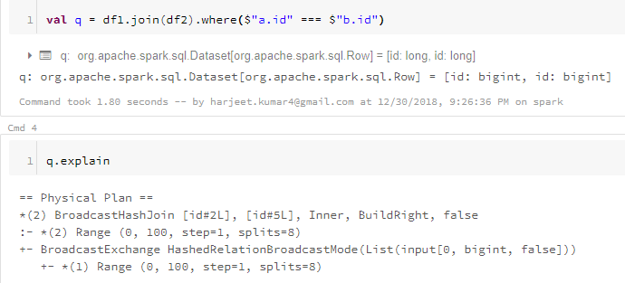
Broadcast Join
spark.sql.autoBroadcastJoinThreshold
Explicitly mark a dataset for Broadcast

