Slide 1
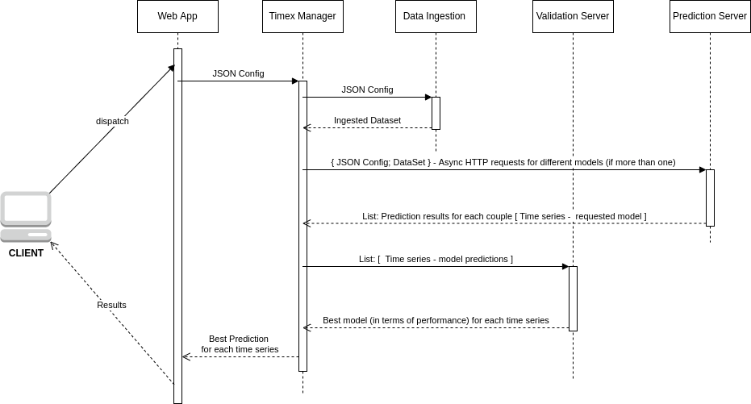
TIMEX WorkFlow

Slide 2
... in Kubernetes ...
POD-1
POD-2
POD-3
Manager
Validator
Ingestion
(MVI)
Timex-app
Timex-predictor
Different replicas of each pod may be spawned based on the workload

Slide 3
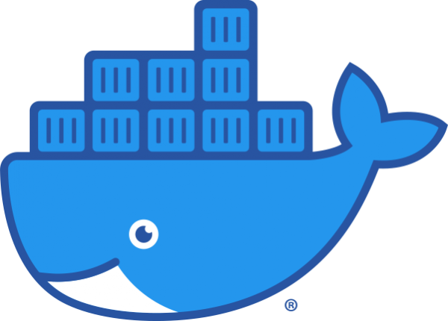
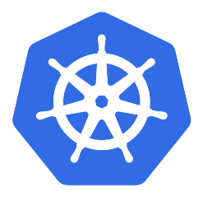
POD 1: the web application
S
E
R
V
I
C
E
Timex_app
Docker Container

Slide 4
POD 2: the MVI
data_ingestion
Docker Container
S
E
R
V
I
C
E
Timex_manager
Docker Container
validation_server
Docker Container

Slide 5
POD 3: the predictor
S
E
R
V
I
C
E
Timex-predictor Docker Container

