Slide 1
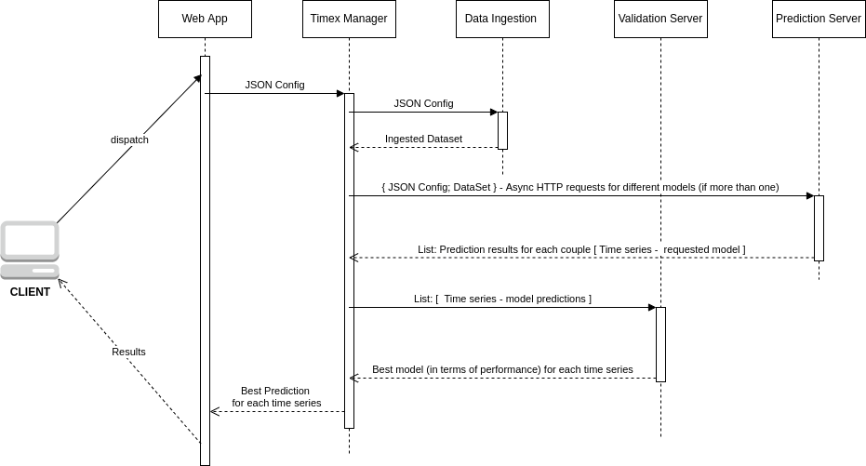
TIMEX WorkFlow

Slide 2
... in Kubernetes ...
POD-1
POD-2
POD-4
Timex Web App
Manager - Validator
Timex Predictor
POD-3
Data Ingestion
Note: Different replicas of each pod may be spawned based on the workload

Slide 3
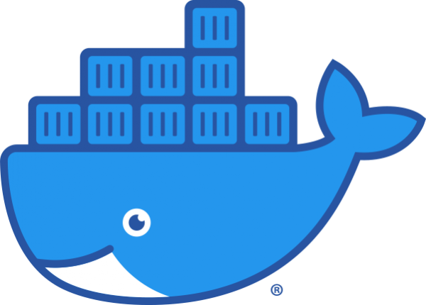
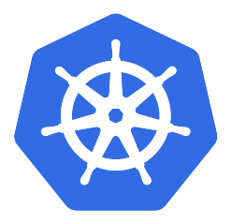
POD 1: the web application
S
E
R
V
I
C
E
Timex_app
Docker Container

Slide 4
POD 2: the manager-validator
validation_server
Docker Container
S
E
R
V
I
C
E
Timex_manager
Docker Container

Slide 5
POD 3: the data ingestion
S
E
R
V
I
C
E
data_ingestion_server
Docker Container

Slide 6
POD 4: the predictor
S
E
R
V
I
C
E
prediction_server Docker Container

