Slide 1
UML

Slide 2
Overview
What is UML?
A brief history of UML and its origins.
Understanding the basics of UML.
UML diagrams
UML Modeling tools

Slide 3
What is UML?
UML: Unified Modeling Language
An industry-standard graphical language for specifying, visualizing, constructing, and documenting the artifacts of software systems, as well as for business modeling.
The UML uses mostly graphical notations to express the OO analysis and design of software projects.
Simplifies the complex process of software design

Slide 4
Why UML for Modeling?
A diagram/picture = thousands words
Uses graphical notation to communicate more clearly than natural language (imprecise) and code(too detailed).
Makes it easier for programmers and software architects to communicate.
Helps acquire an overall view of a system.
UML is not dependent on any one language or technology.
UML moves us from fragmentation to standardization.

Slide 5
History
Time
Year Version
2003: UML 2.0
2001: UML 1.4
1999: UML 1.3
1997: UML 1.0, 1.1
1996: UML 0.9 & 0.91
1995: Unified Method 0.8
Booch ‘93
OMT - 2
Other methods
Booch ‘91
OMT - 1

Slide 6
Types of UML Diagrams
Use Case Diagram: capture requirements. Clarify exactly
what the system is supposed to do
Displays the relationship among actors and use cases. Different from traditional flow chart.
Class Diagram: static relationships between classes.
Describe the types of objects in the system and various kinds of static relationship that exist among them.
Sequence Diagram:
Displays the time sequence of the objects participating in the interaction.

Slide 7
Types of UML Diagrams (Cont.)
Collaboration Diagram
Displays an interaction organized around the objects and their links to one another.
State Diagram
Displays the sequences of states that an object of an interaction goes through during its life in response to received stimuli, together with its responses and actions.
Component Diagram
Illustrate the organizations and dependencies of the physical components in a system. A higher level than class diagrams.

Slide 8
Use Case Diagrams
Use Case
Boundary
Actor
Library System
Borrow
Employee
Client
Order Title
Fine Remittance
Supervisor
A generalized description of how a system will be used.
Provides an overview of the intended functionality of the system

Slide 9
Use Case Diagram(core components)
Actors: A role that a user plays with respect to the system,including human users and other systems. e.g.,inanimate physical objects (e.g. robot); an external system that needs some information from the current system.
Use case: A set of scenarios that describing an interaction between a user and a system.

Slide 10
Use Case Diagram (core components)
A use case is a single unit of meaningful work. E.g. login, register, place an order, etc.
Each Use Case has a description which describes the functionality that will be built in the proposed system.
E.g. for use case “order title” , a brief description: This use case receives orders from employee or supervisor, then return the ordered title.
System boundary: a rectangle diagram representing the boundary between the actors and the system.

Slide 11
Use Case Diagram(core relationship)
Association: communication between an actor and a use case; represented by a solid line.
Generalization: relationship between one general use case and one specific use case.
Represented by a line with a triangular arrow head toward the parent use case, the more general modeling element.
employee
waitress

Slide 12
Use Case Diagram(core relationship)
Include: a dotted line labeled <<include>> beginning at base use case and ending with an arrows pointing to the include use case. An “Include” relationship is used to indicate that a particular Use Case must include another use case to perform its function.
<<include>>
or in MS Visio
A Use Case may be included by one or more Use Cases, so it reduces duplication of functionality.
Example: the <list orders> Use Case may be included
every time when the <modify order> Use Case is run.

Slide 13
Use Case Diagram (core relationship)
Extend: a dotted line labeled <<extend>> with an arrow toward the base case. The extending use case may add behavior to the base use case. The base class declares “extension points”.
<<extend>>
Used when exceptional circumstances are encountered. For example, the <get approval> Use Case may optionally extend the regular <modify order> Use Case.
Note: other expressions. For example, in MS Visio

Slide 14
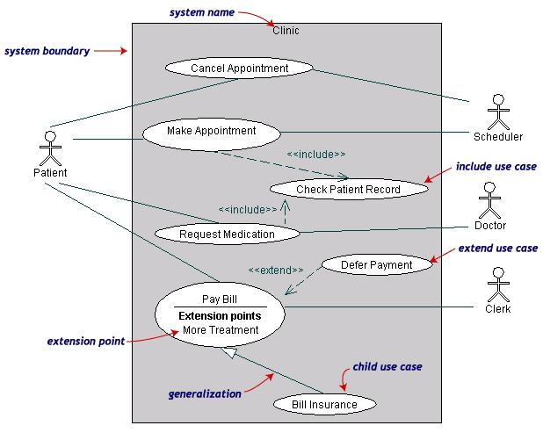
Use Case Diagrams(cont.)
Both Make Appointment and Request Medication include Check Patient Record as a subtask (include)
The extension point is written inside the base case Pay bill; the extending class Defer payment adds the behavior of this extension point. (extend)
Pay Bill is a parent use case and Bill Insurance is the child use case. (generalization)
(TogetherSoft, Inc)

Slide 15
Class Diagram
Each class is represented by a rectangle subdivided into three compartments
Name
Attributes
Operations
Modifiers are used to indicate visibility of attributes and operations.
‘+’ is used to denote Public visibility (everyone)
‘#’ is used to denote Protected visibility (friends and derived)
‘-’ is used to denote Private visibility (no one)
By default, attributes are hidden and operations are visible.
The last two compartments may be omitted to simplify the class diagrams

Slide 16
An example of Class
Name
Account_Name
- Custom_Name
- Balance
Attributes
+AddFunds( )
+WithDraw( )
+Transfer( )
Operations

Slide 17
C++ Class Example
class Checking { private:
char Customer_name[20]; float Balance; public: AddFunds(float); WithDraw(float); Transfer(float);
set_name(string);
get_name();
set_balance(float);
get_balance();
};

Slide 18
Person
firstName lastName email
getName() getEmail() setEmail( ) equals( ) toString()
SocialNetwork
friendList numFriends DEFAULT_MAX_FRIENDS
add( ) remove() toString()

Slide 19
There are two kinds of Relationships
Generalization (parent-child relationship)
Association (student enrolls in course)
Associations can be further classified as
Aggregation
Composition

Slide 20
Associations
Represent relationship between instances of classes
Student enrolls in a course
Courses have students
Courses have exams
Etc.
Association has two ends
Role names (e.g. enrolls)
Multiplicity (e.g. One course can have many students)
Navigability (unidirectional, bidirectional)

Slide 21
Notation of Class Diagram: association
Associations represent relationships between instances
of classes .
An association is a link connecting two classes.
Bi-directional association Associations are assumed to be bi-directional
e.g. Flight and plane
notation:
Uni-directional association e.g. Order and item
notation:

Slide 22
Association: Multiplicity and Roles
student
1
*
University
Person
0..1
*
employer
teacher
Multiplicity
Symbol Meaning
1 One and only one
0..1 Zero or one
M..N From M to N (natural language)
* From zero to any positive integer
0..* From zero to any positive integer
1..* From one to any positive integer
Role
Role
“A given university groups many people; some act as students, others as teachers. A given student belongs to a single university; a given teacher may or may not be working for the university at a particular time.”

Slide 23
Notation of Class Diagram: Generalization
Supertype
Example:
Customer
Regular
Customer
Loyalty
Customer
Subtype1
Subtype2
or:
Customer
Generalization expresses a relationship among related classes. It is a class that includes its subclasses.
Regular
Customer
Loyalty
Customer

Slide 24
Notation of Class Diagram: Composition
COMPOSITION
Composition: expresses a relationship among instances
of related classes. It is a specific kind of Whole-Part relationship.
It expresses a relationship where an instance of the Whole-class has the responsibility to create and initialize instances of each Part-class. It may also be used to express a relationship where instances of the Part-classes have privileged access or visibility to certain attributes and/or behaviors defined by the Whole-class. Composition should also be used to express relationship where instances of the Whole-class have exclusive access to and control of instances of the Part-classes.
Composition should be used to express a relationship where the behavior of Part instances is undefined without being related to an instance of the Whole. And, conversely, the
behavior of the Whole is ill-defined or incomplete if one or more of the Part instances are undefined.
Whole Class
Class W
Class P₁
Class P₂
Part Classes
Example
Automobile
Engine
Transmission

Slide 25
Notation of Class Diagram: Aggregation
Container Class
Class C
Aggregation: expresses a relationship among instances
of related classes. It is a specific kind of Container-Containee relationship.
It expresses a relationship where an instance of the Container-class has the responsibility to hold and maintain instances of each Containee-class that have been created outside the auspices of the Container-class. Aggregation should be used to express a more informal relationship than composition expresses. That is, it is an appropriate relationship where the Container and its Containees can be manipulated independently.
Aggregation is appropriate when Container and Containees have no special access privileges to each other.
AGGREGATION
Class E₁
Class E₂
Containee Classes
Example
Bag
Apples
Milk
[From Dr.David A. Workman]

Slide 26
Aggregation vs. Composition
Composition is really a strong form of aggregation
components have only one owner
components cannot exist independent of their owner;
both have coincident lifetimes
components live or die with their owner
e.g. (1)Each car has an engine that can not be shared
with other cars.
(2) If the polygon is destroyed, so are the points.
Aggregations may form "part of" the aggregate, but may not be essential to it. They may also exist independent of the aggregate. Less rigorous than a composition.
e.g. (1)Apples may exist independent of the bag.
(2)An order is made up of several products, but the
products are still there even if an order is
cancelled.

Slide 27
Class Diagram example
Name
Order
class
Multiplicity: mandatory
Attributes
-dateReceived
*
Customer
-isPrepaid
1
-number :String
-name
-price : Money
-address
Operations
+dispatch()
Association
+creditRating() : String()
+close()
1
{if Order.customer.creditRating is
Generalization
"poor", then Order.isPrepaid must
be true }
Corporate Customer
Personal Customer
Constraint
(inside braces{}}
-contactName
-creditCard#
-creditRating
Multiplicity:
Many value
-creditLimit
+remind()
+billForMonth(Integer)
Multiplicity: optional
*
0..1
*
Employee
OrderLine
-quantity: Integer
*
1
Product
-price: Money
-isSatisfied: Boolean
[from UML Distilled Third Edition]

Slide 28
Sequence Diagram: Object interaction
A
B
Self-Call: A message that an
Object sends to itself.
Condition: indicates when a message is sent. The message is sent only if the condition is true.
Synchronous
Asynchronous
Transmission delayed
Condition
[condition] remove()
Iteration
*[for each] remove()
Self-Call

Slide 29
Sequence Diagrams – Object Life Spans
Lifelines
The dotted line that extends down the vertical axis from the base of each object.
Messages
Labeled as arrows, with the arrowhead indicating the direction of the call.
Activation bar
The long, thin boxes on the lifelines are method-invocation boxes indicting that indicate processing is being performed by the target object/class to fulfill a message.
Rectangle also denotes when object is deactivated.
Deletion
Placing an ‘X’ on lifeline
Object’s life ends at that point
A
Create
B
Activation bar
X
Return
Deletion
Lifeline

Slide 30
Sequence Diagram
Message
Sequence diagrams demonstrate the behavior of objects in a use case
by describing the objects and the messages they pass.
The horizontal dimension shows the objects participating in the interaction.
The vertical arrangement of messages indicates their order.
The labels may contain the seq. # to indicate concurrency.

Slide 31
Interaction Diagrams: Collaboration diagrams
Shows the relationship between objects and the order of messages passed between them.
The objects are listed as rectangles and arrows indicate the messages being passed.
The numbers next to the messages are called sequence numbers. They show the sequence of the messages as they are passed between the objects.
Convey the same information as sequence diagrams, but focus on object roles instead of the time sequence.

Slide 32
Interaction Diagrams: Collaboration diagrams (cont.)
start
6: remove reservation
3 : [not available] reserve title
User
Reservations
6 : borrow title
5: title available
2: title data
1: look up
4 : title returned
Catalog
5 : hold title

Slide 33
CRC Card
A collection of standard index cards, each of which is
divided into three sections; can be printed or hand-written.
Benefits: It is easy to describe how classes work by moving cards around; allows to quickly consider alternatives.
Class
Reservations
Collaborators
Catalog
User session
Responsibility
Keep list of reserved titles
Handle reservation

Slide 34
How to create CRC cards?
Find classes
Look for main classes first, then find relevant classes.
Find responsibilities
Know what a class does; what information you wish to maintain about it.
Define collaborators
A class often needs to collaborate with other classes to get the job done. Collaboration diagram is an example to show class relationship.
Move cards around
Cards that collaborate with one another should be placed close together, whereas cards that don’t collaborate should be placed far apart.

Slide 35
State Diagrams (Billing Example)
State Diagrams show the sequences of states an object goes through during its life cycle in response to stimuli, together with its responses and actions; an abstraction of all possible behaviors.
Start
End
Unpaid
Paid
Invoice created
paying
Invoice destroying

Slide 36
Basic rules for State Diagrams
Draw only one object's chart at a time.
A state is drawn as a box with rounded corners.
From each state draw an arrow to another state if the object can change from one to the other in one step.
Label the arrow with the event that causes it.
Show the initial state by drawing an arrow from a black filled circle to the initial state.
Show the end state by drawing an arrow to a circle with a filled circle inside it.

Slide 37
State Diagrams (Traffic light example)
Traffic Light
Start
State
Red
Transition
Yellow timer expires
Car trips sensor
Yellow
Green timer expires
Green
Event

Slide 38
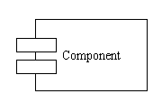
Component Diagram
Illustrate the organizations and dependencies of the physical components in a system.
Has a higher level of abstraction than a Class diagram - usually implemented by one or more classes.
Symbols and Notations
Components
a large rectangle with two smaller rectangles on the side.

Slide 39
Component Diagram (cont.)
Interface An interface describes a group of operations used or created by components. It represents a declaration of a set of coherent public features and obligations, similar to a contract.
Dependencies
dashed arrows.

Slide 40
Component Diagram (cont.)
order
customer
account
Order provides a component interface, which is a collection of one or more methods with or without attributes.
Account and customer components are dependent upon the interface of the order.

Slide 41
UML Modeling Tools
Rational Rose (www.rational.com) by IBM
UML Studio 7.1 ( http://www.pragsoft.com/) by Pragsoft Corporation
Capable of handling very large models (tens of thousands of classes). Educational License US$ 125.00; Freeware version.
Microsoft Visio
Dia: open source, much like visio. (http://www.gnome.org/projects/dia/)
ArgoUML (Open Source; written in java ) (http://www.apple.com/downloads/macosx/development_tools/argouml.html )
Others (http://www.objectsbydesign.com/tools/umltools_byCompany.html )

Slide 42
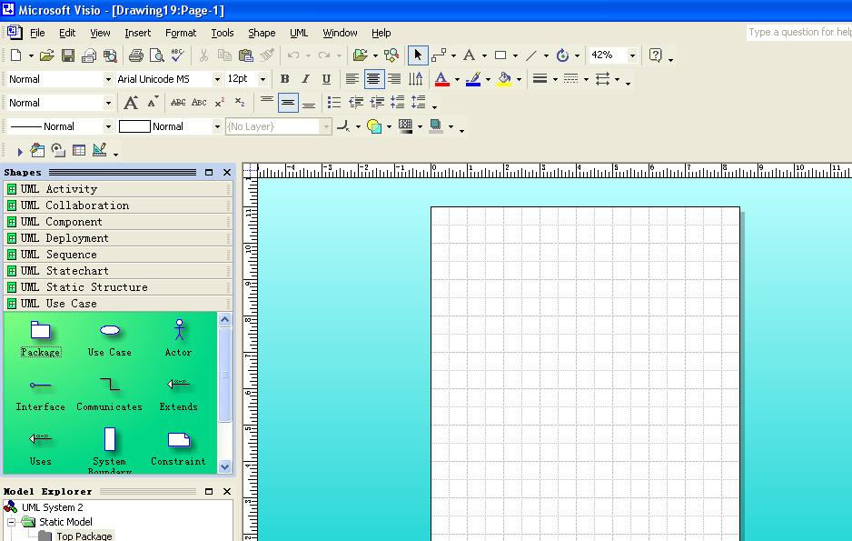
Microsoft Visio

Slide 43
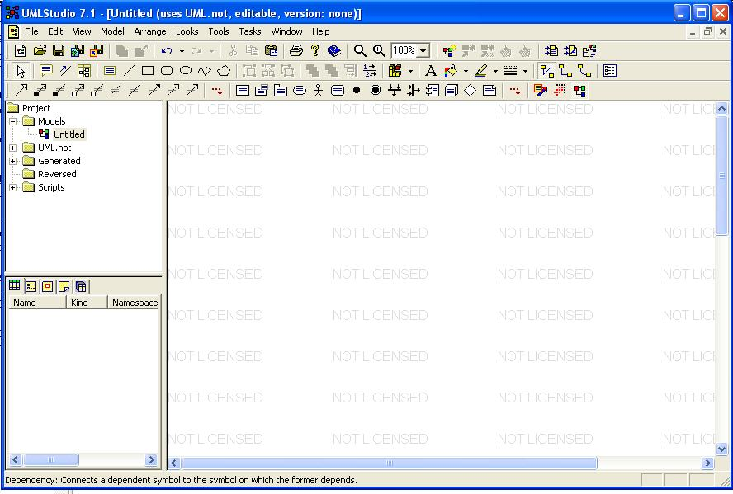
UML studio 7.1

Slide 44
