Slide 1
Heart Disease Detection Using Machine Learning
Submitted By:
Devesh Chandra
Dhirendra Yadav
Utkarsh Singh
Dharmendra Singh Yadav
Guide Name:
Prof. Pushpendra Kumar

Slide 2
Contents:
Introduction
Problem Statement
Motivation
Objectives
Literature Review
Proposed Model in Base Paper
Algorithm used in Base Paper
Applications
Summary
References

Slide 3


Introduction:-
It is difficult to identify heart disease because of several contributory risk factors such as diabetes, high blood pressure, high cholesterol, abnormal pulse rate and many other factors.
Among various life-threatening diseases, heart disease has garnered a great deal of attention in medical research.
The diagnosis of heart disease is a challenging task, which can offer automated prediction about the heart condition of patient so that further treatment can be made effective.
The diagnosis of heart disease is usually based on signs, symptoms of the patient.
The severity of the disease is classified based on various methods like K-Nearest Neighbor Algorithm (KNN), Decision Tree (DT), Genetic algorithm (GA), and Naïve Bayes (NB).
The nature of heart disease is complex and hence, the disease must be handled carefully. Not doing so may affect the heart or cause premature death.

Slide 4

Problem Statement:-
Identify the prevalence and impact of heart disease: Begin by providing an overview of heart disease as a leading cause of mortality worldwide, emphasizing the need for accurate and timely detection methods.
Highlight the limitations of traditional diagnostic approaches: Discuss the challenges associated with conventional diagnostic techniques, such as reliance on subjective interpretation and the potential for human error, leading to delayed or inaccurate diagnoses.
Introduce machine learning as a potential solution: Present the concept of machine learning and its ability to analyze large volumes of medical data, including patient records, genetic information, and imaging results, to develop robust heart disease detection models.
Outline the objectives of the report: Clearly state the objectives of the report, which include evaluating the performance of machine learning algorithms in heart disease detection, exploring the impact on patient outcomes, and identifying potential challenges and future directions for research in this field.

Slide 5

Motivation:-
A major challenge facing healthcare organizations is the provision of quality services at affordable costs.
Quality service implies diagnosing patients correctly and administering treatments that are effective.
Poor clinical decisions can lead to disastrous consequences which are therefore unacceptable.
Hospitals must also minimize the cost of clinical test.
They can achieve this results by employing appropriate computer-based information and decision support system.

Slide 6

Objectives:-
The main objective of this research is to develop a heart prediction system, the system can discover and extract hidden knowledge associated with diseases from heart data set.
This system aims to exploit machine learning techniques on medical data set to assist in the prediction of the heart disease.
Reduce the cost of medical tests.
To help avoid human biases.

Slide 7
Literature Survey 1:-
AUTHOR | TITLE | PURPOSE | ALGORITHMS & ACCURACY
Mr. Santhana Krishnan J., Dr. Geetha S. | Prediction of Heart Disease Using Machine Learning Algorithms | In this system, a heart disease data set is used. The main aim of this system is to predict the possibilities of occurring heart disease of the patients in terms of percentage. This is performed through data mining classification techniques. | Decision Tree 91% Naïve Bayes 87%
M. Marimuthu, S. Deivarani, Gayathri R. | Analysis of Heart Disease Prediction using Various Machine Learning Techniques | To achieve better accuracy and to make the more efficient so that it can predict the chances of heart attack. | KNN 83.60% NB 80.66% Decision Tree 75.58% SVM 65.56%
Sanchayita Dhar, Pritha Datta, Ankur Biswas, Tanusree Dey, Krishna Roy | A Hybrid Machine Learning Approach for Prediction of Heart Diseases | In this paper, to develop a prediction system that can be capable to envisage heart diseases based on measurements, are extracted from the ERIC laboratory consisting of 209 test cases. | Naïve Bayes Decision Tree Random Forest
Rajesh N., T Maneesha, Shaik Hafeez, Hari Krishna | Prediction of Heart Disease Using Machine Learning Algorithms | In this paper, processing patient’s dataset and a data of patients to whom we need to predict the chance of occurrence of a heart disease. | Naïve Bayes Decision Tree (ID3 Algorithm)

Slide 8
Literature Survey 2 :-
 | Paper 1 | Paper 2 | Paper 3 | Paper 4
TITLE | Effective heart disease prediction using hybrid machine learning techniques. | Prediction of Heart Disease Using Machine Learning. | Prediction of Heart Disease Using Machine Learning Algorithm. (Decision Tree and naïve Bayes) | Prediction of Heart Disease at early stage using Data Mining and Big Data Analytics: A Survey.
YEAR | 2019 | 2018 | 2019 | 2019
METHOD USED | HRFLM(Hybrid Random Forest with Linear Model). | Neural Networks. | Decision Tree, Naïve Bayes. | Decision Tree, Naïve Bayes, Neural Networks, K-NN, SVM.
PARAMETER CONSIDERED | Age, FBS, restec g, exang, oldpeak, slope, sex, thal | Age, Sex, BP, Heart Rate, Diabetes, Hyper Cholesterol, BMI | Cholesterol, BP, Diabetes, Smoking, Alcohol, overweight, coronary illness. | Chest Pain, BP, Cholesterol, and Blood sugar.
BEST METHOD | HRFLM | Neural Networks | Decision Tree. | Neural Networks.
STRENGTH | Accuracy is high among all. Classification error rate is low. | MLP algorithm gives reliable o/p terms of accuracy, efficiency. | Accuracy rate higher than naïve bayes and others. | Accuracy and MLP of NN is higher than DT, NB, SVM, K-NN.

Slide 9
Literature Survey 3 :-
Sr. No. | TITLE | AUTHORS | YEAR | ALGORITHMS USED
1. | Heart Disease Prediction Using Effective Machine Learning Techniques. | Avinash Golande, Pavan Kumar T | 2019 | Decision Tree, KNN, k-mean, adaboost.
2. | Prediction of Heart Disease Using Machine Learning Algorithms | Mr. Santhana Krishnan. J, Dr. Geetha S. | 2018 | Decision tree, Naïve Bayes.
3. | Heart Disease prediction using machine learning techniques: a survey | V.V. Ramalingam , Ayantan Dandapath, M Karthik Raja | 2018 | Naïve Bayes, SVM, K-Nearest Neighbor(KNN), Decision Tree
4. | A hybrid Intelligent System Framework for the Prediction of Heart Disease Using Machine Learning Algorithms. | Amin Ul Haq, 1 Jian Ping Li, Muhammad Hammad Memon, 1 Shah Nazir, 2 and Ruinan Sun | 2018 | Logistic regression, SVM, Naïve Bayes, Artificial Neural Network.

Slide 10
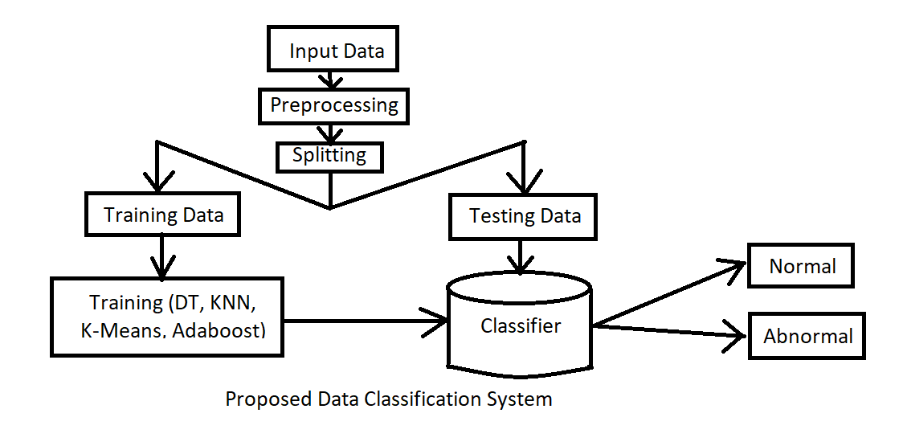
Proposed Model :-

Slide 11
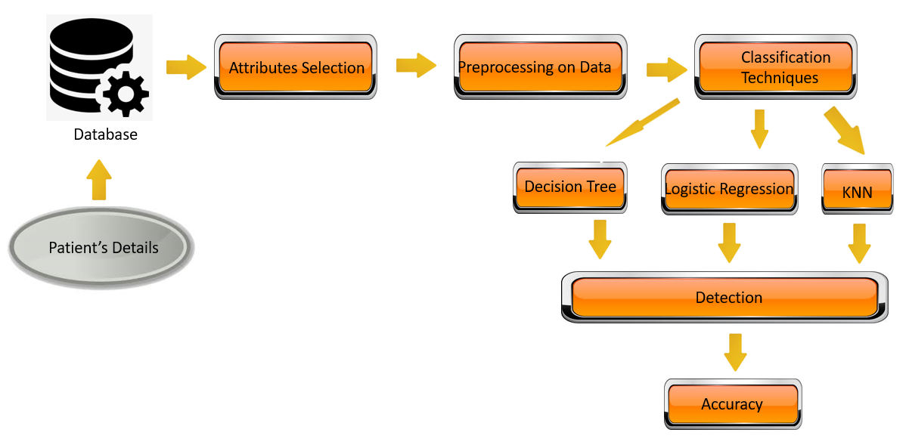
Proposed Model (Implementation) :-

Slide 12
MACHINE LEARNING ALGORITHMS
1. Logistic Regression:
Logistic regression is a popular statistical modeling technique used for binary classification problems. Unlike linear regression, which predicts continuous values, logistic regression predicts the probability of an instance belonging to a specific class. It is particularly suited for problems where the dependent variable is categorical, such as determining whether a patient has a heart disease or not.
In logistic regression, the input variables are combined linearly, and a logistic function (sigmoid function) is applied to the result. This transforms the output into a probability value between 0 and 1. If the probability is above a predetermined threshold, typically 0.5, the instance is classified as belonging to one class; otherwise, it is assigned to the other class.
The logistic regression model estimates the coefficients for each input variable, indicating the strength and direction of their influence on the outcome. These coefficients are typically determined using optimization algorithms like gradient descent, maximizing the likelihood of the observed data.
Despite its simplicity, logistic regression has several advantages, including its interpretability, ease of implementation, and efficiency with large datasets. However, it assumes a linear relationship between the predictors and the log-odds of the outcome, which may limit its performance in complex, nonlinear problems.

Slide 13
MACHINE LEARNING ALGORITHMS
2. Decision Tree :
A decision tree is a popular machine learning algorithm used for both classification and regression tasks. It represents a flowchart-like structure where each internal node denotes a feature or attribute, and each leaf node represents a class label or a predicted value. Decision trees partition the data recursively based on the feature values to make predictions.
The tree structure is built by splitting the dataset at each internal node, aiming to maximize the information gain or decrease in impurity. Common splitting criteria include Gini impurity and entropy. The algorithm chooses the best feature and threshold to split the data, creating branches that lead to subsequent nodes. This process continues until a stopping criterion is met, such as reaching a maximum tree depth or a minimum number of samples in a leaf node.
Decision trees offer several advantages, including their interpretability, as the flowchart-like structure allows easy understanding of the decision-making process. They can handle both numerical and categorical features and handle missing values without the need for imputation. Decision trees can also capture non-linear relationships and interactions between features.
However, decision trees are prone to overfitting, particularly when the tree becomes too complex. Ensemble methods like random forests and boosting algorithms are often used to mitigate this issue by combining multiple decision trees. Overall, decision trees are a versatile and intuitive algorithm that can provide valuable insights and accurate predictions in various domains.

Slide 14
MACHINE LEARNING ALGORITHMS
3. KNN:
K-Nearest Neighbors (KNN) is a non-parametric supervised learning algorithm used for classification and regression tasks. It is a simple yet powerful algorithm that relies on the proximity of data points in feature space.
In KNN, the value of K, a hyperparameter, determines the number of nearest neighbors used for making predictions. For a given data point, the algorithm finds the K nearest neighbors based on a distance metric, often Euclidean distance. The class or value of the majority of these neighbors is assigned as the prediction for the target data point. In the case of regression, the average or weighted average of the neighbors' values is taken.
KNN is known for its simplicity and ease of implementation. It is a non-parametric algorithm, meaning it does not make any assumptions about the underlying data distribution. KNN can handle complex decision boundaries and adapt well to local patterns in the data.
However, KNN has some limitations. It can be computationally expensive, especially with large datasets, as it requires calculating distances between all data points. It is also sensitive to the choice of K and the distance metric. Imbalanced data can bias the predictions, as the majority class tends to dominate. Feature scaling is often necessary to prevent certain features from dominating the distance calculation.
Overall, KNN is a versatile algorithm that can be effective in many situations, particularly with smaller datasets and when local patterns are important.

Slide 15
Dataset Attributes
S. No. | Attributes | Description | Type
1. | Age | Patient’s age (29 to 77) | Numeric data
2. | Sex | Male or Female | M/F
3. | Chest Pain Type | Chest pain type | Nominal
4. | RBP | Resting blood pressure | Numeric data
5. | Cholesterol | Serum cholesterol in mg/dl | Numeric data
6. | FBS | Fasting blood sugar | Numeric data
7. | Resting ECG | Resting electrocardiograph | Nominal
8. | Max HR | Maximum Heart Rate | Numeric data
9. | Exercise Angina | Angina Pain | Nominal
10. | Old Peak | ST Depression | Numeric data
11. | ST Slope | ST segment shift | Nominal

Slide 16
Result and discussion
S.No. | Algorithm | Accuracy
1. | Decision Tree Classifier | 78.5%
2. | Logistic Regression Classifier | 83.5%
3. | KNN Classifier | 67.5%
Our aim was to use a preprocessed dataset, split into training and testing sets, to detect the presence or absence of heart disease in individuals. Various classification algorithms, such as Decision Tree, Logistic Regression, and KNN, were employed to analyze the data. The project involved evaluating different machine learning algorithms for detecting heart disease using properly processed patient data. After training and testing the three models, the highest scores obtained were as follows:

Slide 17
Applications :-
Early Diagnosis: Machine learning algorithms can analyze various data sources, such as patient records, medical imaging, and genetic information, to detect patterns and identify early signs of heart disease. This allows for timely intervention and treatment, potentially saving lives and improving patient outcomes.
Risk Assessment: Machine learning models can assess an individual's risk of developing heart disease by analyzing various risk factors, such as age, gender, family history, lifestyle choices, and medical history. These models can provide personalized risk scores, enabling healthcare professionals to prioritize preventive measures and interventions.
ECG Analysis: Electrocardiogram (ECG) signals provide valuable information about heart function. Machine learning algorithms can analyze ECG data to detect abnormalities, such as arrhythmias or ST segment changes, which can be indicative of heart disease. This automated analysis helps in early detection and reduces the reliance on manual interpretation.
Image-based Diagnosis: Medical imaging techniques, such as echocardiography and coronary angiography, provide detailed images of the heart. Machine learning algorithms can analyze these images to detect structural abnormalities, measure cardiac parameters, and identify features associated with heart disease, assisting in accurate diagnosis and treatment planning.
Predictive Modeling: Machine learning can develop predictive models that estimate the likelihood of future heart disease events, such as heart attacks or strokes. By analyzing a patient's medical history, lifestyle factors, and other clinical data, these models can provide risk predictions and assist in developing personalized preventive strategies.
Drug Response Prediction: Machine learning can help predict how an individual will respond to specific medications or treatments for heart disease. By analyzing patient characteristics and genetic information, these models can identify patients who are likely to benefit from certain drugs or have an increased risk of adverse reactions, allowing for tailored treatment plans.

Slide 18
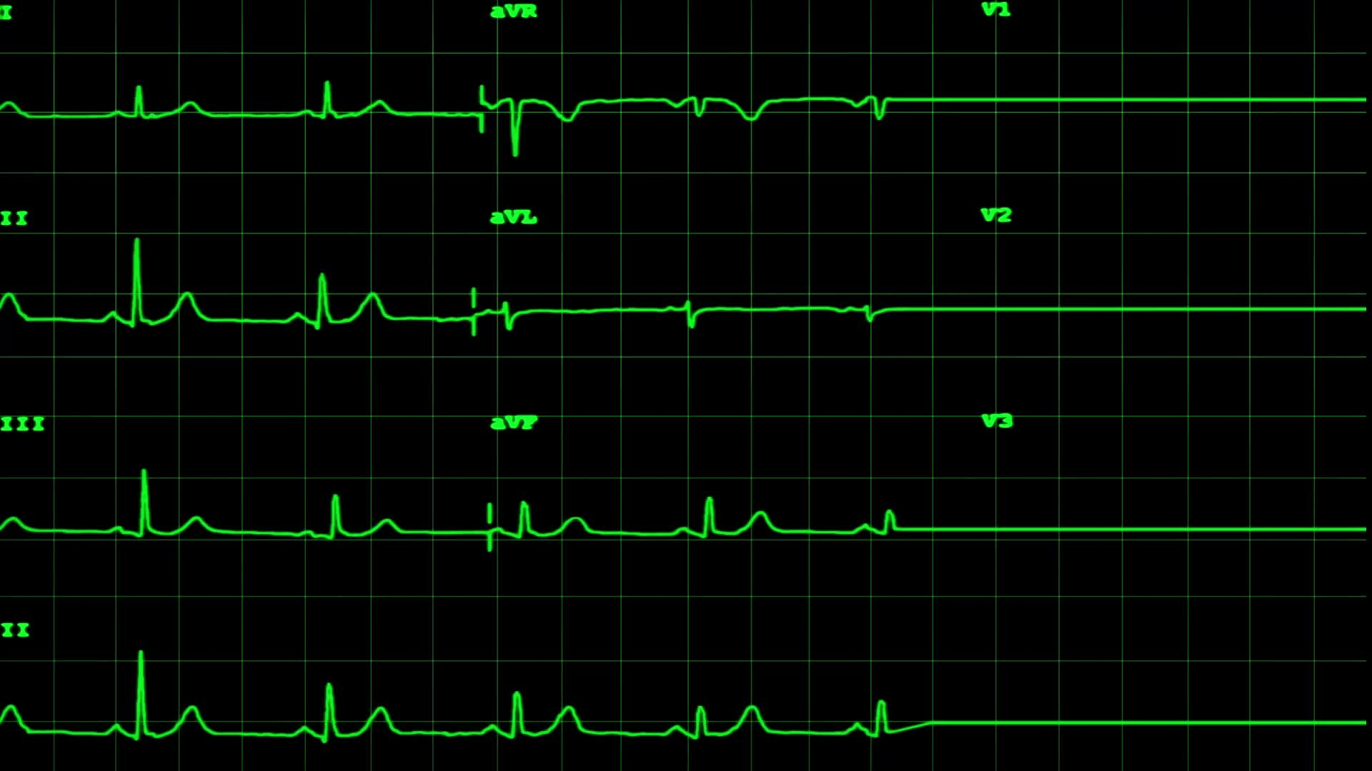
Summary :-
In recent years, there has been a significant increase in the use of machine learning algorithms for improving the accuracy of heart disease detection. These algorithms can learn intricate relationships between independent and dependent variables from extensive datasets, resulting in more precise predictions than traditional methods. Among the machine learning algorithms employed for heart disease detection, Decision Trees, k-Nearest Neighbors (KNN), and Logistic Regression have been proven to be successful. However, each algorithm has its own strengths and limitations, and choosing the optimal algorithm for a particular application depends on various factors, such as the dataset's size and characteristics, the complexity of the feature relationships, and the availability of computational resources.
In summary, machine learning algorithms have significantly increased the precision of heart disease detection. Nonetheless, there is still a need for more investigation to improve the interpretability and robustness of these models, as well as their effectiveness in practical situations.

Slide 19
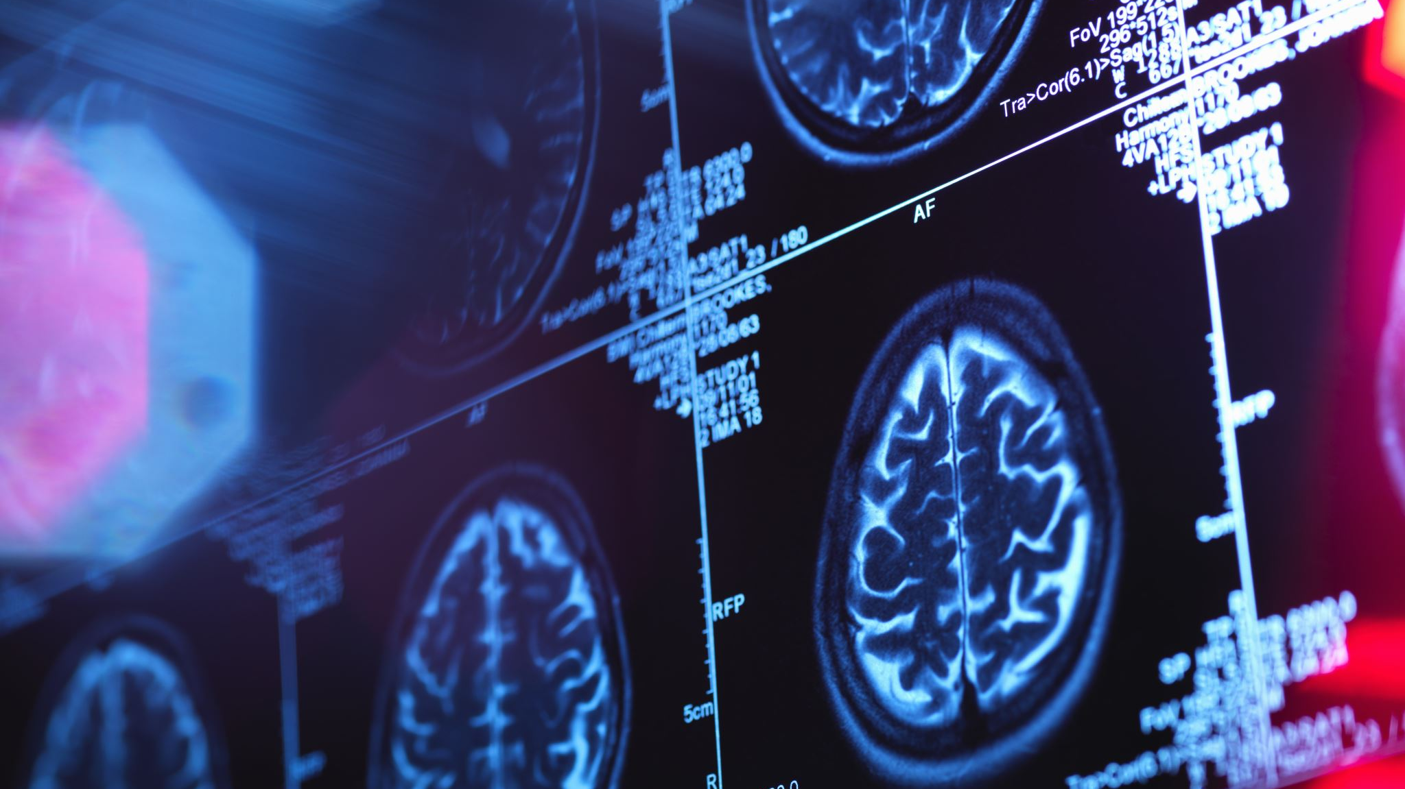
References :-
[1] Effective heart disease prediction using hybrid machine learning techniques :-Senthil Kumar Mohan, Chandrasegar Thirumalai, and Gautam Srivastava -(19 JUNE 2019).
[2] Prediction of Heart Disease Using Machine Learning:- Aditi Gavhane, Gouthami Kokkula, Isha Pandya, Prof. Kailas Devadkar (PhD) - 2018.
[3] Prediction of Heart Disease at early stage using Data Mining and Big Data Analytics: A Survey:- Salma Banu N.K, Suma Swamy.-2019.
[4] Prediction of Heart Disease Using Machine Learning Algorithms. :- Mr. Santhana Krishnan. J, Dr. Geetha. S. - 2019.

Slide 20
Thank You !!!

