Slide 1

CLOUD COMPUTING LABORATORY
CS4V51
Ex.No : 06 Transfer Files Between Virtual Machines
Aim: Find a procedure to transfer files from one virtual machine
to another virtual machine.
Department of Computer Science and Engineering

Slide 2

Aim & Overview
Aim
To find a procedure to transfer files from one virtual machine to another virtual machine, using the facilities built into VirtualBox.
Copy & Paste
(Devices ▸ Drag and Drop)
Three Transfer Methods
▼
USB Passthrough
(Extension Pack + Filters)
Copy & Paste — via Drag and Drop between host and guest
USB Drive — passing a physical USB device into the VM
Network Share — a shared folder mounted in the guest OS
▼
Shared Folder
(Guest Additions + Auto-mount)
Ex.No: 06
21/08/2026

Slide 3
Method 1 — Copy & Paste (Drag and Drop)
The simplest option for occasional transfers between the host and a single guest, or between two guest windows on the same host.
Host → Guest Drag a file from the host desktop into the running VM window.
Guest → Host Drag a file from inside the VM out onto the host desktop.
Bidirectional Allows dragging in both directions — the recommended setting.
Disabled The default option; no drag-and-drop transfer is possible.
Steps: 1. With the virtual machine running, select Devices → Drag and Drop from the VM window menu.
2. Choose Bidirectional for the best results.
3. Drag files directly between the host desktop and the guest OS window.
Ex.No: 06
21/08/2026

Slide 4
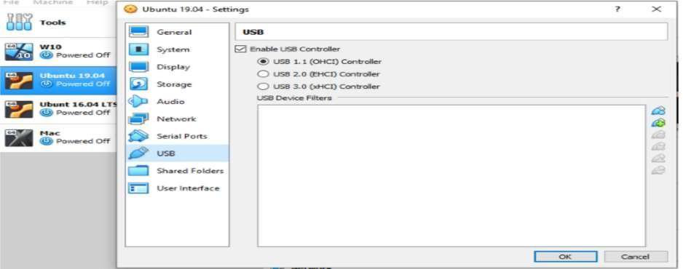
Method 2 — Transfer via a USB Stick
Step 1: Install the VirtualBox Extension Pack from virtualbox.org/wiki/Downloads to enable USB device access.
Step 2: Insert the USB device to be used for the transfer.
Step 3: Open VirtualBox → File → Preferences → Extensions, click +, browse to the downloaded Extension Pack, then Install.
VirtualBox Settings — USB controller enabled
Step 4: Confirm USB is enabled under Settings → USB, choosing the appropriate controller (1.1 / 2.0 / 3.0).
Tip: USB Device Filters can be added so a specific device is automatically captured by the VM whenever it is plugged in.
Step 5: Copy files onto the USB device from one VM, then access the same device from another VM to complete the transfer.
Ex.No: 06
21/08/2026

Slide 5
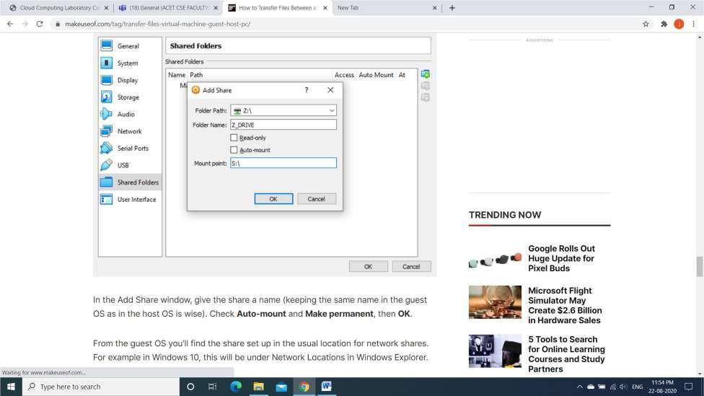
Method 3 — Create a Shared Folder
Step 1: Install VirtualBox Guest Additions via Devices → Install Guest Additions, browsing to the EXE and finishing with default options.
Step 2: Open Devices → Shared Folders → Shared Folders Settings, click +, then in Folder Path choose Other and browse to the host folder to share.
Step 3: In the Add Share window, give the share a name — keeping it the same in guest and host is best practice.
Add Share dialog — folder path, name, and auto-mount
Step 4: Check Auto-mount and Make permanent, then click OK.
From the guest OS: the share appears under the usual network-share location — for example, under Network Locations in Windows Explorer on a Windows guest.
Ex.No: 06
21/08/2026

Slide 6
Method Comparison & Result
Choosing a Method
Key Takeaways
VirtualBox supports at least three built-in ways to move files without external tools
Guest Additions unlock both drag-and-drop and shared folders — install them first
Shared folders are the most durable option for ongoing work between VMs
Copy & Paste Best for: Quick, one-off files No setup beyond enabling Drag & Drop
USB Drive Best for: Large files, offline transfer Needs Extension Pack + physical device
Network Share Best for: Frequent, ongoing transfers Needs Guest Additions; persists across sessions
Result A procedure to transfer files from one virtual machine to another virtual machine — via copy-paste, USB device, and network shared folder — was found and executed successfully.
Ex.No: 06
21/08/2026

