Slide 1

CLOUD COMPUTING LABORATORY
CS4V51
Ex.No : 02 Virtual Machine – C Compiler
Aim: Install a C compiler in the virtual machine created using VirtualBox,
and execute simple C programs.
Department of Computer Science and Engineering

Slide 2

Aim & Overview
Aim
To install a C compiler in the virtual machine created using VirtualBox, and execute simple C programs inside the guest OS.
Power On
CorePlus VM
▼
Load Compiler
(tce-load compiletc)
Environment Used
Host: VMware Player / VirtualBox
Guest OS: CorePlus (lightweight Linux distro)
Package manager: tce-load (Tiny Core Extension loader)
Compiler suite: compiletc (GCC toolchain for Tiny Core)
▼
Write Program
(sudo editor)
▼
Compile & Run
(cc + ./a.out)
Ex.No: 02
21/08/2026

Slide 3
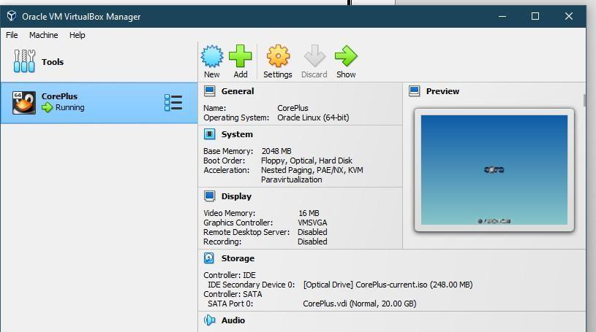
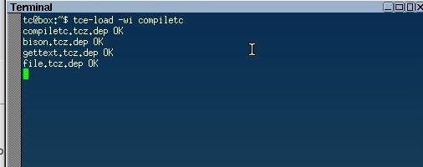
Procedure — Setup VM & Install Compiler (Steps 1–3)
Step 1: Install VMware Player and host the virtual machine (CorePlus).
Step 2: Open the VMware workstation / VirtualBox and power on the CorePlus virtual machine.
Step 3: Once the guest OS loads, open the terminal and run:
tc@box:~$ tce-load -wi compiletc
This downloads and installs GCC and the required libraries (bison, gettext, file, etc.).
VirtualBox Manager — CorePlus VM running
tce-load -wi compiletc command
Ex.No: 02
21/08/2026

Slide 4
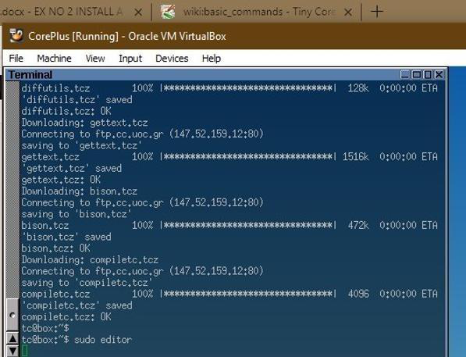
Procedure — Write & Compile the Program (Steps 4–7)
Step 4: Open a terminal and type sudo editor. A text window opens — type the C program and save it with a .c extension.
Step 5: After completing the program, exit the editor with CTRL+Q, returning to the terminal.
Step 6: Compile the program: tc@box:~$ cc demo.c
Step 7: Run the compiled output: tc@box:~$ ./a.out
Sample run: Enter year: 1991
1991 is not a Leap Year
Terminal — launching 'sudo editor'
Ex.No: 02
21/08/2026

Slide 5
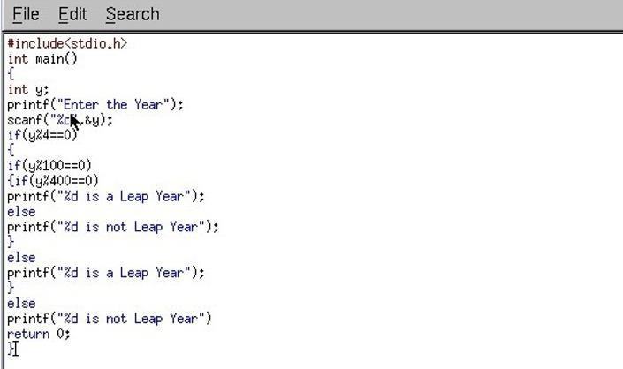
Sample Program — Leap Year Check
The following C program checks whether a given year is a Leap Year, typed inside the CorePlus text editor and saved with a .c extension:
#include<stdio.h>
int main() {
int y;
printf("Enter the Year");
scanf("%d",&y);
if(y%4==0) {
if(y%100==0)
{ if(y%400==0)
printf("%d is a Leap Year");
else
printf("%d is not Leap Year");
}
else
printf("%d is a Leap Year");
}
else
printf("%d is not Leap Year");
return 0;
}
Program typed in the editor (nano/vi-style)
Compile & Run: tc@box:~$ cc demo.c
tc@box:~$ ./a.out
Enter year: 1991
1991 is not a Leap Year
Ex.No: 02
21/08/2026

Slide 6
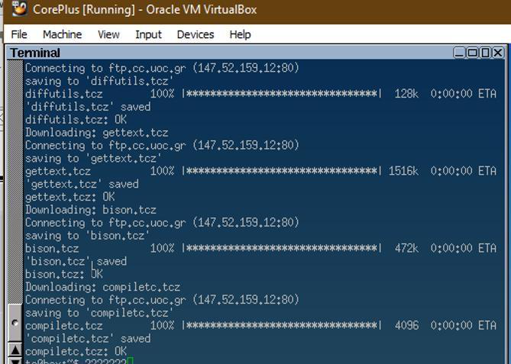
Downloaded Packages & Result
Package download: tce-load fetches diffutils, gettext, bison and compiletc from the Tiny Core repository, then confirms each is OK before returning to the prompt.
Key Takeaways
Tiny Core Linux keeps the guest OS minimal — packages load on demand via tce-load
compiletc bundles GCC with the libraries needed to build and run C programs
The same cc → ./a.out workflow used here applies to any C program on the VM
Result A C compiler (GCC via compiletc) was successfully installed in the CorePlus virtual machine, and a sample C program (Leap Year check) was written, compiled with cc, and executed successfully using ./a.out.
Compiler & library packages downloading successfully
Ex.No: 02
21/08/2026

