Slide 1

CLOUD COMPUTING LABORATORY
CS4V51
Ex.No : 07 Install Hadoop Single Node Cluster &
Run a WordCount Application
Aim: Find the procedure to set up a one-node Hadoop cluster,
and run simple applications like WordCount using MapReduce.
Department of Computer Science and Engineering

Slide 2

Aim & Overview — What is Hadoop?
Aim
Install Java
& Setup SSH
To find the procedure to set up a one-node Hadoop cluster, and run simple applications like WordCount using MapReduce.
▼
Apache Hadoop is an open-source framework for storage and large-scale processing of data-sets on clusters of commodity hardware.
Extract Hadoop &
Set Env Variables
▼
Core Modules
Configure
XML Files
Hadoop Common — libraries and utilities used by other modules
HDFS — distributed file-system storing data across the cluster
▼
Format HDFS &
Start Daemons
Hadoop YARN — resource management & job scheduling
Hadoop MapReduce — programming model for large-scale data processing
▼
Run WordCount
via MapReduce
Ex.No: 07
21/08/2026

Slide 3
Procedure — Install Java & Configure SSH (Steps 1–5)
Step 1: Install Java (prerequisite for Hadoop):
Steps 4–5: Enable password-less SSH to localhost, then create the hadoop group and user account:
sudo apt-get update
sudo apt-get install openjdk-7-jdk
sudo apt-get install openjdk-7-jre
cat $HOME/.ssh/id_rsa.pub >> \
$HOME/.ssh/authorized_keys
sudo addgroup hadoop
sudo adduser --ingroup hadoop hadoop
Step 2: Install SSH server for password-less setup:
sudo apt-get install openssh-server
Why this matters: • Hadoop is written in Java, so a JDK/JRE is required to run its daemons.
• Hadoop's master node communicates with worker nodes over SSH — even in a single-node setup, it SSHes into 'localhost', so password-less login must work.
• Running Hadoop under its own 'hadoop' user isolates its files and permissions from other system accounts.
Step 3: Generate an SSH key pair:
ssh-keygen -t rsa -P "" -f ~/.ssh/id_rsa
Ex.No: 07
21/08/2026

Slide 4
Procedure — Extract Hadoop & Set Environment (Steps 6–13)
Steps 6–9: Copy hadoop-2.7.0.tar.gz to home, extract it, set ownership to the hadoop user, and create HDFS directories:
export JAVA_HOME=/usr/lib/jvm/java-7-openjdk-amd64
export HADOOP_INSTALL=/usr/local/lib/hadoop-2.7.0
export PATH=$PATH:$HADOOP_INSTALL/bin
export PATH=$PATH:$HADOOP_INSTALL/sbin
export HADOOP_MAPRED_HOME=$HADOOP_INSTALL
export HADOOP_COMMON_HOME=$HADOOP_INSTALL
export HADOOP_HDFS_HOME=$HADOOP_INSTALL
export YARN_HOME=$HADOOP_INSTALL
export HADOOP_COMMON_LIB_NATIVE_DIR=\
$HADOOP_INSTALL/lib/native
export HADOOP_OPTS=\
"-Djava.library.path=$HADOOP_INSTALL/lib/native"
source ~/.bashrc
sudo tar -xzvf hadoop-2.7.0.tar.gz \
-C /usr/local/lib/
sudo chown -R hadoop:hadoop \
/usr/local/lib/hadoop-2.7.0
sudo mkdir -p /var/lib/hadoop/hdfs/namenode
sudo mkdir -p /var/lib/hadoop/hdfs/datanode
sudo chown -R hadoop /var/lib/hadoop
Steps 10–13: Locate Java, then add environment variables to ~/.bashrc and reload it:
Tip: readlink -f /usr/bin/java reveals the real Java install path, needed for JAVA_HOME.
Ex.No: 07
21/08/2026

Slide 5
Procedure — Configure Hadoop XML Files (Steps 14–19)
core-site.xml (Step 14)
yarn-site.xml (Step 15)
Sets the default filesystem URI
Configures NodeManager auxiliary services
<property>
<name>fs.default.name</name>
<value>hdfs://localhost:9000</value>
</property>
<property>
<name>yarn.nodemanager.aux-services</name>
<value>mapreduce_shuffle</value>
</property>
mapred-site.xml (Steps 16–17)
hdfs-site.xml (Step 18)
Copied from template; sets the MR framework
Sets replication factor & data directories
<property>
<name>mapreduce.framework.name</name>
<value>yarn</value>
</property>
<property>
<name>dfs.replication</name>
<value>1</value>
</property>
Step 19: Set JAVA_HOME and PATH in /etc/profile as well, then run: source /etc/profile
Ex.No: 07
21/08/2026

Slide 6
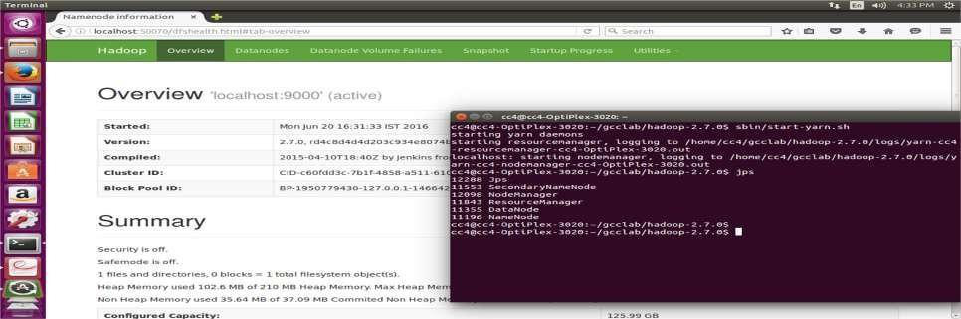
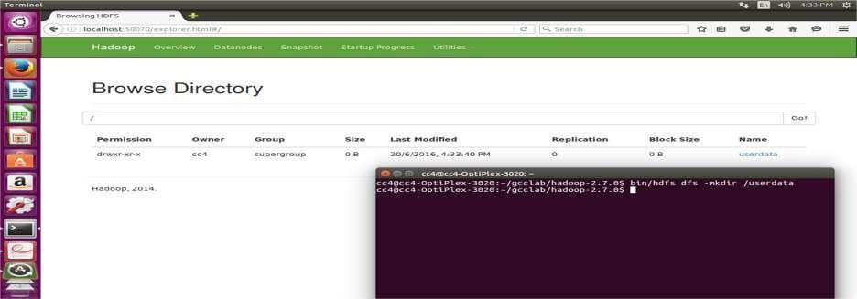
Procedure — Format & Start the Cluster (Steps 20–22)
Step 20: Format the NameNode (only once, before first use):
hdfs namenode –format
Step 21: Switch to the hadoop user and start the daemons:
start-dfs.sh
start-yarn.sh
NameNode web UI (localhost:50070) + jps daemons running
Step 22: Verify with jps — expect NameNode, DataNode, SecondaryNameNode, ResourceManager, and NodeManager:
jps
6334 SecondaryNameNode
6498 ResourceManager
6142 DataNode
5990 NameNode
6696 NodeManager
6927 Jps
hdfs dfs -mkdir /userdata — browsing HDFS via the web UI
Ex.No: 07
21/08/2026

Slide 7
MapReduce — WordCount Program
A MapReduce program has a Map() step that filters/sorts data and a Reduce() step that summarizes it. WordCount tokenizes each line and counts occurrences of every word.
public class WordCount {
public static class TokenizerMapper
extends Mapper<Object,Text,Text,IntWritable>{
static IntWritable one = new IntWritable(1);
Text word = new Text();
public void map(Object key, Text value,
Context context) {
StringTokenizer itr = new StringTokenizer(
value.toString());
while (itr.hasMoreTokens()) {
word.set(itr.nextToken());
context.write(word, one);
}
}
}
public static class IntSumReducer extends
Reducer<Text,IntWritable,Text,IntWritable>{
public void reduce(Text key,
Iterable<IntWritable> values,
Context context) {
int sum = 0;
for (IntWritable val : values)
sum += val.get();
context.write(key, new IntWritable(sum));
}
}
public static void main(String[] args) {
Job job = Job.getInstance();
job.setMapperClass(TokenizerMapper.class);
job.setCombinerClass(IntSumReducer.class);
job.setReducerClass(IntSumReducer.class);
FileInputFormat.addInputPath(job,
new Path(args[0]));
FileOutputFormat.setOutputPath(job,
new Path(args[1]));
job.waitForCompletion(true);
}
}
Map Each worker tokenizes its local data and emits (word, 1) pairs to temporary storage.
Shuffle Records are redistributed by key so all pairs for a word land on the same worker.
Reduce Each worker sums the counts per word, in parallel, producing the final totals.
Ex.No: 07
21/08/2026

Slide 8
Compile, Run & Result
1. Set environment:
Key Takeaways
export JAVA_HOME=/usr/java/default
export PATH=${JAVA_HOME}/bin:${PATH}
export HADOOP_CLASSPATH=${JAVA_HOME}/lib/tools.jar
A single-node Hadoop cluster runs HDFS + YARN daemons all on one machine, useful for learning and development
Correct JAVA_HOME and password-less SSH are the two most common setup blockers
WordCount is the 'Hello World' of MapReduce — it proves the Map, Shuffle, and Reduce pipeline works end-to-end
2. Compile to a JAR:
bin/hadoop com.sun.tools.javac.Main WordCount.java
jar cf wc.jar WordCount*.class
3. Run the application:
bin/hadoop jar wc.jar WordCount \
/user/joe/wordcount/input /user/joe/wordcount/output
Result The one-node Hadoop cluster was installed successfully, and the WordCount program demonstrating the Map and Reduce tasks was run successfully.
4. View the output:
bin/hadoop fs -cat /user/joe/wordcount/output/part-r-00000
Bye 1
Goodbye 1
Hadoop 2
Hello 2
World 2
Ex.No: 07
21/08/2026

