Slide 1

CLOUD COMPUTING LABORATORY
CS4V51
Ex.No : 01 Virtual Workstation
Aim: Install VirtualBox / VMware / equivalent open-source cloud workstation
with different flavours of Linux or Windows OS on top of Windows 8 and above.
Department of Computer Science and Engineering

Slide 2

Aim & Overview
Aim
To install VirtualBox / VMware / an equivalent open-source cloud workstation with different flavours of Linux or Windows OS on top of Windows 8 and above, and to create a guest virtual machine.
Download
VirtualBox
▼
Install on
Host OS
Why Virtualization?
▼
Run multiple operating systems on one physical machine
Isolated, safe environment for testing & experimentation
Foundation concept for cloud computing & IaaS
No extra hardware required — uses host machine resources
Create New
Virtual Machine
▼
Install Guest
OS (e.g. Win98)
Ex.No: 01
21/08/2026

Slide 3
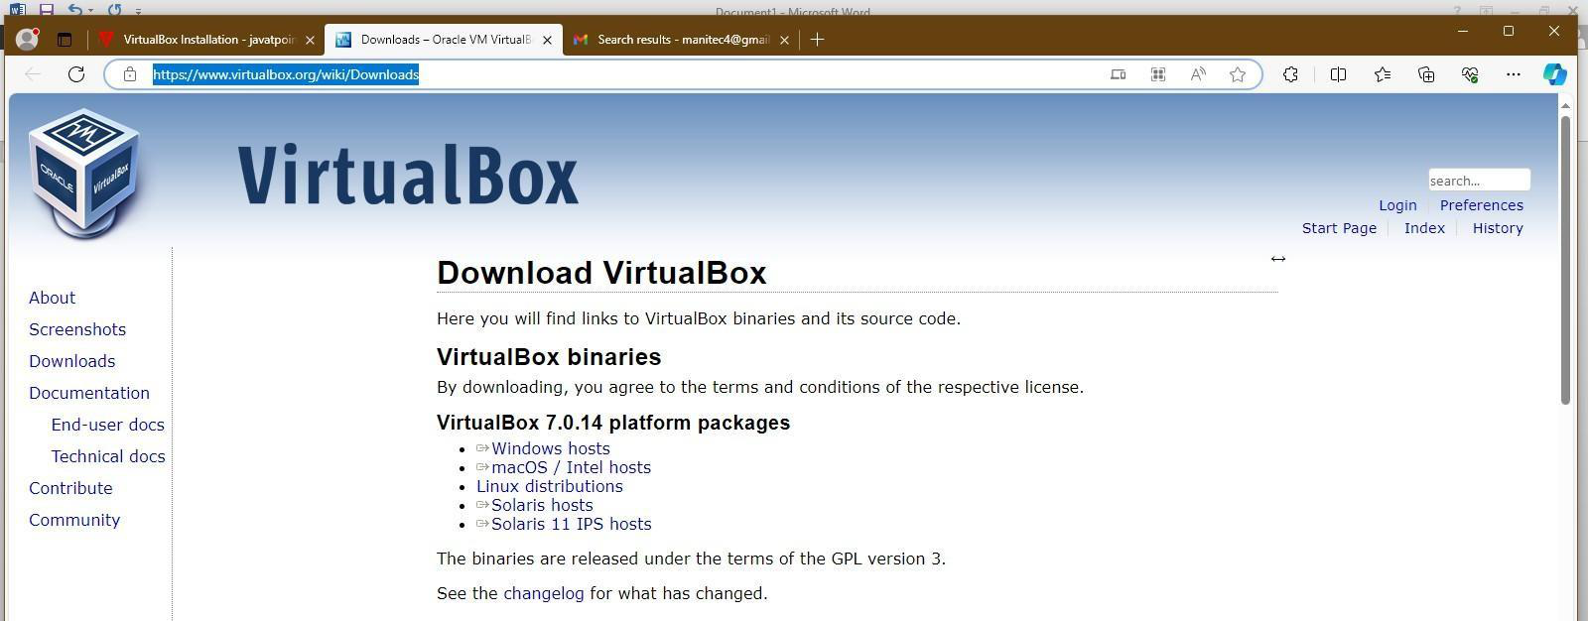
Procedure — Download & Install (Steps 1–4)
Step 1: Go to the VirtualBox website (virtualbox.org/wiki/Downloads) in the system's browser.
Step 2: Click the Download VirtualBox button on the page.
Step 3: Click the Windows hosts link under 'VirtualBox 7.0.14 platform packages'.
VirtualBox download page
Step 4: Open the downloaded VirtualBox EXE file to launch the installation window.
Note: Choose the package matching the host OS — here, Windows x86_64.
Ex.No: 01
21/08/2026

Slide 4
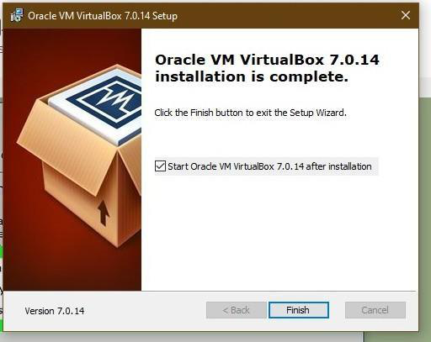
Procedure — Installation Wizard (Steps 5–10)
Step 5–6: Click Next in the Welcome window; choose the installation folder.
Step 7: Select the features to install (USB support, Networking, Python support), then click Next.
Step 8: Click Yes to install the Oracle VirtualBox network interfaces.
Step 9: Click Install to begin copying files to the system.
Step 10: Click Finish — the installation closes and VirtualBox opens, ready to create a VM.
Setup wizard — installation complete
Ex.No: 01
21/08/2026

Slide 5
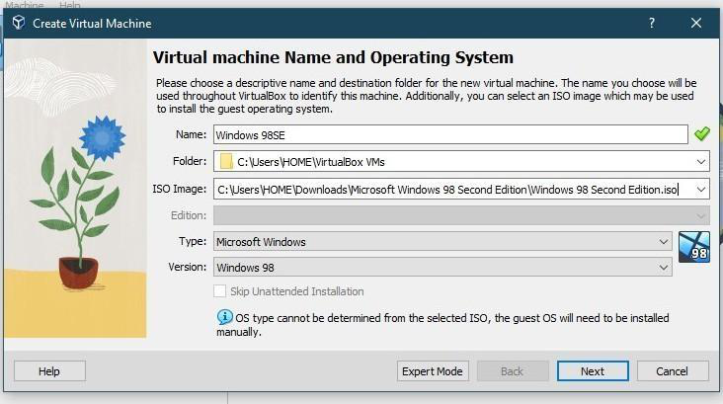
Procedure — Creating the Virtual Machine (Steps 11–13)
Step 11: Open VirtualBox, click New, and fill the form — Name, ISO image, Type & Version of the guest OS.
Step 12: Click Next and allocate resources: Base Memory = 512 MB, Processors = 1 CPU.
Step 13: In the Virtual Hard Disk wizard, set Disk Size = 2.00 GB, review the summary, then click Finish.
Configuration used: Name: Windows 98SE • Type: Microsoft Windows
Memory: 512 MB • CPU: 1 • Disk: 2.00 GB
Virtual machine name & OS selection
Ex.No: 01
21/08/2026

Slide 6
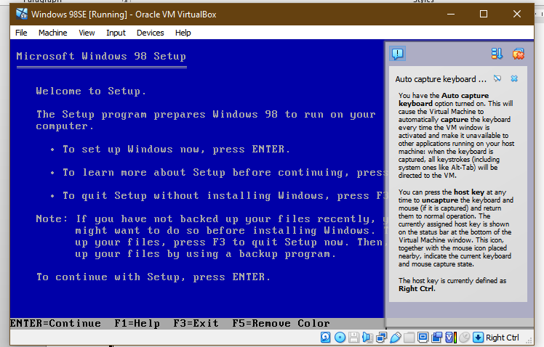
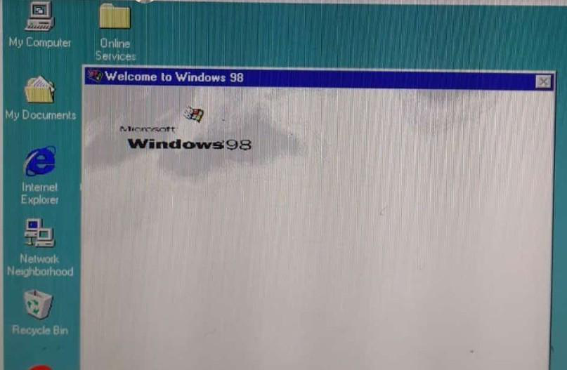
Guest OS Installation & Result
Step 14–15: Start the virtual machine and follow the on-screen setup to install the guest OS (Windows 98), finally reaching the desktop.
Key Takeaways
VirtualBox provides a free, cross-platform virtualization layer
A guest OS runs isolated, with its own allocated CPU, RAM & disk
This VM becomes the base workstation for later experiments (C compiler, Hadoop, Docker, etc.)
Windows 98 setup running inside VirtualBox, and the completed guest desktop
Result VirtualBox was installed successfully on the Windows 10 host, and a Windows 98 guest operating system was created and run successfully.
Windows 98 guest desktop
Ex.No: 01
21/08/2026

