Slide 1

CLOUD COMPUTING LABORATORY
CS4V51
Ex.No : 03 Install Google App Engine — Hello World App
Aim: Install Google App Engine and create a hello world app and
other simple web applications using Python/Java.
Department of Computer Science and Engineering

Slide 2

Aim & Overview
Aim
To install Google App Engine (GAE), create a hello world app and other simple web applications using Python/Java, and deploy them.
Install Google
Plugin for Eclipse
▼
Create New Web
Application Project
Tools Used
Eclipse IDE with the Google Plugin for Eclipse
Google App Engine Java SDK
A Google account & App Engine application ID
Local development server (localhost:8888)
▼
Run & Test
Locally
▼
Deploy to
Google App Engine
Ex.No: 03
21/08/2026

Slide 3
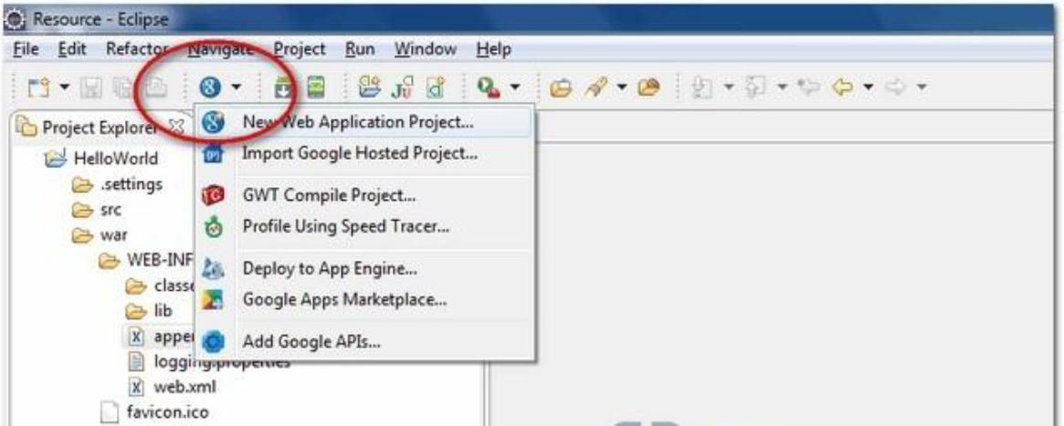
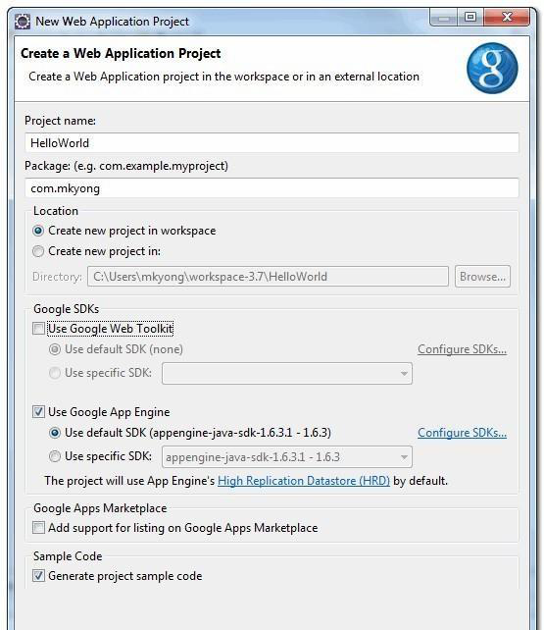
Procedure — Install Plugin & Create Project
Step 1 — Install Google Plugin for Eclipse: Install the Google Plugin for Eclipse together with the Google App Engine Java SDK (or install the SDK separately and extract it).
Step 2 — Create New Web Application Project: In the Eclipse toolbar, click the Google icon and select 'New Web Application Project…'
Google Plugin menu — New Web Application Project
Note: Deselect 'Use Google Web Toolkit' and link the GAE Java SDK via the 'Configure SDKs' link before creating the project.
Ex.No: 03
21/08/2026
Project creation dialog

Slide 4
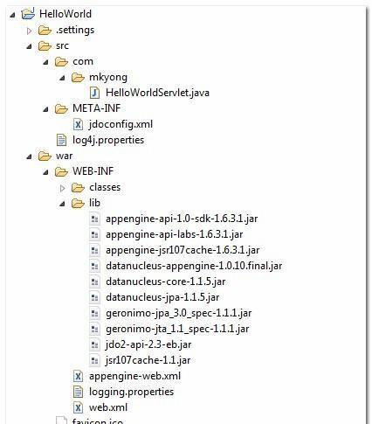
Generated Project Structure
Click Finish, and the Google Plugin for Eclipse generates a sample project automatically — a standard Java web project layout:
HelloWorld/
src/
...Java source code...
META-INF/
...other configuration...
war/
...JSPs, images, data files...
WEB-INF/
...app configuration...
lib/
...JARs for libraries...
classes/
...compiled classes...
Project Explorer — HelloWorld project tree
Key file: appengine-web.xml — the extra file App Engine needs to run and deploy the application (sets application ID, version, logging).
Ex.No: 03
21/08/2026

Slide 5
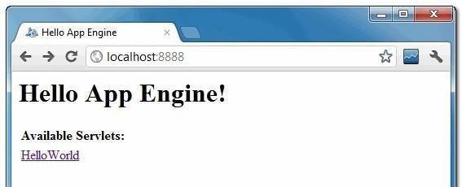
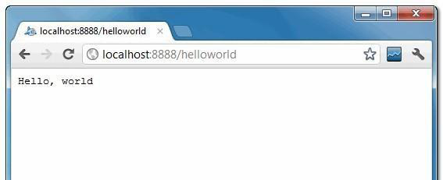
Procedure — Run the App Locally (Step 4)
Right-click the project and select Run As → 'Web Application'. The Eclipse console confirms the local dev server is running:
INFO: The server is running at http://localhost:8888/
INFO: The admin console is running at
http://localhost:8888/_ah/admin
Hello App Engine — home page (localhost:8888)
Access http://localhost:8888/ to see the Hello App Engine home page
Access http://localhost:8888/helloworld to see the servlet output
HelloWorld servlet output (localhost:8888/helloworld)
Ex.No: 03
21/08/2026

Slide 6
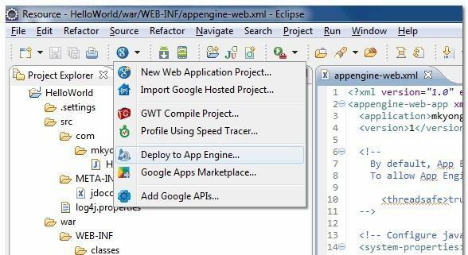
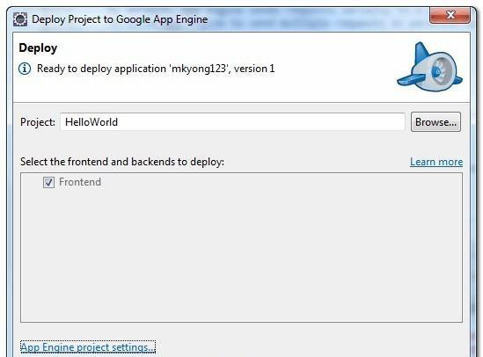
Procedure — Deploy to Google App Engine (Step 5)
5.1: Register an account at appengine.google.com and create an application ID (e.g. 'mkyong123'); set it in appengine-web.xml.
5.2: In Eclipse, click the Google icon on the toolbar and select 'Deploy to App Engine…'
5.3: Sign in with the Google account and click the Deploy button.
Click 'Deploy to App Engine' on the toolbar
appengine-web.xml (excerpt): <application>mkyong123</application>
<version>1</version>
Sign in and click Deploy
Ex.No: 03
21/08/2026

Slide 7
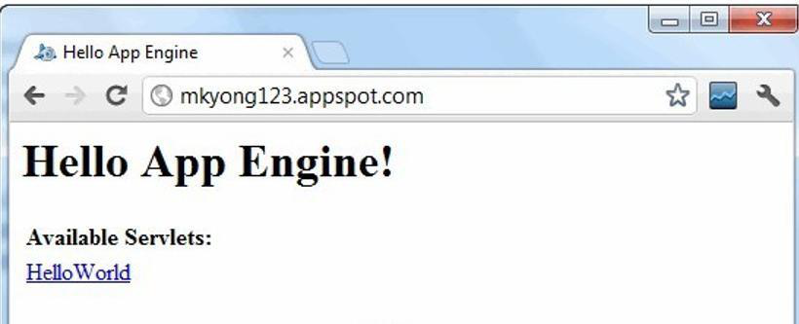
Deployed Application & Result
If deployment succeeds, the hello world web application is live at: http://mkyong123.appspot.com/
Key Takeaways
Google App Engine (GAE) is a fully managed Platform-as-a-Service (PaaS) for hosting web apps
The Google Plugin for Eclipse streamlines project creation, local testing, and one-click deployment
appengine-web.xml links a local project to a specific application ID on Google's servers
Result Google App Engine was installed successfully, and a web application displaying 'Hello World' using Java was developed, run locally, and deployed to GAE.
Hello App Engine — live on appspot.com
Ex.No: 03
21/08/2026

