Slide 1

CLOUD COMPUTING LABORATORY
CS4V51
Ex.No : 05 Simulate a Cloud Scenario Using CloudSim
Aim: Simulate a cloud scenario using CloudSim and run a
scheduling algorithm that is not present in CloudSim.
Department of Computer Science and Engineering

Slide 2

Aim & Overview
Aim
To simulate a cloud scenario using CloudSim and run a scheduling algorithm that is not present in CloudSim, using the Eclipse IDE.
Download Eclipse,
CloudSim & Commons-Math
▼
Create Java Project
& Link CloudSim Source
Tools & Libraries Used
Eclipse IDE for Java Developers (64-bit)
CloudSim 3.0.3 toolkit (github.com/Cloudslab/cloudsim)
Apache Commons Math 3.6.1 (dependency library)
Java Runtime Environment (JRE 1.7 / 1.8)
▼
Add External JARs
(Commons-Math)
▼
Run CloudSimExample1
& View Output
Ex.No: 05
21/08/2026

Slide 3
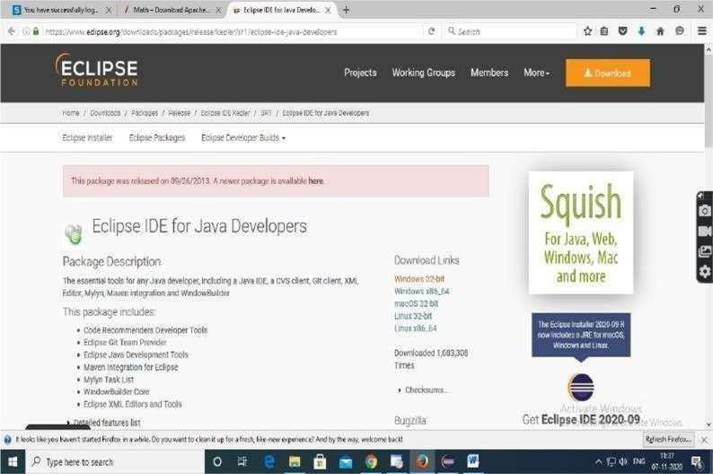
Procedure — Download Required Tools (Steps 1–4)
Step 1: Download Eclipse IDE for Java Developers (Windows 64-bit) from eclipse.org.
Step 2: Download CloudSim 3.0.3 from the Cloudslab GitHub repository.
Step 3: Download Apache Commons Math 3.6.1 (commons-math3-3.6.1-bin.zip).
Step 4: Extract cloudsim-3.0.3 and Apache Commons Math 3.6.1 in the local machine.
Downloaded archives: cloudsim-3.0.3.zip • commons-math3-3.6.1-bin.zip
Both extracted into the local Projects folder.
Eclipse IDE for Java Developers — download page
Ex.No: 05
21/08/2026

Slide 4
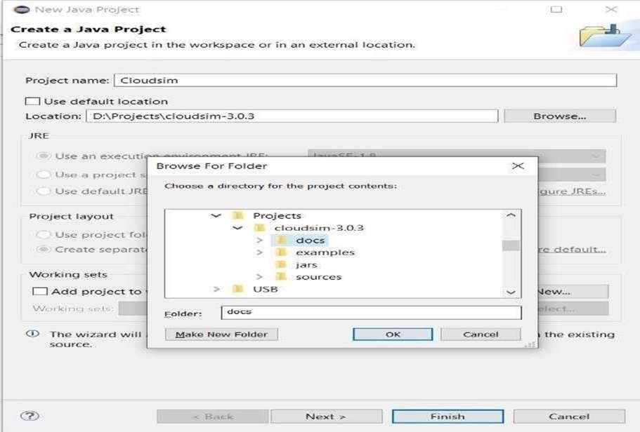
Procedure — Create the Java Project (Steps 5–8)
Step 5–6: Open Eclipse; navigate File → New → Project to open the wizard, and select Java Project.
Step 7: Enter Project Name: CloudSim.
Step 8: Uncheck 'Use default location' and Browse to the path where CloudSim was unzipped, then click Next.
Browse to the unzipped cloudsim-3.0.3 folder
Note: Make sure the chosen location shows the bin, docs, examples, jars and sources folders of CloudSim before proceeding.
Ex.No: 05
21/08/2026

Slide 5
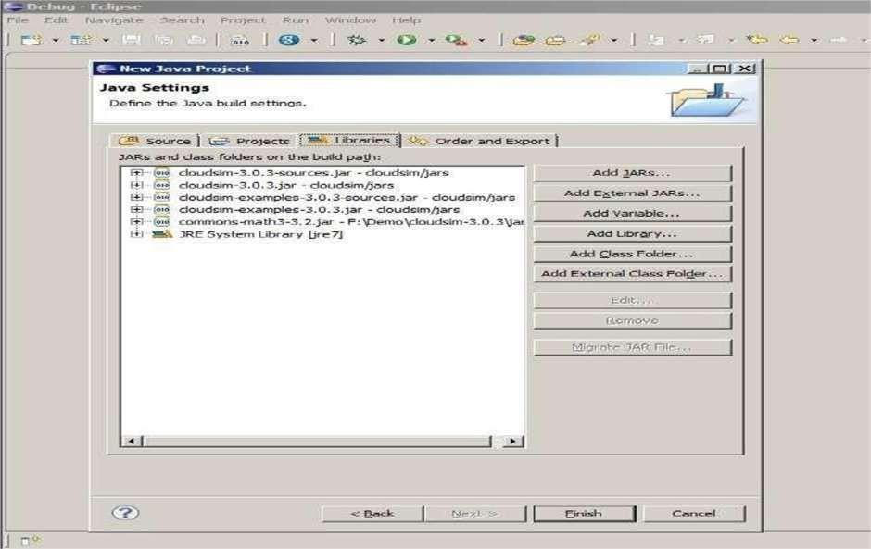
Procedure — Add External Libraries (Steps 9–14)
Step 9–11: Open the Libraries tab. If commons-math3-3.x.jar is missing, click 'Add External JARs'.
Step 12–13: Browse to the unzipped commons-math binaries, select the JAR, and click Open.
Step 14: Confirm the external JAR is listed, then click Finish (allow 2–3 minutes to configure).
commons-math3-3.2.jar added to the build path
Final library set: cloudsim-3.0.3.jar, cloudsim-examples-3.0.3.jar,
commons-math3-3.2.jar, JRE System Library
Ex.No: 05
21/08/2026

Slide 6
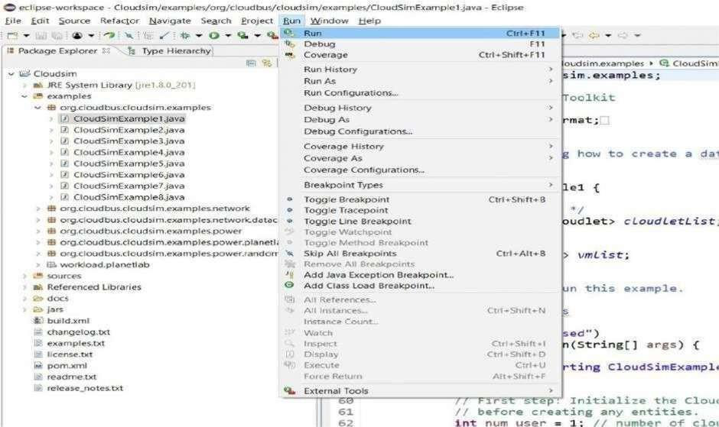
Procedure — Run CloudSimExample1 (Steps 15–17)
Step 15: In Project Explorer, expand examples → org.cloudbus.cloudsim.examples and locate CloudSimExample1.java.
Step 16: Double-click to open CloudSimExample1.java — it creates one datacenter with one host and runs one cloudlet on it.
Step 17: Navigate Run → Run, or press Ctrl+F11, to execute CloudSimExample1.java.
Run → Run (Ctrl+F11) to execute the example
Ex.No: 05
21/08/2026

Slide 7
Simulation Output & Result
On successful execution, the Eclipse console shows the CloudSim simulation lifecycle — datacenter and broker startup, VM creation, cloudlet execution, and a final output table with cloudlet status, timing, and completion:
Key Takeaways
CloudSim lets researchers model datacenters, hosts, VMs, and cloudlets without real infrastructure
Custom scheduling algorithms can be plugged in by extending CloudSim's broker/scheduler classes
The example models one datacenter, one host, one VM, and one cloudlet completing successfully
Starting CloudSimExample1...
Initialising...
Starting CloudSim version 3.0
Datacenter_0 is starting...
Broker is starting...
0.0: Broker: Cloud Resource List received
0.1: Broker: VM #0 has been created
0.1: Broker: Sending cloudlet 0 to VM #0
400.1: Broker: Cloudlet 0 received
400.1: Broker: All Cloudlets executed.
Simulation completed.
===== OUTPUT =====
Cloudlet STATUS Datacenter VM Time Finish
0 SUCCESS 2 0 400 400.1
CloudSimExample1 finished!
Result A cloud scenario was successfully simulated using CloudSim in the Eclipse environment, and CloudSimExample1 executed with the cloudlet completing successfully (Status: SUCCESS).
Ex.No: 05
21/08/2026

