Slide 1
product demand prediction with machine learning

Slide 2


Slide 3
Data Collection and Preprocessing:
1. Data Sources:
Historical sales data
Market trends
Product attributes
External factors (e.g., weather, holidays)
Customer behavior data (if available)
Inventory levels

Slide 4
2. Data Gathering:
Extract data from the identified sources. This may involve data acquisition
from databases, APIs, spreadsheets, or other data storage systems.
3. Data Cleaning:
Clean the raw data to ensure it is free from errors and inconsistencies.
Common tasks include Handling missing values: Decide whether to
impute missing data or remove incomplete records.
Removing duplicates: Eliminate duplicate entries from the dataset.
Outlier detection: Identify and handle outliers that may skew
predictions.

Slide 5
4. Data Visualization:
Explore the data visually to gain insights into its distribution, trends, and
relationships. Visualization can help you identify patterns that might inform
feature selection and model choice.
5. Data Integration:
If data is coming from multiple sources, integrate it into a single dataset, ensuring that the data is in a consistent format.

Slide 6
Data Set
ID,Store ID,Total Price,Base Price,Units Sold
1,8091,99.0375,111.8625,20 2,8091,99.0375,99.0375,28
3,8091,133.95,133.95,19 4,8091,133.95,133.95,44
5,8091,141.075,141.075,52 9,8091,227.2875,227.2875,18
10,8091,327.0375,327.0375,47 13,8091,210.9,210.9,50
14,8091,190.2375,234.4125,82 17,8095,99.0375,99.0375,99
18,8095,97.6125,97.6125,120 19,8095,98.325,98.325,40
22,8095,133.2375,133.2375,68 23,8095,133.95,133.95,87
24,8095,139.65,139.65,186

Slide 7
Program
import pandas as pd
import numpy as np
import plotly.express as px
import seaborn as sns
import matplotlib.pyplot as plt
from sklearn.model_selection import train_test_split
from sklearn.tree import DecisionTreeRegressor
data = pd.read_csv("https://raw.githubusercontent.com/Rjrajamanickam/Ibmphase-
2/main/PoductDemand.csv?token=GHSAT0AAAAAACIYIOV7E4W5JDPQ6JFMCPESZJMBY
WA")
data.head()

Slide 8
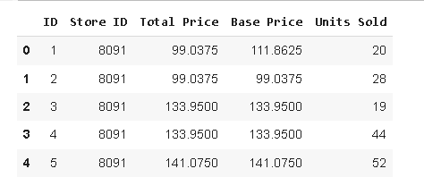

Slide 9
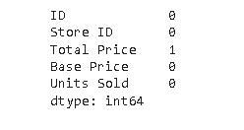
data.isnull().sum()

Slide 10
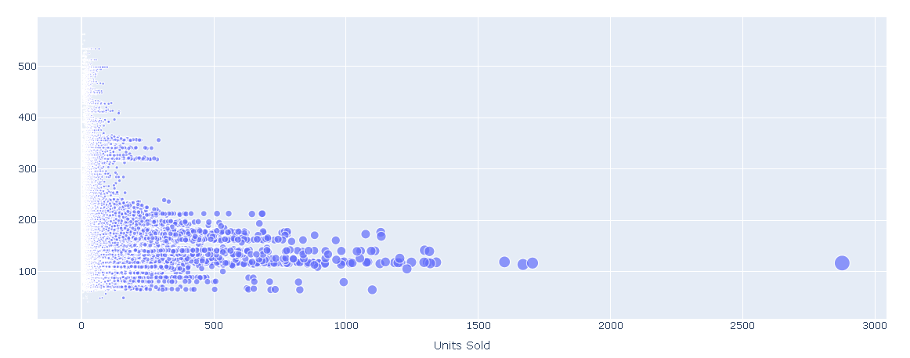
data = data.dropna()
fig = px.scatter(data, x="Units Sold", y="Total Price",
size='Units Sold')
fig.show()

Slide 11
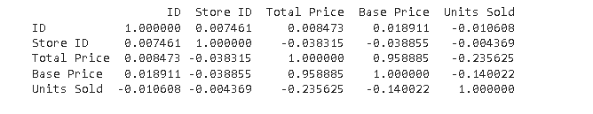
print(data.corr())

Slide 12
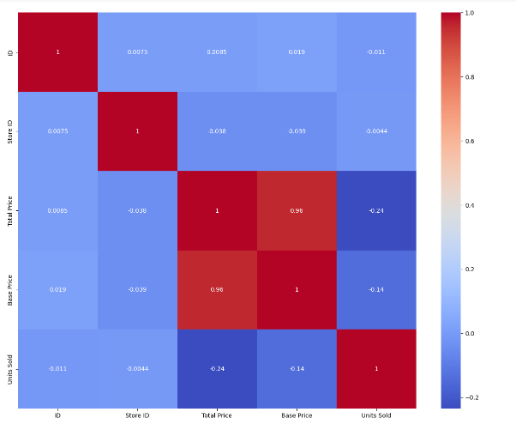
correlations = data.corr(method='pearson')
plt.figure(figsize=(15, 12))
sns.heatmap(correlations, cmap="coolwarm", annot=True)
plt.show()

Slide 13
x = data[["Total Price", "Base Price"]]
y = data["Units Sold"]
xtrain, xtest, ytrain, ytest = train_test_split(x, y,
test_size=0.2,
random_state=42)
from sklearn.tree import DecisionTreeRegressor
model = DecisionTreeRegressor()
model.fit(xtrain, ytrain)
features = np.array([[133.00, 140.00]])
model.predict(features)

