Slide 1
PREDICTION OF CYBER-ATTACKS USING DATA SCIENCE TECHNIQUE

Slide 2
ABSTRACT:
Cyber-attack, via cyberspace, targeting an enterprise's use of cyberspace for the purpose of disrupting, disabling, destroying, or maliciously controlling a computing environment/infrastructure; or destroying the integrity of the data or stealing controlled information. The state of the cyberspace portends uncertainty for the future Internet and its accelerated number of users. New paradigms add more concerns with big data collected through device sensors divulging large amounts of information, which can be used for targeted attacks. Though a plethora of extant approaches, models and algorithms have provided the basis for cyber-attack predictions, there is the need to consider new models and algorithms, which are based on data representations other than task-specific techniques. However, its non-linear information processing architecture can be adapted towards learning the different data representations of network traffic to classify type of network attack. In this paper, we model cyber-attack prediction as a classification problem, Networking sectors have to predict the type of Network attack from given dataset using machine learning techniques. The analysis of dataset by supervised machine learning technique(SMLT) to capture several information’s like, variable identification, uni-variate analysis, bi-variate and multi-variate analysis, missing value treatments etc. A comparative study between machine learning algorithms had been carried out in order to determine which algorithm is the most accurate in predicting the type cyber Attacks. We classify four types of attacks are DOS Attack, R2L Attack, U2R Attack, Probe attack. The results show that the effectiveness of the proposed machine learning algorithm technique can be compared with best accuracy with entropy calculation, precision, Recall, F1 Score, Sensitivity, Specificity and Entropy.

Slide 3
EXISTING SYSTEM:
They proposed first to create a contrastive self-supervised learning to the anomaly detection problem of attributed networks. CoLa, is mainly consists of three components: contrastive instance pair sampling, GNN-based contrastive learning model, and multiround sampling-based anomaly score computation. Their model captures the relationship between each node and its neighbouring structure and uses an anomaly-related objective to train the contrastive learning model. We believe that the proposed framework opens a new opportunity to expand self-supervised learning and contrastive learning to increasingly graph anomaly detection applications. The multiround predicted scores by the contrastive learning model are further used to evaluate the abnormality of each node with statistical estimation. The training phase and the inference phase. In the training phase, the contrastive learning model is trained with sampled instance pairs in an unsupervised fashion. After that the anomaly score for each node is obtained in the inference phase.

Slide 4
DIS-ADVANTAGES:
1. The performance is not good and its get complicated for other networks.
2. The performance metrics like recall F1 score and comparison of machine learning algorithm is not done.

Slide 5
DATA SCIENCE:
Data science is an interdisciplinary field that uses scientific methods, processes, algorithms and systems to extract knowledge and insights from structured and unstructured data, and apply knowledge and actionable insights from data across a broad range of application domains.
The term "data science" has been traced back to 1974, when Peter Naur proposed it as an alternative name for computer science. In 1996, the International Federation of Classification Societies became the first conference to specifically feature data science as a topic. However, the definition was still in flux.
The term “data science” was first coined in 2008 by D.J. Patil, and Jeff Hammerbacher, the pioneer leads of data and analytics efforts at LinkedIn and Facebook. In less than a decade, it has become one of the hottest and most trending professions in the market.
Data science is the field of study that combines domain expertise, programming skills, and knowledge of mathematics and statistics to extract meaningful insights from data.
Data science can be defined as a blend of mathematics, business acumen, tools, algorithms and machine learning techniques, all of which help us in finding out the hidden insights or patterns from raw data which can be of major use in the formation of big business decisions.

Slide 6
DATA SCIENTIST:
Data scientists examine which questions need answering and where to find the related data. They have business acumen and analytical skills as well as the ability to mine, clean, and present data.
Businesses use data scientists to source, manage, and analyze large amounts of unstructured data.
Required Skills for a Data Scientist:
Programming: Python, SQL, Scala, Java, R, MATLAB.
Machine Learning: Natural Language Processing, Classification, Clustering.
Data Visualization: Tableau, SAS, D3.js, Python, Java, R libraries.
Big data platforms: MongoDB, Oracle, Microsoft Azure, Cloudera.

Slide 7
ARTIFICIAL INTELLIGENCE:
Artificial intelligence (AI) refers to the simulation of human intelligence in machines that are programmed to think like humans and mimic their actions. The term may also be applied to any machine that exhibits traits associated with a human mind such as learning and problem-solving.
Artificial intelligence (AI) is intelligence demonstrated by machines, as opposed to the natural intelligence displayed by humans or animals. Leading AI textbooks define the field as the study of "intelligent agents" any system that perceives its environment and takes actions that maximize its chance of achieving its goals. Some popular accounts use the term "artificial intelligence" to describe machines that mimic "cognitive" functions that humans associate with the human mind, such as "learning" and "problem solving", however this definition is rejected by major AI researchers.
Artificial intelligence is the simulation of human intelligence processes by machines, especially computer systems. Specific applications of AI include expert systems, natural language processing, speech recognition and machine vision.
AI applications include advanced web search engines, recommendation systems (used by Youtube, Amazon and Netflix), Understanding human speech (such as Siri or Alexa), self-driving cars (e.g. Tesla), and competing at the highest level in strategic game systems (such as chess and Go), As machines become increasingly capable, tasks considered to require "intelligence" are often removed from the definition of AI, a phenomenon known as the AI effect.
For instance, optical character recognition is frequently excluded from things considered to be AI, having become a routine technology.
Artificial intelligence was founded as an academic discipline in 1956, and in the years since has experienced several waves of optimism, followed by disappointment and the loss of funding (known as an "AI winter"), followed by new approaches, success and renewed funding.

Slide 8
Learning processes. This aspect of AI programming focuses on acquiring data and creating rules for how to turn the data into actionable information. The rules, which are called algorithms, provide computing devices with step-by-step instructions for how to complete a specific task.
Reasoning processes. This aspect of AI programming focuses on choosing the right algorithm to reach a desired outcome.
Self-correction processes. This aspect of AI programming is designed to continually fine-tune algorithms and ensure they provide the most accurate results possible.

Slide 9
NATURAL LANGUAGE PROCESSING:
Natural language processing (NLP) allows machines to read and understand human language. A sufficiently powerful natural language processing system would enable natural-language user interfaces and the acquisition of knowledge directly from human-written sources, such as newswire texts. Some straightforward applications of natural language processing include information retrieval, text mining, question answering and machine translation. Many current approaches use word co-occurrence frequencies to construct syntactic representations of text. "Keyword spotting" strategies for search are popular and scalable but dumb; a search query for "dog" might only match documents with the literal word "dog" and miss a document with the word "poodle". "Lexical affinity" strategies use the occurrence of words such as "accident" to assess the sentiment of a document. Modern statistical NLP approaches can combine all these strategies as well as others, and often achieve acceptable accuracy at the page or paragraph level. Beyond semantic NLP, the ultimate goal of "narrative" NLP is to embody a full understanding of commonsense reasoning. By 2019, transformer-based deep learning architectures could generate coherent text.

Slide 10
MACHINE LEARNING:
Machine learning is to predict the future from past data. Machine learning (ML) is a type of artificial intelligence (AI) that provides computers with the ability to learn without being explicitly programmed. Machine learning focuses on the development of Computer Programs that can change when exposed to new data and the basics of Machine Learning, implementation of a simple machine learning algorithm using python. Process of training and prediction involves use of specialized algorithms. It feed the training data to an algorithm, and the algorithm uses this training data to give predictions on a new test data. Machine learning can be roughly separated in to three categories. There are supervised learning, unsupervised learning and reinforcement learning. Supervised learning program is both given the input data and the corresponding labeling to learn data has to be labeled by a human being beforehand. Unsupervised learning is no labels. It provided to the learning algorithm. This algorithm has to figure out the clustering of the input data. Finally, Reinforcement learning dynamically interacts with its environment and it receives positive or negative feedback to improve its performance.

Slide 11
PROPOSED SYSTEM:
The proposed model is to build a machine learning model for anomaly detection. Anomaly detection is an important technique for recognizing fraud activities, suspicious activities, network intrusion, and other abnormal events that may have great significance but are difficult to detect. The machine learning model is built by applying proper data science techniques like variable identification that is the dependent and independent variables. Then the visualisation of the data is done to insights of the data .The model is build based on the previous dataset where the algorithm learn data and get trained different algorithms are used for better comparisons. The performance metrics are calculated and compared.

Slide 12
ADVANTAGES:
1. The anomaly detection can be automated process using the machine learning.
2. Performance metric are compared in order to get better model.

Slide 13
LITERATURE SURVEY:
A literature review is a body of text that aims to review the critical points of current knowledge on and/or methodological approaches to a particular topic. It is secondary sources and discuss published information in a particular subject area and sometimes information in a particular subject area within a certain time period. Its ultimate goal is to bring the reader up to date with current literature on a topic and forms the basis for another goal, such as future research that may be needed in the area and precedes a research proposal and may be just a simple summary of sources. Usually, it has an organizational pattern and combines both summary and synthesis.
A summary is a recap of important information about the source, but a synthesis is a re-organization, reshuffling of information. It might give a new interpretation of old material or combine new with old interpretations or it might trace the intellectual progression of the field, including major debates. Depending on the situation, the literature review may evaluate the sources and advise the reader on the most pertinent or relevant of them.
Loan default trends have been long studied from a socio-economic stand point. Most economics surveys believe in empirical modeling of these complex systems in order to be able to predict the loan default rate for a particular individual. The use of machine learning for such tasks is a trend which it is observing now. Some of the survey’s to understand the past and present perspective of loan approval or not.

Slide 14
Title : A Prediction Model of DoS Attack’s Distribution Discrete Probability
Author : Wentao Zhao, Jianping Yin and Jun Long
Year : 2008
The process of prediction analysis is a process of using some method or technology to explore or stimulate some unknown, undiscovered or complicated intermediate processes based on previous and present states and then speculated the results. In an early warning system, accurate prediction of DoS attacks is the prime aim in the network offence and defense task. Detection based on abnormity is effective to detect DoS attacks. A various studies focused on DoS attacks from different respects. However, these methods required a priori knowledge being a necessity and were difficult to discriminate between normal burst traffics and flux of DoS attacks. Moreover, they also required a large number of history records and cannot make the prediction for such attacks efficiently. Based on data from flux inspecting and intrusion detection, it proposed a prediction model of DOS attack’s distribution discrete probability based on clustering method of genetic algorithm and Bayesian method and the clustering problem first, and then utilizes the genetic algorithm to implement the optimization of clustering methods. Based on the optimized clustering on the sample data, we get various categories of the relation between traffics and attack amounts, and then builds up several prediction sub-models about DoS attack. Furthermore, according to the Bayesian method and deduce discrete probability calculation about each sub-model and then get the distribution discrete probability prediction model for DoS attack. This paper begins with the relation exists between network traffic data and the amount of DoS attack, and then proposes a clustering method based on the genetic optimization algorithm to implement the classification of DoS attack data.

Slide 15
Title : Apriori Viterbi Model for Prior Detection of Socio-Technical Attacks in a Social Network
Author : Preetish Ranjan, Abhishek Vaish
Year : 2014
Socio-technical attack is an organized approach which is defined by the interaction among people through maltreatment of technology with some of the malicious intent to attack the social structure based on trust and faith. Awful advertisement over internet and mobile phones may defame a person, organization, group and brand value in society which may be proved to be fatal. People are always very sensitive towards their religion therefore mass spread of manipulated information against their religious belief may create pandemonium in the society and can be one of the reasons for social riots, political misbalance etc. Cyber-attack on water, electricity, finance, healthcare, food and transportation system are may create chaos in society within few minutes and may prove even more destructive than that of a bomb as it does not attack physically but it attacks on the faith and trust which is the basic pillar of our social structure. Trust is a belief that the person who is being trusted will do what is being expected for and it starts from the family which grows to build a society. Trust for information may be established if it either comes from genuine source or information is validated by authentic body so that there is always a feeling of security and optimism. In the huge and complex social network formed using cyberspace or telecommunication technology, the identification or prediction of any kind of socio-technical attack is always difficult.

Slide 16
Title : New Attack Scenario Prediction Methodology
Author : Seraj Fayyad, Cristoph Meinel
Year : 2013
Intrusion detection systems (IDS) are used to detect the occurrence of malicious activities against IT system. Through monitoring and analyzing of IT system activities the malicious activities will be detected. In ideal case IDS generate alert(s) for each detected malicious activity and store it in IDS database. Some of stored alerts in IDS database are related. Alerts relations are differentiated from duplication relation to same attack scenario relation. Duplication relation means that the two alerts generated as a result of same malicious activity. Where same attack scenario relation means that the two related alert are generated as a result of related malicious activities. Attack scenario or multi-step attack is a set of related malicious activities run by same attacker to reach specific goal. Normal relation between malicious activities belong to same attack scenario is causal relation. Causal relation means that current malicious activity output is pre-condition to run the next malicious activity. Possible multi-step attack against a network start with information gathering about network and the information gathering is done through network Reconnaissance and fingerprinting process. Through reconnaissance network configuration and running services are identified. Through fingerprint process Operating system type and version are identified. propose a real time prediction methodology for predicting most possible attack steps and attack scenarios. Proposed methodology benefits from attacks history against network and from attack graph source data. it comes without considerable computation overload such as checking of attack plans library. It provides parallel prediction for parallel attack scenarios.

Slide 17
Title : Cyber Attacks Prediction Model Based on Bayesian Network
Author : Jinyu W1, Lihua Yin and Yunchuan Guo
Year : 2012
The prediction results reflect the security situation of the target network in the future, and security administrators can take corresponding measures to enhance network security according to the results. To quantitatively predict the possible attack of the network in the future, attack probability plays a significant role. It can be used to indicate the possibility of invasion by intruders. As an important kind of network security quantitative evaluation measure, attack probability and its computing methods has been studied for a long time. Many models have been proposed for performing evaluation of network security. Graphical models such as attack graphs become the main-stream approach. Attack graphs which capture the relationships among vulnerabilities and exploits show us all the possible attack paths that an attacker can take to intrude all the targets in the network. The traffics to different hosts or servers may differ from each other. The hosts or servers with big traffic may be more risky since they are often important hosts or servers, and intruders may have more contacts and understanding with them. In our cyber-attacks prediction model, they used attack graph to capture the vulnerabilities in the network. In addition we consider 3 environment factors that are the major impact factors of the cyber-attacks in the future. They are the value of assets in the network, the usage condition of the network and the attack history of the network. Cyber-attacks prediction is an important part of risk management.

Slide 18
Title : A Prediction Model of DoS Attack’s Distribution Discrete Probability
Author : Wentao Zhao, Jianping Yin
Year : 2008
This paper begins with the relation exists between network traffic data and the amount of DoS attack, and then proposes a clustering method based on the genetic optimization algorithm to implement the classification of DoS attack data. This method first gets the proper partition of the relation between the network traffic and the amount of DoS attack based on the optimized clustering and builds the prediction sub-models of DoS attack. Meanwhile, with the Bayesian method, the calculation of the output probability corresponding to each sub-model is deduced and then the distribution of the amount of DoS attack in some range in future is obtained. This paper describes the clustering problem first, and then utilizes the genetic algorithm to implement the optimization of clustering methods. Based on the optimized clustering on the sample data, we get various categories of the relation between traffics and attack amounts, and then builds up several prediction sub-models about DoS attack. Furthermore, according to the Bayesian method, we deduce discrete probability calculation about each sub-model and then get the distribution discrete probability prediction model for DoS attack.

Slide 19
Title : Adversarial Examples: Attacks and Defenses for Deep Learning
Author : Xiaoyong Yuan , Pan He, Qile Zhu, and Xiaolin Li
Year : 2019
It reviewed the recent findings of adversarial examples in DNNs. We investigated the existing methods for generating adversarial examples. A taxonomy of adversarial examples was proposed. We also explored the applications and countermeasures for adversarial examples. This paper attempted to cover the state-of-the-art studies for adversarial examples in the DL domain. Compared with recent work on adversarial examples, we analyzed and discussed the current challenges and potential solutions in adversarial examples. However, deep neural networks (DNNs) have been recently found vulnerable to well-designed input samples called adversarial examples. Adversarial perturbations are imperceptible to human but can easily fool DNNs in the testing/deploying stage. The vulnerability to adversarial examples becomes one of the major risks for applying DNNs in safety-critical environments. Therefore, attacks and defenses on adversarial examples draw great attention. In this paper, we review recent findings on adversarial examples for DNNs, summarize the methods for generating adversarial examples, and propose taxonomy of these methods. Under the taxonomy, applications for adversarial examples are investigated. We further elaborate on countermeasures for adversarial examples. In addition, three major challenges in adversarial examples and the potential solutions are discussed.

Slide 20
Title : Distributed Secure Cooperative Control Under Denial-of-Service Attacks From Multiple Adversaries
Author : Wenying Xu , Guoqiang Hu
Year : 2019
This paper has investigated the distributed secure control of multiagent systems under DoS attacks. We focus on the investigation of a jointly adverse impact of distributed DoS attacks from multiple adversaries. In this scenario, two kinds of communication schemes, that is, sample-data and event-triggered communication schemes, have been discussed and, then, a fully distributed control protocol has been developed to guarantee satisfactory asymptotic consensus. Note that this protocol has strong robustness and high scalability. Its design does not involve any global information, and its efficiency has been proved. For the event-triggered case, two effective dynamical event conditions have been designed and implemented in a fully distributed way, and both of them have excluded Zeno behavior. Finally, a simulation example has been provided to verify the effectiveness of theoretical analysis. Our future research topics focus on fully distributed event/self-triggered control for linear/nonlinear multiagent systems to gain a better understanding of fully distributed control.

Slide 21
SYSTEM STUDY:
CLASSIFICATION OF ATTACKS:
The data set in KDD Cup99 have normal and 22 attack type data with 41 features and all generated traffic patterns end with a label either as ‘normal’ or any type of ‘attack’ for upcoming analysis. There are varieties of attacks which are entering into the network over a period of time and the attacks are classified into the following four main classes.
Denial of Service (DoS)
User to Root (U2R)
Remote to User (R2L)
Probing

Slide 22
OBJECTIVES:
This analysis aims to observe which features are most helpful in predicting the network attacks of DOS, R2L, U2R, Probe and combination of attacks or not and to see the general trends that may help us in model selection and hyper parameter selection. To achieve used machine learning classification methods to fit a function that can predict the discrete class of new input.
The repository is a learning exercise to:
Apply the fundamental concepts of machine learning from an available dataset and Evaluate and interpret my results and justify my interpretation based on observed dataset.
Create notebooks that serve as computational records and document my thought process and investigate the network connection whether attacked or not to analyses the data set.
Evaluate and analyses statistical and visualized results, which find the standard patterns for all regiments.

Slide 23
PROJECT GOALS:
Exploration data analysis of variable identification
Loading the given dataset
Import required libraries packages
Analyze the general properties
Find duplicate and missing values
Checking unique and count values
Uni-variate data analysis
Rename, add data and drop the data
To specify data type

Slide 24
Exploration data analysis of bi-variate and multi-variate
Plot diagram of pairplot, heatmap, bar chart and Histogram
Method of Outlier detection with feature engineering
Pre-processing the given dataset
Splitting the test and training dataset
Comparing the Decision tree and Logistic regression model and random forest
Comparing algorithm to predict the result
Based on the best accuracy

Slide 25
SCOPE:
The scope of this project is to investigate a dataset of network connection attacks for KDD records for medical sector using machine learning technique. To identifying network connection is attacked or not.

Slide 26
FEASIBILITY STUDY:
Data Wrangling
In this section of the report will load in the data, check for cleanliness, and then trim and clean given dataset for analysis. Make sure that the document steps carefully and justify for cleaning decisions.
Data collection
The data set collected for predicting given data is split into Training set and Test set. Generally, 7:3 ratios are applied to split the Training set and Test set. The Data Model which was created using Random Forest, logistic, Decision tree algorithms and Support vector classifier (SVC) are applied on the Training set and based on the test result accuracy, Test set prediction is done.
Preprocessing
The data which was collected might contain missing values that may lead to inconsistency. To gain better results data need to be preprocessed so as to improve the efficiency of the algorithm. The outliers have to be removed and also variable conversion need to be done.

Slide 27
Building the classification model
The prediction of Phishing Website, A Random Forest Algorithm prediction model is effective because of the following reasons: It provides better results in classification problem.
It is strong in preprocessing outliers, irrelevant variables, and a mix of continuous, categorical and discrete variables.
It produces out of bag estimate error which has proven to be unbiased in many tests and it is relatively easy to tune with.
Construction of a Predictive Model
Machine learning needs data gathering have lot of past data’s. Data gathering have sufficient historical data and raw data. Before data pre-processing, raw data can’t be used directly. It’s used to preprocess then, what kind of algorithm with model. Training and testing this model working and predicting correctly with minimum errors. Tuned model involved by tuned time to time with improving the accuracy.

Slide 28
LIST OF MODULES:
Data validation process and Visualization (Module-01)
DOS Attack Algorithm Comparision (Module-02)
R2L Attack Algorithm Comparision (Module-03)
U2R Attack Algorithm Comparision (Module-04)
Probe Attack Algorithm Comparision (Module-05)
Overall Attack Algorithm Comparision (Module-06)
Deployment in GUI

Slide 29
PROJECT REQUIREMENTS:
Requirements are the basic constrains that are required to develop a system. Requirements are collected while designing the system. The following are the requirements that are to be discussed.
1. Functional requirements
2. Non-Functional requirements
3. Environment requirements
A. Hardware requirements
B. software requirements

Slide 30
Functional requirements:
The software requirements specification is a technical specification of requirements for the software product. It is the first step in the requirements analysis process. It lists requirements of a particular software system. The following details to follow the special libraries like sk-learn, pandas, numpy, matplotlib and seaborn.
Non-Functional Requirements:
Process of functional steps,
Problem define
Preparing data
Evaluating algorithms
Improving results
Prediction the result

Slide 31
ENVIRONMENT REQUIREMENTS:
Software Requirements:
Operating System : Windows
Tool : Anaconda with Jupyter Notebook
Hardware requirements:
Processor : Pentium IV/III
Hard disk : minimum 80 GB
RAM : minimum 2 GB

Slide 32
PYTHON:
Python is an interpreted high-level general-purpose programming language. Its design philosophy emphasizes code readability with its use of significant indentation. Its language constructs as well as its object-oriented approach aim to help programmers write clear, logical code for small and large-scale projects.
Python is dynamically-typed and garbage-collected. It supports multiple programming paradigms, including structured (particularly, procedural), object-oriented and functional programming. It is often described as a "batteries included" language due to its comprehensive standard library.
Guido van Rossum began working on Python in the late 1980s, as a successor to the ABC programming language, and first released it in 1991 as Python 0.9.0. Python 2.0 was released in 2000 and introduced new features, such as list comprehensions and a garbage collection system using reference counting. Python 3.0 was released in 2008 and was a major revision of the language that is not completely backward-compatible. Python 2 was discontinued with version 2.7.18 in 2020.
Python consistently ranks as one of the most popular programming languages

Slide 33
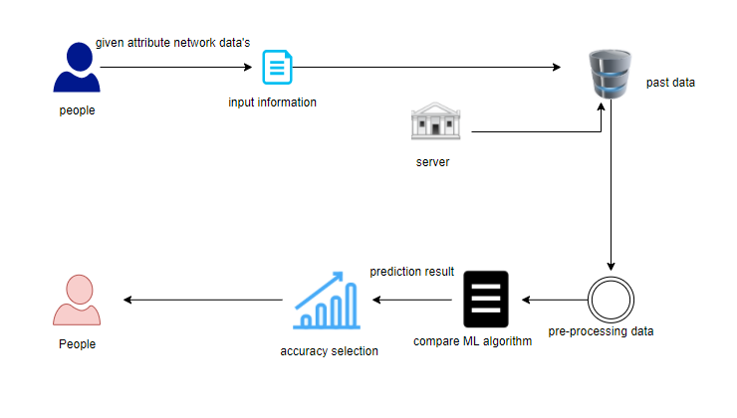
SYSTEM ARCHITECTURE:

Slide 34
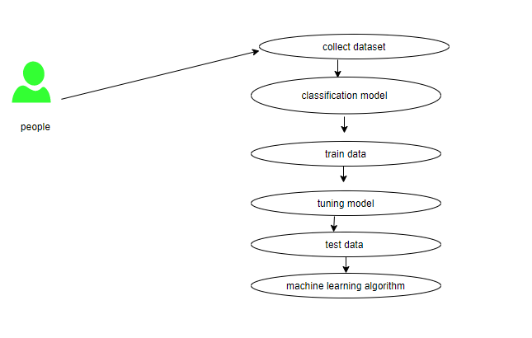
USE CASE DIAGRAM:

Slide 35
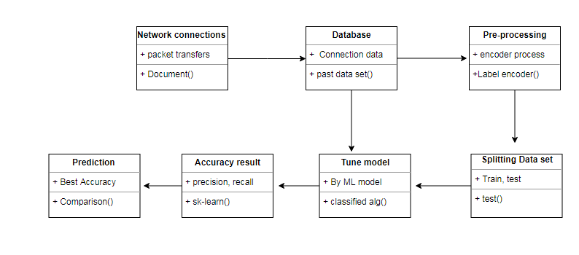
CLASS DIAGRAM:

Slide 36
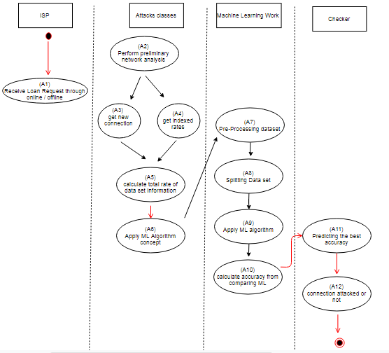
ACTIVITY DIAGRAM:

Slide 37
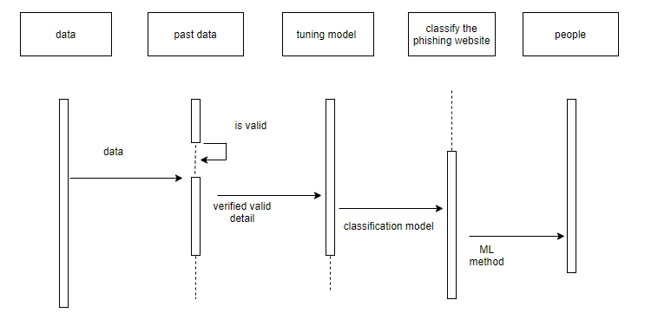
SEQUENCE DIAGRAM:

Slide 38
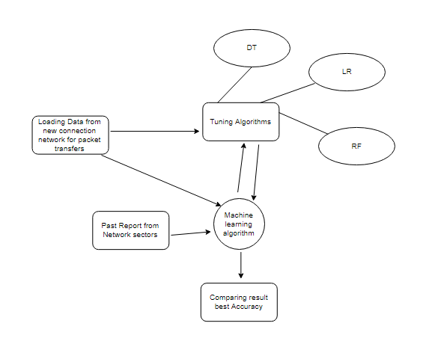
E-R DIAGRAM:

Slide 39
MODULE DESCRIPTION:
Data validation process by each attack (Module-01)
Performance measurements of DoS attacks (Module-02)
Performance measurements of R2L attacks (Module-03)
Performance measurements of U2R attacks (Module-04)
Performance measurements of Probe attacks (Module-05)
Performance measurements of overall network attacks (Module-06)
GUI based prediction results of Network attacks (Module-07)

Slide 40
DATA PRE-PROCESSING:
Pre-processing refers to the transformations applied to our data before feeding it to the algorithm. Data Preprocessing is a technique that is used to convert the raw data into a clean data set. In other words, whenever the data is gathered from different sources it is collected in raw format which is not feasible for the analysis. To achieving better results from the applied model in Machine Learning method of the data has to be in a proper manner. Some specified Machine Learning model needs information in a specified format; for example, Random Forest algorithm does not support null values. Therefore, to execute random forest algorithm null values have to be managed from the original raw data set. And another aspect is that data set should be formatted in such a way that more than one Machine Learning and Deep Learning algorithms are executed in given dataset.

Slide 41
EXPLORATION DATA ANALYSIS OF VISUALIZATION:
Data visualization is an important skill in applied statistics and machine learning. Statistics does indeed focus on quantitative descriptions and estimations of data. Data visualization provides an important suite of tools for gaining a qualitative understanding. This can be helpful when exploring and getting to know a dataset and can help with identifying patterns, corrupt data, outliers, and much more. With a little domain knowledge, data visualizations can be used to express and demonstrate key relationships in plots and charts that are more visceral and stakeholders than measures of association or significance. Data visualization and exploratory data analysis are whole fields themselves and it will recommend a deeper dive into some the books mentioned at the end.

Slide 42
ALGORITHM EXPLANATION:
In machine learning and statistics, classification is a supervised learning approach in which the computer program learns from the data input given to it and then uses this learning to classify new observation. This data set may simply be bi-class (like identifying whether the person is male or female or that the mail is spam or non-spam) or it may be multi-class too. Some examples of classification problems are: speech recognition, handwriting recognition, bio metric identification, document classification etc. In Supervised Learning, algorithms learn from labeled data. After understanding the data, the algorithm determines which label should be given to new data based on pattern and associating the patterns to the unlabeled new data.

Slide 43
LOGISTIC REGRESSION:
It is a statistical method for analysing a data set in which there are one or more independent variables that determine an outcome. The outcome is measured with a dichotomous variable (in which there are only two possible outcomes). The goal of logistic regression is to find the best fitting model to describe the relationship between the dichotomous characteristic of interest (dependent variable = response or outcome variable) and a set of independent (predictor or explanatory) variables. Logistic regression is a Machine Learning classification algorithm that is used to predict the probability of a categorical dependent variable. In logistic regression, the dependent variable is a binary variable that contains data coded as 1 (yes, success, etc.) or 0 (no, failure, etc.).
In other words, the logistic regression model predicts P(Y=1) as a function of X. Logistic regression Assumptions:
Binary logistic regression requires the dependent variable to be binary.
For a binary regression, the factor level 1 of the dependent variable should represent the desired outcome.
Only the meaningful variables should be included.
The independent variables should be independent of each other. That is, the model should have little.
The independent variables are linearly related to the log odds.
Logistic regression requires quite large sample sizes.

Slide 44
DECISION TREE:
It is one of the most powerful and popular algorithm. Decision-tree algorithm falls under the category of supervised learning algorithms. It works for both continuous as well as categorical output variables. Assumptions of Decision tree:
At the beginning, we consider the whole training set as the root.
Attributes are assumed to be categorical for information gain, attributes are assumed to be continuous.
On the basis of attribute values records are distributed recursively.
We use statistical methods for ordering attributes as root or internal node.
Decision tree builds classification or regression models in the form of a tree structure. It breaks down a data set into smaller and smaller subsets while at the same time an associated decision tree is incrementally developed. A decision node has two or more branches and a leaf node represents a classification or decision. The topmost decision node in a tree which corresponds to the best predictor called root node. Decision trees can handle both categorical and numerical data. Decision tree builds classification or regression models in the form of a tree structure. It utilizes an if-then rule set which is mutually exclusive and exhaustive for classification. The rules are learned sequentially using the training data one at a time. Each time a rule is learned, the tuples covered by the rules are removed.
This process is continued on the training set until meeting a termination condition. It is constructed in a top-down recursive divide-and-conquer manner. All the attributes should be categorical. Otherwise, they should be discretized in advance. Attributes in the top of the tree have more impact towards in the classification and they are identified using the information gain concept. A decision tree can be easily over-fitted generating too many branches and may reflect anomalies due to noise or outliers.

Slide 45
RANDOM FOREST:
Random forests or random decision forests are an ensemble learning method for classification, regression and other tasks, that operate by constructing a multitude of decision trees at training time and outputting the class that is the mode of the classes (classification) or mean prediction (regression) of the individual trees. Random decision forests correct for decision trees’ habit of over fitting to their training set. Random forest is a type of supervised machine learning algorithm based on ensemble learning. Ensemble learning is a type of learning where you join different types of algorithms or same algorithm multiple times to form a more powerful prediction model. The random forest algorithm combines multiple algorithm of the same type i.e. multiple decision trees, resulting in a forest of trees, hence the name "Random Forest". The random forest algorithm can be used for both regression and classification tasks.

Slide 46
SUPPORT VECTOR MACHINE:
A classifier that categorizes the data set by setting an optimal hyper plane between data. I chose this classifier as it is incredibly versatile in the number of different kernelling functions that can be applied and this model can yield a high predictability rate. Support Vector Machines are perhaps one of the most popular and talked about machine learning algorithms. They were extremely popular around the time they were developed in the 1990s and continue to be the go-to method for a high-performing algorithm with little tuning.
How to disentangle the many names used to refer to support vector machines.
The representation used by SVM when the model is actually stored on disk.
How a learned SVM model representation can be used to make predictions for new data.
How to learn an SVM model from training data.
How to best prepare your data for the SVM algorithm.
Where you might look to get more information on SVM.

Slide 47
GRAPHICAL USER INTERFACE:
GUI means Graphical User Interface. It is the common user Interface that includes Graphical representation like buttons and icons, and communication can be performed by interacting with these icons rather than the usual text-based or command-based communication. A common example of a GUI is Microsoft operating systems.
The graphical user interface (GUI) is a form of user interface that allows users to interact with electronic devices through graphical icons and audio indicator such as primary notation, instead of text-based user interfaces, typed command labels or text navigation. GUIs were introduced in reaction to the perceived steep learning curve of command-line interfaces (CLIs) which require commands to be typed on a computer keyboard.

Slide 48
TKINTER
Tkinter is Python's de-facto standard GUI (Graphical User Interface) package. It is a thin object-oriented layer on top of Tcl/Tk. Tkinter is not the only GUI Programming toolkit for Python. It is however the most commonly used one. ... Graphical User Interfaces with Tk, a chapter from the Python Documentation.
The tkinter package (“Tk interface”) is the standard Python interface to the Tcl/Tk GUI toolkit. Both Tk and tkinter are available on most Unix platforms, including macOS, as well as on Windows systems.
Running python –m tkinter from the command line should open a window demonstrating a simple Tk interface, letting you know that tkinter is properly installed on your system, and also showing what version of Tcl/Tk is installed, so you can read the Tcl/Tk documentation specific to that version.
Tkinter supports a range of Tcl/Tk versions, built either with or without thread support. The official Python binary release bundles Tcl/Tk 8.6 threaded. See the source code for the _tkinter module for more information about supported versions.

Slide 49
CONCLUSION:
The analytical process started from data cleaning and processing, missing value, exploratory analysis and finally model building and evaluation. The best accuracy on public test set is higher accuracy score will be find out by comparing each algorithm with type of all network attacks for future prediction results by finding best connections. This brings some of the following insights about diagnose the network attack of each new connection. To presented a prediction model with the aid of artificial intelligence to improve over human accuracy and provide with the scope of early detection. It can be inferred from this model that, area analysis and use of machine learning technique is useful in developing prediction models that can helps to network sectors reduce the long process of diagnosis and eradicate any human error.

Slide 50
FUTURE WORK:
Network sector want to automate the detecting the attacks of packet transfers from eligibility process (real time) based on the connection detail.
To automate this process by show the prediction result in web application or desktop application.
To optimize the work to implement in Artificial Intelligence environment.

