Slide 1


KNOWLEDGE INSTITUTE OF TECHNOLOGY
ANALYSING THE PERFORMANCE & EFFICIENCY OF THE INDIAN FOOD EDA USING DATA VISUALIZATION
DATA ANALYTICS
NM2023TMID02592
MENTOR NAME: Mrs.M.SARANYA
TEAM MEMBERS:
ARUNKUMAR P (611220104008)
BHARATH S (611220104022)
DHIVYA K (611220104040)
INDHUJA P (611220104057)

Slide 2
OBJECTIVE
To Analysing “The Performance & Efficiency Of The Indian Food EDA ” Using Data Visualization.

Slide 3
ABSTRACT
"ANALYSING THE PERFORMANCE & EFFICIENCY OF THE INDIAN FOOD EDA USING DATA VISUALIZATION" is a data visualization project that aims to provide a visually compelling and insightful exploration of the rich and diverse world of Indian food. Indian cuisine is renowned for its complexity, regional variations, and cultural significance. Through data visualization, this project seeks to present a dynamic and informative perspective on the culinary landscape of India. India is a vast country with a wide range of regional cuisines, each characterized by unique flavors and ingredients. This project will utilize data visualization techniques to depict the culinary diversity across India, showcasing prominent dishes, ingredients, and regional specialties. By analyzing recipe data, this project will reveal trends in the popularity of Indian dishes over time, enabling viewers to see how certain dishes have evolved or gained international recognition.

Slide 4
PROBLEM STATEMENT
This project aims in enhancing Understanding and visualizing of Indian Culinary Heritage through EDA and to shed light on the complexities and richness of Indian food, providing valuable insights for a diverse audience, from researchers and food enthusiasts to health-conscious individuals and social media users Indian cuisine is known for its immense diversity, with each state and region offering unique dishes and culinary traditions. The findings will contribute to a deeper appreciation and understanding of this culinary heritage.

Slide 5
SOLUTION
Gather data from various sources, including cookbooks, websites, food blogs, and government publications. Collaborate with local experts, chefs, and culinary historians to ensure the accuracy and authenticity of the data. Clean and format the collected data to ensure consistency. Categorize recipes and culinary information by state, region, and type of cuisine. Utilize data visualization tools and techniques to perform EDA on the collected data. Explore various dimensions of Indian culinary heritage, such as ingredients, cooking methods, regional variations, and historical context.
Utilize data visualization tools and techniques to perform EDA on the collected data. Explore various dimensions of Indian culinary heritage, such as ingredients, cooking methods, regional variations, and historical context.
Gather data from various sources, including cookbooks, websites, food blogs, and government publications.

Slide 6
Use GIS tools to create interactive maps that visually represent the regional diversity of Indian cuisine. Highlight the key ingredients, flavors and dishes associated with each state or region. Analyze the popularity of specific dishes and ingredients across different regions. Analyze the popularity of specific dishes and ingredients across different regions.
Create visually appealing and informative graphics, charts, and diagrams to present the findings. Develop an interactive website or mobile app to make the data accessible to a diverse . Encourage food enthusiasts to share their experiences and recipes related to Indian cuisine.
Encourage feedback from our audience and continuously improve our project based on their suggestions and needs. By following these steps, you can create a comprehensive solution to enhance the understanding and visualization of Indian food EDA.

Slide 7
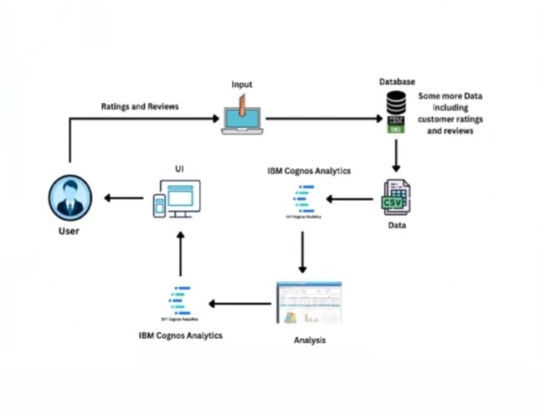
SOLUTION ARCHITECTURE

Slide 8
TOOLS USED
HARDWARE REQUIREMENTS
Processor : Intel Core i3
RAM : 8 GB
Hard disk : 500 GB
SOFTWARE REQUIREMENTS
Operating System : Windows
Language : HTML, CSS, JavaScript, Python
Web Framework : Flask
TOOL REQUIREMENTS
Operating System : Window 10
Disk Space : 256 MB
Processor : Intel atom processor
Version : 3.6.2

Slide 9
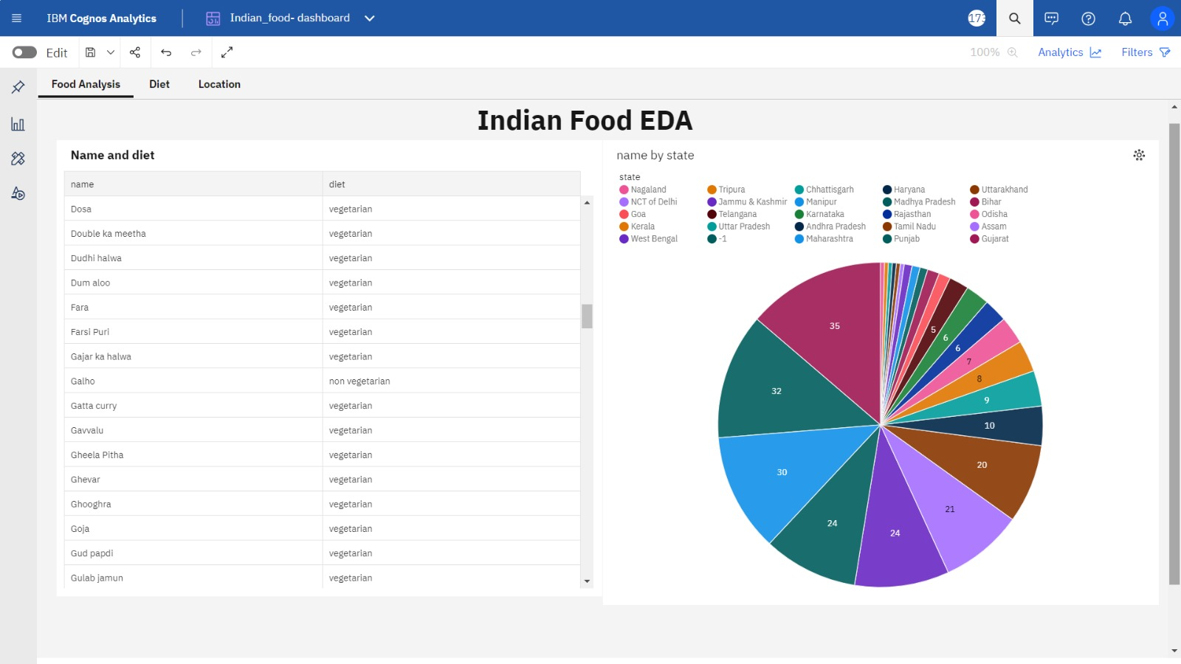
DASHBOARD

Slide 10
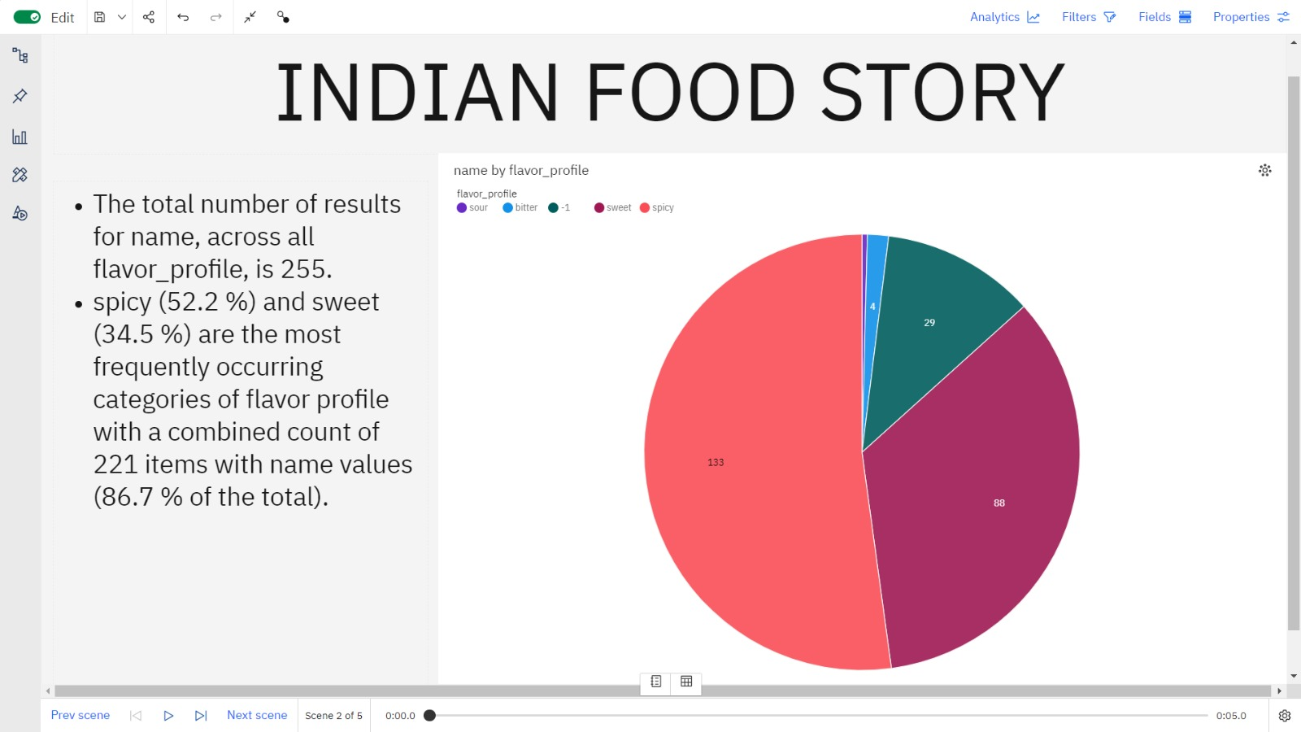
STORY

Slide 11
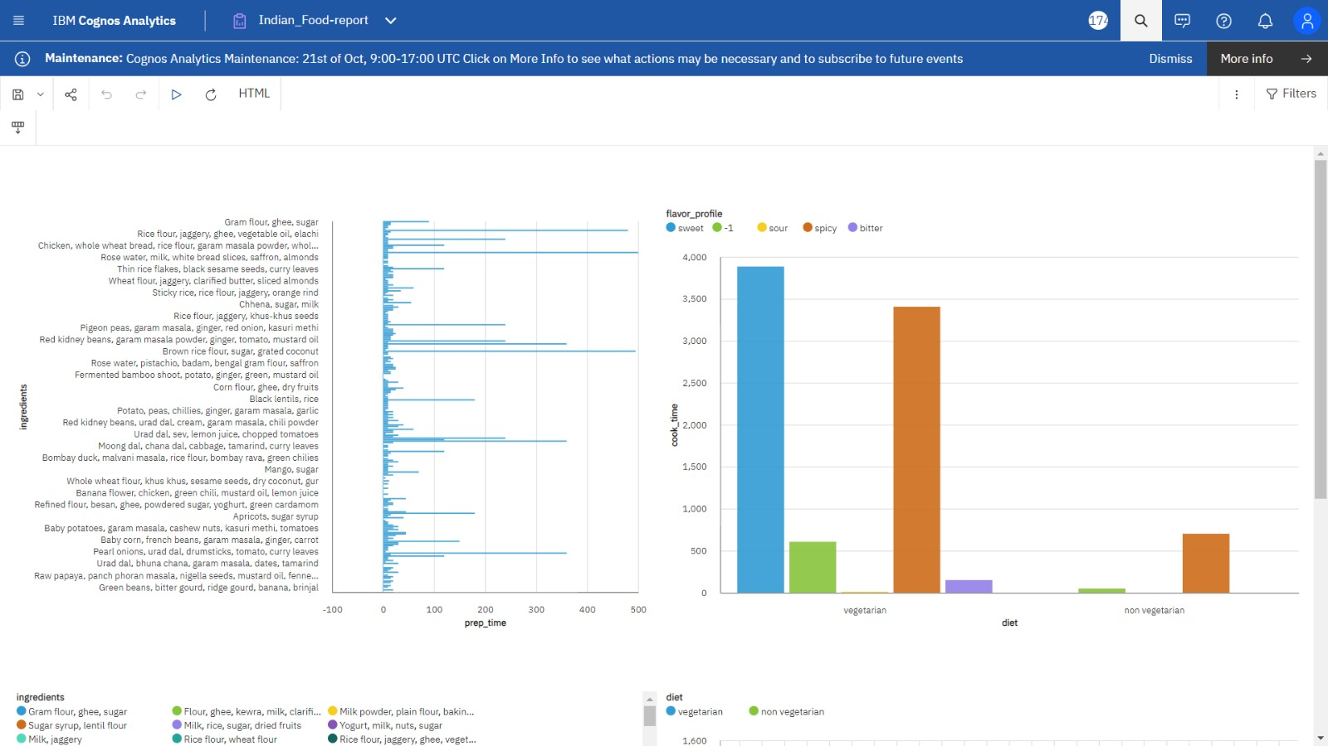
REPORT

Slide 12
THANK YOU…!

