Slide 1


K.RAMAKRISHNAN COLLEGE OF TECHNOLOGY
(AUTONOMOUS), TRICHY.
MOVIE TICKET BOOKING SYSTEM
PRESENTED
Dhivyadharshini J
2303811710422031
SUPERVISOR
Mr. M. Saravanan, M.E.,
AP/CSE.

Slide 2
PRESENTATION OVERVIEW
Objective
Project Introduction
Problem Statement
Methodologies (Programming concepts relevant to problem statement)
Architecture of the proposed system
List of Modules
Merits
Results and Discussion
Queries

Slide 3
OBJECTIVE
Facilitate Movie Ticket Booking: Provide an intuitive interface for users to select a movie, choose show timings, specify the number of tickets, and confirm their booking.
Dynamic Seat and Pricing Management: Display real-time seat availability and calculate ticket prices dynamically based on the selected movie and the number of tickets.
Automate Booking Workflow: Automate the process of seat allocation, ensuring smooth and efficient booking, while updating the seat availability to reflect changes in real-time.

Slide 4
PROJECT INTRODUCTION
This program provides users with a simple and intuitive interface to book movie tickets effortlessly.
Users can select their preferred movie, choose a show timing, specify the number of tickets, and receive real-time updates on seat availability and ticket pricing.
The system dynamically manages seat allocation for multiple movies and show timings, ensuring accurate bookings.

Slide 5
PROBLEM STATEMENT
The manual process of booking movie tickets in theaters is prone to inefficiencies and errors, such as overbooking, inaccurate seat allocation, and time delays in checking seat availability and calculating ticket prices.
Users often face challenges in accessing real-time seat availability, calculating ticket costs, and confirming their bookings seamlessly.
This system will enable users to select movies, view available show timings, check seat availability in real-time, and book tickets with accurate price calculations.

Slide 6
METHODOLOGIES
1. Object-Oriented Programming (OOP):
The program uses OOP principles, such as creating a class MovieTicketBookingSystem to encapsulate related data (e.g., movie prices, seat availability) and behavior (e.g., booking tickets, resetting inputs).
2. Event-Driven Programming:
The program heavily relies on event listeners like ActionListener and ItemListener to handle user interactions such as button clicks and dropdown selections.
3. Graphical User Interface (GUI) Development with AWT:
The program leverages Java's AWT library to create graphical components like Frame, Label, Choice, TextField, and Button for building the user interface.
4. Dynamic Data Handling:
Real-time updates of ticket prices and seat availability are managed dynamically based on user selections, such as movie and show timing.

Slide 7
METHODOLOGIES
5. Map-Based Data Storage:
HashMap is used to store and retrieve movie-related data efficiently, including prices and seat availability for different show timings.
6. Validation and Error Handling:
The program includes input validation to ensure users provide valid data (e.g., non-empty name, valid ticket number). Error handling mechanisms are implemented to manage invalid inputs, such as non-numeric ticket entries.
7. Seat Management Using Arrays:
An array of Boolean values represents the seat availability for each movie and show timing, enabling efficient seat allocation and tracking.
8. Modular Design:
The program organizes functionality into distinct sections, such as UI setup, event handling, and seat booking logic, promoting modularity and maintainability.

Slide 8
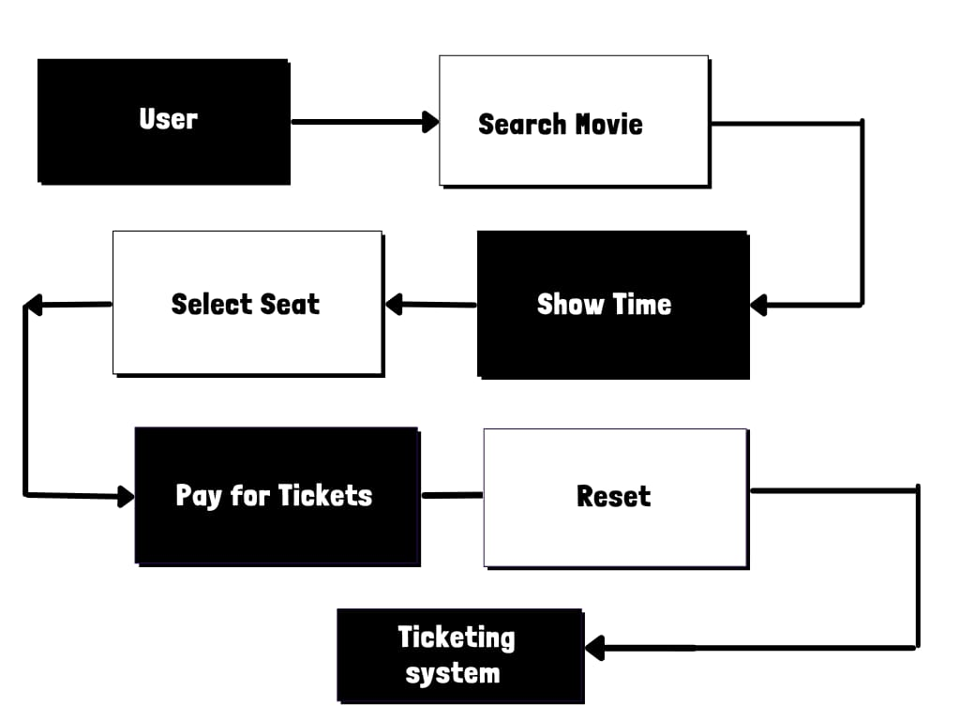
ARCHITECTURE OF THE PROPOSED SYSTEM

Slide 9
LIST OF MODULES
3.1 User Input Module
This module enables users to input essential booking details, such as their name, the desired movie, show timing, and the number of tickets. It employs text fields and dropdown menus (Choice components) for seamless data entry. The module ensures that all required fields are filled before proceeding with the booking process. Input validation is incorporated to check for valid ticket numbers and prevent errors caused by incomplete or incorrect data.
3.2 Movie Data Module
This module stores and manages the core data of the application, including movie names, ticket prices, and show timings, using HashMap data structures. It dynamically updates seat availability based on the selected movie and timing. The module also provides real-time pricing updates, ensuring users have accurate information about ticket costs for their chosen movie and show timing.

Slide 10
LIST OF MODULES
3.3 Seat Management Module
This module tracks seat availability using a nested HashMap and Boolean[] arrays, representing the seating layout for each movie and show timing. It efficiently updates the seat status during the booking process by marking reserved seats as unavailable. This module ensures that users always see the latest count of available seats and prevents overbooking by validating seat requests against current availability.
3.4 Booking Module
The booking module handles the core functionality of processing user inputs and confirming reservations. It validates input data, calculates the total ticket cost, and allocates seats by updating the seat availability data. Upon successful booking, it generates a confirmation message, including the user’s name, movie, show timing, booked seat numbers, and total cost. This module ensures accurate and efficient ticket booking.
2/7/20

Slide 11
MERITS
User-Friendly Interface:
  The program provides an intuitive graphical user interface (GUI) with clear labels, dropdowns, and text fields, making it easy for users to interact with the system.
Dynamic Seat Management:
  Real-time updates of seat availability and automatic seat allocation ensure accurate booking and a seamless experience for users.
Efficient Data Handling:
  Use of HashMap for storing movie data (prices and seat availability) ensures efficient data retrieval and management, even as the number of movies and showtimes increases.
4. Cost Calculation Automation:
  The program automatically calculates the total cost based on the number of tickets booked and the selected movie's price, reducing manual effort and errors.
5. Real-Time Availability Display:
  Users can view the available seats for the selected movie and timing, helping them make informed decisions before booking.

Slide 12
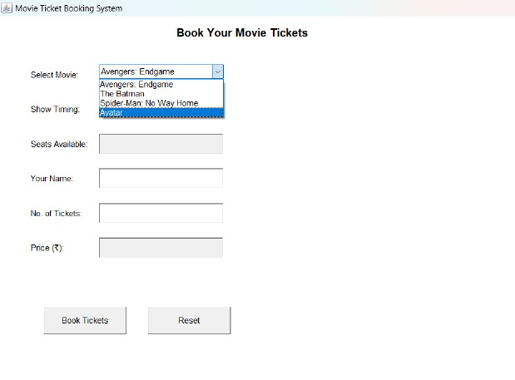
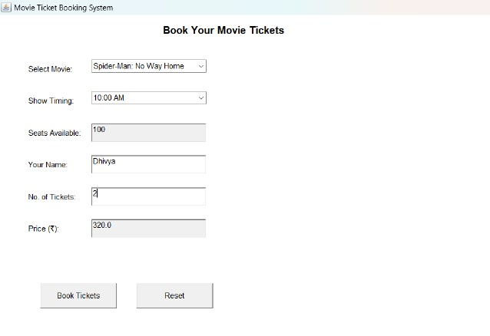
RESULTS AND DISCUSSION

Slide 13
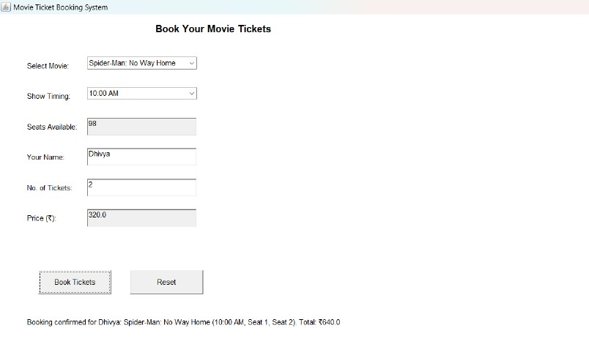
RESULTS AND DISCUSSION
2/7/20

Slide 14
QUERIES ?

