Slide 1
AtliQ Mart Fast Moving Goods Market
Presented by Dhivya T

Slide 2
Agenda
Problem Statement
AtliQ Mart market
AtliQ Mart product overview
Campaigns and Promotion types
Dataset
Business Requests
Power BI Dashboard
Insights
Recommendations

Slide 3
Problem Statement
AtliQ Mart is a retail giant with over 50 supermarkets in the southern region of India. All their 50 stores ran a massive promotion during the Diwali 2023 and Sankranti 2024 (festive time in India) on their AtliQ branded products.
Now the sales director wants to understand which promotions did well and which did not so that they can make informed decisions for their next promotional period.

Slide 4
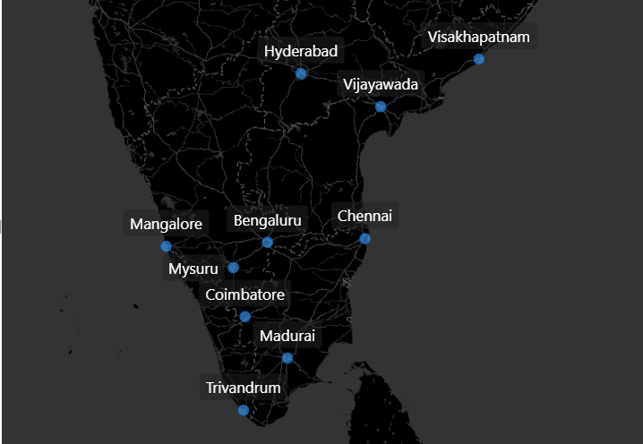
AtliQ Mart Market

Slide 5
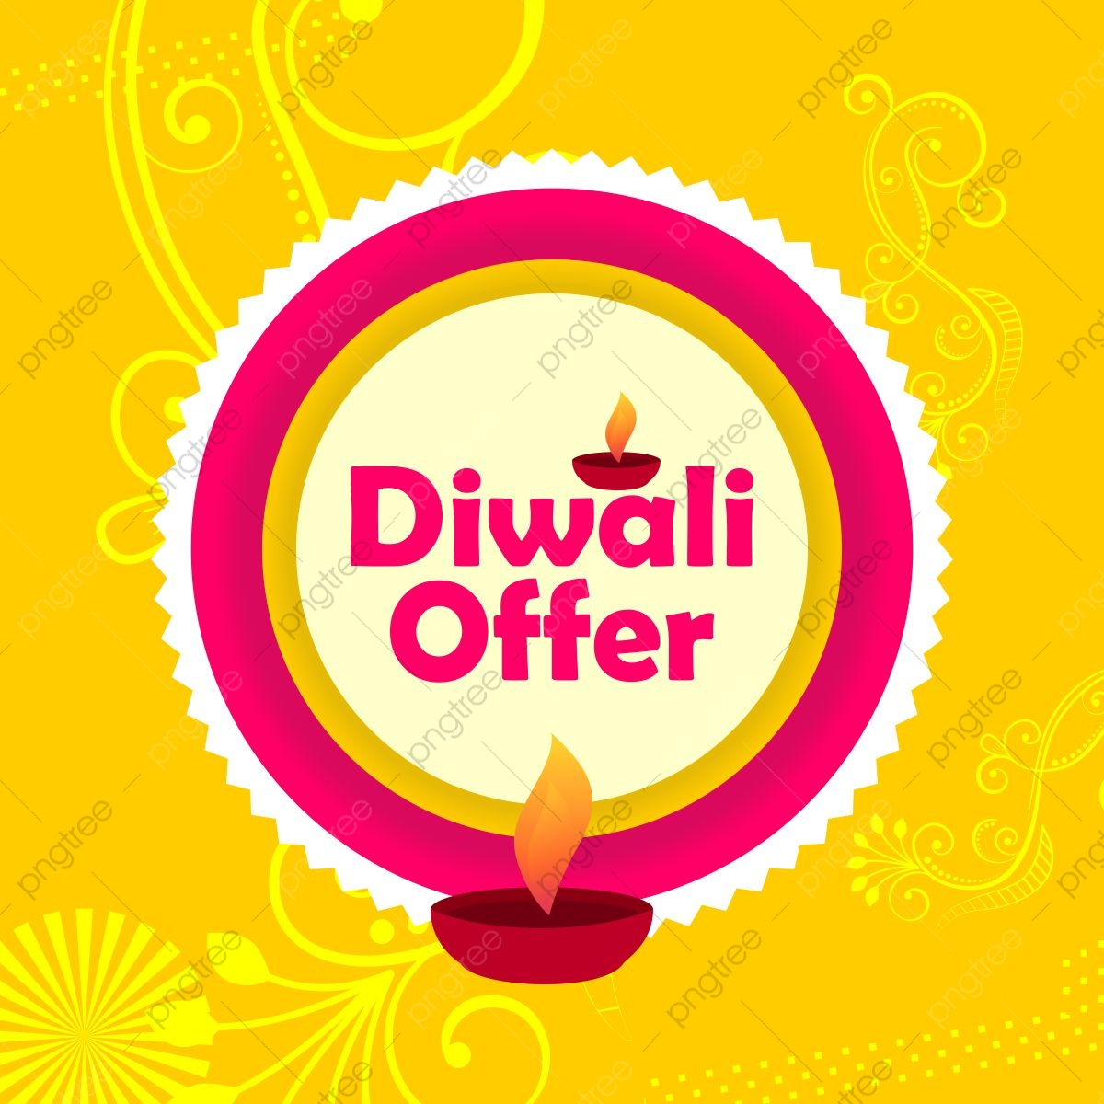


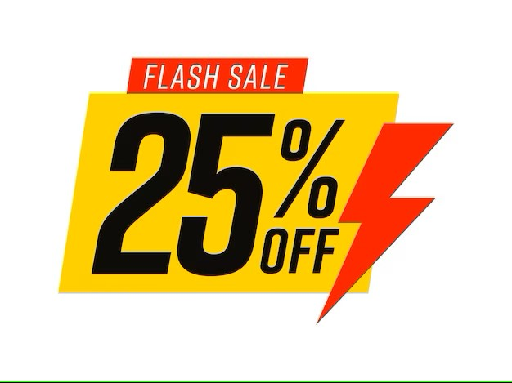

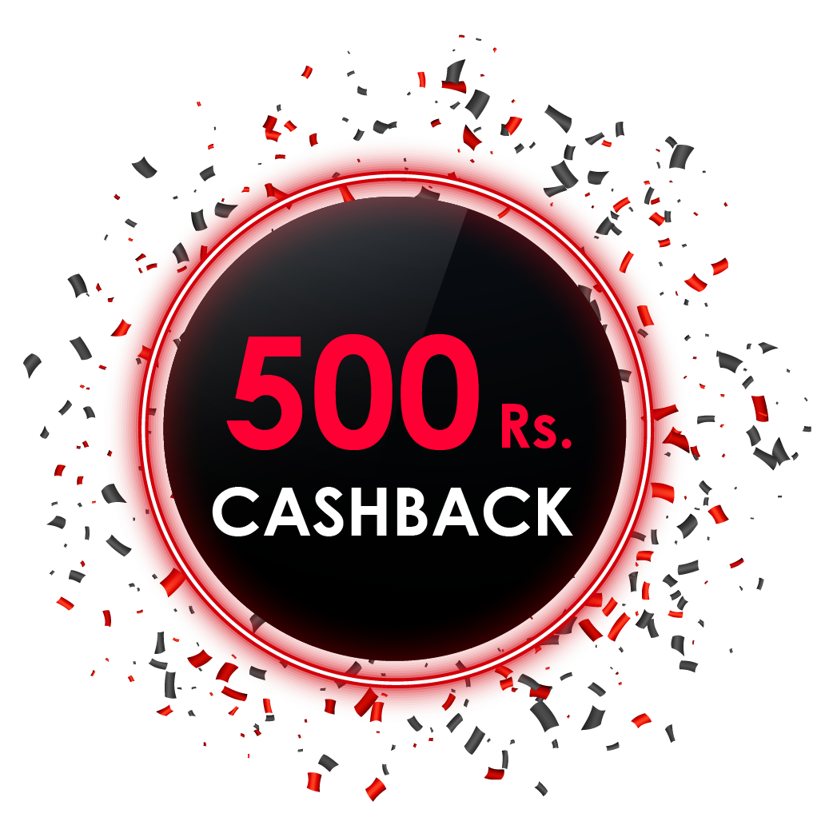
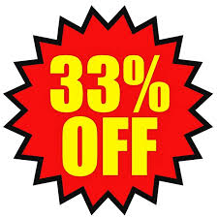
Campaigns
Promotion types

Slide 6
AtliQ Mart product overview
Grocery & Staples
Home Care
Personal Care
Atliq_Body_Milk_Nourishing_Lotion (120ML)
Atliq_Masoor_Dal (1KG)
Atliq_Scrub_Sponge_For_Dishwash
Atliq_Fusion_Container_Set_of_3
Atliq_Curtains
Atliq_Double_Bedsheet_set
Atliq_Cream_Beauty_Bathing_Soap (125GM)
Atliq_Doodh_Kesar_Body_Lotion (200ML)
Atliq_Lime_Cool_Bathing_Bar (125GM)
Atliq_Sonamasuri_Rice (10KG)
Atliq_Suflower_Oil (1L)
Atliq_Farm_Chakki_Atta (1KG)
Home Appliances
Atliq_High_Glo_15W_LED_Bulb
Atliq_waterproof_Immersion_Rod
Combo1
Atliq_Home_Essential_8_Product_Combo

Slide 7
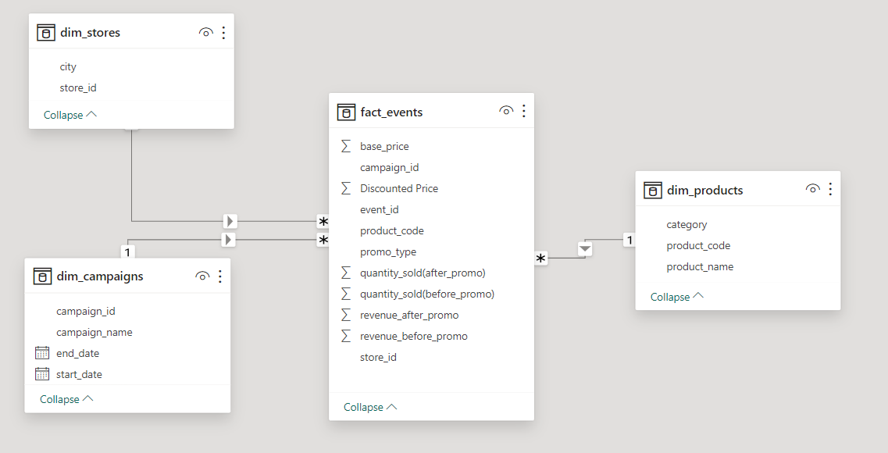
Dataset

Slide 8
Business Requests

Slide 9

Request 1
Provide a list of products with a base price greater than 500 and that are featured in promo type of 'BOGOF' (Buy One Get One Free).

Slide 10
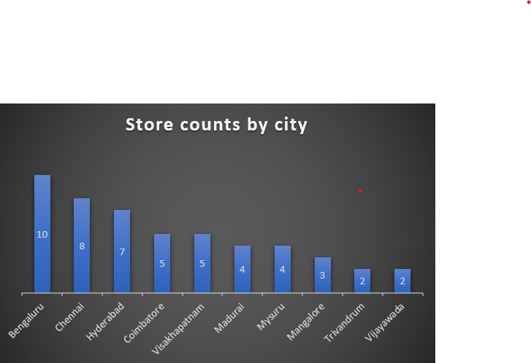
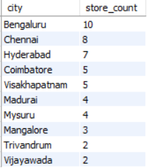
Request 2
Generate a report that provides an overview of the number of stores in each city.

Slide 11

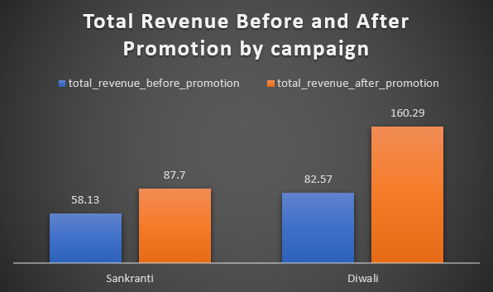
Request 3
Generate a report that displays each campaign along with the total revenue generated before and after the campaign?

Slide 12
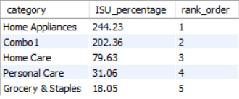
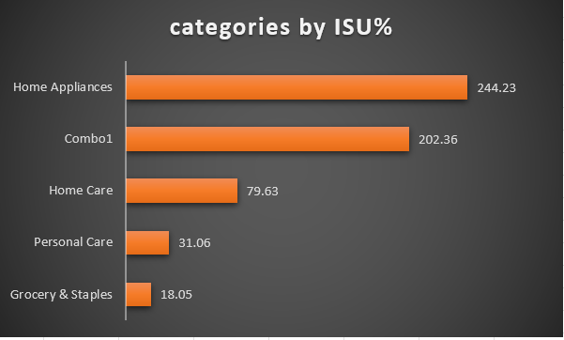
Request 4
Produce a report that calculates the incremental Sold Quantity (ISU) for each category during the diwali campaign. additionally, provide rankings for the categories based on their ISU%.

Slide 13
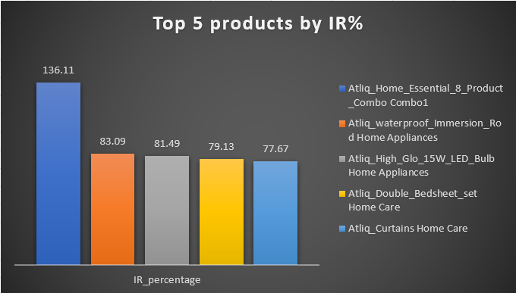
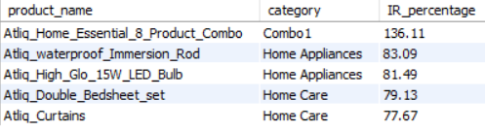
Request 5
Create a report featuring the top 5 products, ranked by incremental revenue percentage (IR%), across all campaigns.

Slide 14
Power BI Dashboard
Live Dashboard link: https://app.powerbi.com/view?r=eyJrIjoiNmI4OWRhYWYtNTU2MS00MWUzLWI1NTktMzBiMzhhZDAzZTczIiwidCI6ImM2ZTU0OWIzLTVmNDUtNDAzMi1hYWU5LWQ0MjQ0ZGM1YjJjNCJ9

Slide 15
Insights
The Diwali campaign was significantly more successful in generating revenue for the company, achieving an impressive 94.12%, while the Sankranti campaign resulted in a lower revenue of 50.87%.
Bangalore is the top revenue-generating city, followed by Chennai and Hyderabad. Mysuru and Mangalore contribute less revenue.
Promotion types '500 Cashback' and 'BOGOF' lead to higher revenue, while '25% OFF' has the lowest revenue impact.
The 'Combo1' category generates the highest revenue, but the Grocery & Staples category, despite higher quantity sold, has lower revenue due to BOGOF promotions.
Personal Care category products contribute the least to revenue.

Slide 16
Recommendations
Keep collecting feedback to improve campaigns and make customers more satisfied.
Expand stores in Bangalore to tap into its high revenue potential. Consider opening new stores in Mysuru and Mangalore to address the lower revenue in these areas.
Exclude the '25% OFF' promotion type in future campaigns due to its lower revenue impact.
Diversify the 'Combo' category by introducing more combo products to enhance sales and revenue.
Focus on improving products under the Personal Care category to boost sales and contribute more to overall revenue.

Slide 17
Thank You

