Slide 1
SLEEP TRACKER ANDROID APPLICATION
TEAM MEMBER’S
DHIVYA P
KEERTHANA S
JEEVADHARSHINI M
KIRUBADHARSHINI R

Slide 2
DESCRIPTION
The Sleep Tracker app utilizes Android Jetpack Compose to monitor and analyze
sleep quality, providing users with a comprehensive understanding of their sleep patterns.
By tracking sleep duration and rating sleep quality, users can gain valuable insights into their
restful nights and identify areas for improvement.
Through this project, you will gain hands-on experience in Android app development,
Android Jetpack Compose, and database integration. You will design and develop a sleep
tracking app, integrate a database to store user data and sleep records, and analyze sleep data
to provide meaningful feedback to users.
The app includes features such as user authentication, sleep timer functionality, sleep
quality rating, data analysis, and database integration. By completing this project, you will
create a valuable tool for monitoring and improving sleep quality, while gaining proficiency
in Android Studio and Android Jetpack Compose. Additionally, you will learn to design and
develop a user-friendly interface, integrate databases, and analyze data to provide meaningful
insights.

Slide 3
Main Activity:
package com.example.projectone
import android.content.Context
import android.content.Intent
import android.icu.text.SimpleDateFormat
import android.os.Bundle
import androidx.activity.ComponentActivity
import androidx.activity.compose.setContent
import androidx.compose.foundation.Image
import androidx.compose.foundation.layout.*
import androidx.compose.material.Button
import androidx.compose.material.MaterialTheme
import androidx.compose.material.Surface
import androidx.compose.material.Text
import androidx.compose.runtime.*
import androidx.compose.ui.Alignment

Slide 4
import androidx.compose.ui.Modifier
import androidx.compose.ui.draw.alpha
import androidx.compose.ui.layout.ContentScale
import androidx.compose.ui.res.painterResource
import androidx.compose.ui.unit.dp
import androidx.core.content.ContextCompat
import com.example.projectone.ui.theme.ProjectOneTheme
import java.util.*
class MainActivity : ComponentActivity() {
private lateinit var databaseHelper: TimeLogDatabaseHelper
override fun onCreate(savedInstanceState: Bundle?) {
super.onCreate(savedInstanceState)
databaseHelper = TimeLogDatabaseHelper(this)
databaseHelper.deleteAllData()

Slide 5
setContent {
ProjectOneTheme {
// A surface container using the 'background' color from the theme
Surface(
modifier = Modifier.fillMaxSize(),
color = MaterialTheme.colors.background
) {
MyScreen(this,databaseHelper)
}
}
}
}
}

Slide 6
@Composable
fun MyScreen(context: Context, databaseHelper: TimeLogDatabaseHelper) {
var startTime by remember { mutableStateOf(0L) }
var elapsedTime by remember { mutableStateOf(0L) }
var isRunning by remember { mutableStateOf(false) }
val imageModifier = Modifier
Image(
painterResource(id = R.drawable.tracking),
contentScale = ContentScale.FillHeight,
contentDescription = "",
modifier = imageModifier
.alpha(0.3F),
)
Column(
modifier = Modifier.fillMaxSize(),
horizontalAlignment = Alignment.CenterHorizontally,
verticalArrangement = Arrangement.Center

Slide 7
) {
if (!isRunning) {
Button(onClick = {
startTime = System.currentTimeMillis()
isRunning = true
}) {
Text("Start")
//databaseHelper.addTimeLog(startTime)
}
} else {
Button(onClick = {
elapsedTime = System.currentTimeMillis()
isRunning = false
}) {
Text("Stop")
databaseHelper.addTimeLog(elapsedTime,startTime)
}
}
Spacer(modifier = Modifier.height(16.dp))
Text(text = "Elapsed Time: ${formatTime(elapsedTime - startTime)}")

Slide 8
Spacer(modifier = Modifier.height(16.dp))
Button(onClick = { context.startActivity(
Intent(
context,
TrackActivity::class.java
)
) }) {
Text(text = "Track Sleep")
}
}
}
private fun startTrackActivity(context: Context) {
val intent = Intent(context, TrackActivity::class.java)
ContextCompat.startActivity(context, intent, null)
}

Slide 9
fun getCurrentDateTime(): String {
val dateFormat = SimpleDateFormat("yyyy-MM-dd HH:mm:ss", Locale.getDefault())
val currentTime = System.currentTimeMillis()
return dateFormat.format(Date(currentTime))
}
fun formatTime(timeInMillis: Long): String {
val hours = (timeInMillis / (1000 * 60 * 60)) % 24
val minutes = (timeInMillis / (1000 * 60)) % 60
val seconds = (timeInMillis / 1000) % 60
return String.format("%02d:%02d:%02d", hours, minutes, seconds)
}

Slide 10
Androidmainfest.xml
<?xml version="1.0" encoding="utf-8"?>
<manifest xmlns:android="http://schemas.android.com/apk/res/android"
xmlns:tools="http://schemas.android.com/tools">
<application
android:allowBackup="true"
android:dataExtractionRules="@xml/data_extraction_rules"
android:fullBackupContent="@xml/backup_rules"
android:icon="@mipmap/ic_launcher"
android:label="@string/app_name"
android:supportsRtl="true"
android:theme="@style/Theme.ProjectOne"
tools:targetApi="31">
<activity
android:name=".TrackActivity"
android:exported="false"
android:label="@string/title_activity_track"
android:theme="@style/Theme.ProjectOne" />

Slide 11
<activity
android:name=".MainActivity"
android:exported="false"
android:label="@string/app_name"
android:theme="@style/Theme.ProjectOne" />
<activity
android:name=".MainActivity2"
android:exported="false"
android:label="RegisterActivity"
android:theme="@style/Theme.ProjectOne" />
<activity
android:name=".LoginActivity"
android:exported="true"
android:label="@string/app_name"
android:theme="@style/Theme.ProjectOne">
<intent-filter>
<action android:name="android.intent.action.MAIN" />

Slide 12
<category android:name="android.intent.category.LAUNCHER" />
</intent-filter>
</activity>
</application>
</manifest>

Slide 13
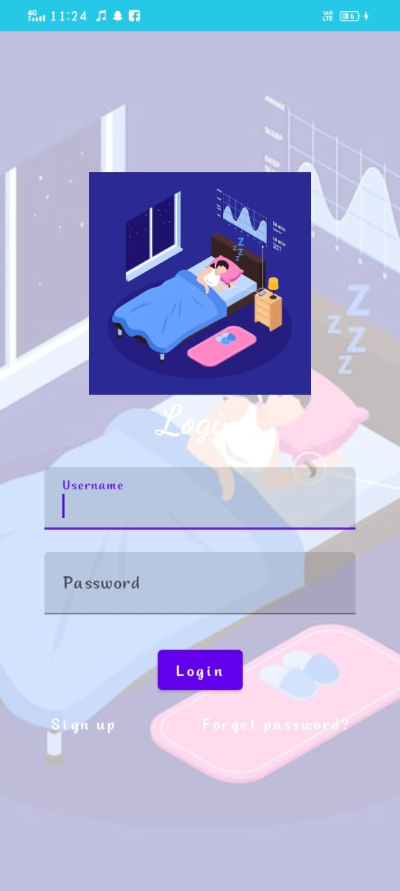
Output :

Slide 14
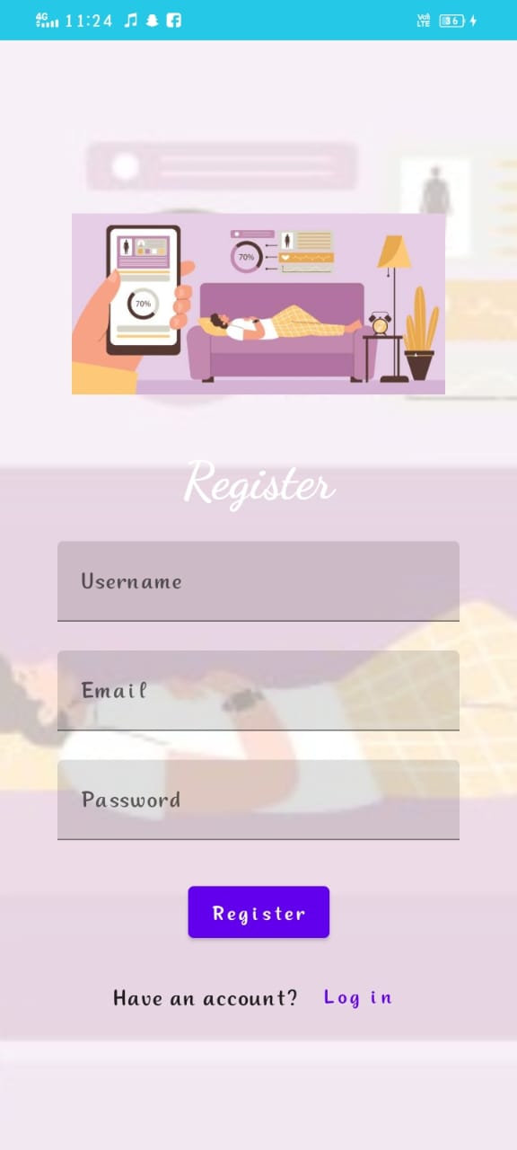

Slide 15
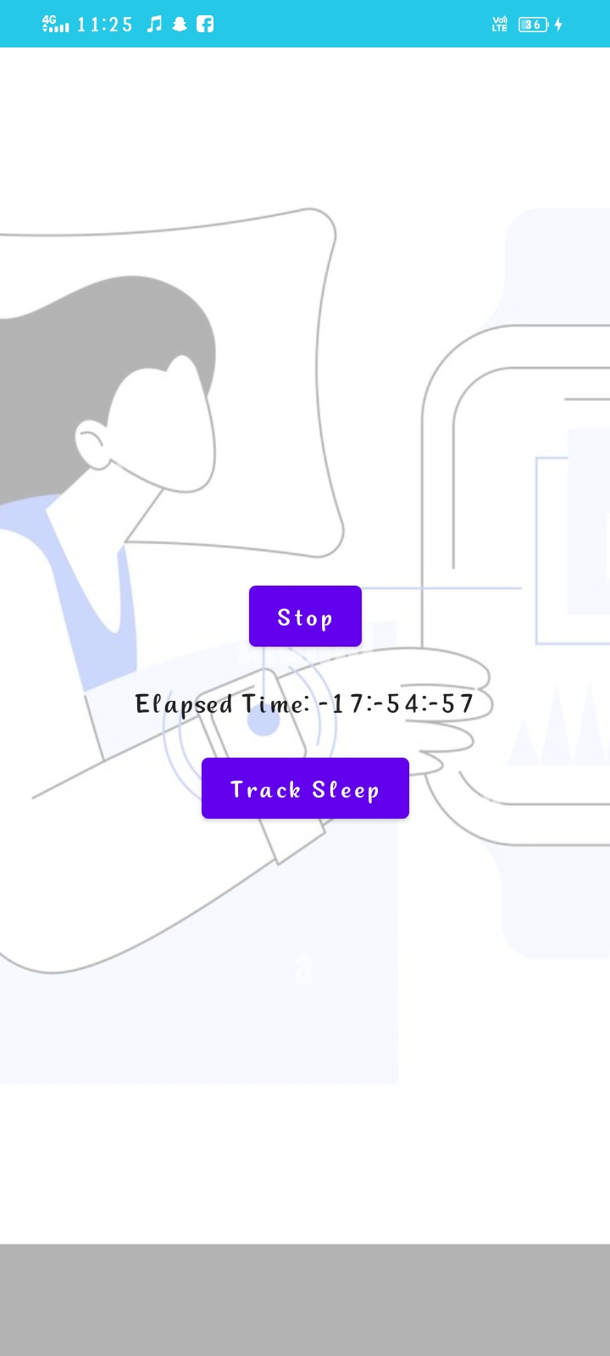

Slide 16
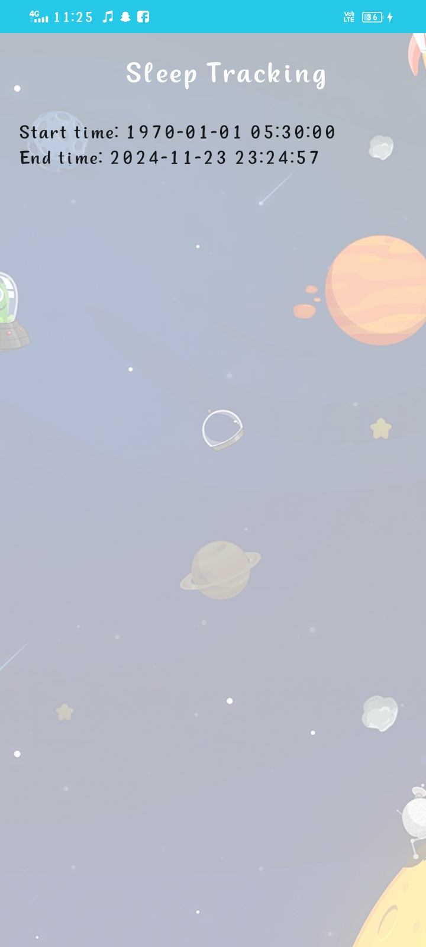

Slide 17
THANK YOU

