Slide 1

Department of Computer Science and Engineering
(Cyber Security)
CS23533– Foundations of Artificial Intelligence
2026-2027
AI POWERED EMERGENCY EVACUATION ROUTE PLANNING SYSTEM
SUPERVISOR
Dr. S.Bhuvana Ph.D.
ASSISTANT PROFESSOR (SG)
STUDENTS
Dharani K – 241901025
Dhivya M - 241901027

Slide 2
Problem Statement and Motivation
During emergencies such as floods and road blockages, finding a safe evacuation route becomes difficult.
People, emergency responders, and rescue teams may face delays due to hazardous roads.
Normal route planning may not adequately account for blocked or flooded roads.
This project uses OpenStreetMap and the A* Search Algorithm to identify safe alternate routes by avoiding hazardous roads.
The main motivation is to improve evacuation route planning and help people make safer decisions during emergencies.

Slide 3
Objectives
Develop a Chennai road network using OpenStreetMap data.
Apply the A* algorithm to calculate evacuation routes and distances.
Implement hazard-aware rerouting by avoiding blocked roads.
Visualize routes, hazardous roads, and alternate paths on an interactive map.
Completed: Road network integration, A* pathfinding, hazard-based rerouting, and Flask–Leaflet map integration.

Slide 4
Abstract
The proposed system develops an AI-Powered Emergency Evacuation Route Planning System for Chennai using OpenStreetMap road-network data. It allows users to select source and destination locations and calculates the shortest available route using the A Search Algorithm*.
The system identifies blocked and flooded roads using hazard information maintained in a CSV file. When a road is marked as hazardous, the system avoids the affected road segment and recalculates an alternative route whenever a valid path is available.
The calculated route, identified hazards, and travel distance are displayed through an interactive web map. The system is developed using Python, Flask, OSMnx, NetworkX, and Leaflet to support road-network processing, route calculation.

Slide 5
Literature Survey
S. No. | Author(s) & Year | Paper Title | Methodology / Algorithm | Limitations
1 | Taeyoung Choe et al. (2023) | Complex Disaster Response Framework to Reduce Urban Disaster Vulnerability . | Multilayer road network and evacuation route planning . | Depends on accurate disaster and road-network information.
2 | Arief Rahman & Ahmad Kamil Mahmood (2007) | Feasible Route Determination Using Ant Colony Optimization in Evacuation Planning . | Modified Ant Colony Optimization | Focuses on building evacuation and exit selection.
3 | Hojat Behrooz & Mohammad Ilbeigi (2025) | Adaptive Emergency Evacuation Routing: A Graph-Based Approach | Dynamic graph and Depth-First Search (DFS) | Requires road-capacity and traffic-flow information.

Slide 6
Literature Survey
S. No. | Author(s) & Year | Paper Title | Methodology / Algorithm | Limitations
4 | Diya Li et al. (2023) | A Reinforcement Learning-Based Routing Algorithm for Large Street Networks | Reinforcement learning | Training can require substantial data and computation.
5 | Lei Xu, Kai Huang, Jiepeng Liu, Dongsheng Li (2022) | Intelligent Planning of Fire Evacuation Routes Using an Improved Ant Colony Optimization Algorithm | Improved Ant Colony Optimization (ACO) | Focuses on building fire evacuation; real-world road networks are not its main focus.

Slide 7
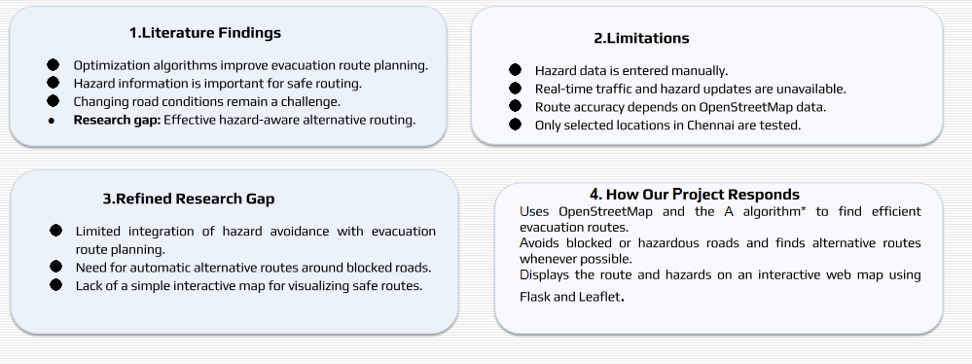
Research Gap/Existing System

Slide 8
Proposed System System
Generates alternative evacuation routes when roads are marked as hazardous.
Avoids known blocked and flooded roads using available hazard data.
Finds the shortest available route using the A* Search Algorithm.
Displays routes, hazards, and distances on an interactive map.
Supports faster route planning during emergency situations.
Uses open-source tools and map data, making the system cost-effective to develop.

Slide 9
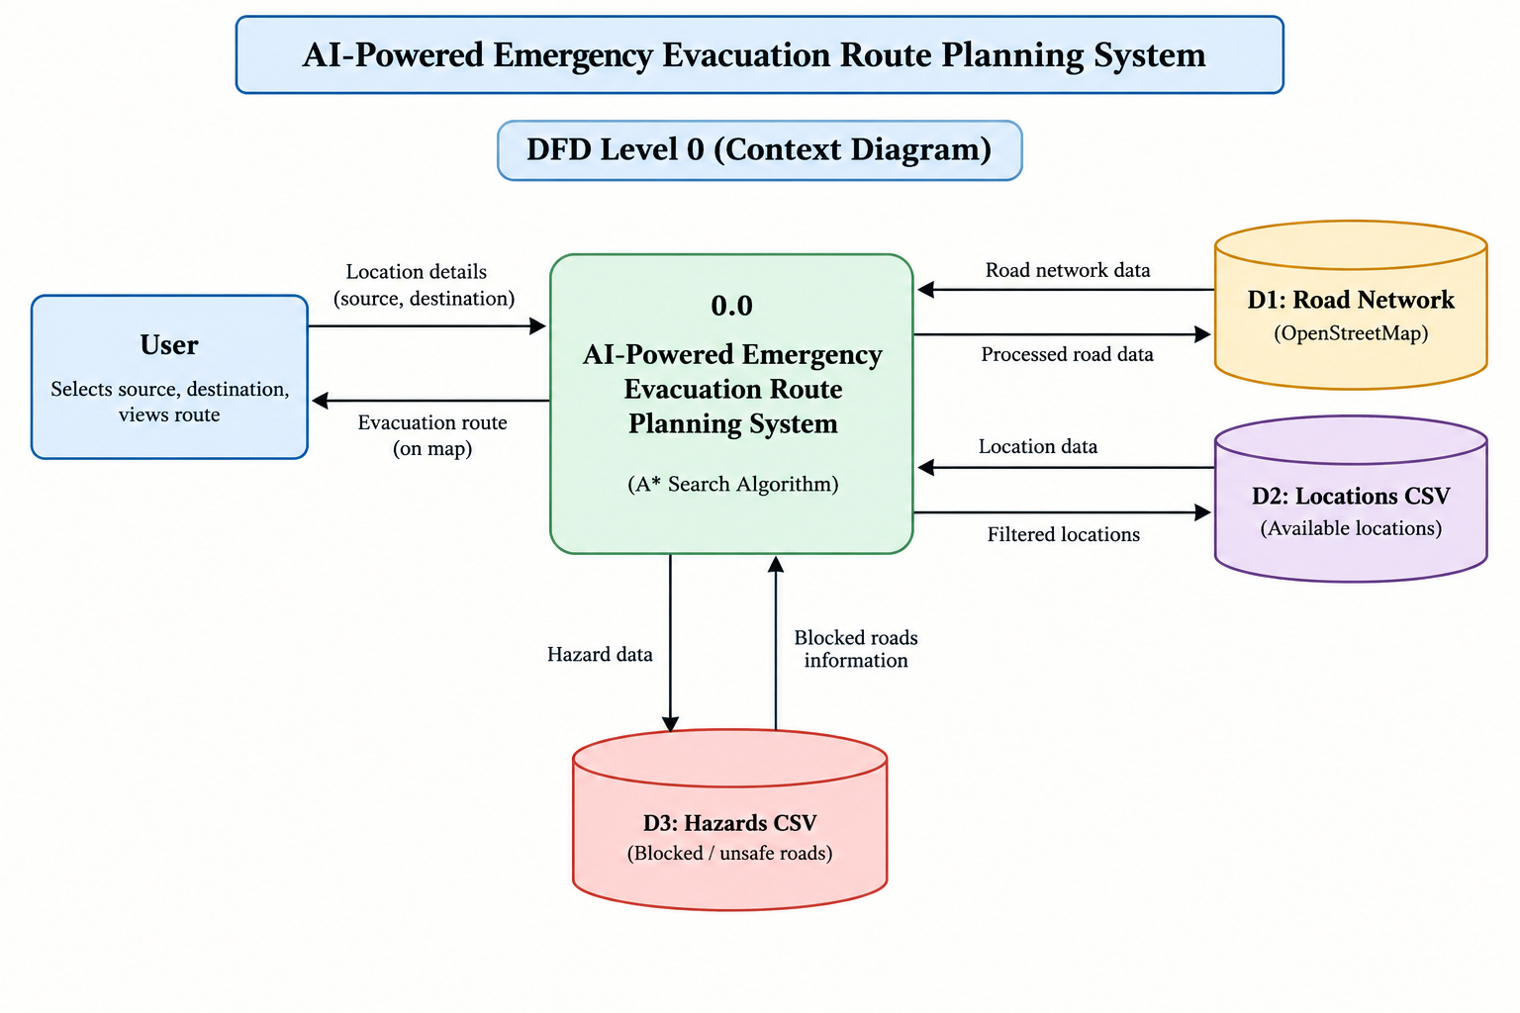
DFD Diagram

Slide 10
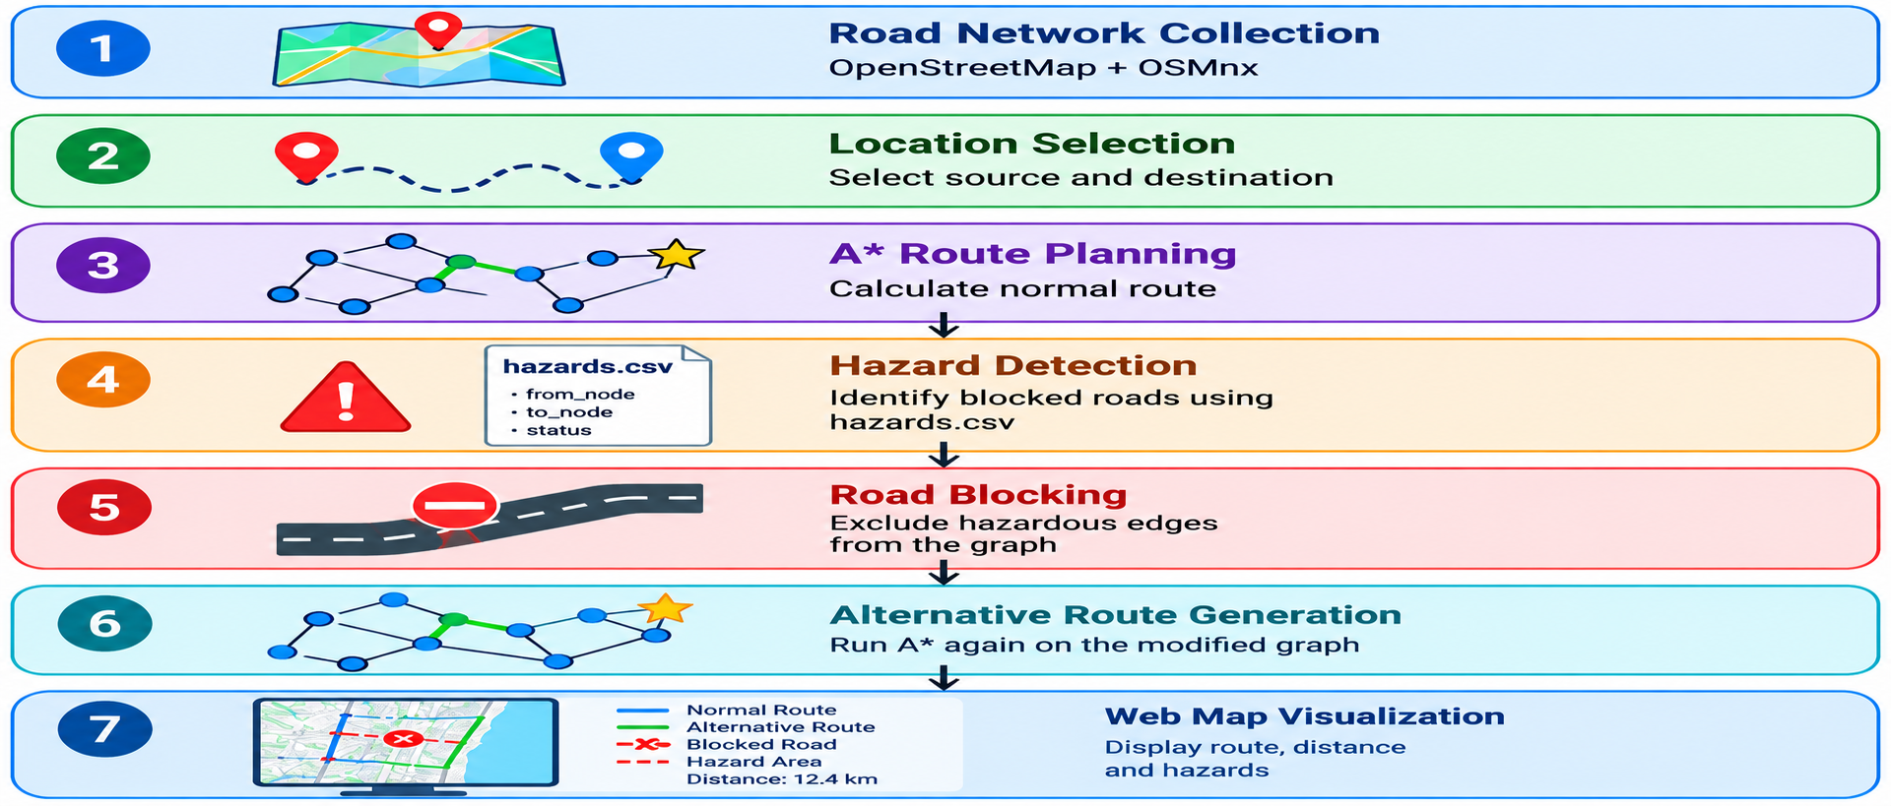
Methodology/Work Flow Diagram

Slide 11
Tools and Technologies
Programming Languages: Python, JavaScript, HTML, CSS
Libraries: Flask, OSMnx, NetworkX, Pandas, Leaflet.js
Software: Visual Studio Code, Web Browser
Dataset: Chennai OpenStreetMap, hazards.csv
Hardware: Laptop/PC, Internet connection
Justification: These tools support A* route planning, hazard avoidance, and interactive map visualization.

Slide 12
List of Modules
Module 1 – OSM Road Network & Location HandlingChennai road data and location mapping.
Module 2 – ARoute Planning*Shortest route calculation using the A* Search Algorithm.
Module 3 – Hazard Detection & ReroutingHazard identification and alternative route generation.
Module 4 – Map Visualization & Web ServerRoute and hazard display using Flask and Leaflet.
Module 5 – Testing & EvaluationRoute calculation and hazard avoidance testing.

Slide 13
Module Description(Module 1)
Downloads the Chennai road network using OpenStreetMap.
Represents the road network as a graph.
Identifies road nodes and connecting edges.
Maps six selected Chennai locations to road-network nodes.
Stores the road network for further route calculations.

Slide 14
Module Description(Module 2)
Accepts the selected source and destination.
Uses the A* Search Algorithm for route planning.
Calculates the shortest-distance route through the road network.
Computes the total distance of the generated route.
Displays the route nodes and distance in the output.

Slide 15
Module Description(Module 3)
Stores hazardous road information in hazards.csv.
Identifies blocked, flooded, and hazardous road segments.
Excludes blocked road edges from the routing network.
Runs A* Search again after a hazard is added.
Generates an alternate route when a valid path is available.

Slide 16
Module Description(Module 4)
Uses Flask to serve the web application.
Displays an interactive Chennai map using Leaflet.js.
Provides source and destination selection options.
Visualizes the calculated route and hazardous roads.
Displays route distance and other route information.

Slide 17
Module Description(Module 5)
Tested normal route generation between selected locations.
Tested route recalculation after blocking a road.
Verified the generation of alternative routes.
Checked route distances before and after hazard insertion.
Evaluated route and hazard visualization on the web map.

Slide 18
Results & Discussion
Results and Discussion
Chennai road network integrated using OpenStreetMap.
A* algorithm implemented for evacuation route planning.
Hazard-based road avoidance and alternative routing tested.
Interactive map developed using Flask and Leaflet.
Route distance and hazard locations displayed for six selected locations.
Initial testing confirms successful rerouting when a road is marked as blocked.

Slide 19
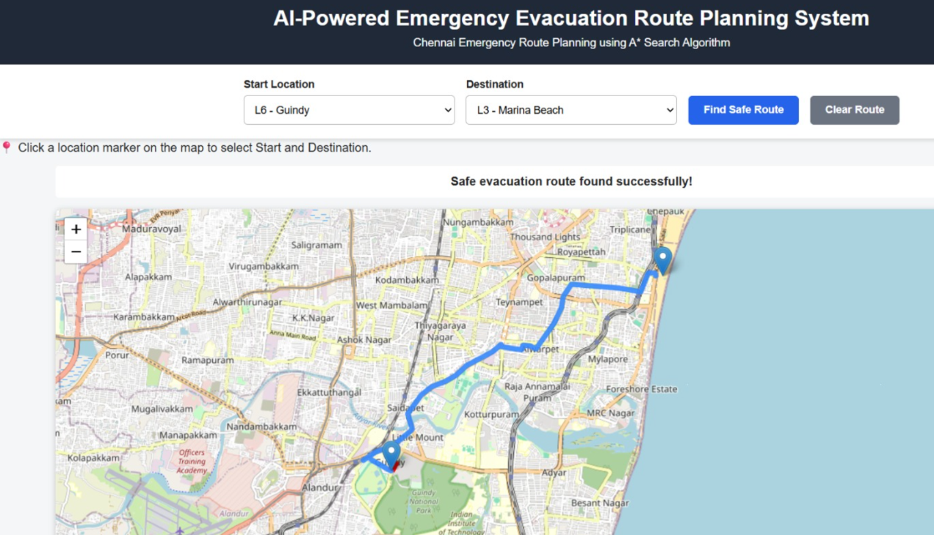
User Interface/ Screenshots

Slide 20
Conclusion
The system uses OpenStreetMap and the A algorithm* to find efficient evacuation routes in Chennai.
It avoids blocked or hazardous roads and identifies alternative routes whenever possible.
The interactive web map helps users view routes and hazards, supporting safer emergency evacuation planning.

Slide 21
Future Work
Integrate real-time hazard updates for floods and road blockages.
Include live traffic data to improve route planning.
Add GPS integration to identify the user's current location.
Develop emergency alerts and notifications for users.
Expand the system to cover more locations and road networks.

Slide 22
References
OpenStreetMap Contributors. (n.d.). Copyright and License. https://www.openstreetmap.org/copyright
NetworkX Developers. (n.d.). A shortest path algorithm documentation.* https://networkx.org/documentation/stable/
Boeing, G. (2017). OSMnx: New methods for acquiring, constructing, analyzing, and visualizing complex street networks. Computers, Environment and Urban Systems, 65, 126–139.
Pallets Projects. (n.d.). Flask Documentation. https://flask.palletsprojects.com/

Slide 23
Thank You

