Slide 1

Department of Computer Science and Engineering
(Cyber Security)
CS23533– Foundations of Artificial Intelligence
2026-2027
AI POWERED EMERGENCY EVACUATION ROUTE PLANNING SYSTEM — REVIEW 2
SUPERVISOR
Dr. S.Bhuvana Ph.D.
ASSISTANT PROFESSOR (SG)
STUDENTS
Dharani K - 241901025
Dhivya M - 241901027

Slide 2
Problem Statement and Motivation
During emergencies such as floods and road blockages, finding a safe evacuation route becomes difficult.
People, emergency responders, and rescue teams may face delays due to hazardous roads.
Normal route planning may not adequately account for blocked or flooded roads.
This project uses OpenStreetMap and the A* Search Algorithm to identify safe alternate routes by avoiding hazardous roads.
The main motivation is to improve evacuation route planning and help people make safer decisions during emergencies.

Slide 3
Objectives
Objectives & Expected Outcomes
Develop a Chennai road network using OpenStreetMap data.
Apply the A* algorithm to calculate evacuation routes and distances.
Implement hazard-aware rerouting by avoiding blocked roads.
Visualize routes, hazardous roads, and alternate paths on an interactive map.
Completed: Road network integration, A* pathfinding, hazard-based rerouting, and Flask–Leaflet map integration.

Slide 4
Project Progress Since Review 1
Work Completed After Review 1
Integrated Chennai road network data using OpenStreetMap.
Developed A* pathfinding and distance calculation.
Implemented hazard-based road avoidance and alternative routing.
Built an interactive map using Flask and Leaflet.
Current Status: Core modules integrated and route rerouting demonstrated successfully.

Slide 5
Literature Survey
S. No. | Author(s) & Year | Paper Title | Methodology / Algorithm | Limitations
1 | Taeyoung Choe et al. (2023) | Complex Disaster Response Framework to Reduce Urban Disaster Vulnerability | Multilayer road network and evacuation route planning | Depends on accurate disaster and road-network information.
2 | Arief Rahman & Ahmad Kamil Mahmood (2007) | Feasible Route Determination Using Ant Colony Optimization in Evacuation Planning | Modified Ant Colony Optimization | Focuses on building evacuation and exit selection.
3 | Hojat Behrooz & Mohammad Ilbeigi (2025) | Adaptive Emergency Evacuation Routing: A Graph-Based Approach | Dynamic graph and Depth-First Search (DFS) | Requires road-capacity and traffic-flow information.

Slide 6
Literature Survey
S. No. | Author(s) & Year | Paper Title | Methodology / Algorithm | Limitations
4 | Diya Li et al. (2023) | A Reinforcement Learning-Based Routing Algorithm for Large Street Networks | Reinforcement learning | Training can require substantial data and computation.
5 | Lei Xu, Kai Huang, Jiepeng Liu, Dongsheng Li (2022) | Intelligent Planning of Fire Evacuation Routes Using an Improved Ant Colony Optimization Algorithm | Improved Ant Colony Optimization (ACO) | Focuses on building fire evacuation; real-world road networks are not its main focus.

Slide 7
Research Gap and Project Response
1.Literature Findings
Optimization algorithms improve evacuation route planning.
Hazard information is important for safe routing.
Changing road conditions remain a challenge.
Research gap: Effective hazard-aware alternative routing.
2.Limitations
Hazard data is entered manually.
Real-time traffic and hazard updates are unavailable.
Route accuracy depends on OpenStreetMap data.
Only selected locations in Chennai are tested.
3.Refined Research Gap
Limited integration of hazard avoidance with evacuation route planning.
Need for automatic alternative routes around blocked roads.
Lack of a simple interactive map for visualizing safe routes.
4. How Our Project Responds
Uses OpenStreetMap and the A algorithm* to find efficient evacuation routes.
Avoids blocked or hazardous roads and finds alternative routes whenever possible.
Displays the route and hazards on an interactive web map using Flask and Leaflet.

Slide 8
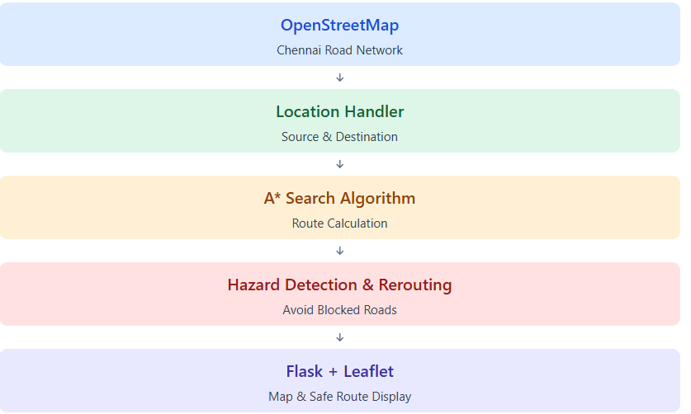
System Architecture / Proposed System
Proposed System
Uses real road-network data from
OpenStreetMap.
Applies A* Search for route planning.
Avoids manually recorded blocked
roads.
Generates alternative routes when
available.
Displays routes and hazards on an
interactive map.

Slide 9
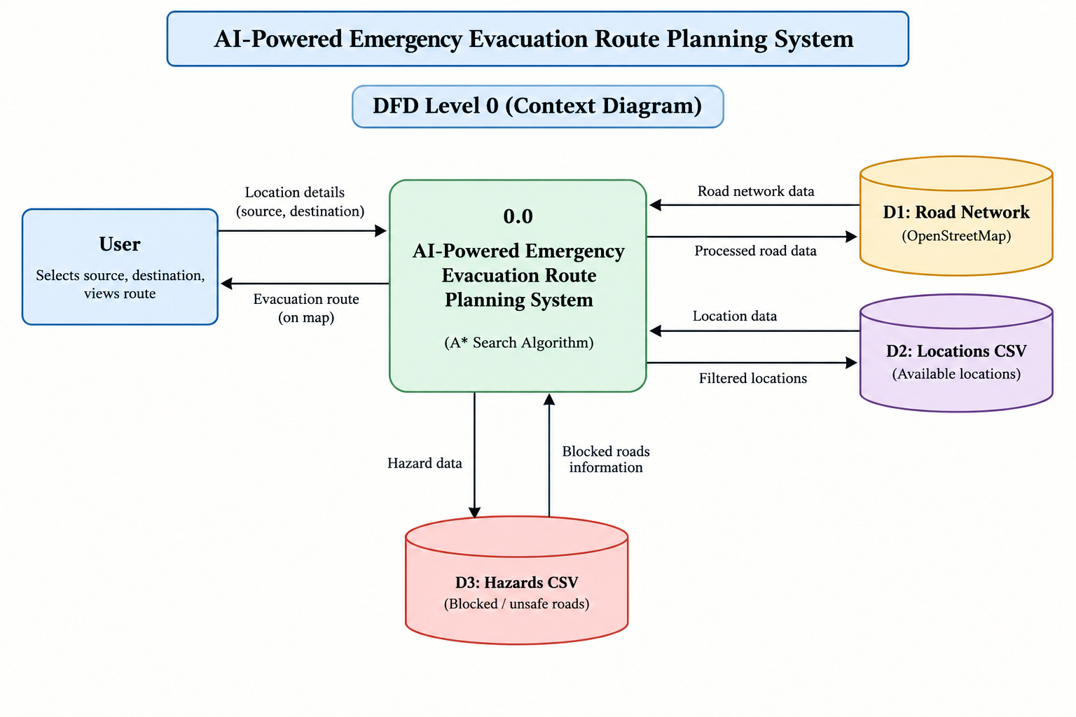
DFD Diagram

Slide 10
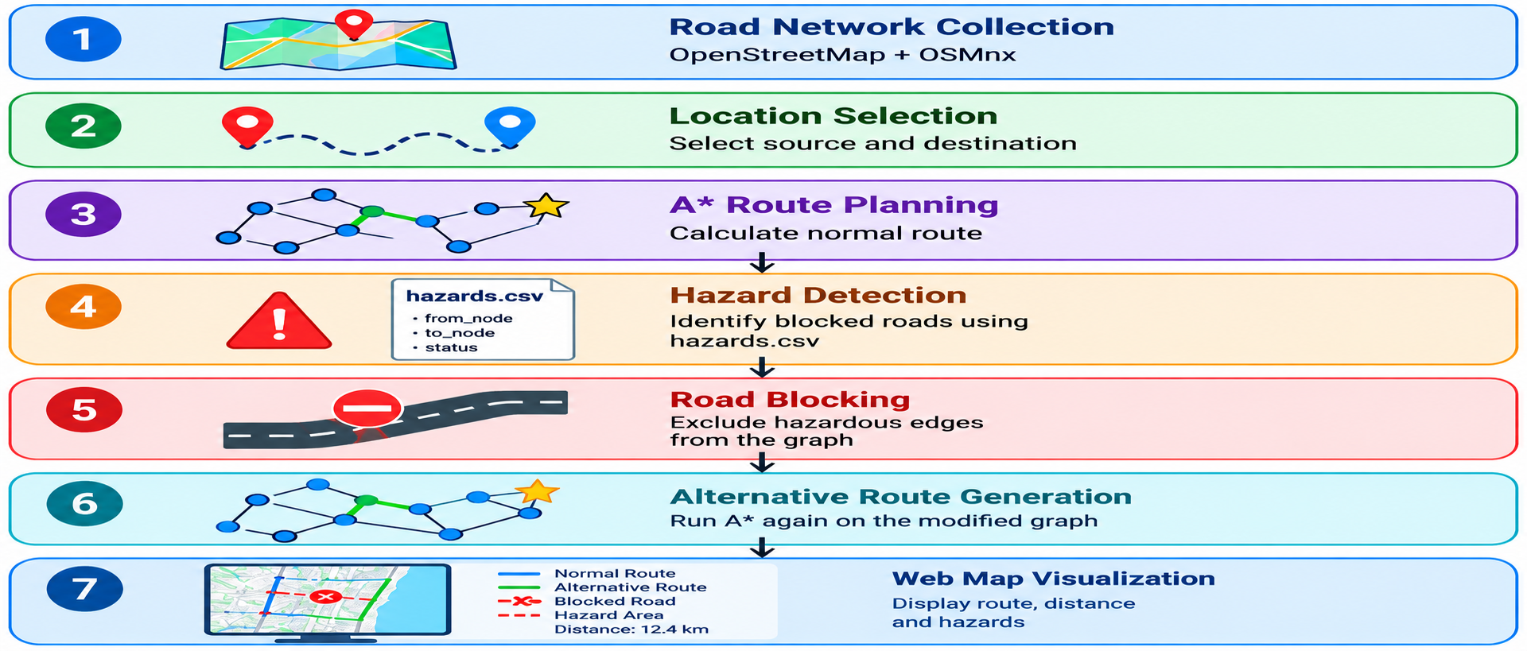
Methodology / Workflow Diagram

Slide 11
Tools and Technologies
Programming Languages: Python, JavaScript, HTML, CSS
Libraries: Flask, OSMnx, NetworkX, Pandas, Leaflet.js
Software: Visual Studio Code, Web Browser
Dataset: Chennai OpenStreetMap, hazards.csv
Hardware: Laptop/PC, Internet connection
Justification: These tools support A* route planning, hazard avoidance, and interactive map visualization.

Slide 12
List of Modules
Module 1 – OSM Road Network & Location HandlingChennai road data and location mapping.
Module 2 – ARoute Planning*Shortest route calculation using the A* Search Algorithm.
Module 3 – Hazard Detection & ReroutingHazard identification and alternative route generation.
Module 4 – Map Visualization & Web ServerRoute and hazard display using Flask and Leaflet.
Module 5 – Testing & EvaluationRoute calculation and hazard avoidance testing.

Slide 13
Module Implementation – Part (1-3)
1. Module 1 – OSM Road Network & Location Handling — Completed
Downloads Chennai road network using OpenStreetMap.
Maps selected locations to road network nodes.
2. Module 2 – A Route Planning — Completed
Finds routes between source and destination.
Calculates route distance using the A* algorithm.
3. Module 3 – Hazard Detection & Rerouting — Completed
Identifies blocked, flooded, and hazardous roads from hazards.csv.
Finds an alternate safe route by avoiding blocked road edges.

Slide 14
Module Implementation – Part (4-5)
4. Module 4 – Map Visualization & Web Server — Completed
Uses Flask to serve the web application.
Displays routes, locations, and hazards using Leaflet.js.
5. Testing & Final Evaluation — Completed
Tested normal route generation and hazard-based rerouting.
Verified route distance and hazard visualization on the map.

Slide 15
Preliminary Results and Discussion
Preliminary Results and Discussion
Chennai road network integrated using OpenStreetMap.
A* algorithm implemented for evacuation route planning.
Hazard-based road avoidance and alternative routing tested.
Interactive map developed using Flask and Leaflet.
Route distance and hazard locations displayed for six selected locations.
Initial testing confirms successful rerouting when a road is marked as blocked.

Slide 16
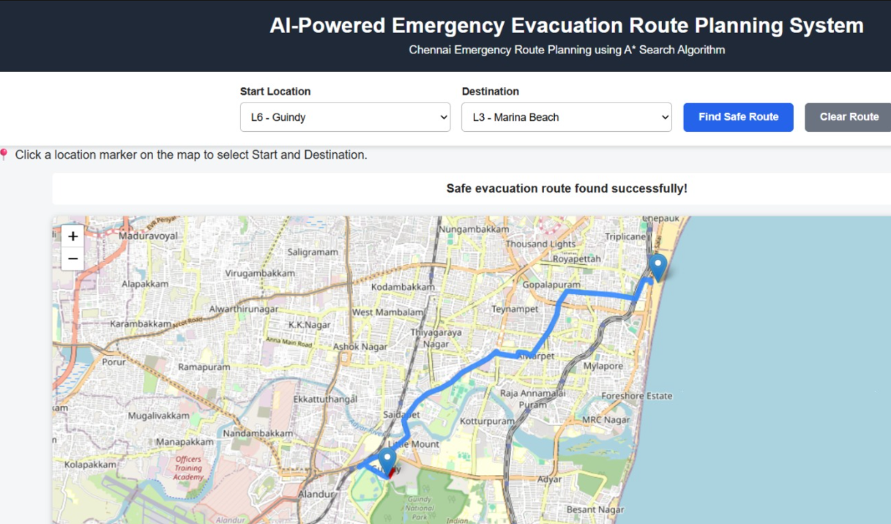
User Interface / Implementation Screenshots

Slide 17
Challenges Faced and Solutions
Challenges Faced and Solutions
Road Network Data: Integrated Chennai road data using OpenStreetMap.
Route Planning: Used the A* algorithm to calculate routes efficiently.
Hazard Avoidance: Removed blocked roads from the graph to find alternative routes.
Map Integration: Connected Flask APIs with Leaflet for route visualization.

Slide 18
Work Plan Until Final Review
Work Plan Until Final Review
Week 1: Complete module integration and fix errors.
Week 2: Test route planning and hazard-based rerouting.
Week 3: Evaluate results and improve map visualization.
Week 4: Complete project documentation and report.
Week 5: Prepare PPT, finalize screenshots, and rehearse the presentation.
Final Milestone: Complete system testing and demonstrate the working project during the final review.

Slide 19
References
OpenStreetMap Contributors. (n.d.). Copyright and License. https://www.openstreetmap.org/copyright
NetworkX Developers. (n.d.). A shortest path algorithm documentation.* https://networkx.org/documentation/stable/
Boeing, G. (2017). OSMnx: New methods for acquiring, constructing, analyzing, and visualizing complex street networks. Computers, Environment and Urban Systems, 65, 126–139.
Pallets Projects. (n.d.). Flask Documentation. https://flask.palletsprojects.com/

Slide 20
Thank You

