Slide 1
EJB
Enterprise JavaBeans

Slide 2
Software Component
A software component is code that implements a set of well-defined interfaces
Manageable
Components are not entire applications—they cannot run alone
Can be used as puzzle pieces (module) to solve some larger problem.
Component

Slide 3
Component
For example, suatu software component berfungsi menghitung harga-harga barang, sebut namanya adalah pricing component.
Kita dapatkan informasi dari pricing component tentang product-product yang dijual, dan the total price of the order.
  let’s assume we’re ordering computer parts, such as memory and hard drives. The pricing component figures out the correct price based on a set of pricing rules such as:
    Base prices of a single memory upgrade or a single hard disk
    Quantity discounts that a customer receives for ordering more than 10 memory modules
    Bundling discounts that the customer receives for ordering both memory and a hard disk
    Preferred customer discounts that you can give to big-name customers
    Locale discounts depending on where the customer lives
    Overhead costs such as shipping and taxes

Slide 4
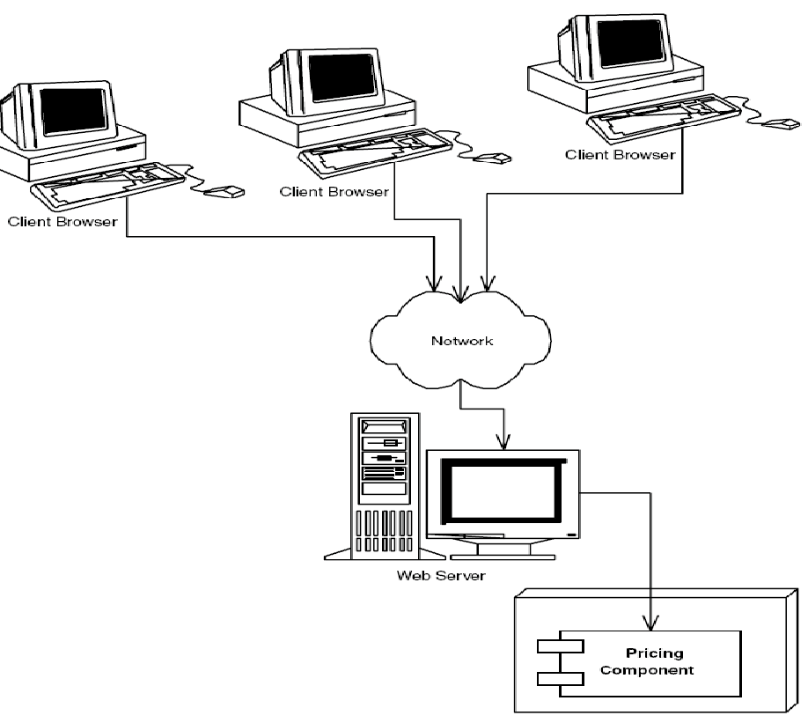
Component

Slide 5
Component Architectures
To facilitate the component development process, there should be a standardized way to build, manage, and maintain components. This approach consists of the following:
    Tools for developing components.
    A container that manages your deployed components.
    Tools for deploying and maintaining components.

Slide 6
Component Architectures
Thankfully, object-oriented design introduced a great programming practice to help solve this problem by separating the interface of a component from its implementation:
    A component’s interface defines the component’s contract with the code that calls it.
    A component’s implementation is the core programming logic that an object provides. It should be hidden from all client code that calls the component.
For interface/implementation separation to be effective, developers must write client code to a component’s interface only (this is called interface-based programming).

Slide 7
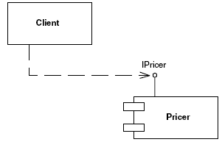
Component Architectures
The Client code depends upon the IPricer interface.
The Pricer component implements the IPricer interface.

Slide 8
Component Architectures in Java
Enterprise JavaBeans (EJB) standard defines a component architecture for deployable components called enterprise beans.
Enterprise beans are very similar to two other types of Java components: applets and servlets.
    Applets can be deployed in a Web page, where the browser’s applet viewer provides a runtime container for the applets.
    Servlets can be deployed in a Web server, where the Web server’s servlet engine provides a runtime container for the servlets.
    Enterprise beans are deployed in an application server, where the application server provides a runtime container for the Enterprise JavaBeans.
Web Page
applets
servlets
servlets
Web Server
Appl. Server

Slide 9
Multi-tier Architecture
Any well-written deployment has a logical software partitioning into layers. Each layer has a different responsibility in the overall deployment, and within each layer there can be one or more components. Note that these layers are purely abstractions, and they may not correspond to physical distribution. A layered system is a well-designed system because each layer is responsible for a separate task. Here is a typical layer partitioning:
  A presentation layer contains components dealing with user interfaces and user interaction. The presentation layer of a Web-based deployment could use Java servlets, JSP, and/or Java applets.
  A business logic layer contains components that work together to solve business problems. These components could be high-performance engines, such as catalog engines or pricing engines. Typically, these components are written in a type-safe language such as Java or C++.
  A data layer is used by the business logic layer to persist state permanently. Central to the data layer is one or more databases that house the stored state.

Slide 10
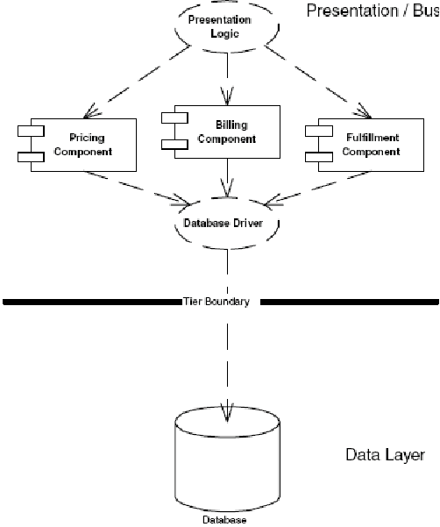
Two-Tier Architectures
two of these layers are physically separated from the third, forming two physically separated tiers.
Client
Server

Slide 11
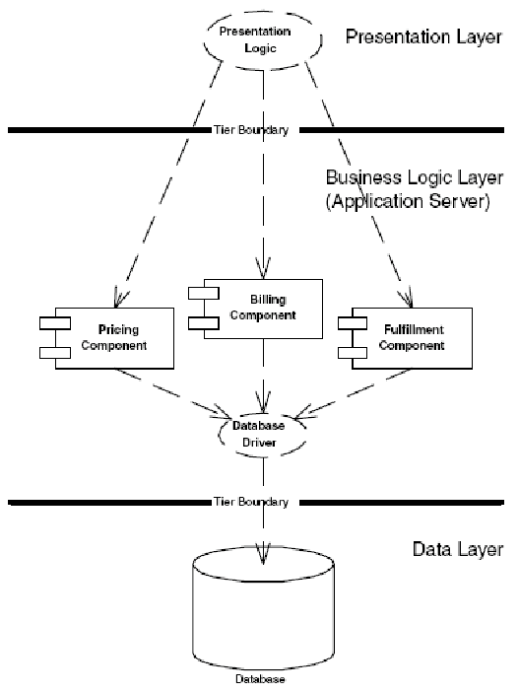
N-Tier Architectures
In N-tier deployments, your presentation layer, business logic layer, and data layer are separated into respective physical tiers. With four or more tiers, you decompose each of these layers even further to allow various parts of your system to scale independently.
client
server
database

Slide 12
J2EE
Thus, to enable server-side computing in Java, Sun has produced a complete development platform called the Java 2 Platform, Enterprise Edition (J2EE). The mission of J2EE is to provide a platform-independent, portable, multiuser, secure, and standard enterprise-class platform for server-side deployments written in the Java language. The cornerstone of J2EE is Enterprise JavaBeans (EJB), a standard for building server-side components in Java.
J2EE simplifies many of the complexities surrounding the construction of a scalable, component-based server-side application, and it is very analogous to Windows DNA.
J2EE is a specification, whereas Windows DNA is a product. J2EE specifies the rules of engagement that people must agree on when writing enterprise software. Vendors then implement the J2EE specifications with their J2EE-compliant products.

Slide 13
J2EE & CORBA
Like J2EE, CORBA is a specification, not a product. Vendors (such as Inprise, Iona, and IBM) implement the CORBA specification with their products.
The big distinction between CORBA and J2EE is that (until now)
CORBA has had only the notion of an object and had no notion of a deployable server-side component that is automatically managed by an application server.

Slide 14
The J2EE Technologies
Enterprise JavaBeans (EJB).
  EJB defines how server-side components are written and provides a standard contract between components and the application servers that manage them. EJB promotes the spawning of a component marketplace, where vendors can sell reusable components that can be purchased to help solve business problems. EJB is the cornerstone for J2EE
Java Remote Method Invocation (RMI) and RMI-IIOP.
  RMI allows for interprocess communication and provides other communication-related services. RMI-IIOP is a portable extension of RMI that can use the Internet Inter-ORB Protocol (IIOP) and can be used for CORBA integration.
Java Naming and Directory Interface (JNDI).
  JNDI identifies the locations of components or other resources across the network.
Java Database Connectivity (JDBC).
  JDBC is a relational database bridge that allows for relatively portable database operations.
Extensible Markup Language (XML).
  Several J2EE technologies (such as EJB 1.1 and JSP) depend on XML as a meta-markup language for describing content.

Slide 15
The J2EE Technologies
Java Transaction API (JTA) and Java Transaction Service (JTS).
  The JTA and JTS specifications allow for components to be bolstered with reliable transaction support.
Java Messaging Service (JMS).
  JMS allows for asynchronous distributed object communications.
Java Servlets and Java Server Pages (JSPs).
  Servlets and JSPs are networked components which are ideally suited for request/response oriented computing, such as interacting with clients over HTTP.
Java IDL.
  Java IDL is Sun Microsystem’s Java-based implementation of CORBA. Java IDL allows for integration with other languages. Java IDL also allows for distributed objects to leverage CORBA’s full range of services. Thus, J2EE is fully compatible with CORBA, rounding out the Java 2 Platform, Enterprise Edition completely.
JavaMail.
  The JavaMail service allows you to send e-mail messages in a platform-independent, protocol-independent manner from your Java programs.

Slide 16
EJB
EJBs = Enterprise JavaBeans
  EJB is a component architecture that allows Developers to quickly create scalable enterprise applications. It provides complex middleware enterprise features at no cost to application developers.
Distributed Transactions
  Menjamin integritas data untuk pertukaran antar database dan antar aplikasi servers

Slide 17
CORBA and EJB
EJB and CORBA share much functionality—many of the qualities of service that EJB offers are also in CORBA. In fact, you can think of EJB as CORBA plus standards for how your components should be written and managed, increasing productivity.
A massive amount of development effort has gone into CORBA. It would be a shame if Enterprise JavaBeans did not integrate with CORBA. Fortunately, Sun Microsystems and the OMG are both supporting EJB/CORBA interoperability, and they have produced standards that will allow that to happen.
The EJB/CORBA mapping specification, along with RMI-IIOP, lifts the restriction that EJB must be solely Java-based. You can expose EJB components as CORBA objects, which generalizes EJB and makes it well suited for cross-language interoperability.

Slide 18
EJB Overview
An enterprise bean is a server-side software component that can be deployed in a distributed multi-tier environment.
An enterprise bean can comprise one or more Java objects because a component may be more than just a simple object
Types of Beans
  Session Beans
      Stateful Session Beans
      Stateless Session Beans
  Entity Beans

Slide 19
Session Beans
Session beans are called session beans because they live for about as long as the session (or lifetime) of the client code that’s calling the session bean. When the client later disconnects, the application server may destroy the session bean instance.
Session beans are usable by one client at a time—that is, they are not shared between clients. When a client is using a session bean, that client is the only client dealing with that session bean.

Slide 20
Session Beans
A stateful session bean is a bean that’s designed to service business processes that span multiple method requests or transactions. To accomplish this, stateful session beans retain state on behalf of an individual client. If a stateful session bean’s state is changed during a method invocation, that same state will be available to that same client upon the following invocation.
Stateless session beans are components that can accommodate these types of single request business processes. They are anonymous method providers—anonymous because they are not aware of any client history. Usually a stateless bean only has one method.

Slide 21
entity bean
An entity bean is a component that represents such persistent data. Entity beans model bank accounts, orders, order line items, stock portfolios, and so on.
Entity beans represent real data objects, such as customers, products, or employees.
Entity beans do not contain business process logic—they model data.
Session beans handle the business processes. Session beans might use entity beans to represent the data they use, similar to how a bank teller uses a bank account.

Slide 22
EJB specification
The EJB specification defines a few standard interfaces that your bean class can implement.
All bean classes must implement (both session and entity) is the javax.ejb.EnterpriseBean interface.
All session beans must implement javax.ejb.SessionBean,
All entity beans must implement javax.ejb.EntityBean.

Slide 23
Remote interface
EJB container is acting as a layer of indirection between the client code and the bean. This layer of indirection manifests itself as a single network aware object, called the EJB object.
Bean clients invoke methods on EJB objects, rather than the beans themselves. To perform this, EJB objects must clone every business method that your bean classes expose.
Remote interface duplicates all the businesslogic methods that the corresponding bean class exposes. This interface is called the.

Slide 24
EJB Object
Home
Interface
Home Object
Client
Applets
Servlets
4. return value
3. Method
return
1. Call a method
EJB Object
Remote
Interface
2. Acquire &
Delegates the method

Slide 25
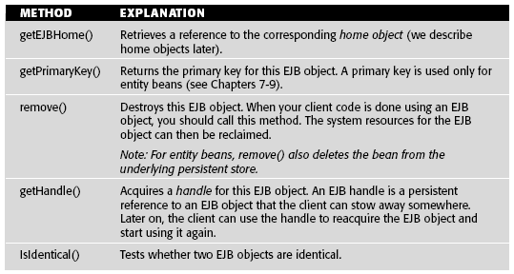
EJB Object
Required Methods That All EJB Objects Must Expose

Slide 26
EJB Object
public interface javax.ejb.EJBObject extends java.rmi.Remote {
public abstract javax.ejb.EJBHome getEJBHome() throws java.rmi.RemoteException;
public abstract java.lang.Object getPrimaryKey() throws java.rmi.RemoteException;
public abstract void remove() throws java.rmi.RemoteException,
javax.ejb.RemoveException;
public abstract javax.ejb.Handle getHandle() throws java.rmi.RemoteException;
public abstract boolean isIdentical(javax.ejb.EJBObject) throws java.rmi.RemoteException;
}

Slide 27
Home Object
The client cannot instantiate an EJB object directly because EJB objects could exist on a different machine than the one the client is on. Similarly, EJB promotes location transparency, so clients should never be aware of exactly where EJB objects reside.
To acquire a reference to an EJB object, your client code asks for an EJB object from home object. The chief responsibilities of home objects are to do the following:
    Create EJB objects
    Find existing EJB objects
    Remove EJB objects

Slide 28
Home Object
Home
Interface
Create me an
EJB Object
Home Object
Client
Applets
Servlets
3. Return EJB Object
reference
2. Create an
EJB Object
EJB Object
Remote
Interface

Slide 29
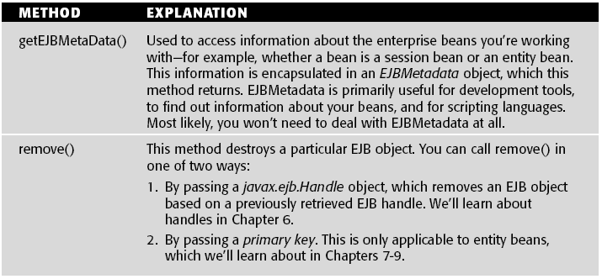
Home Object
Required Methods That All Home Objects Expose

Slide 30
Home Object
public interface javax.ejb.EJBHome extends java.rmi.Remote {
public abstract EJBMetaData getEJBMetaData() throws java.rmi.RemoteException;
public abstract void remove(Handle handle) throws java.rmi.RemoteException, javax.ejb.RemoveException;
public abstract void remove(Object primaryKey) throws java.rmi.RemoteException, javax.ejb.RemoveException;
}

Slide 31
Home Interface
Home objects are factories for EJB objects.
Home interfaces simply define methods for creating, destroying, and finding EJB objects. The container’s home object implements your home interface.

Slide 32
Deployment Descriptors
The next file that you must include with your enterprise bean component is a deployment descriptor.
You can use a deployment descriptor to specify the following requirements of your bean:
  Bean management and life-cycle requirements. For example, you specify the name of the bean’s class, whether the bean is a session or entity bean, and the home interface that generates the beans.
  Persistence requirements (entity beans only). Authors of entity beans use the deployment descriptors to inform the container about whether the bean handles its persistence on its own or delegates the persistence to the EJB container in which it’s deployed.
  Transaction requirements. You can also specify transaction settings for beans in deployment descriptors. These settings control what the bean requirements are for running in a transaction.
  Security requirements. Deployment descriptors contain access control entries,
  which the beans and container use to control access control to certain
  operations. For example, you can specify who is allowed to use which beans,
  and even who is allowed to use each method on a particular bean.

Slide 33
Ejb-jar File
Once you’ve generated your bean classes, your home interfaces, your remote interfaces, your deployment descriptors, and your bean’s properties, it’s time to package them up into one entity.
This entity is called the Ejb-jar file.
Ejb-jar file is a compressed file that contains everything we have described, and it follows the .ZIP compression format.

Slide 34
Ejb-jar File
Properties
File
Remote
Interface
Bean
Classes
.class
Deployment
Descriptor
.xml
EJB jar File
Home
Interface
Jar
Manifest
.mf
The bean’s properties are attributes that your bean uses at runtime. You
use properties to allow people to customize how your bean’s logic works
internally.

Slide 35
Example, Simple openEJB
Constructing the “Hallo Sayang….” Remote Interface
The remote interface duplicates every business method that our beans expose. The container will implement the remote interface; the implementation is the EJB object. Things to notice about our remote interface include the following:
  We extend javax.ejb.EJBObject.
  We have one business method—hello()—which returns the String “Hallo Sayang….” back to the client.

Slide 36
Simple EJB : Remote Interface
package ejb02;
import java.rmi.*;
import javax.ejb.*;
import java.util.*;
public interface HelloRemote extends EJBObject {
public String sayHello() throws RemoteException;
}
Home
Interface
Home Object
2. Create an
EJB Object
EJB Object
Remote
Interface

Slide 37
Simple EJB: Bean Class
package ejb02;
import java.rmi.RemoteException;
import javax.ejb.*;
public class HelloBean implements SessionBean {
private SessionContext sessionContext;
public void ejbCreate() {
  System.out.println("ejbCreate()");
}
public void ejbRemove() {
System.out.println("ejbRemove()");
}
public void ejbActivate() {
System.out.println("ejbActivate()");
}
public void ejbPassivate() {
System.out.println("ejbPassivate()");
}
public void setSessionContext (SessionContext sessionContext) {
this.sessionContext = sessionContext;
System.out.println("setSessionContext()");
}
// Business methods
public String sayHello() throws java.rmi.RemoteException {
return "Hello Sayang….";
}
}

Slide 38
Simple EJB: Bean Class
Home
Interface
Home Object
2. Create an
EJB Object
Bean Class
EJB Object
Remote
Interface

Slide 39
Simple EJB: Bean Class
This is about the most basic bean you can have. Notice the following:
  Our bean implements the javax.ejb.SessionBean interface
  The bean is stateless and does not contain any client-specific state that spans method calls.
  The setSessionContext() method associates a bean with an environment.
  The ejbActivate() and ejbPassivate() methods are used when beans are activated and passivated, respectively.

Slide 40
Simple EJB: Home Interface
home interface is to create and destroy EJB objects.
home interface extends javax.ejb.EJBHome.
home interface exposes one method to create an EJB object and takes no arguments.
home interface’s create() method throws a java.rmi.RemoteException and javax.ejb.CreateException.

Slide 41
Simple EJB: Home Interface
package ejb02;
import java.rmi.*;
import javax.ejb.*;
import java.util.*;
public interface HelloHome extends EJBHome {
public HelloRemote create() throws RemoteException, CreateException;
}
Home
Interface
Home Object
2. Create an
EJB Object
Bean Class
EJB Object
Remote
Interface

Slide 42
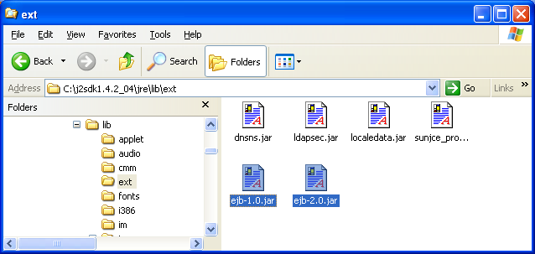
Compiling
To compile an EJB, you need to have Sun's EJB library in your classpath. One has been included for you in the directory lib/ejb-1.0.jar
Copy-kan ejb-1.0.jar dan ejb-2.0.jar dari C:\openejb-0.9.2\lib menuju ke C:\j2sdk1.4.2_04\jre\lib\ext

Slide 43
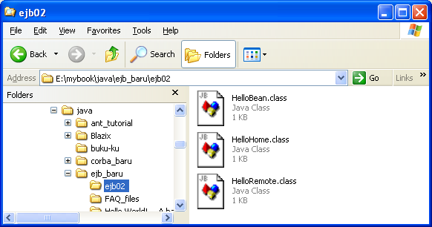
Compiling
>javac -d . *.java
>

Slide 44
Simple EJB: Deployment Descriptor
Deployment descriptors are one of the key features of EJB because they allow you to declaratively specify attributes on your beans, rather than programming this functionality into the bean itself.
The application server we tested against, BEA’s WebLogic, ships with a deployment descriptor generation wizard.
Major Integrated Development Environments (IDEs) such as Inprise’s JBuilder, Symantec’s VisualCafe, or IBM’s VisualAge for Java are beginning to provide such tools as well.

Slide 45
Simple EJB: Deployment Descriptor
This is the deployment descriptor settings that are relevant to session beans:
  Bean home name. The nickname that clients use to look up your bean’s home object.
  Enterprise bean class name. The fully qualified name of the enterprise bean class.
  Home interface class name. The fully qualified name of the home interface.
  Remote interface class name. The fully qualified name of the remote interface.
  Re-entrant. Whether the enterprise bean allows re-entrant calls. This setting must be false for session beans (it applies to entity beans only).
  Stateful or stateless. Whether the session bean is a stateful or stateless session bean.
  Session timeout. The length of time (in seconds) before a client should time out when calling methods on your bean.

Slide 46
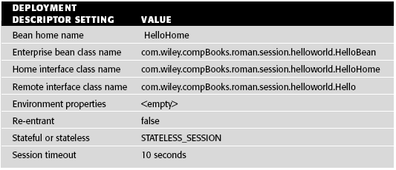
Simple EJB: Deployment Descriptor
Contoh Deployment Descriptor Setting

Slide 47
Deployment Descriptor: ejb-jar.xml
<?xml version="1.0" encoding="UTF-8"?>
<ejb-jar>
<enterprise-beans>
<session>
<ejb-name>Hello</ejb-name>
<home>ejb02.HelloHome</home>
<remote>ejb02.HelloRemote </remote>
<ejb-class>ejb02.HelloBean</ejb-class>
<session-type>Stateless</session-type>
<transaction-type>Container</transaction-type>
</session>
</enterprise-beans>
<assembly-descriptor>
<container-transaction>
<method>
<ejb-name>Hello</ejb-name>
<method-name>*
</method-name>
</method>
<trans-attribute>Required</trans-attribute>
</container-transaction>
</assembly-descriptor>
</ejb-jar>

Slide 48
Simple EJB: Ejb-jar File
After we’ve written all the necessary files for our component, we need to package the files together in an Ejb-jar file.
Note that you can have more than one bean in an Ejb-jar file, allowing you to ship an entire product set of beans in a single jar file.
  The following files must be included in an Ejb-jar file:
  Enterprise bean(s)
  Remote interface(s)
  Home interface(s)
  Deployment descriptor(s), including properties to customize your beans’ logic
    If you’re developing with EJB 1.0, you can also include a manifest file containing a list of what’s in the Ejb-jar

Slide 49
Packaging/Jarring
>jar -cvf openhello.jar ejb02 META-INF
added manifest
adding: ejb02/(in = 0) (out= 0)(stored 0%)
adding: ejb02/HelloBean.class(in = 750) (out= 391)(deflated 47%)
adding: ejb02/HelloHome.class(in = 257) (out= 188)(deflated 26%)
adding: ejb02/HelloRemote.class(in = 231) (out= 177)(deflated 23%)
ignoring entry META-INF/
adding: META-INF/ejb-jar.xml(in = 663) (out= 268)(deflated 59%)
>

Slide 50
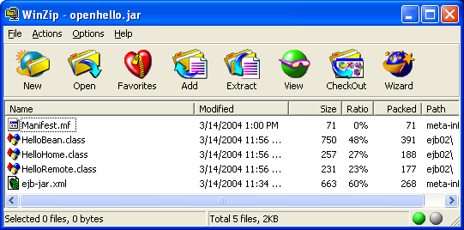
Simple EJB: Ejb-jar File

Slide 51
Simple EJB: Deploying the Bean
Finally, we’re ready to deploy our bean in an EJB container. This step will vary from container to container.
When deploying an Ejb-jar file into a container, the following steps are usually performed:
  The Ejb-jar file is verified. The container checks that the enterprise bean class, the remote interface, and other items are valid. Any commercial tool should report intelligent errors back to you, such as “You need to define one ejbCreate() method in a stateless session bean.”
  The container tool generates an EJB object and home object for you.
  The container tool generates any necessary RMI stubs and skeletons

Slide 52
Deploying
C:\openejb-0.9.2>openejb.bat deploy -a -m e:\mybook\java\ejb_baru\openhello.jar
--------------SUPPORT INFO-------------
Windows_NT
Using JAVA_HOME: C:\j2sdk1.4.2_04
Using OPENEJB_HOME: C:\openejb-0.9.2
.
OpenEJB Deploy Tool 0.9.2 build: 20030605-0409
http://openejb.sf.net
This jar contains the following beans:
Hello
-----------------------------------------------------------
Deploying bean: Hello
-----------------------------------------------------------
==--- Step 1 ---==

Slide 53
Deploying
Auto assigning the ejb-name as the deployment id for this bean.
Deployment ID: Hello
==--- Step 2 ---==
Auto assigning the container the bean will run in.
Container: Default Stateless Container
-----------------------------------------------------------
Done collecting deployment information!
Creating the openejb-jar.xml file...done
Writing openejb-jar.xml to the jar...done
Congratulations! Your jar is ready to use with OpenEJB.
If the OpenEJB remote server is already running, you will need to restart it in order for OpenEJB to recognize your bean.
NOTE: If you move or rename your jar file, you will have to update the path in this jar's deployment entry in your OpenEJB config file.
C:\openejb-0.9.2>

Slide 54
Starting Server
C:\openejb-0.9.2>openejb.bat start -h 127.0.0.1 -p 4201
--------------SUPPORT INFO-------------
Windows_NT
Using JAVA_HOME: C:\j2sdk1.4.2_04
Using OPENEJB_HOME: C:\openejb-0.9.2
.
OpenEJB Remote Server 0.9.2 build: 20030605-0409
http://openejb.sf.net
----------------STARTUP----------------
[init] OpenEJB Container System
[init] OpenEJB Remote Server
** Starting Services **
NAME IP PORT
ejb server 127.0.0.1 4201
admin console 127.0.0.1 4200
-----------------INFO------------------
To log into the admin console, telnet to:
telnet 127.0.0.1 4200
---------------------------------------
Ready!

Slide 55
Simple EJB: Writing Client Code
Next, let’s write a sample client to call our enterprise bean.
package ejbexamp;
import javax.ejb.*;
import javax.naming.*;
import java.rmi.*;
import java.util.Properties;
public class HelloClient {
public static void main(String[] args) {
try {
Properties props = System.getProperties();
Context ctx = new InitialContext(props);
Home_Interface01 home = (Home_Interface01) ctx.lookup(" Home_Interface01");
Remote_Interface01 hello = home.create();
System.out.println(hello.hello());
hello.remove();
} catch (Exception e) {
e.printStackTrace();
}
}
}

Slide 56
Simple EJB: Writing Client Code
package ejb02;
import javax.rmi.*;
import javax.naming.*;
import java.util.*;
public class HelloClient {
public static void main( String args[]) {
try{
Properties p = new Properties();
p.put("java.naming.factory.initial", "org.openejb.client.RemoteInitialContextFactory");
p.put("java.naming.provider.url", "127.0.0.1:4201");
p.put("java.naming.security.principal", "myuser");
p.put("java.naming.security.credentials", "mypass");
InitialContext ctx = new InitialContext( p );
Object obj = ctx.lookup("/hello");
HelloHome ejbHome = (HelloHome)
PortableRemoteObject.narrow(obj,HelloHome.class);
HelloRemote ejbObject = ejbHome.create();
String message = ejbObject.sayHello();
System.out.println( message );
} catch (Exception e){
e.printStackTrace();
}
}
}

Slide 57
Writing Client Code
The client code performs the following tasks:
  Looks up a home object
  Uses the home object to create an EJB object
  Calls hello() on the EJB object
  Removes the EJB object

Slide 58
Running Client
>Runit
Hello World!!!!!
>

