Slide 1
J2EE
Java 2 Enterprise Edition

Slide 2

Relevant Topics in The Java Tutorial
Topic Web Page
JDBC http://java.sun.com/docs/books/tutorial/jdbc
Threads http://java.sun.com/docs/books/tutorial/essential/threads

Slide 3
Relevant Topics in The Java Tutorial
JavaBeans http://java.sun.com/docs/books/tutorial/javabeans
Security http://java.sun.com/docs/books/tutorial/security1.2

Slide 4
Required Software
You need to download The J2EE 1.4 Tutorial from:
http://java.sun.com/j2ee/1.4/download.html#tutorial

Slide 5
To build, deploy, and run the examples you need a copy of the:
J2EE 1.4 Application Server Beta 2
and the Java 2 Platform, Standard Edition (J2SE ) SDK 1.4.1.

Slide 6
You download this version of the J2EE 1.4 Application Server from:
http://java.sun.com/j2ee/1.4/download.html#sdk
The J2SE 1.4.1 SDK from:
http://java.sun.com/j2se/1.4.1/download.html

Slide 7
Overview
Today, more and more developers want to write distributed transactional applications for the enterprise and leverage the speed, security, and reliability of server-side technology.

Slide 8
Overview
If you are already working in this area, you know that in today's fast-moving and demanding world of e-commerce

Slide 9
Overview
and information technology, enterprise applications have to be designed, built, and produced for less money, with greater speed, and with fewer resources than ever before.

Slide 10
Overview
To reduce costs and fast-track application design and development, Java 2 Platform, Enterprise Edition (J2EE ) provides a component-based approach to the design, development, assembly, and deployment of enterprise applications.

Slide 11
Overview
The J2EE platform offers a multitiered distributed application model, reusable components, a unified security model, flexible transaction control, ...

Slide 12
Overview
... and Web services support through integrated data interchange on Extensible Markup Language (XML)-based open standards and protocols.

Slide 13
Overview
Not only can you deliver innovative business solutions to market faster than ever, but your platform-independent J2EE component-based solutions are not tied to the products and application programming interfaces (APIs) of any one vendor.

Slide 14
Overview
Vendors and customers enjoy the freedom to choose the products and components that best meet their business and technological requirements.

Slide 15
Overview
This tutorial takes an examples-based approach to describing the features and functionalities available in J2EE version 1.4 for developing enterprise applications.

Slide 16
Overview
Whether you are a new or an experienced developer, you should find the examples and accompanying text a valuable and accessible knowledge base for creating your own solutions.

Slide 17
Overview
If you are new to J2EE enterprise application development, this chapter is a good place to start.
Here you will learn development basics, be introduced to the J2EE architecture and the APIs,
Becoming acquainted with important terms and concepts, and find out how to approach J2EE application programming, assembly, and deployment.

Slide 18
Overview
Becoming acquainted with important terms and concepts, and find out how to approach J2EE application programming, assembly, and deployment.

Slide 19
2. Distributed Multitiered Applications
The J2EE platform uses a multitiered distributed application model for both enterprise applications.

Slide 20
Distributed Multitiered Applications
Application logic is divided into components according to function, and the various application components that make up a J2EE application are installed on different machines depending on the tier in the multitiered J2EE environment to which the application component belongs.

Slide 21
Distributed Multitiered Applications
Figure 1-1 shows two multitiered J2EE applications divided into the tiers described in the following list. The J2EE application parts shown in Figure 1-1 are presented in J2EE Components.

Slide 22
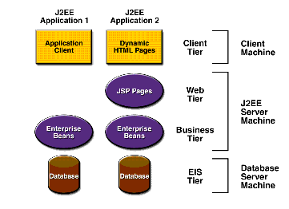
Multitiered Applications
Figure 1-1

Slide 23
Distributed Multitiered Applications
Client-tier components run on the client machine.
Web-tier components run on the J2EE server.
Business-tier components run on the J2EE server.
Enterprise information system (EIS)-tier software runs on the EIS server

Slide 24
Three-tiered applications
Although a J2EE application can consist of the three or four tiers shown in Figure 1-1, J2EE multitiered applications are generally considered to be three-tiered applications ...

Slide 25
Three-tiered applications
... because they are distributed over three different locations: client machines, the J2EE server machine, and the database or legacy machines at the back end.

Slide 26
Three-tiered applications
Three-tiered applications that run in this way extend the standard two-tiered client and server model by placing a multithreaded application server between the client application and back-end storage.

Slide 27
3. J2EE Components
J2EE applications are made up of components.
A J2EE component is a self-contained functional software unit that is assembled into a J2EE application with its related classes and files and that communicates with other components.

Slide 28
J2EE Components
The J2EE specification defines the following J2EE components:
Application clients and applets are components that run on the client.
Java Servlet and JavaServer Pages (JSP ) technology components are Web components that run on the server.
Enterprise JavaBeans (EJB ) components (enterprise beans) are business components that run on the server.

Slide 29
J2EE Components
J2EE components are written in the Java programming language and are compiled in the same way as any program in the language.

Slide 30
J2EE Components
The difference between J2EE components and "standard" Java classes is that J2EE components are assembled into a J2EE application, verified to be well formed and in compliance with the J2EE specification, and deployed to production, where they are run and managed by the J2EE server.

Slide 31
J2EE Components
... verified to be well formed and in compliance with the J2EE specification, and deployed to production, where they are run and managed by the J2EE server.

Slide 32
J2EE Clients
A J2EE client can be a Web client or an application client.

Slide 33
Web Clients
A Web client consists of two parts: dynamic Web pages containing various types of markup language (HTML, XML, and so on), which are generated by Web components running in the Web tier, and a Web browser, which renders the pages received from the server.

Slide 34
Web Clients
A Web client is sometimes called a thin client.
Thin clients usually do not do things like query databases, execute complex business rules, or connect to legacy applications.

Slide 35
When you use a thin client, heavyweight operations like these are off-loaded to enterprise beans executing on the J2EE server where they can leverage the security, speed, services, and reliability of J2EE server-side technologies.

Slide 36
Application Clients
A J2EE application client runs on a client machine and provides a way for users to handle tasks that require a richer user interface than can be provided by a markup language.

Slide 37
Application Clients
It typically has a graphical user interface (GUI) created from Swing or Abstract Window Toolkit (AWT) APIs, but a command-line interface is certainly possible.

Slide 38
Application Clients
Application clients directly access enterprise beans running in the business tier.
However, if application requirements warrant it, a J2EE application client can open an HTTP connection to establish communication with a servlet running in the Web tier.

Slide 39
Application Clients
However, if application requirements warrant it, a J2EE application client can open an HTTP connection to establish communication with a servlet running in the Web tier.

Slide 40
JavaBeans Component Architecture
The server and client tiers might also include components based on the JavaBeans component architecture (JavaBeans component) to manage the data flow between an application client

Slide 41
JavaBeans Component Architecture
... or applet and components running on the J2EE server or between server components and a database. JavaBeans components are not considered J2EE components by the J2EE specification.

Slide 42
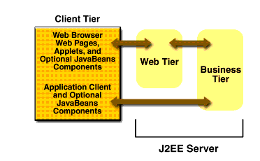
Server Communications

Slide 43
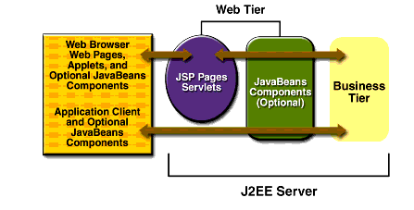
Web Tier and J2EE Applications

Slide 44
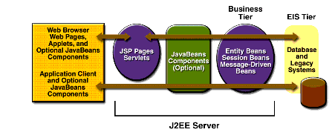
Business and EIS Tiers

Slide 45
Container Types
The deployment process installs J2EE application components in the J2EE containers illustrated in Figure 1-5.

Slide 46
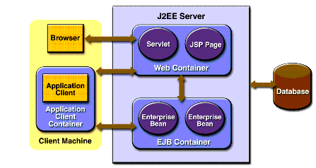
J2EE Server and Containers

Slide 47
Container Types
J2EE server
The runtime portion of a J2EE product. A J2EE server provides EJB and Web containers.

Slide 48
Container Types
Enterprise JavaBeans (EJB) container
Manages the execution of enterprise beans for J2EE applications.
Enterprise beans and their container run on the J2EE server.

Slide 49
Container Types
Web container
Manages the execution of JSP page and servlet components for J2EE applications.
Web components and their container run on the J2EE server.

Slide 50
Container Types
Application client container
Manages the execution of application client components.
Application clients and their container run on the client.

Slide 51
Container Types
Applet container
Manages the execution of applets. Consists of a Web browser and Java Plug-in running on the client together.

Slide 52
Packaging
A J2EE application is delivered in an Enterprise Archive (EAR) file.
An EAR file is a standard Java Archive (JAR) file with an .ear extension.
The EAR file contains J2EE modules.

Slide 53
EAR Files
Using EAR files and modules makes it possible to assemble a number of different J2EE applications using some of the same components.
No extra coding is needed; it is just a matter of assembling various J2EE modules into J2EE EAR files.

Slide 54
J2EE Module
A J2EE module consists of one or more J2EE components for the same container type and one component deployment descriptor of that type.

Slide 55
Deployment Descriptor
A deployment descriptor is an XML document with an .xml extension that describes a component's deployment settings.

Slide 56
An enterprise bean module deployment descriptor, for example, declares transaction attributes and security authorizations for an enterprise bean.

Slide 57
Because deployment descriptor information is declarative, it can be changed without modifying the bean source code.
At run time, the J2EE server reads the deployment descriptor and acts upon the component accordingly.

Slide 58
J2EE module
A J2EE module without an application deployment descriptor can be deployed as a stand-alone module.

Slide 59
Types of J2EE modules
The four types of J2EE modules are:
Enterprise JavaBeans modules contain class files for enterprise beans and an EJB deployment descriptor.
EJB modules are packaged as JAR files with a .jar extension.

Slide 60
Types of J2EE modules
Web modules contain JSP files, class files for servlets, GIF and HTML files, and a Web deployment descriptor.
Web modules are packaged as JAR files with a .war (Web ARchive) extension.

Slide 61
Types of J2EE modules
Resource adapter modules contain all Java interfaces, classes, native libraries, and other documentation, along with the resource adapter deployment descriptor.

Slide 62
Types of J2EE modules
Together, these implement the Connector architecture (see J2EE Connector Architecture) for a particular EIS.
Resource adapter modules are packages as JAR files with a .rar (Resource adapter ARchive) extension.

Slide 63
Types of J2EE modules
Application client modules contain class files and an application client deployment descriptor.
Application client modules are packaged as JAR files with a .jar extension.

