Slide 1
Struts 2.0

Slide 2
What is Struts?
Open Source java framework for creating web applications.
Action Based Framework
Create web application using MVC 2 architecture
Apache Struts offer two major version
    Struts 1.x
    Struts 2.0
Struts 2 = WebWork + Struts

Slide 3
What is a Web framework?
Web framework is a basic readymade underlying structure, where you have to just add components related to your business.
  For example, if you take struts, it comes with all jars you might need to develop basic request response cycle, and with basic configuration. It provides the controller servlet or filter which will read your request and convert it to integer or float etc according to your business requirements. If there is any exception while converting, you don’t have to deal with that. Framework deals with the problem and displays you exact message.
  After all conversion, the framework automatically populate all your data needed from form to the java object.
  You don’t have to write much code to validate all your form data. Frame work provides some basic automatic validations.
  After you write business logic, you don’t have to write code to dispatch request to another page. Etc
It forces the team to implement their code in a standard way. (helps debugging, fewer bugs etc).
  For Example, in struts immediate backend logic should be in action classes’s method. Action class functions intern can call other components to finish business logic.
Framework might also help you develop complex User Interface easily like iterating tables, the menu etc (provide some tag libraries )
Using frameworks like struts 2.0, one need not have to have deep knowledge of Http protocol and its request and responses interfaces to write business logic.

Slide 4
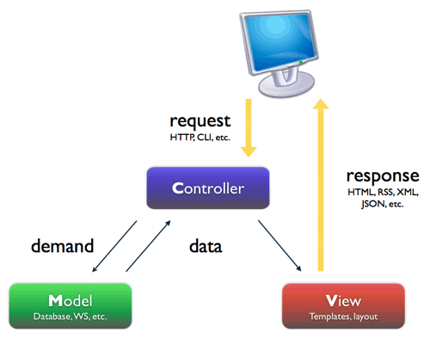
Stucture of JSP+Servlets+JavaBeans :Model 2 architecture
Servlet
JSP File
Java function

Slide 5
Why struts? What’s wrong with jsp/servlet coding?
Using only Servlets – difficult to output a html and needs lot of out.printlns – hard to read and clumsy
Using only JSP – added scriptlets and implicit objects into jsp - awkward to see java inside html– hard to read and maintain – useful if very small application
Using JSP+ Java beans – Code inside bean and jsp to display . Good choice for small applications. But what if there is need of multiple type of views? Eg: if there is need of different language display depending on client location? - making request to a general servlet, which outputs data according to the client locale, for same url request, will be good choice – Model 2 architecture evolved.
Using JSP+Servlets+JavaBeans → Model 2 architecture
Request made to servlet, servlet does business calculation using simple java POJO gets the result. Also decides the view and give back the response using the view to the client.
Here servlet called – Controller, Business calculation POJO called – Model and JSP called - View
Uses : the business logic is separated from JSPs and JSP gets displayed depending upon the result of model (the business function). → similar behavior like all applications above, but the code is more structured now. Changing business logic will not affect view and vice versa.
Struts 2.0 also uses Model 2 MVC pattern
Still the question remains: Why struts?

Slide 6
Why struts?
Free to develop & deploy –open source
Stable & Mature
Many supported third-party tools
Feature-rich
Flexible & Extendable
Large User Community, Expert Developers and Committers
Rich tag library (html, bean tags etc)
Easy to test and debug

Slide 7
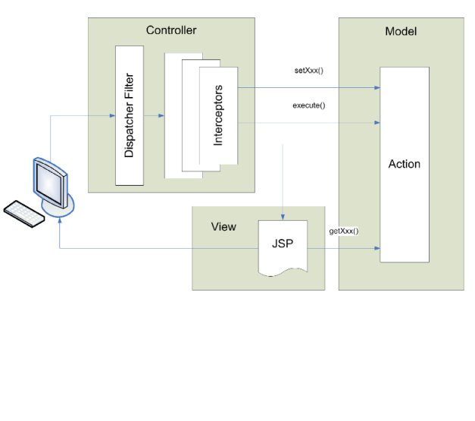
Struts 2.0
Complete new framework based on webwork framework.
Struts 2.0 implements MVC 2 design pattern.

Slide 8
How does struts make code simpler?
A Sample Jsp / sevrlet code:
your application might have to do following in you beans or in jsp to get a value of user input in double:
    Jsp file: <input name=“txtAmount”> </input>
    In Bean or Jsp file:
    String strAmount = request.getParameter(“txtAmount”);
    double amount = 0.0;
    try{
    double amount = Double.parseDouble(strAmount );
    }catch(Exception e){
    // got error so return back.
    // Big code for dispatching – also used in several places
    // return back to same page - hard coded
    }
    bean.setAmout(amount);
    boolean flgResult = ejbObject.processAmount(amount);;
    if(flgResult){
    // success
    // dispatch request to same or different page - hard coded
    }else{
    // dispatch request to same or different page - hard coded
    }

Slide 9
Using web framework like struts 2.0 it will look simpler
Jsp file:
<s:textfield label=“Amount" name=“amount" value="%{amount}" />
In action file you must have simple getter and setter:
double amount;
public double getAmount(){ return amount;}
public void setAmount(double amount){this.amount = amount;}
That’s it. You can directly use the amount in action method without get extra code:
public String execute() throws Exception{
// use amount directly
return “success”;
}
Also there is no need of extra code for forwarding request.Action method is just returning a string “success”

Slide 10
Struts Framework Features
Action based framework
Model 2 -MVC Implementation
Internationalization(I18N) Support
Rich JSP Tag Libraries
Annotation and XML configuration options
POJO-based actions that are easy to test
Based on JSP, Servlet, XML, and Java
Less xml configuration
Easy to test and debug with new features
Supports Java’s Write Once, Run Anywhere Philosophy
Supports different model implementations (JavaBeans, EJB, etc.)
Supports different presentation implementations( JSP, XML/XSLT, etc)

Slide 11
What are the pieces of struts?
The filter dispatcher, by which all the requests to the applications gets filtered. - Controller
The interceptors which called after filters, before action methods, apply common functionalities like validation, conversion etc
Action classes with execute methods, usually storing and/or retrieving information from a database the view,i.e the jsp files
Result will be figured out and the jsp file will be rendered.

Slide 12
Model Components
System State Beans
A set of one or more JavaBeans classes, whose properties define the current state of the system
Example: shopping cart
In a J2EE application a model is usually encapsulated as a layer of Session Façades

Slide 13
Struts 2.0 MVC Components
Controller:-
Filter Dispatcher:-
  First component that start processing that is why this type of MVC is called front controller MVC
  Looks at the request and apply the appropriate action.
  Struts framework handles all of the controller work.
  Its configured in web.xml
Interceptors:-
  Can execute code before and after an Action is executed.
  They can be configured per action basis.
  Can be used for data validation, file upload, double submit guards.

Slide 14
Struts 2.0 MVC Components contd.
Model:-
  Implemented by action class
  For model you can use any data access technologies like JDBC,EJB,Hibernate
View
  Its your result part. It can be JSP,JSTL,JSF etc.
  Presentation part of the MVC

Slide 15
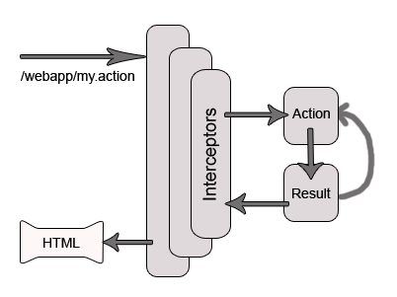
Request Lifecycle in Struts 2.0
User Sends Request
Filter Dispatcher determines the appropriate action
Interceptors are applied
Execution of action
Output Rendering
Return of Request
Display of result to user.

Slide 16
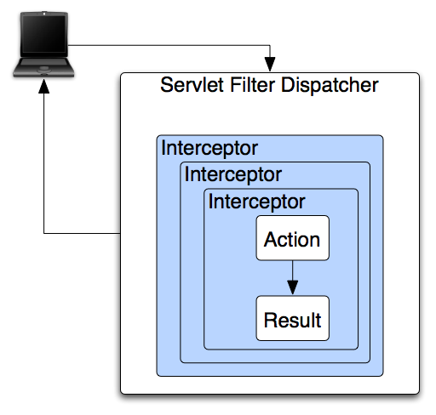
Struts 2.0 Architecture

Slide 17
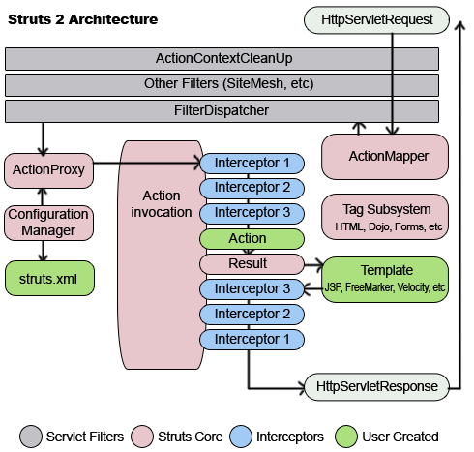
Struts 2.0 Architecture

Slide 18
Why we should use Struts 2.0?
Simplified Design
Simplified Action
Simplified Testability
Better tag features
Annotation introduced
Easy plug-in
AJAX Support

Slide 19
AJAX Support
AJAX client side validation
Remote form submission support (works with the submit tag as well)
An advanced div template that provides dynamic reloading of partial HTML
An advanced template that provides the ability to load and evaluate JavaScript remotely
An AJAX-only tabbed Panel implementation
A rich pub-sub event model
Interactive auto complete tag

Slide 20
Struts 1.x vs Struts 2.0
How Struts 1.x and Struts 2.0 differ from each other?
  Configuration
  Action Class
  Dependency injection.
  Servlet Dependency
  Validation
  Threading model
  Testability
  Expression Language

Slide 21
Struts 1
Action ⇒
ActionForm ⇒
ActionForward ⇒
struts-config.xml ⇒
ActionServlet ⇒
RequestProcessor ⇒
Struts 2
Action
Action or POJO’s
Result
struts.xml
FilterDispatcher
Interceptors

Slide 22


Slide 23
Action
Is a basic unit of work
POJO class which has execute method and properties
Action Mapping maps an identifier to Action class
Mapping also specifies
  Set of Result Types
  Set of Exception Handlers
  An Interceptor Stack

Slide 24
Example: Action Mapping
<action name="Logon" class="tutorial.Logon">
<result type="redirect- action">Menu</result>
<result name="input">/tutorial/Logon.jsp
</result>
</action>

Slide 25
Struts 2
<s:form action="Meeting" validate="true">
<s:token />
<s:textfield label=”Name” name=“name” />
<s:textfield label=”Date" name="date"/>
<s:select label=”Invitees” name="invitees" list="employees"/>
<s:textarea label=”Description” name="description"
rows="4" cols="50" />
<s:submit value=”Save" method="save"/>
</s:form>

Slide 26
Why Interceptors
Many Actions share common concerns.
  Example: Some Actions need input validated. Other Actions may need a file upload to be preprocessed. Another Action might need protection from a double submit. Many Actions need dropdown lists and other controls pre-populated before the page displays.
The framework makes it easy to share solutions to these concerns using an "Interceptor" strategy.

Slide 27
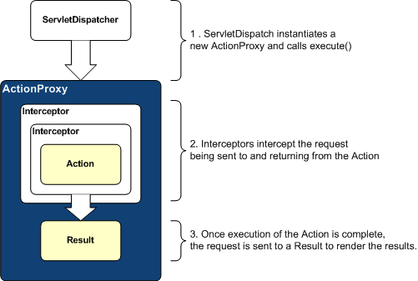

Interceptor in Action Life-cycle

Slide 28
Interceptors
Interceptors can execute code before and after an Action is invoked.
Most of the framework's core functionality is implemented as Interceptors.
  Features like double-submit guards, type conversion, object population, validation, file upload, page preparation, and more, are all implemented with the help of Interceptors.
Each and every Interceptor is pluggable

Slide 29
Configuring Interceptors
<package name="default" extends="struts-default">
<interceptors>
<interceptor name="timer" class=".."/>
<interceptor name="logger" class=".."/>
</interceptors>
<action name="login" class="tutorial.Login">
<interceptor-ref name="timer"/>
<interceptor-ref name="logger"/>
<result name="input">login.jsp</result>
<result name="success"
type="redirect-action">/secure/home</result>
</action>
</package>

Slide 30
Stacking Interceptors
<package name="default" extends="struts-default">
<interceptors>
<interceptor name="timer" class=".."/>
<interceptor name="logger" class=".."/>
<interceptor-stack name="myStack">
<interceptor-ref name="timer"/>
<interceptor-ref name="logger"/>
</interceptor-stack>
</interceptors>
<action name="login" class="tutuorial.Login">
<interceptor-ref name="myStack"/>
<result name="input">login.jsp</result>
<result name="success"
type="redirect-action">/secure/home</result>
</action>
</package>

Slide 31
Framework Interceptor
Struts 2 framework provides an extensive set of ready-to-use interceptors
  Parameter interceptor: Sets the request parameters onto the Action.
  Scope interceptor: Simple mechanism for storing Action state in the session or application scope.
  Validation interceptor: Performs validation using the validators defined in action-validation.xml
  Many more
Configured in struts-default.xml

Slide 32
Available Interceptors
exception
modelDriven
params
prepare
validation
workflow
fileUpload
checkbox
profiling
roles
servletConfig
token

Slide 33
Result
When an Action class method completes, it returns a String.
  The value of the String is used to select a result element.
  An action mapping will often have a set of results representing different possible outcomes.
There are predefined result names (tokens)
Applications can define other result names (tokens) to match specific cases.

Slide 34
Pre-defined result names (tokens)
String SUCCESS = "success";
String NONE = "none";
String ERROR = "error";
String INPUT = "input";
String LOGIN = "login";

Slide 35
Result Element
Provides a logical name (with name attribute)
  An Action can pass back a token like "success" or "error" without knowing any other implementation details.
  If the name attribute is not specified, the framework will give it the name "success".
Provides a Result Type (with type attribute)
  Most results simply forward to a server page or template, but other Result Types can be used to do more interesting things.
  If a type attribute is not specified, the framework will use the dispatcher

Slide 36
Example: Multiple Results
<action name="Hello">
<result>/hello/Result.jsp</result> <!-- name=”success” -->
<result name="error">/hello/Error.jsp</result>
<result name="input">/hello/Input.jsp</result>
</action>

Slide 37
Predefined Result Types
dispatcher
freemarker
velocity
xslt
plainText
chain
httpheader
redirect
redirectAction
stream

Slide 38
Example: Global Result
<global-results>
<result name="error">/Error.jsp</result>
<result name="invalid.token">/Error.jsp</result>
<result name="login" type="redirect-action">Logon</result>
</global-results>

Slide 39
Built in validators
<validators>
<validator name="required" class=".."/>
<validator name="requiredstring" class=".."/>
<validator name="int" class=".."/>
<validator name="double" class=".."/>
<validator name="date" class=".."/>
<validator name="expression" class=".."/>
<validator name="fieldexpression" class=".."/>
<validator name="email" class=".."/>
<validator name="url" class=".."/>
<validator name="visitor" class=".."/>
<validator name="conversion" class="../>
<validator name="stringlength" class=".."/>
<validator name="regex" class=".."/>
</validators>

Slide 40
Defining Validation Rules
Per Action class:
  in a file named <ActionName>-validation.xml
Per Action alias:
  in a file named <ActionName-alias>-validation.xml
Inheritance hierarchy and interfaces implemented by Action class
  Searches up the inheritance tree of the action to find default validations for parent classes of the Action and interfaces implemented

Slide 41
Bundled Plugins
JSF plug-in
REST plug-in
Spring plug-in
Tiles plug-in
SiteGraph plug-in
Sitemesh plug-in
JasperReports plug-in
JFreeChart plug-in
Config Browser plug-in
Struts 1 plug-in

Slide 42

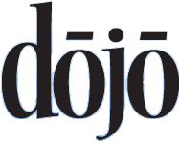








Struts Plugins

Slide 43
Struts 2 Tags
Generic Tags
  Control Tags
  Data Tags
UI Tags
  Form Tags
  Non-Form Tags

Slide 44
Control Tags
If
Elseif
Else
append
Generator
Iterator
Merge
Sort
subset

Slide 45
Data Tags
A
Action
bean
Date
Debug
I18n
Include
Param
Push
Set
Text
url
property

Slide 46
Form Tags
Autocomplete
Checkbox
Checkboxlist
Combobox
Datetimepicker
Doubleselect
Head
File
Form
hidden
Label
Optiontransferselect
Optiongroup
Password
Radio
Select
Submit
Textarea
Textfield
Token
updownselector

Slide 47
Form Helper Tags
Actionerror
actionMessage
Compact
Div
fieldError
Table
tabbedPanel
Tree
treenode

Slide 48
Example: Struts 2 Form
<s:actionerror/>
<s:form action="Profile_update" validate="true">
<s:textfield label="Username" name="username"/>
<s:password label="Password" name="password"/>
<s:password label="(Repeat) Password" name="password2"/>
<s:textfield label="Full Name" name="fullName"/>
<s:textfield label="From Address" name="fromAddress"/>
<s:textfield label="Reply To Address"
name="replyToAddress"/>
<s:submit value="Save" name="Save"/>
<s:submit action="Register_cancel" value="Cancel"
name="Cancel"
onclick="form.onsubmit=null"/>
</s:form>

Slide 49
View
Reusable user interface tags that allow for easy component-oriented development using themes and templates.
Bundled tags ranges from simple text fields to advanced tags like date pickers and tree views.
JSTL-compatible expression language (OGNL) that exposes properties on multiple objects as if they were a single JavaBean.
Pluggable Result Types that support multiple view technologies, including JSP, XSLT, FreeMarker,Velocity, PDF, and JasperReports.

Slide 50
Demo Application

