Slide 1
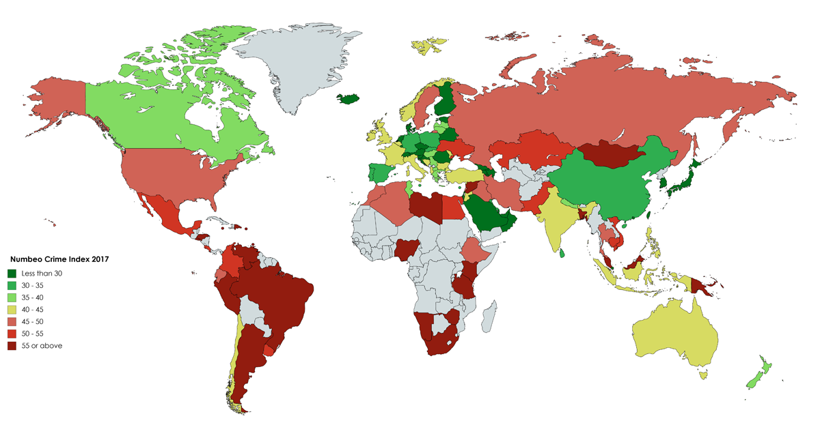
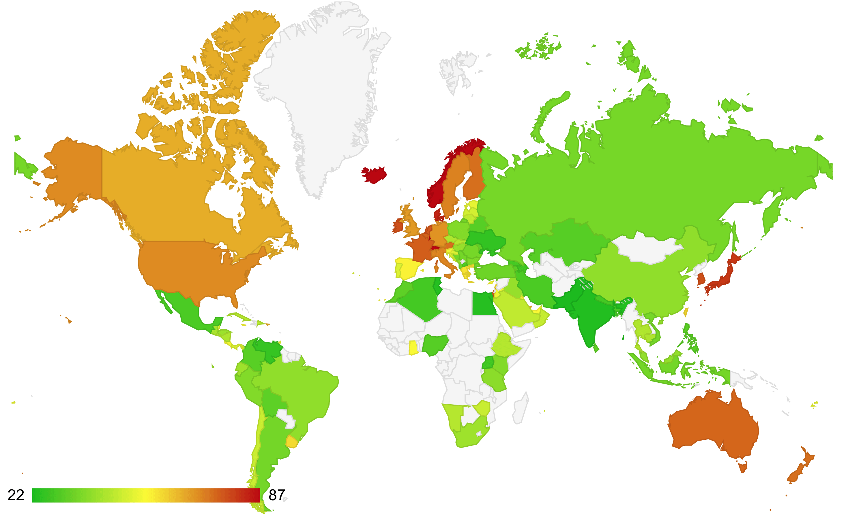
COST OF LIVING ANALYSIS
USING Power BI
- DHIVYA PRABHA

Slide 2
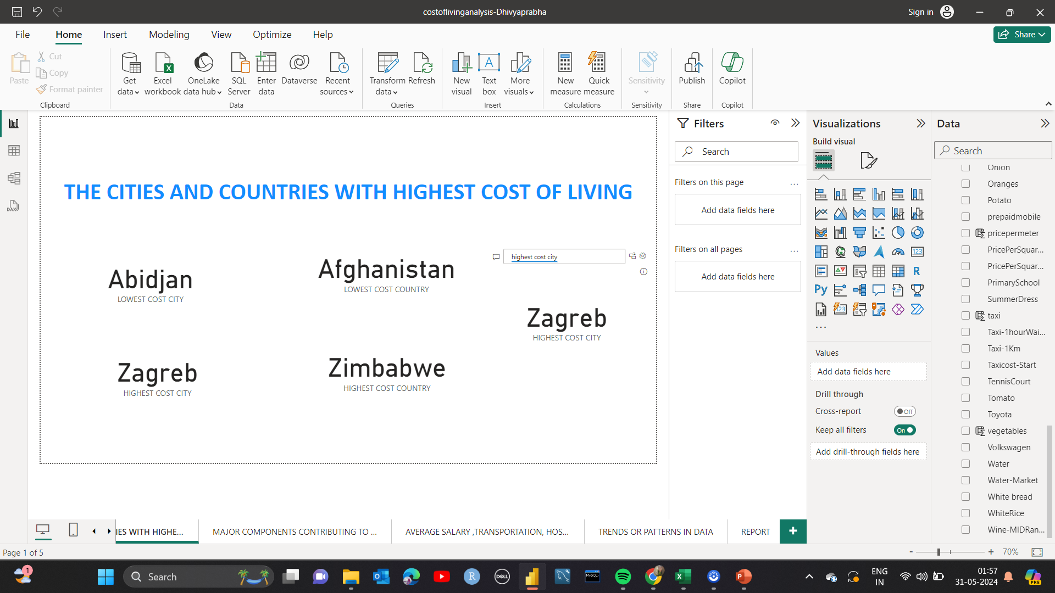
1. THE CITIES AND COUNTRIES WITH HIGHEST COST OF LIVING

Slide 3
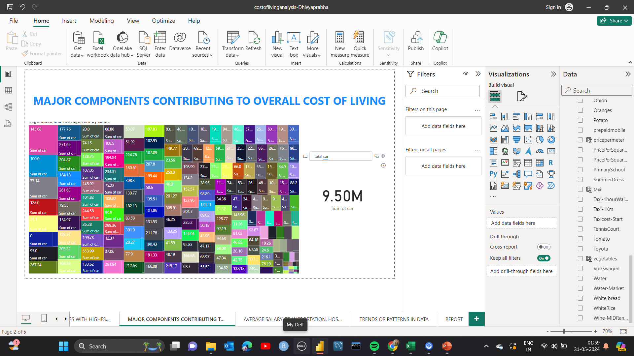
2. MAJOR COMPONENTS CONTRIBUTING TO OVERALL COST OF LIVING

Slide 4
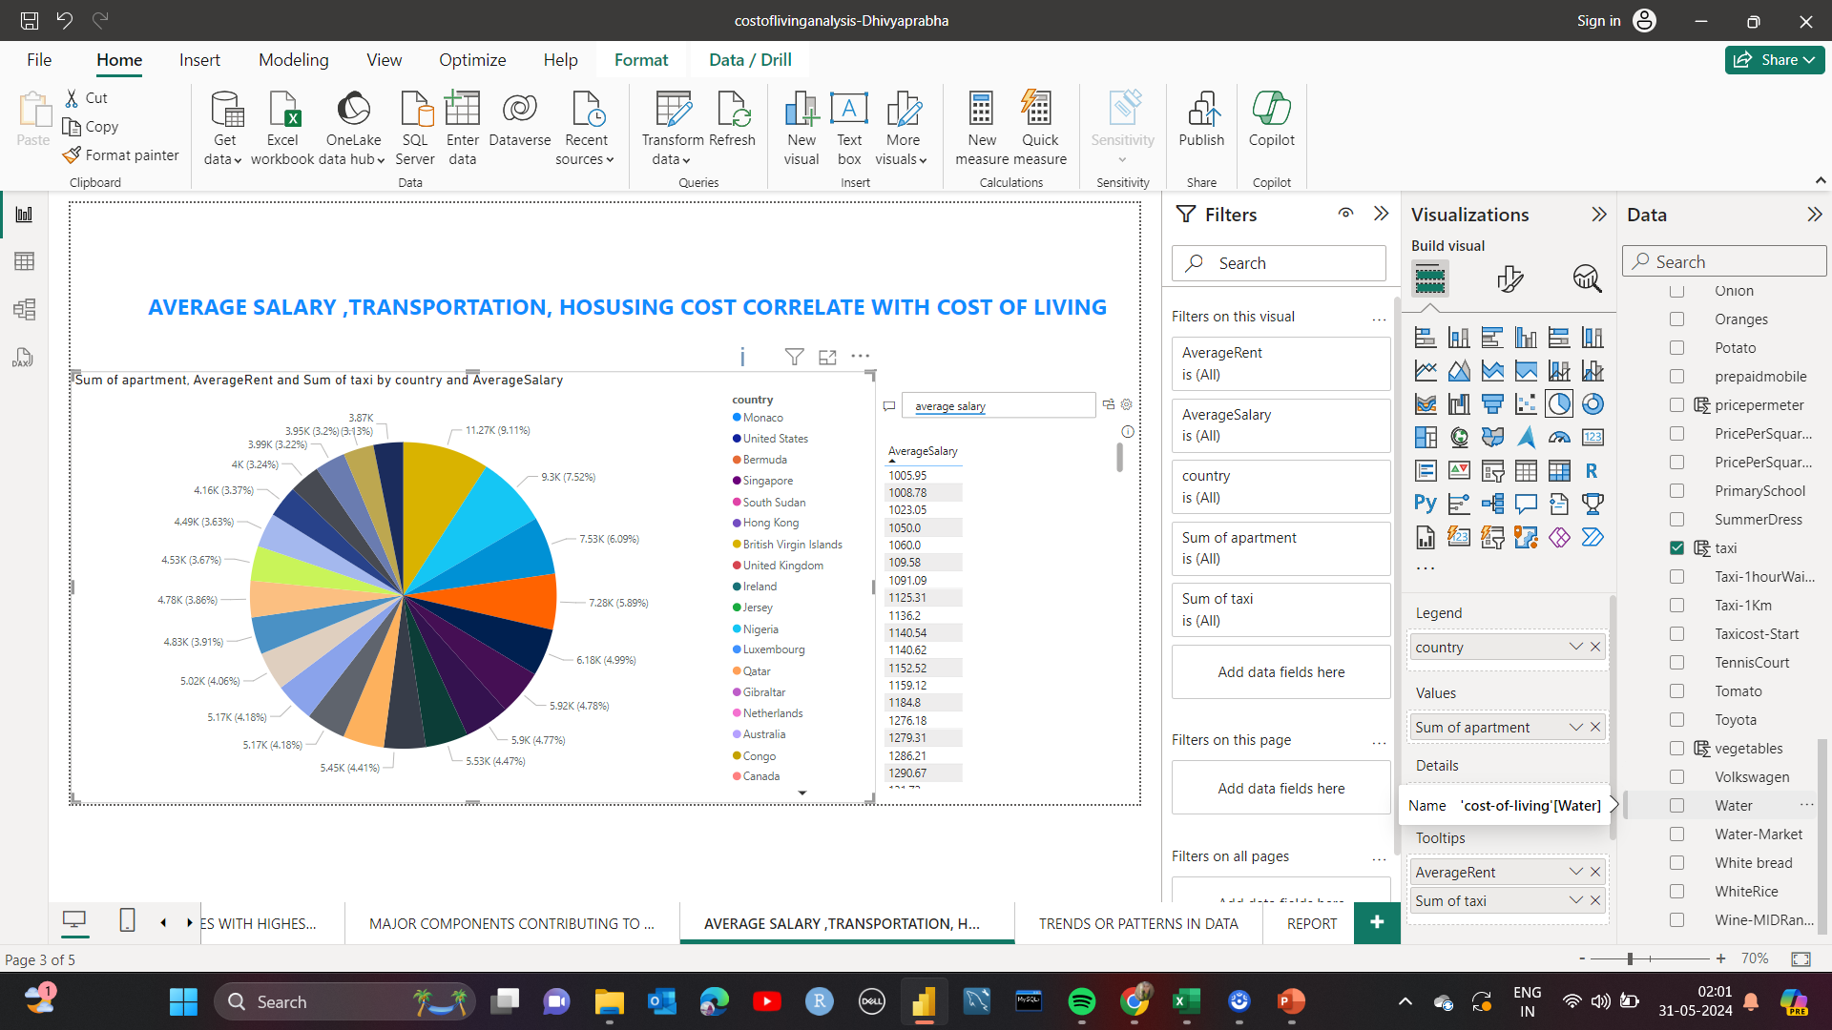
3.AVERAGE SALARY ,TRANSPORTATION, HOSUSING COST CORRELATE WITH COST OF LIVING

Slide 5
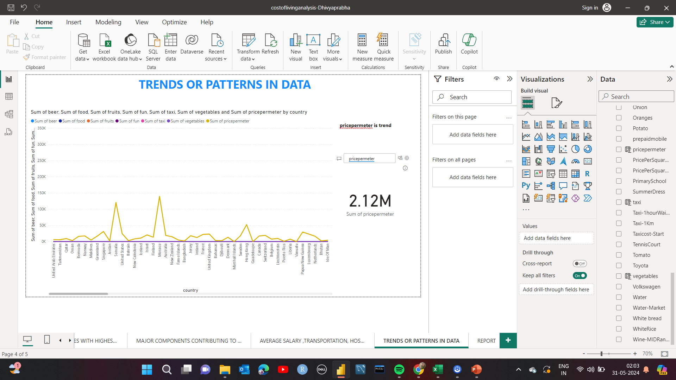
4.TRENDS OR PATTERNS IN DATA

Slide 6
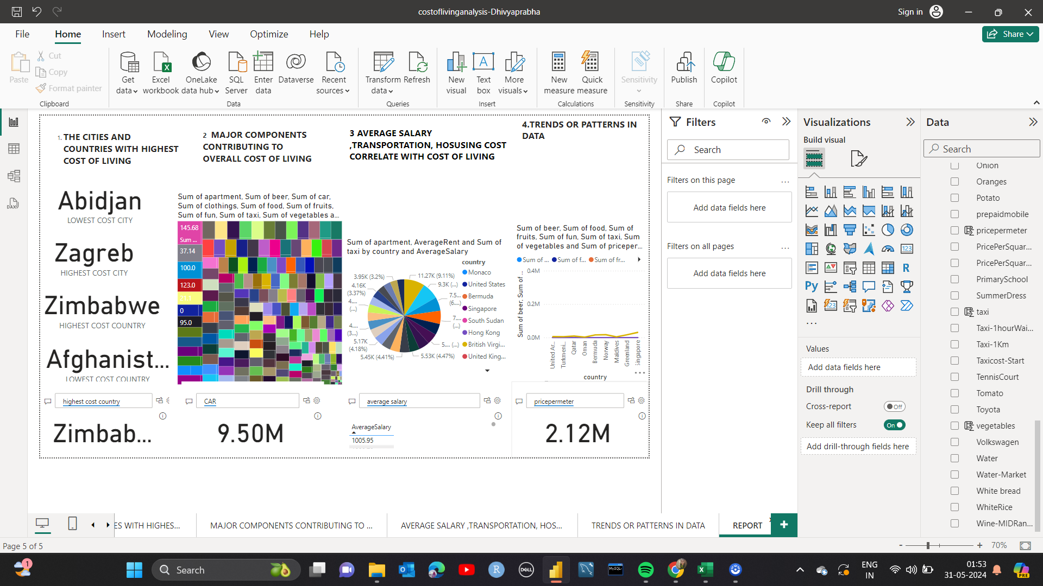
FINAL REPORT

