Slide 1



Smallest and largest elements in an array of n numbers (Presorting Problem)
NAME : DHIVYASHRI K K
ROLL NO : 23ITR037
DEPARTMENT : INFORMATION TECHNOLOGY
JAIHARI D (19ITR028)
PROJECT GUIDE : Ms. KAMALAM

Slide 2
Problem Description
Problem Description
Given an array of n real numbers
Find the smallest and largest elements in the array
Goal
Design a presorting-based algorithm
Compare with:
Brute-force approach
Presorting-based approach
Divide-and-conquer approach
Example
Input Array:8,3,15,2,9,20,18, 1, 15, 2, 9, 20
Output:
Largest = 20
Smallest= 1
2

Slide 3
Algorithm Design Technique
Technique Used:
Presorting-Based Algorithm:
Sorts the array before extracting the result.
By sorting, the smallest and largest elements can be directly accessed from the first and last positions.
Brute-Force Method :
Traverses the array linearly, comparing each element to track the minimum and maximum
Divide and Conquer Method:
Recursively divides the array into smaller segments, finds the min and max in each, and then merges the results.
Reduces the number of comparisons.

Slide 4
Appropriate Data Structure
Data Structures Used: Array
Direct Access: Enables quick retrieval of elements using indices (e.g., arr[0], arr[n-1] after sorting).
Simple and Efficient: Minimal overhead; ideal for linear scans and basic operations like comparisons.
Supports Multiple Techniques: Works well with brute-force, presorting, and divide-and-conquer approaches.

Slide 5
Input Size and Output
Input:
Input Format:
1.A array of n numbers
2.Each number is an integer or a real number.
Each interval: A pair of real numbers (a, b), where a < b
Example Input Size:
n = 6
Array = [12, 4, 56, 3, 89, 7]
Output Format:
Smallest Element = 3
Largest Element = 89

Slide 6
Order of Growth / Efficiency Class
Presorting Based Algorithm
Comparison-based sort (like MergeSort or QuickSort):
Recurrence Relation:T(n) = 2T(n/2) + O(n)
Time Complexity: O(nlogn)
Accessing arr[0] and arr[n-1] is
Time Complexity: O(1)
Efficient if array needs sorting anyway.
Step | Time Complexity | Space Complexity
Sorting | O(nlog⁡n) | O(n)or O(log⁡n)
Min/Max Extraction | O(1) | O(1)
Total | O(nlog⁡n) | O(n)

Slide 7
Order of Growth / Efficiency Class
Brute Force Approach
Traverse array once
Compare each element with current min and max.
Time Complexity: O(2n-1)
Simple but makes many comparisons
Efficiency Class:
Time Efficiency: O(n)
Space Efficiency: O(1)
Divide and Conquer – Algorithm Design
Divide array into two halves
Recursively find min and max in each half
Combine results with 2 comparisons
Recurrence Relation:
T(n) = T(n/2) + T(n/2) + 2
T(n) = 2T(n/2) + 2
Time Complexity: O(n)
Optimized for fewer comparisons.

Slide 8
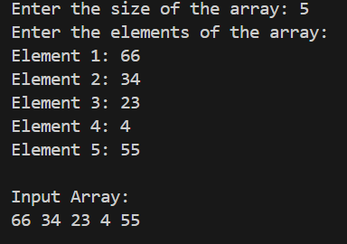
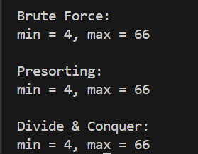
Sample input/Ouput
Input:
Output:

Slide 9
Thank you!

