Slide 1



QUANTIZATION-AWARE KOLMOGOROV-ARNOLD GRAPH NEURAL NETWORKS FOR MOLECULAR TOXICITY PREDICTION WITH EXPLAINABLE AI
PROJECT GUIDE :
DR.R.SHANTHAKUMARI
Associate Professor
Department of Information Technology
PROJECT MEMBERS :
HARSHIGA K (23ITR056)
HARISH V (23ITR055)

Slide 2
OBJECTIVES
predict chemical toxicity across 12 Tox21 biological endpoints covering nuclear receptor and stress-response pathways.
identify important molecular atoms and chemical bonds associated with toxicity-related biological activity.

Slide 3
INTRODUCTION
Tox21 enables molecular toxicity prediction across 12 biological endpoints.
Existing GNNs face challenges in class imbalance, complex features, interpretability, and efficiency.
EQ-KA-GCN combines GCN, Fourier-KAN, imbalance-aware learning, GNNExplainer, and quantization for accurate and efficient prediction.

Slide 4
LITERATURE REVIEW
TITLE | JOURNAL/CONFERENCE | METHADOLOGY | LIMITATIONS
KAN: Kolmogorov-Arnold Networks | arXiv / ICLR Workshop, 2024 | Replaces fixed weight matrices and static node activations in MLPs with learnable 1D spline activation functions placed directly on edges. | Original B-spline implementation suffers from high computational latency, memory overhead during grid updates, and lacks native integration with graph topologies.
Attentive FP: Pushing the Boundaries of Molecular Representation for Drug Discovery | Journal of Medicinal Chemistry, 2020 | Utilizes an edge-to-node graph attention mechanism with multi-hop message passing to learn chemical representations from 2D molecular graphs. | Relies on static MLP prediction heads, struggles with long-range macroscopic pharmacokinetic properties, and experiences degradation on rare bioassay endpoints.
Hybrid Graph and Fingerprint Architectures for Molecular Property Prediction | Journal of Cheminformatics, 2023 | Fuses 2D graph convolutional representations with classical circular Morgan fingerprints (ECFP) to capture both atom connectivity and substructure keys. | Uses simple vector concatenation without multi-scale pooling (mean/max/sum) or physical descriptor normalization, causing fingerprint dominance and feature redundancy..

Slide 5
TITLE | JOURNAL/CONFERENCE | METHADOLOGY | LIMITATIONS
Asymmetric Loss for Multi-Label Classification with Severe Class Imbalance | ICCV, 2021 | Employs asymmetric focusing exponents and probability margin discounting to suppress gradient noise from overwhelming negative classes. | Evaluated primarily on computer vision benchmarks; lacks task-specific gradient scaling required for sparse, multi-endpoint biochemical assay panels..
Degree-Aware Quantization-Aware Training for Graph Neural Networks | Entropy (MDPI), 2023 | Introduces degree-aware normalization with learnable quantization scaling factors for low-bit integer compression of graph convolutional networks | Performance drops significantly below 8-bit precision and does not account for mixed-precision allocation across hybrid non-graph feature channels.
GNNExplainer: Generating Explanations for Graph Neural Networks | NeurIPS, 2019 | Optimizes edge and node feature masks by maximizing mutual information to isolate critical subgraphs that govern model predictions.. | Produces undirected importance scores without isolating directional toxicophores (toxicity drivers vs. stabilizing scaffolds) and requires high optimization epochs.

Slide 6
TITLE | JOURNAL/CONFERENCE | METHADOLOGY | LIMITATIONS
Edge-Featured Graph Convolutional Networks for Molecular Bioactivity Prediction | Briefings in Bioinformatics, 2023 | Integrates chemical bond properties (conjugation, ring membership, and bond order) directly into graph convolutional message-passing updates. | High memory complexity during message passing limits edge deployment, and lacks integration with global continuous physicochemical descriptors...

Slide 7
SUMMARY
Molecular toxicity prediction evolved from traditional descriptors to graph-based representations with GNNs capturing atom–bond relationships more effectively.
Multitask and multimodal approaches enhanced prediction by sharing molecular information across endpoints and combining structural with chemical data.
Advanced architectures like KAN-based models and quantized GNNs improved flexibility, efficiency, and reduced computational demands.
Explainability methods highlighted critical atoms and bonds influencing toxicity predictions, aiding interpretability.
Existing studies explored these techniques separately, indicating the need for an integrated EQ‑KA‑GCN framework for multi-endpoint toxicity prediction.

Slide 8
PROBLEM STATEMENT
Molecular property prediction plays a crucial role in drug discovery and chemical research.
Traditional laboratory testing for molecular analysis is expensive, time-consuming, and requires significant resources.

Slide 9
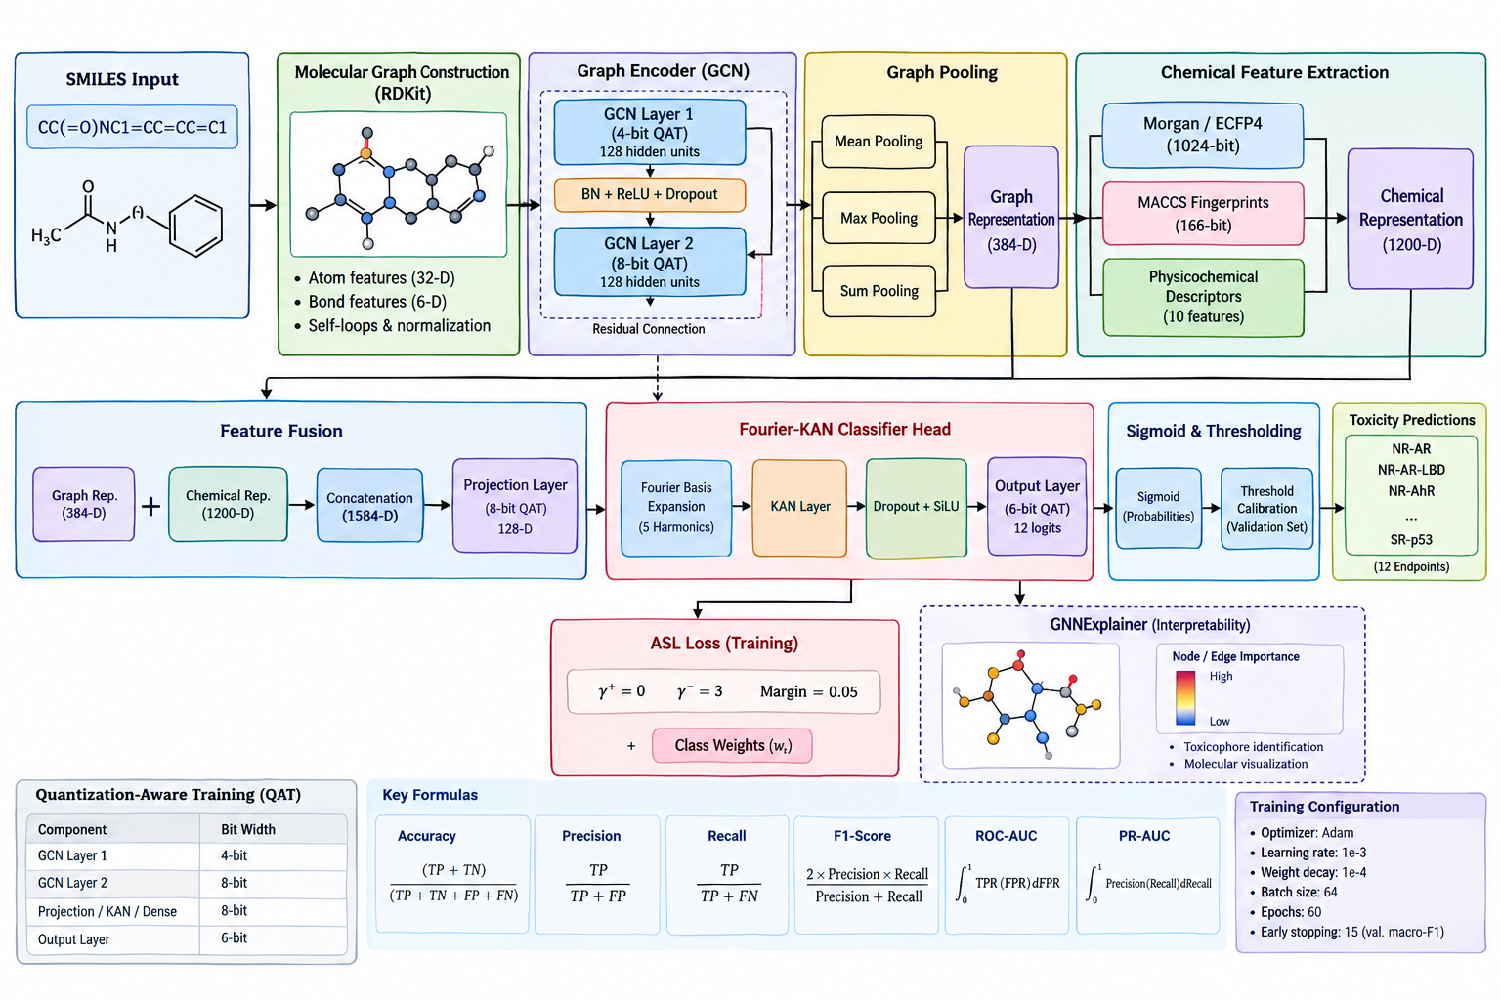
PROPOSED METHADOLOGY

Slide 10
SOFTWARE TOOLS
Programming Language : Python 3.11
Libraries :PyTorch, PyTorch Geometric (PyG), RDKit,Pandas ,Numpy,Scikit-learn,NetworkX, PyTorch AO Quantization,
Development Environment: Google Colab / Jupyter Notebook
Dataset :MoleculeNet – Tox21 Dataset
Version Control : GitHub

Slide 11
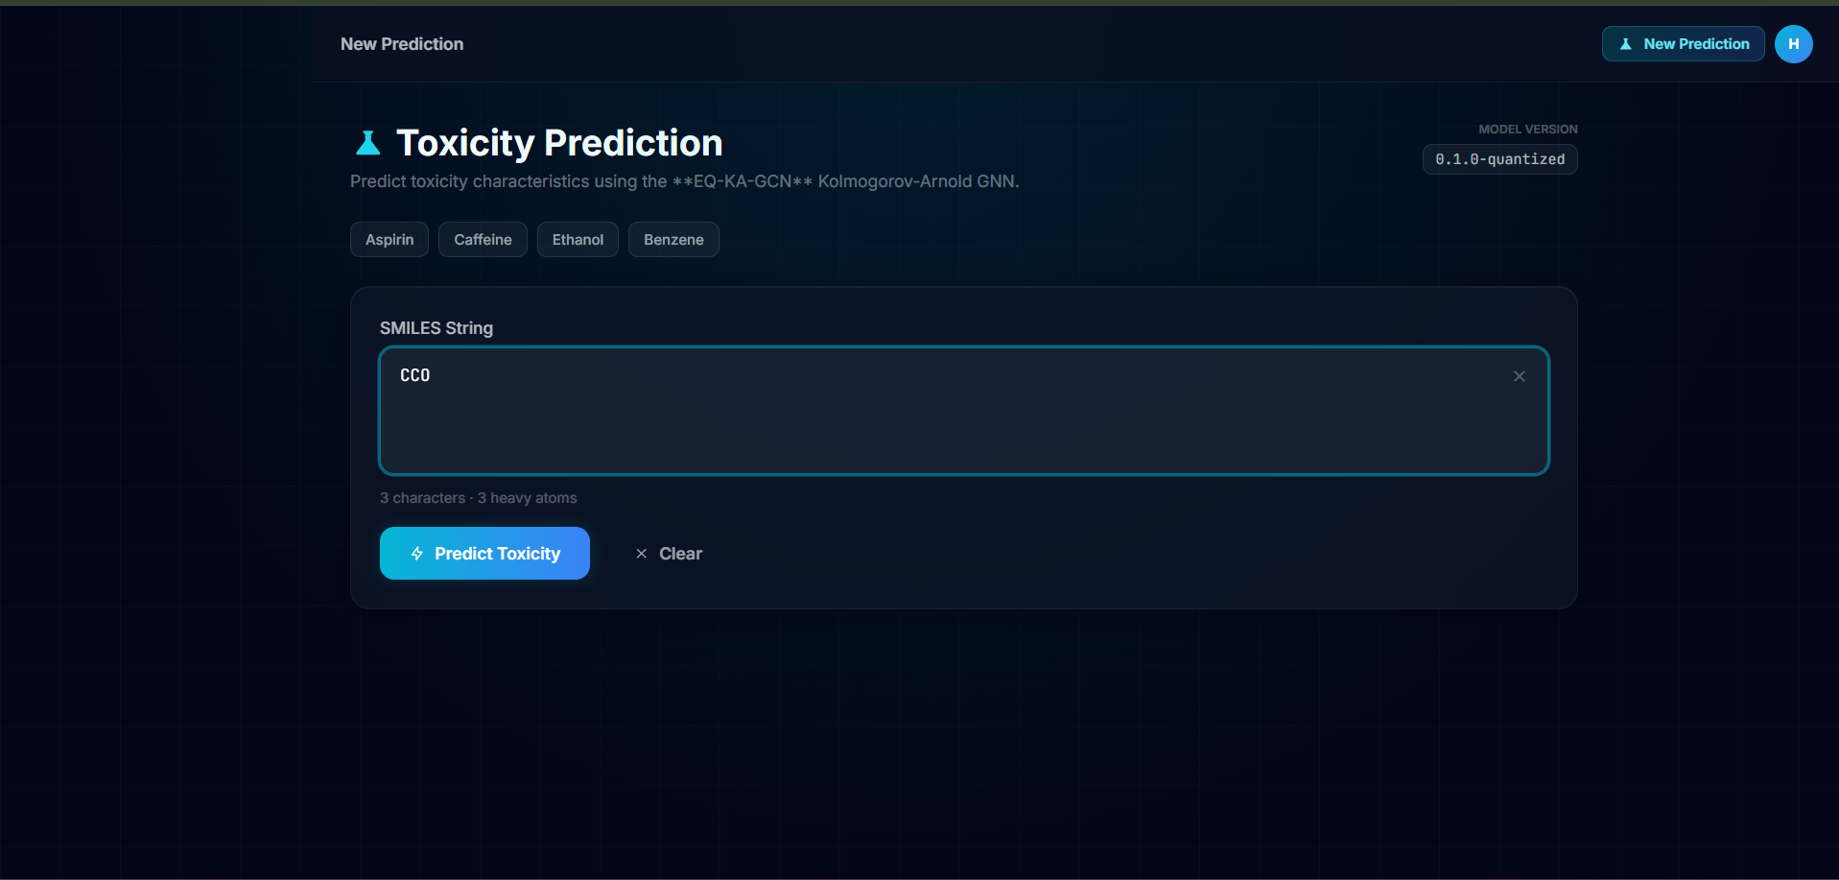
OUTPUT SCREENSHOTS

Slide 12
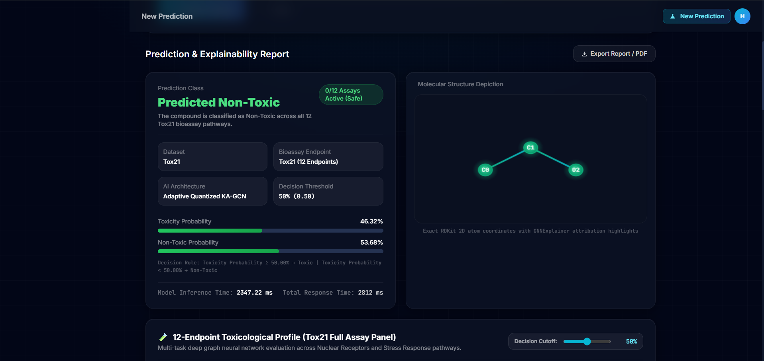

Slide 13
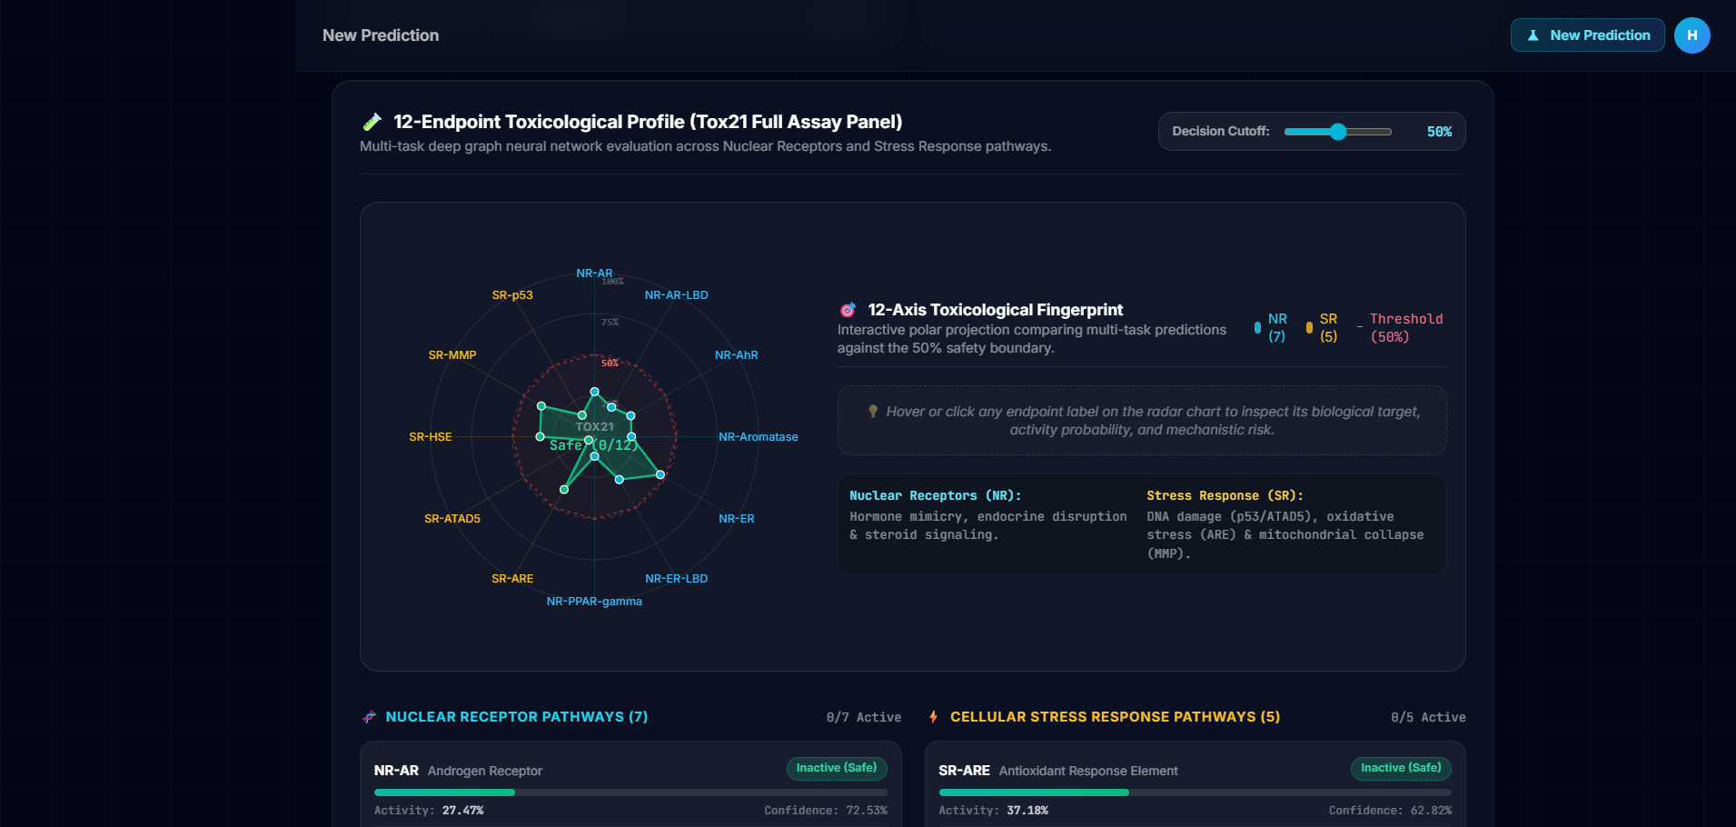

Slide 14
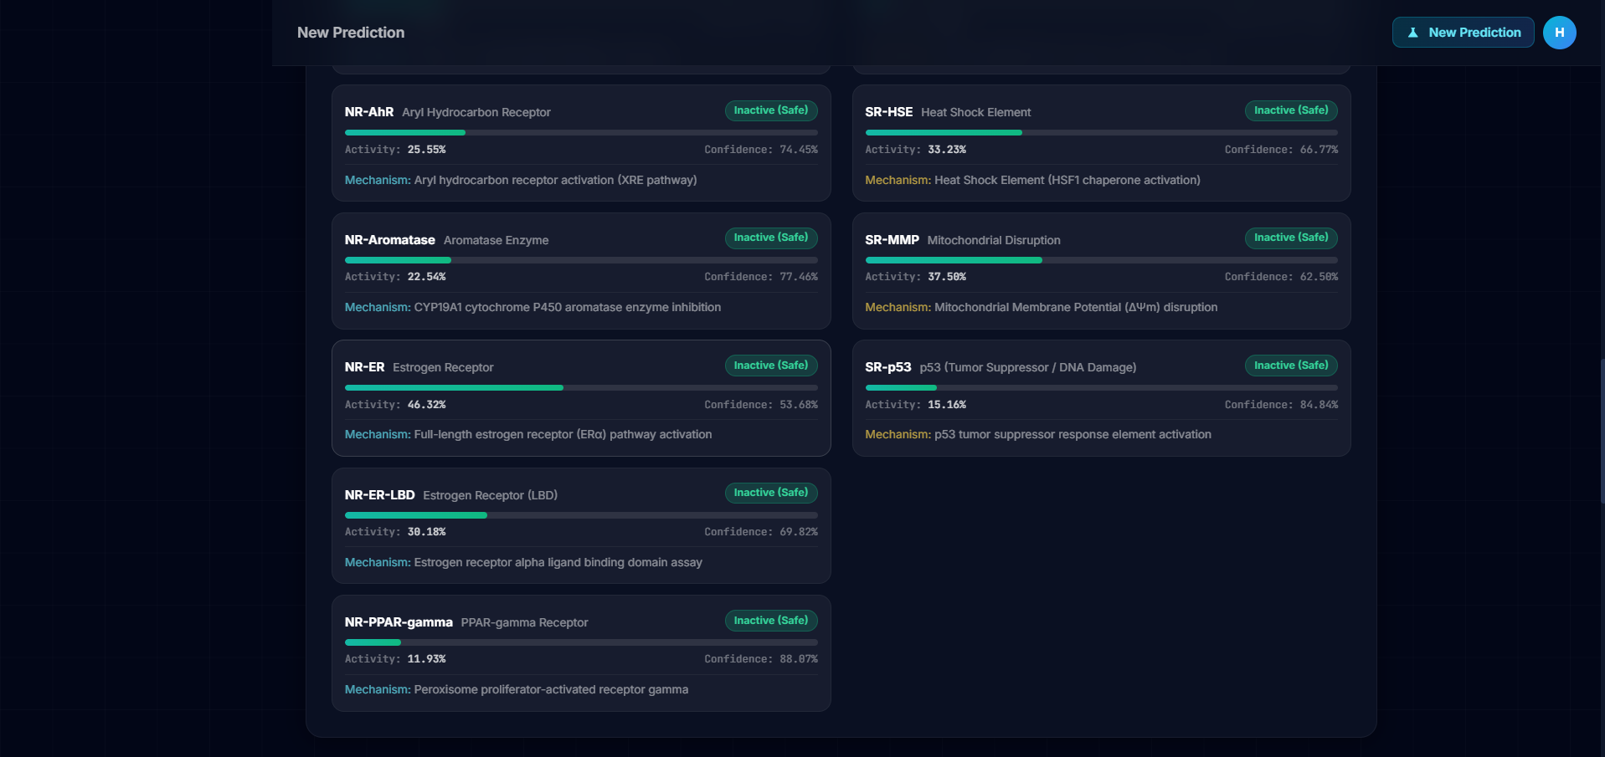

Slide 15
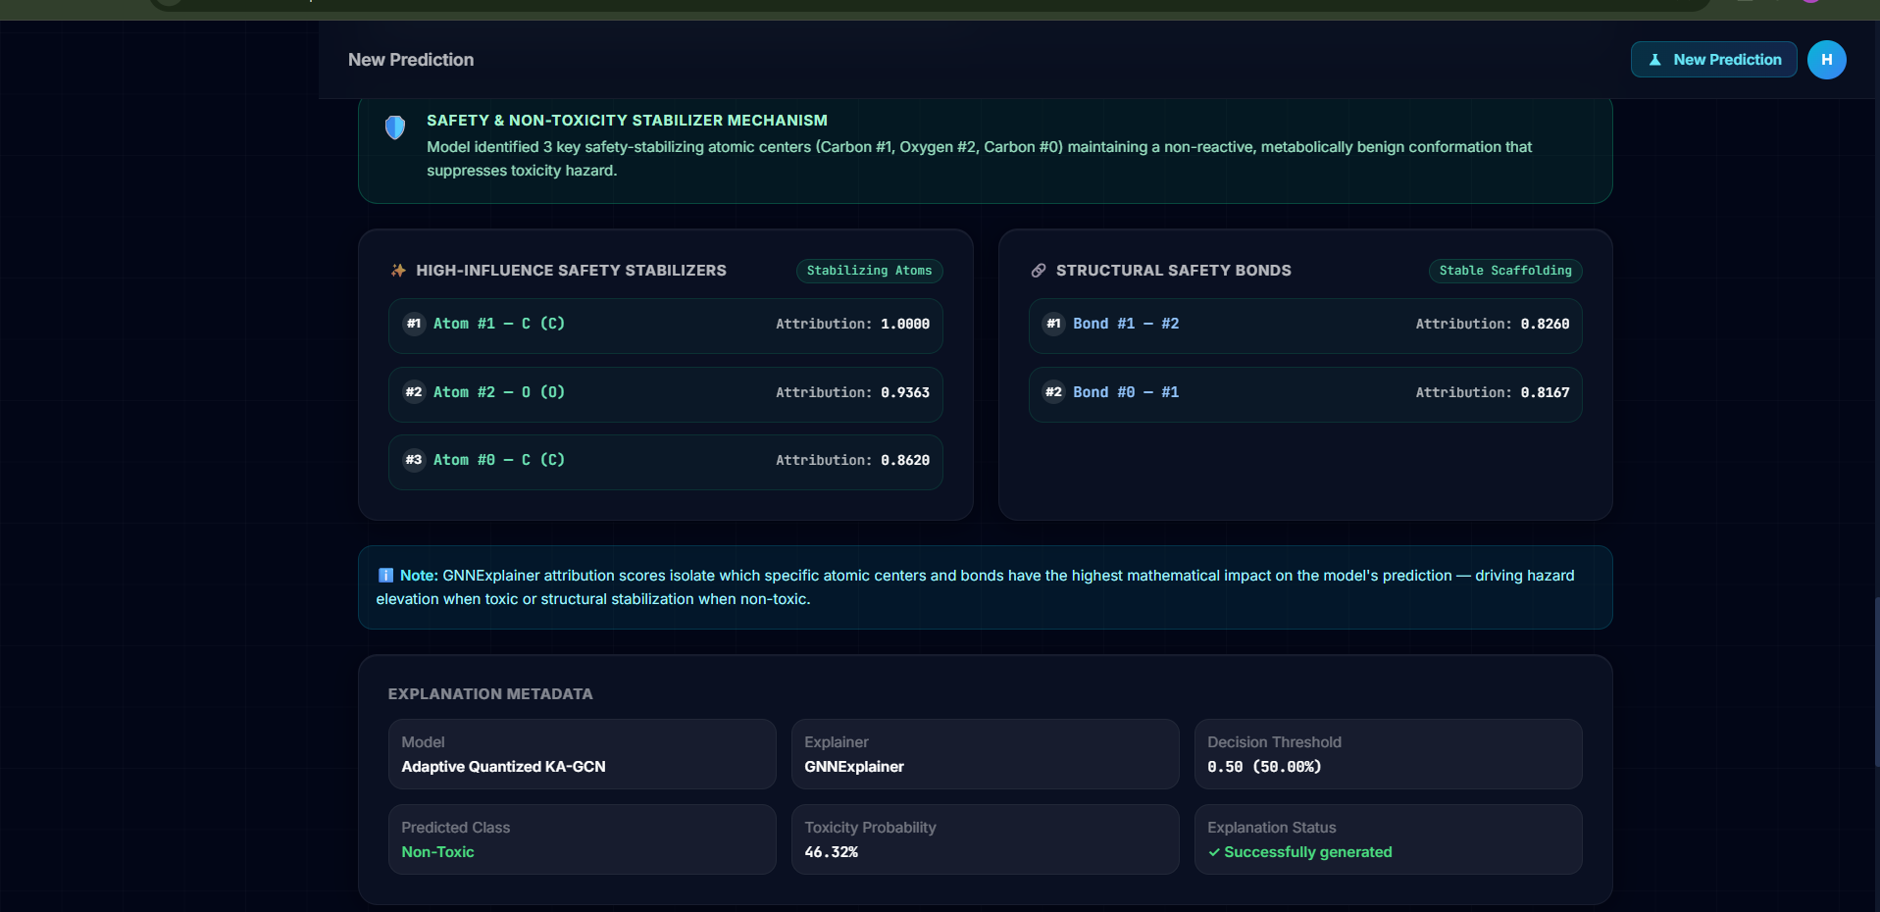

Slide 16
REFERENCES
[1] L. Li, Y. Zhang, G. Wang, and K. Xia, "Kolmogorov–Arnold graph neural networks for molecular property prediction," Nature Machine Intelligence, vol. 7, pp. 1346–1354, Aug. 2025. [Primary Base Paper]
[2] A. Rasool, J. U. Rahman, and R. Uwitije, "Enhancing molecular property prediction with quantized GNN models," Journal of Cheminformatics, vol. 17, no. 81, pp. 1–19, May 2025. [Primary Base Paper]
[3] T. Ridnik, E. Ben-Baruch, A. Zamir, A. Noy, and L. Zelnik-Manor, "Asymmetric Loss for Multi-Label Classification," in Proc. IEEE/CVF Int. Conf. Comput. Vis. (ICCV), 2021, pp. 82–91.
[4] Z. Ying, D. Bourgeois, J. You, M. Zitnik, and J. Leskovec, "GNNExplainer: Generating Explanations for Graph Neural Networks," in Adv. Neural Inf. Process. Syst. (NeurIPS), vol. 32, 2019, pp. 9240–9251.
[5] Z. Wu, B. Ramsundar, E. N. Feinberg, J. Gomes, C. Cao, and V. Pande, "MoleculeNet: a benchmark for molecular machine learning," Chemical Science, vol. 9, no. 2, pp. 513–530, 2018.

Slide 17
THANK YOU !

