Slide 1
PULSE AND OXYGEN SATURATION MONITORING SYSTEM USING ARDUINO
Presented by:
Dhivyasri S

Slide 2
INTRODUCTION :
The Pulse Monitoring System using the MAX30100 Pulse Oximeter sensor and Arduino Uno.
Designed to monitor a person's heart rate (BPM) and blood oxygen saturation levels (SpO2) in real-time.
The readings are displayed on a 16x2 I2C LCD screen and provide an efficient way to track vital health metrics at home or in clinical settings.

Slide 3
COMPONENTS:
Arduino Uno
MAX30100 Pulse Oximeter Sensor
16x2 LCD with I2C interface
9V HW Battery with Connector
Connecting Wires
Breadboard (optional)
USB Cable (for programming)

Slide 4
CONNECTIONS:
MAX30100:
- VIN to 3.3V on Arduino
- GND to GND
- SDA to A4
- SCL to A5
LCD I2C:
- VCC to 5V
- GND to GND
- SDA to A4
- SCL to A5
Power:
- 9V Battery via HW connector to Arduino barrel jack
- USB connection for programming and power (alternative)

Slide 5
WORKING PRINCIPLE:
The MAX30100 sensor uses infrared and red LEDs to detect pulse and oxygen levels in the blood.
The Arduino collects this data via I2C and calculates BPM and SpO2, displaying the result on the LCD.
A callback function detects each heartbeat and prints a message on the LCD

Slide 6
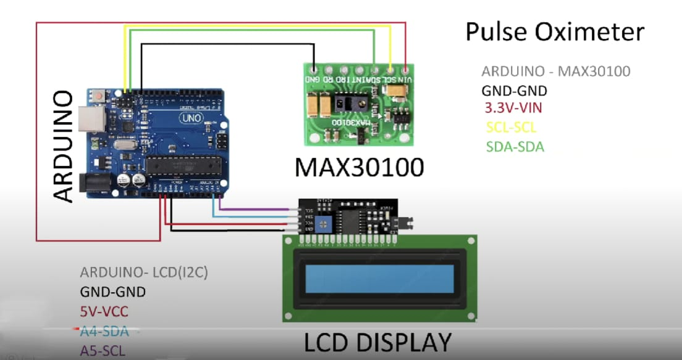
CIRCUIT DIAGRAM:

Slide 7
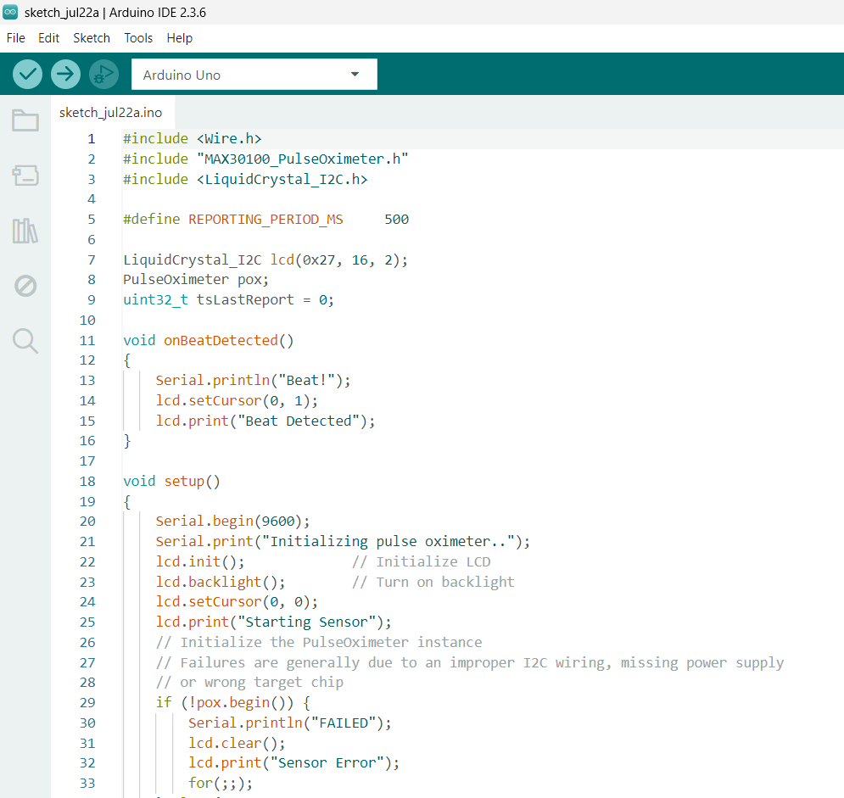
ARDUINO CODE:

Slide 8
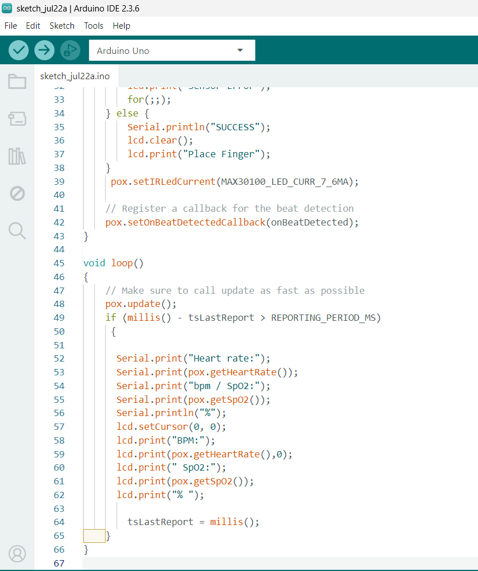

Slide 9
THANK YOU!
ANY QUESTIONS ?

