Slide 1

Intelligent Threat Detection in Cybersecurity Using Advanced Data Mining Techniques

Slide 2
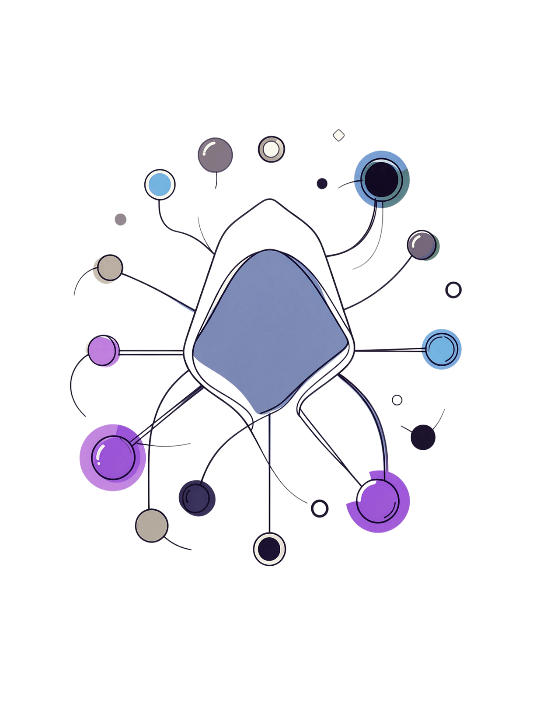
The Cybersecurity Challenge
Explosive Growth
Internet usage, cloud computing, and IoT devices have expanded dramatically — and cyber threats have scaled with them
Known Attacks Only
Traditional signature-based systems detect only previously catalogued attack patterns
Zero-Day Blind Spots
Novel exploits slip through undetected, leaving critical infrastructure exposed
Manual Overload
Log analysis by hand is slow, inconsistent, and error-prone at enterprise scale

Slide 3

Why Current Systems Fall Short
Signature-Based Detection
High False Positives
No Adaptive Intelligence
Alert fatigue overwhelms security teams with noise, causing critical signals to be missed
Rigid rule-based systems cannot learn or evolve in response to emerging threat vectors
Only catches known attack patterns — entirely blind to novel or polymorphic threats

Slide 4

What is the Problem?
Modern organizations face several cybersecurity challenges:
Millions of network events
are generated every day — far exceeding manual analysis capacity
Security analysts cannot manually inspect
every event, creating dangerous blind spots
Signature-based detection
only identifies previously known attacks, leaving zero-day exploits undetected
False alarms overwhelm
security teams, causing alert fatigue and missed critical signals
Delayed detection
leads to data breaches, financial loss, and service disruption
Problem Statement:
Develop an intelligent cybersecurity system that automatically detects malicious activities in network traffic using advanced data mining and machine learning techniques.

Slide 5

Our Solution: Intelligent Threat Detection
Reduce False Positives
Data Mining
Real-Time ML
By combining machine learning with data mining, this system moves beyond static rules to deliver adaptive, accurate, and scalable threat detection.

Slide 6
Core Objectives
1
2
This project targets four measurable outcomes that address the most pressing gaps in modern cybersecurity systems.
Automated Detection
Attack Classification
Detect cyber threats automatically with high accuracy, minimizing human intervention
Classify multiple attack categories including DDoS, intrusion, and malware
3
4
False Positive Reduction
Actionable Recommendations
Minimize noise so security teams focus on genuine threats
Deliver intelligent, context-aware guidance for security response

Slide 7
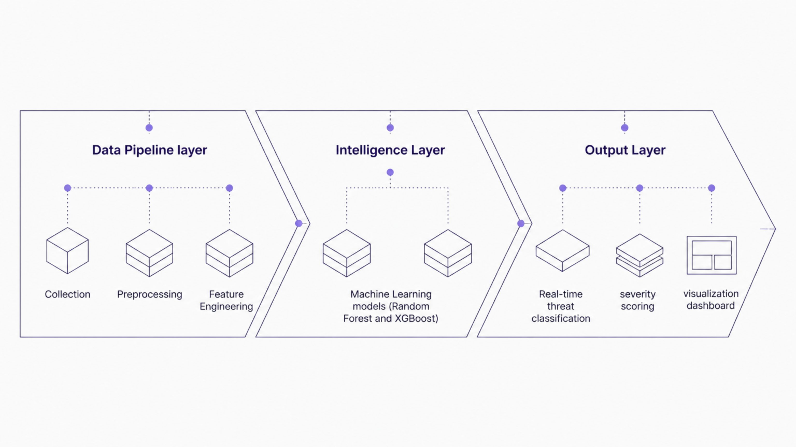
System Architecture
Each layer is modular and independently scalable — enabling incremental upgrades without disrupting the full pipeline.

Slide 8

Technology Stack
ML & Analysis
Backend
Scikit-learn, XGBoost, Pandas, NumPy
Python, Flask, SQLite
Frontend
HTML, CSS, Bootstrap, JavaScript, Plotly

Slide 9

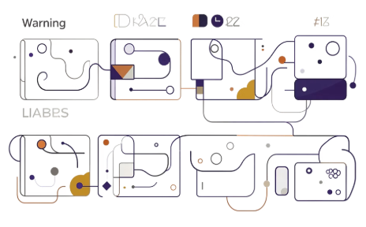


Expected Outcomes
High-Accuracy Detection
Attack Classification
Interactive Dashboard
Intelligent Recommendations
Automated categorization of attack types paired with severity assessment and priority scoring
Graphical analysis interface providing real-time visibility into system security posture
Threat detection with confidence scores quantifying model certainty for each classification
Context-aware guidance delivered directly to security teams for rapid, informed response

Slide 10
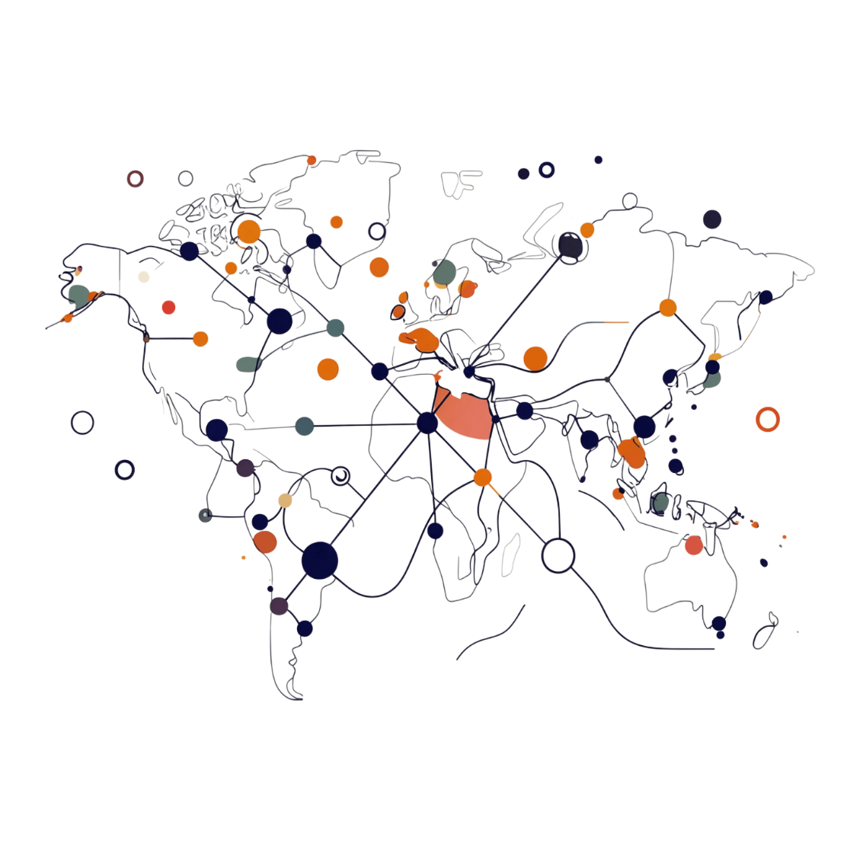
Why This Project Matters
Real-World Relevance
Addresses a critical, unsolved problem in enterprise and institutional cybersecurity
AI/ML Applied to Security
Demonstrates practical application of artificial intelligence in a high-stakes domain
Scalable Architecture
Designed for large-scale deployment across diverse organizational environments
Research Potential
High industrial relevance with clear pathways for continued academic investigation

Slide 11
Future Enhancements
Live Detection
Deep Learning & XAI
Real-time intrusion detection with live packet capture
Advanced deep learning models with explainable AI for audit-ready decisions
1
2
3
4
IoT & Cloud
SIEM & Mobile
Integration with IoT ecosystems and cloud security platforms
Integration with SIEM platforms and mobile monitoring interfaces

Slide 12

Thank You

