Slide 1


DIGITALIZATION OF SPORTS INFRASTRUCTURE
ABSTRACT:
Digitalization of the application process for the sports infrastructure under Khelo India scheme
PROBLEM STATEMENT:
The Khelo India Scheme provides for creation/upgradation of different categories of sports infrastructure on the basis of proposals received from the State/UT Governments and other eligible entities. The proposals consist of a detailed project report and other requisite documents as per the formats delineated in the Operational Guidelines of the Scheme. These proposals are screened before getting approved .

Slide 2
PROBLEMS FACED:
Time consuming
Lack of transparency
Huge paper work
Manual processing
EXISTING SOLUTIONS:
Solution exist only in pen and paper mode.it is not yet digitalized.
TARGET AUDIENCE:
The targeted audience are the ones who would require Utilisation and Creation / Upgradation of Sports Infrastructure.

Slide 3
IDEA FEASIBILITY :
The admin will view the data in terms of various available options.
Acknowledgement and the current status of the application.
The first round is screening to eliminate /reject non eligible candidates.
The previously sanctioned projects will be visible to the admin .
The fields are objective and quantifiable as possible.

Slide 4
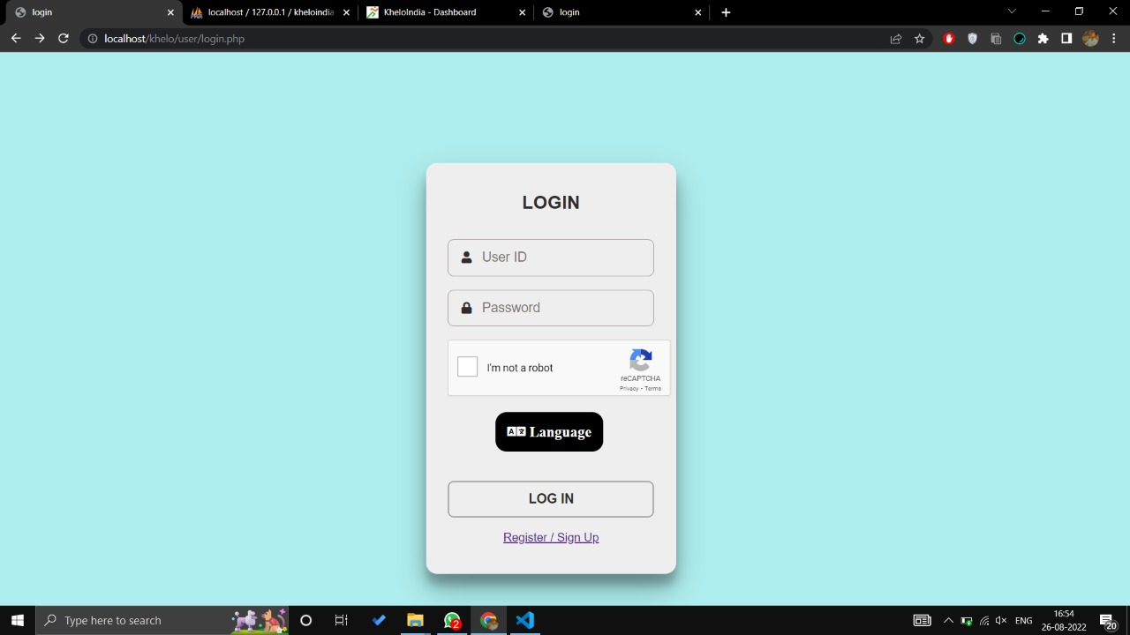
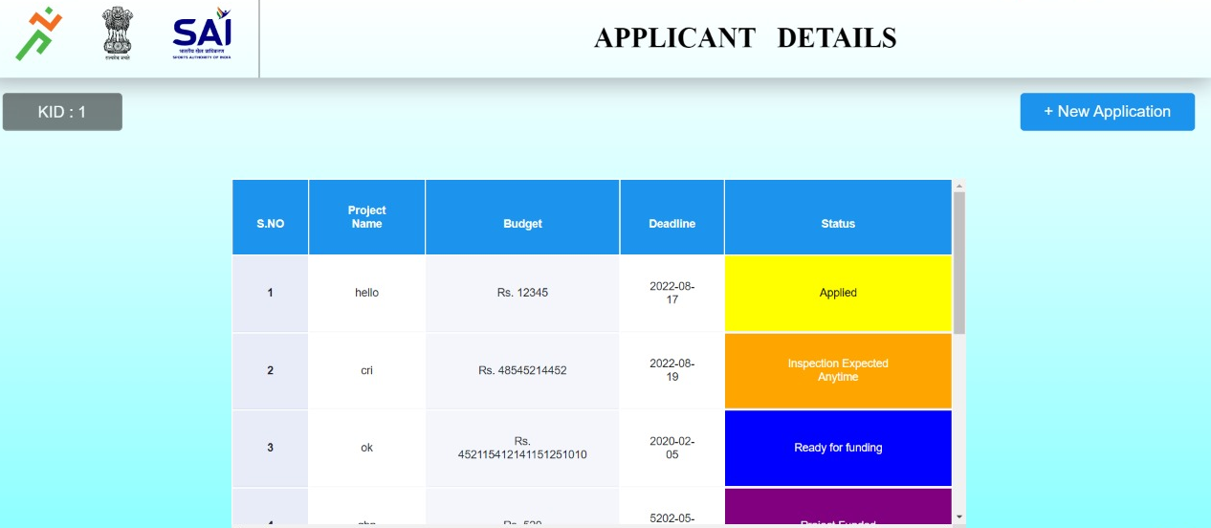
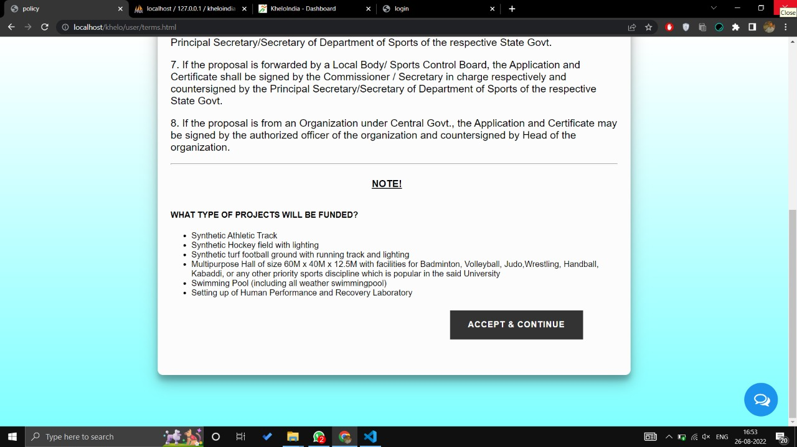
LOOK AND FEEL:

Slide 5
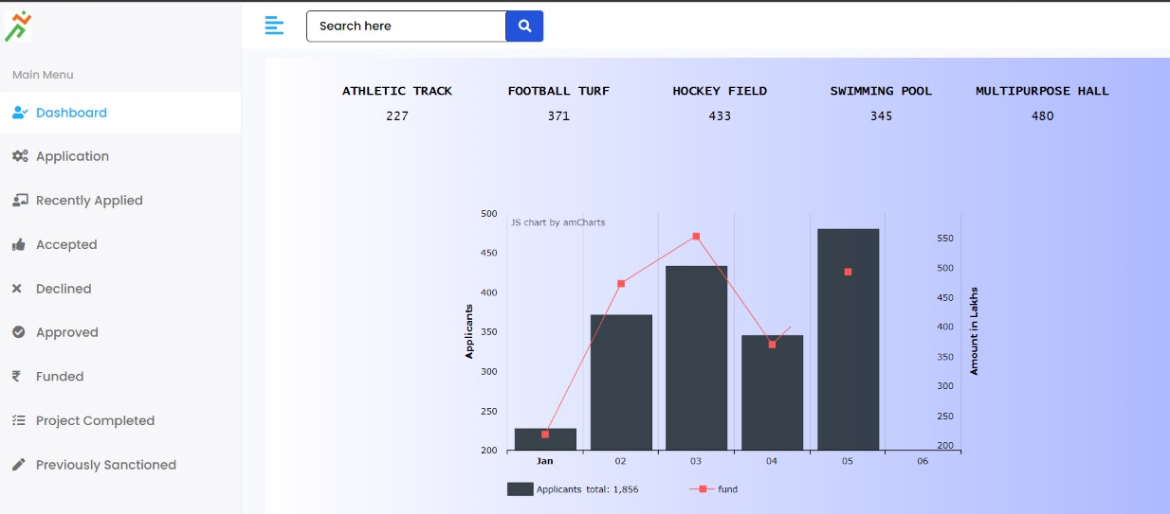
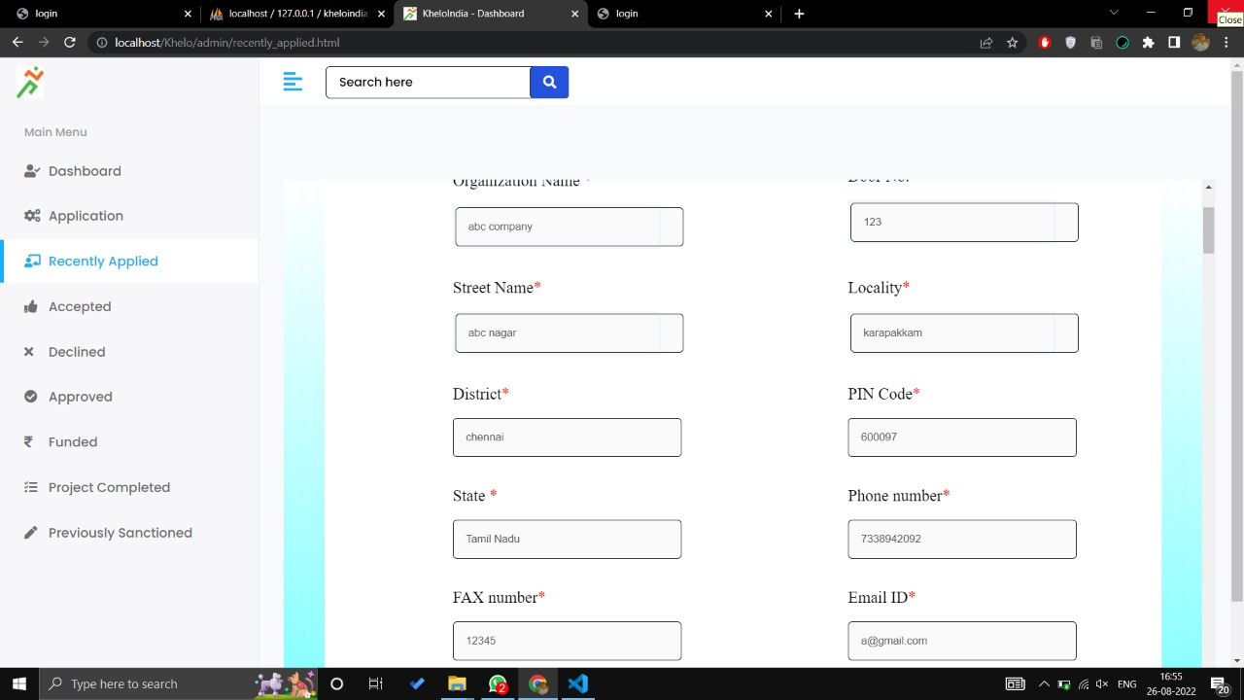

Slide 6
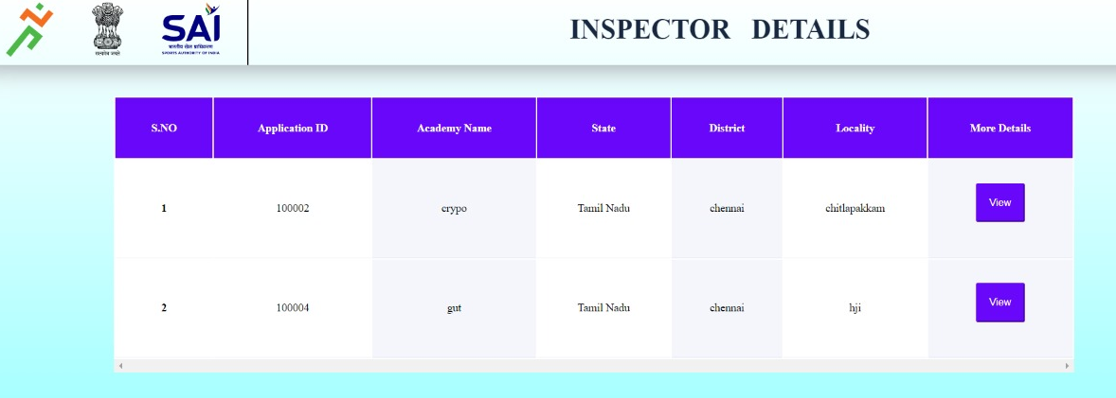
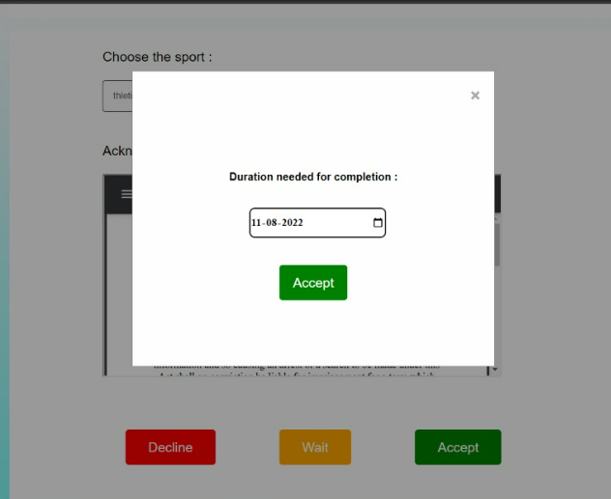

Slide 7
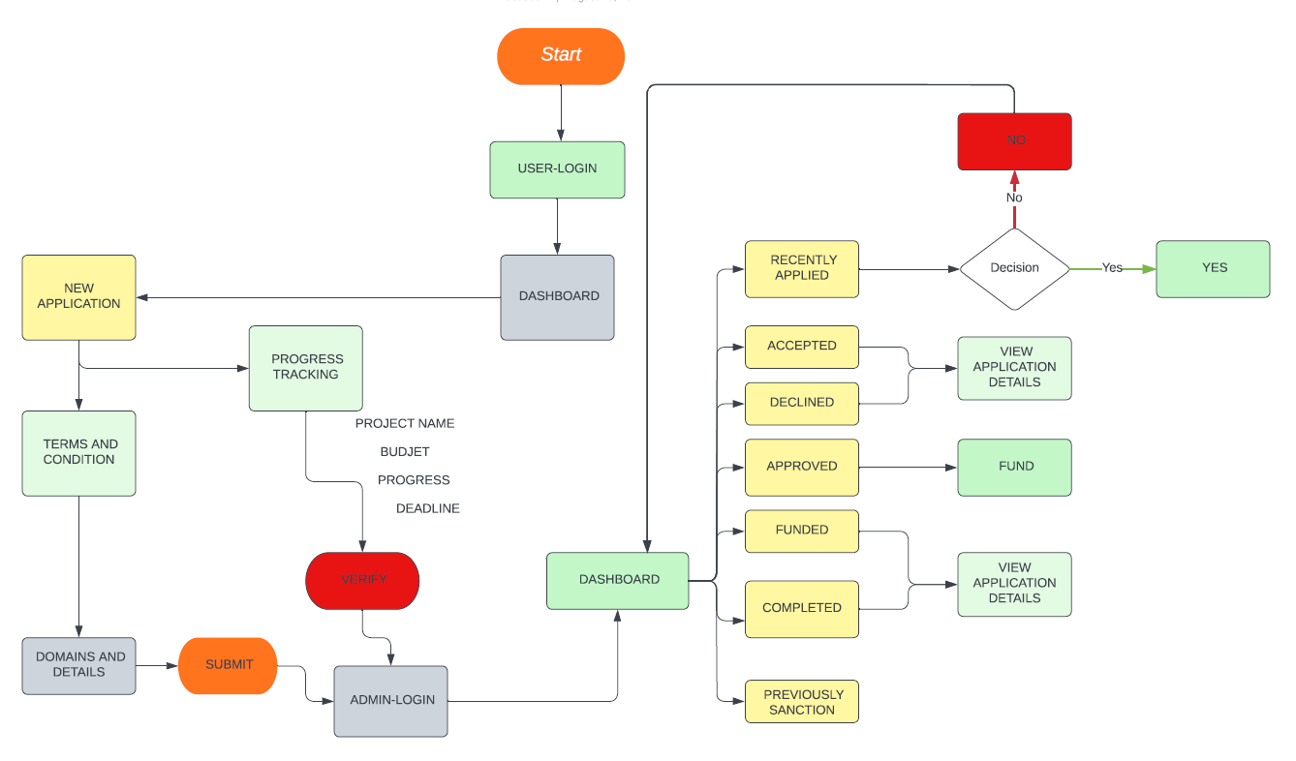
FLOW CHART: Admin &USER

Slide 8
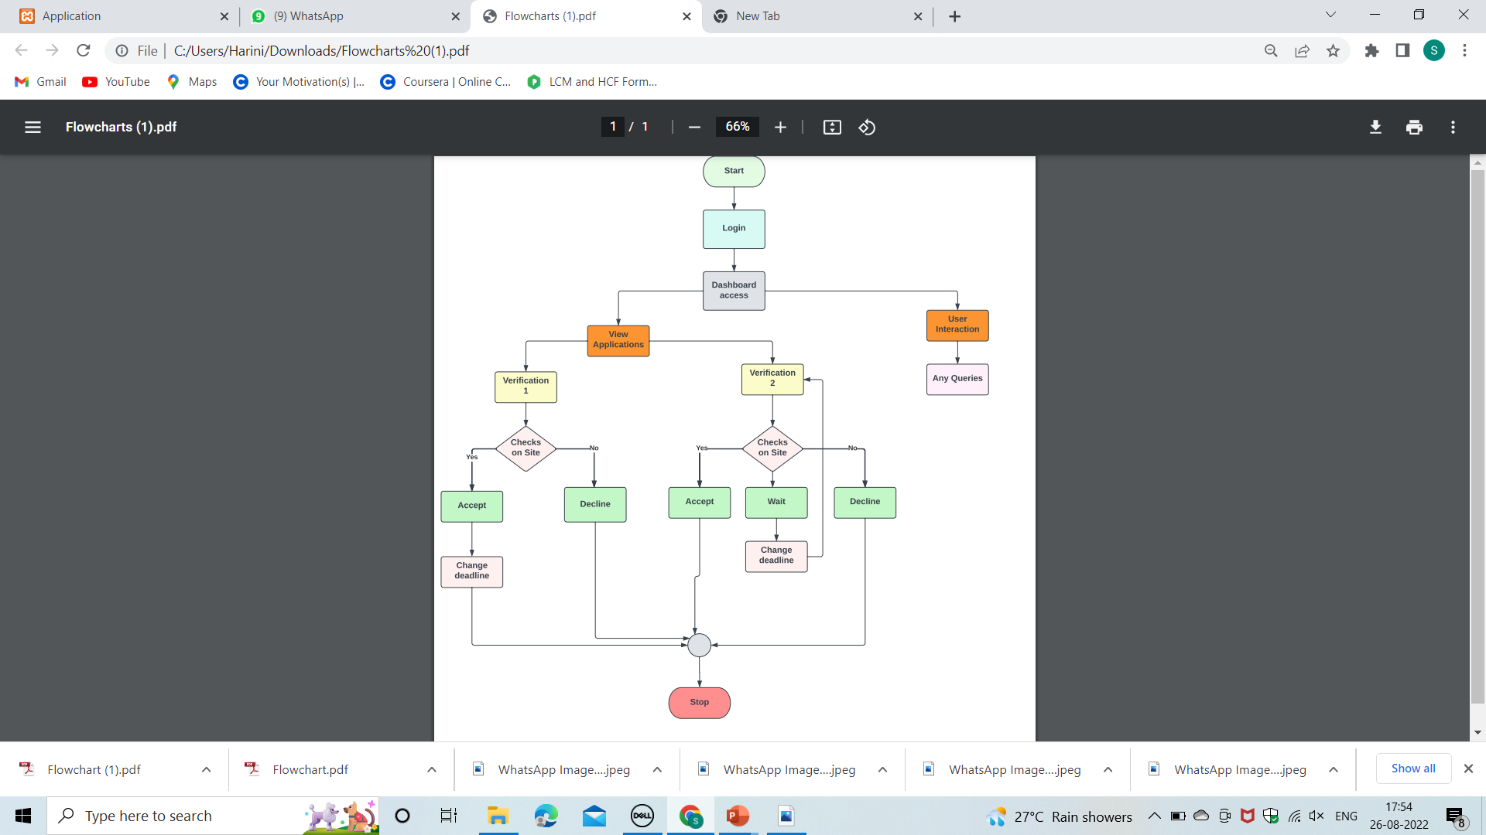
FLOWCHART : INSPECTOR PAGE

Slide 9
TECH STACKS :
BACK END:
BOOTSRAP
PHP
JAVASCRIPT
MY SQL
FRONT END:
HTML
CSS
BOOTSRAP
API’s USED:
Google API(chatbot responses)
Recaptcha API

Slide 10
MILESTONES:
Chatbot in multilinguistic manner.
OCR Recognition(image processing)
Virtual reality in place of manual inspection.
Blockchain Technology for database storage.
Fingerprint Technology for Admin Authentication.
IRIS Scanner.
Cloud Computing for data storage.

Slide 11



St. JOSEPH’S INSTITUTE Of TECHNOLOGY
(An Autonomous Institution)
OMR, Chennai-119.
PS ID: AK1111
Solution by : ANONYMOUS CREW
Ayush G
Bhuwaneshwaran S
Deepak Chandrasekar S
Dhiyanesh S
Guru Dikshit S
Harini S

