Slide 1
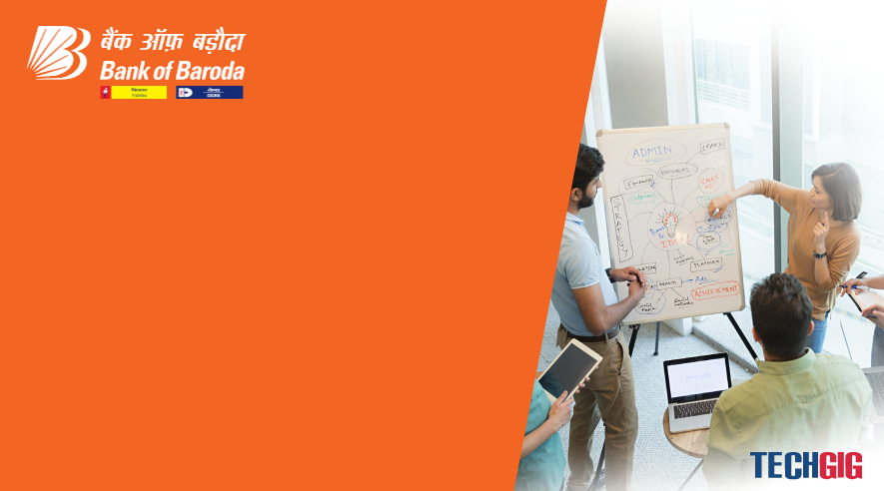


Bank of Baroda Hackathon - 2022
Technology Partner
Your Team Name : Anonymous Crew
We are a team of 4 with knowledge of advanced Artificial Intelligence, Machine Learning, Software Development, Blockchain, etc.
We have provided a better and advanced solution for
AUTOMATED CHEQUE PROCESS SYSTEM

Slide 2
Problem Statement?
Why did you decide to solve this Problem statement?
We decided to solve this problem because we found out that processing of cheques requires more man power. We have solved this statement in such as way that the cheque is processed with minimal man power. Most of the process is automated by Robotic Process Automation in which there exists the usage of Artificial Intelligence, Machine Learning and Optical Character Recognition techniques.
Involving man-work takes lot of time and may happen to delay the process. By involving softwares and electronic techniques, we can make sure the process is not delayed and the transaction occurs on time without any interruptions.

Slide 3
User Segment & Pain Points
Which user/advertiser segment would be early adopter of your product & why?
Our product shall be adopted and used by small scale businesses as they frequently involve the usage of cheques for transaction. Small scale industries involve the usage of cheques frequently as minor transfer of amount happens to tranfer via cheques.
Farmers shall enjoy the essence of this product as many farmers involve the usage of cheques in their day to day life. Most of the transactions happen using cheques and cash and our solution helps to allow to process cheques in a faster and efficient way.

Slide 4
Pre-Requisite
What are the alternatives/competitive products for the problem you are solving?
Some of the alternatives products present in the real world are
1. Krish IT Solutions (Bank Cheque Automation) – Parses only majority of printed text
2. SoftTact Technologies (ChequeReader) – Digital Signature not available
3. Arya.ai (Automated Cheque Process) – EKYC Check not present

Slide 5
Azure tools or resources
Azure tools or resources which are likely to be used by you for the prototype, if your idea gets selected 1. Azure Computer Vision – An AI service to analyse contents in images and video 2. Azure OCR – Used for applying optical character recognition 3. Azure E-Sign – Used for digitally signing data and models generated

Slide 6
Any Supporting Functional Documents
Present your solution, talk about methodology, architecture & scalability
We present here two scenarios where the end user would undergo. One is the online mode and the other is the offline mode. In online mode, A digital cheque is created at the bank side and circulated via their website where there would be a separate portal for uploading cheque from their net banking account. The user uploads his filled digital cheque and uploads in the portal. The filled cheque is made to undergo OCR and AI recognition to extract characters from the cheque and the extracted data is made to digitally sign with Aadhar EKYC in order to validate the authenticity of the data provided. The data is stored using the block chain concepts and later used by the bank to process the necessary details.
The second mode is the offline mode where the user or the customer doesn’t have access to internet facility and so the customer fill up the given physical cheque and hand over it to the bank. The physical cheque is processed by using AI and OCR techniques and also the pre-defined MICR techniques is also added. The generated data is converted to a model and with extra EKYC support at the bank makes the data more secured and digitalized.

Slide 7
Key Differentiators & Adoption Plan
How is your solution better than alternatives and how do you plan to build adoption?
Our Product uses Concepts of Blockchain ,where decentralized ledger of all transactions across a peer-to-peer network. Using this technology, user can confirm transactions without a need for a central clearing authority. Potential applications can include fund transfers, settling trades, voting and many other issues
We use our own developed encryption and decryption method to prevent unauthorized parties from reading any data when data leaks occurs.
We have used improvised, efficient OCR which helps the bank employees to convert the hand written text to digital format by building own models for machine learning process.

Slide 8
GitHub Repository Link & supporting diagrams, screenshots, if any
How far it can go?
Digital cheque created by the bank
OCR
Details gathered
Online Scenario
Aadhar EKYC & Hashing
Data Model Unsigned and Unencrypted
Secured Data
(Parsed by bank)
Physical Cheque filled at bank
OCR
Details gathered
Offline Scenario

Slide 9
Thank You
Team member names
Dhiyanesh S
Shyam S
Bhuwaneshwaran S
Rajin Gangadharan

