Slide 1
Byts hackathon 2.0 team 24 – ragnarok printflow
TEAM MEMBERS :
23ITR007 – ARUN S
23ITR029 – DHARNISH B M
23ITR038 – DHURGASHREE I
23ITR042 – DIVYA R
23ADR126 – PRABAKARAN S B
23CDR039 – DHODDURAAJ S P

Slide 2
PROBLEM STATEMENT
Printing facilities in colleges face heavy congestion during break times, causing long waiting periods, overcrowding, and poor queue management. The lack of real-time tracking and secure payment verification in manual or semi-manual systems leads to confusion, disputes, and inefficient service.
Existing solutions & Difficulties :
Manual Counter-Based Printing
Token or Number-Based Queue Systems

Slide 3
Proposed solution
Develop a Digital Printing Queue Management System.
Allow students to upload documents in advance.
Enable students to configure print settings (copies, color, pages).
Provide a virtual queue to eliminate physical waiting.
Introduce a vendor dashboard for controlled print management.
Implement one-time UPI reference ID validation.
Use real-time communication for instant status updates.
Ensure transparency and fair queue handling.

Slide 4









Tech stack
Frontend: React.js
Backend: Node.js , Express.js
Database: MongoDB
Real-Time Coms: Socket.IO
Authentication : JWT (JSON Web Tokens)
File Handling: Multer, GridFS
Payment Validation: RazorPay
External API: twilio

Slide 5
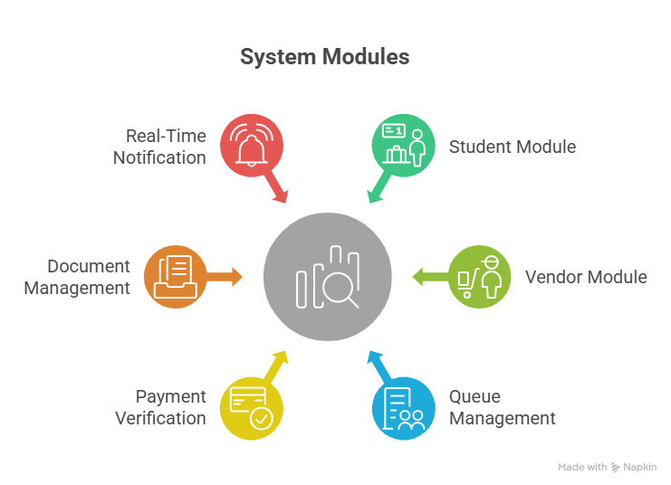
modules

Slide 6
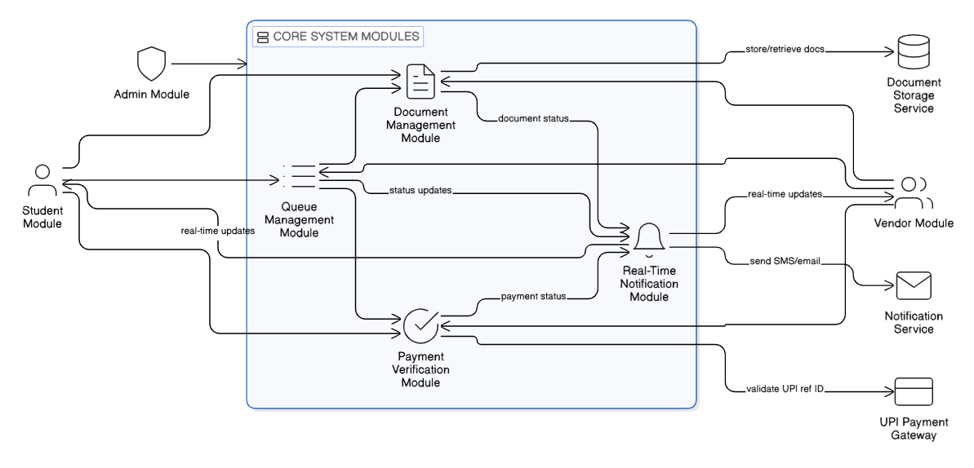
workflow

Slide 7
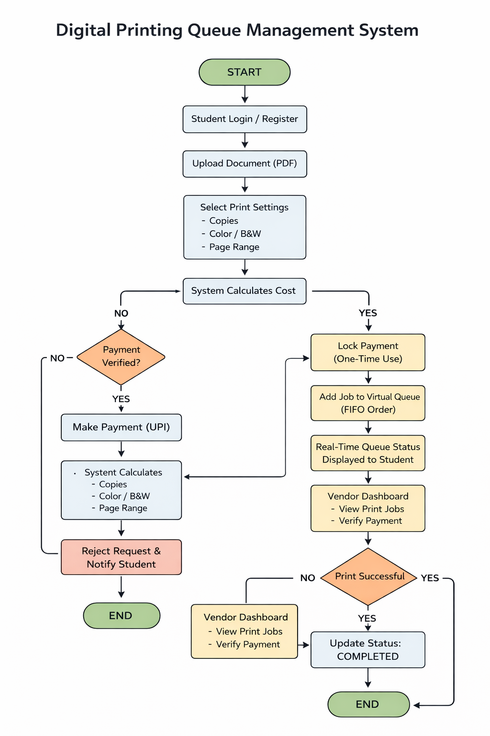
flowchart

Slide 8
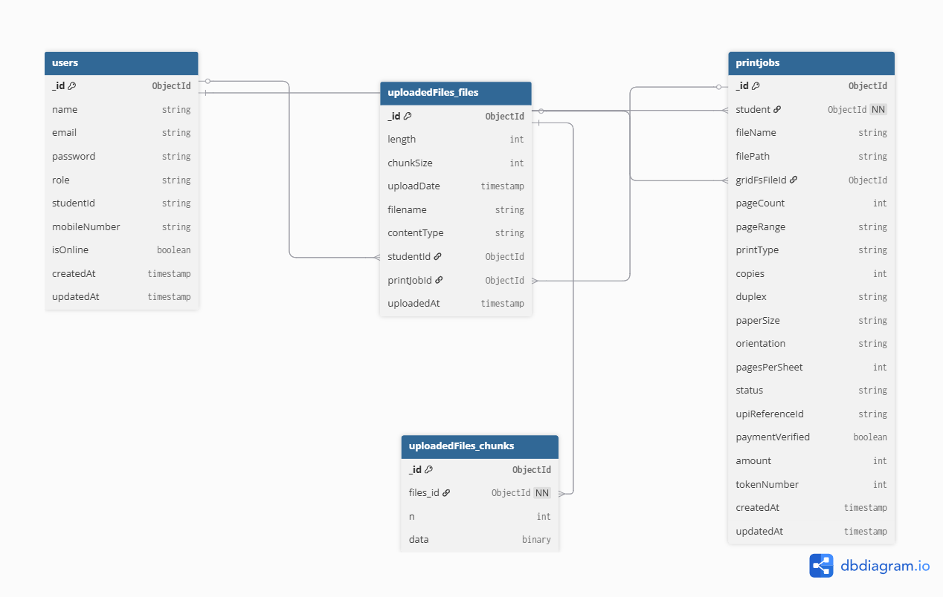
Database flow

Slide 9



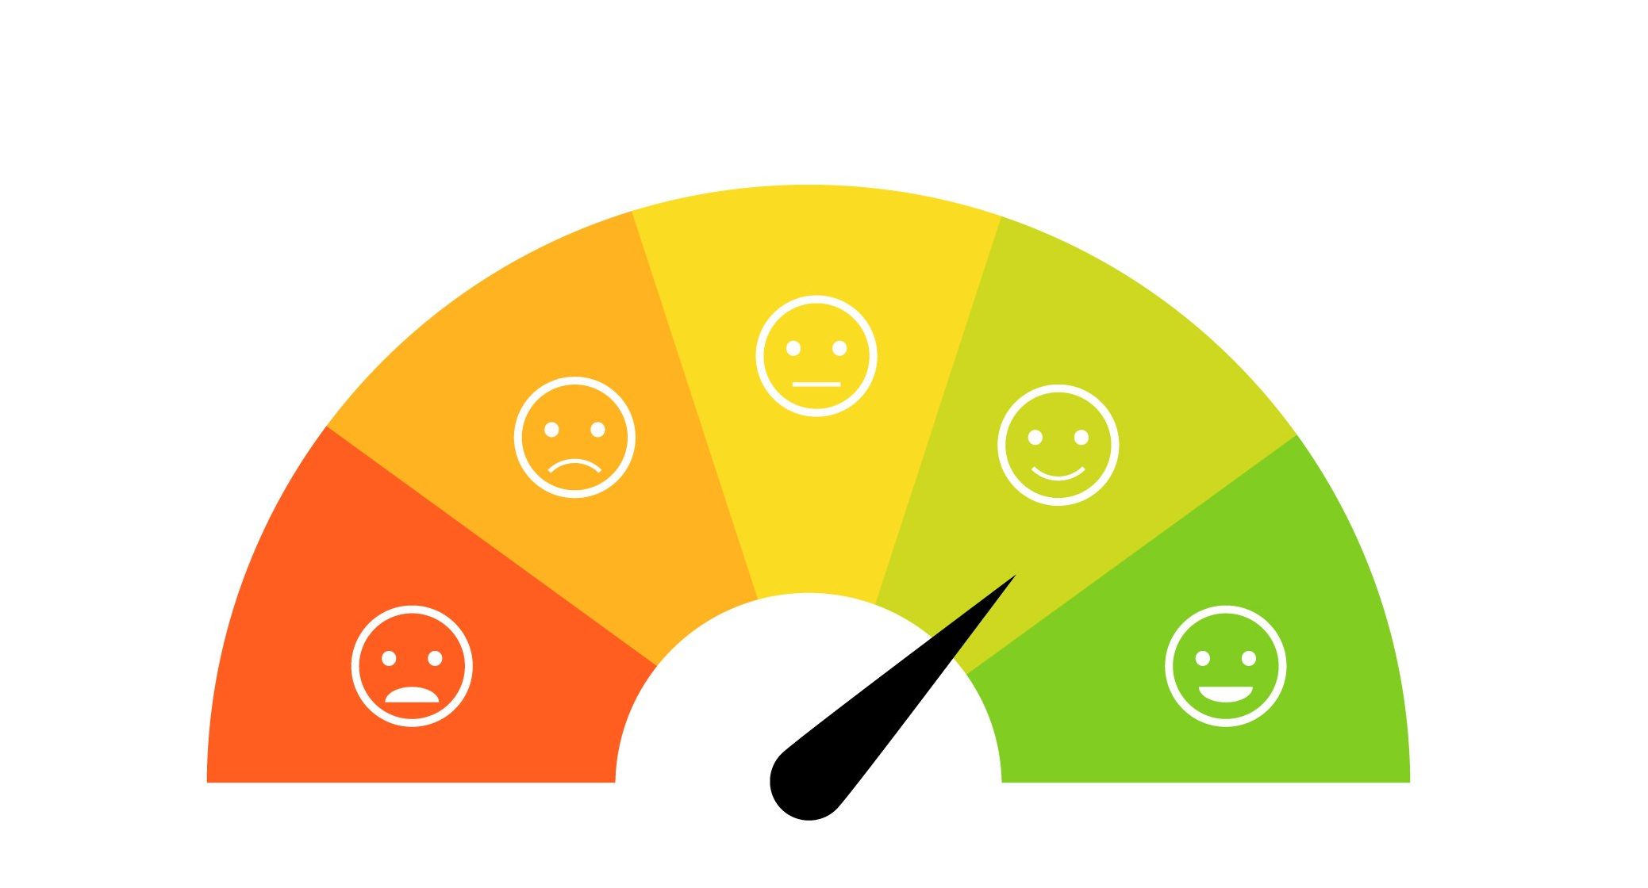


benefits
Reduces physical crowding
Decreases waiting time
Prevents payment misuse
Enchances vendor efficiency
Smooth User Experience
Queue fairness and Transparency

Slide 10
Thank you!!!

