Slide 1
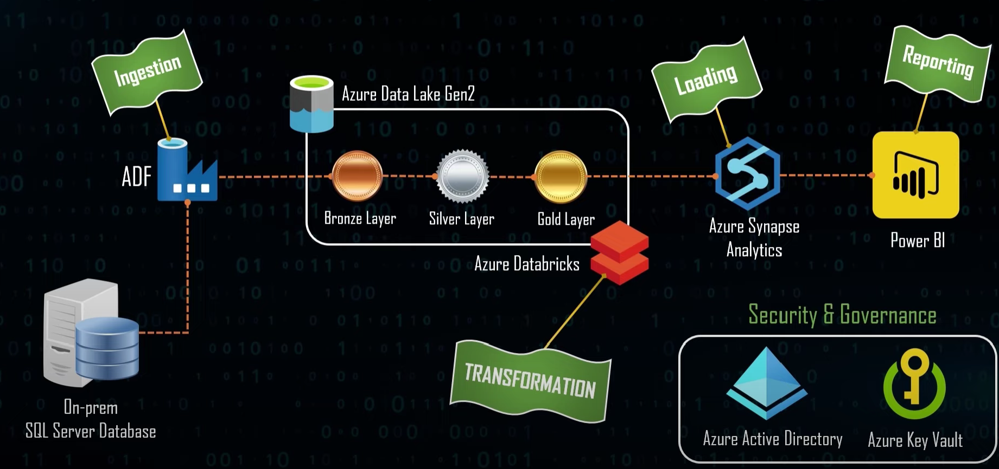
Azure Data Engineering End-to-End Project- Adventure_WorksLT_2019
Project Overview- Architecture

Slide 2
Agenda
Environment Setup
Data Ingestion
Data Transformation
Data Loading
Data Reporting
End to End Pipeline Testing

Slide 3
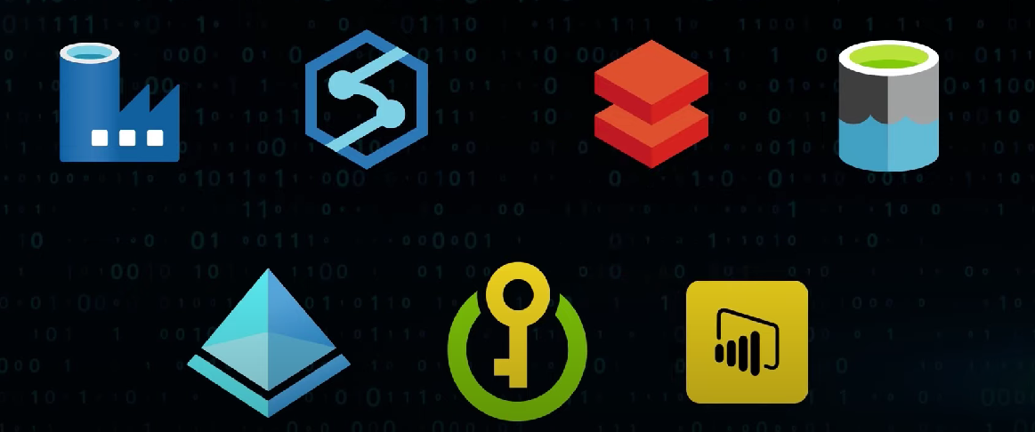
Tools Used in this Project
Azure Data Factory
Synapse Analytics
Databricks
Data Lake Gen 2
Azure Active Directory
Azure Key Vault

Slide 4
Steps to create this project
Create resource group in Azure Portal and create tools required in the resource group (Synapse,ADF,DatLake,Databricks).
Restore a Database (AdventureWorksLT2019) Using SSMS.
Create self hosted runtime integration express setup to build connection with on premises SQL server.
Create pipeline in Azure data factory to import data (Dynamically all the tables) from on premises SQL server to ADLS gen2.
Create compute(cluster) Databricks .
Mount the data from ADLS gen 2.

Slide 5
Steps to create this project
7. Create notebooks in Databricks using python to transform data from raw data(Bronze) to semi transformed(Silver) to fully transformed(Gold) data.
8. Create serverless SQL pool in Synapse Analytics.
9. Create Pipeline in synapse analytics to import the data (dynamically for all tables) from ADLS gen2 to serverless SQL pool.
10. Create the pipeline in ADF to run notebook we create in Databricks .
11. Schedule the Pipeline.
12. Setting for Security and Governance. (Role ,Access Assignment )
13. Reporting

Slide 6
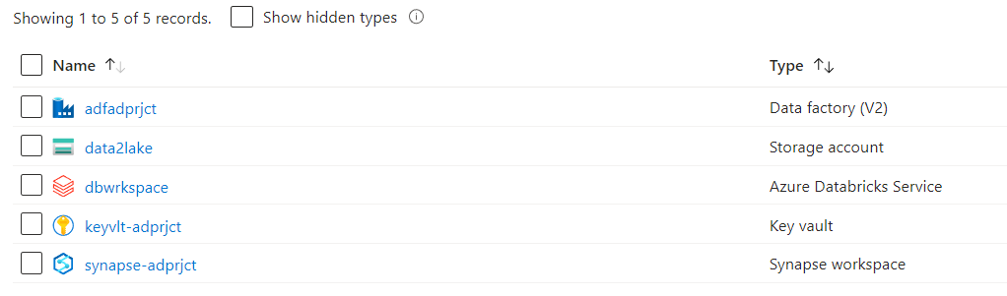
Create resource group in Azure Portal and create tools required in the resource group (Synapse,ADF,DatLake,Databricks,KeyVault) .
Restore a Database (AdventureWorksLT2019) Using SSMS.
We can refer Microsoft documentation on official site for restore the data in SSMS.

Slide 7
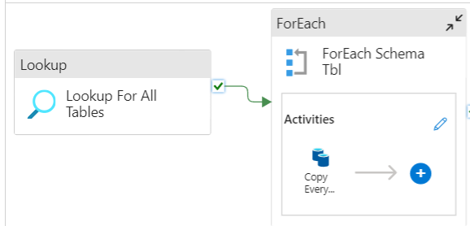
Create self hosted runtime integration express setup to build connection with on premises SQL server.
Create Self hosted runtime integration in Azure portal and install Microsoft integration runtime on the system.
Create pipeline in Azure data factory to import data (Dynamically all the tables) from on premises SQL server to ADLS gen2.

Slide 8
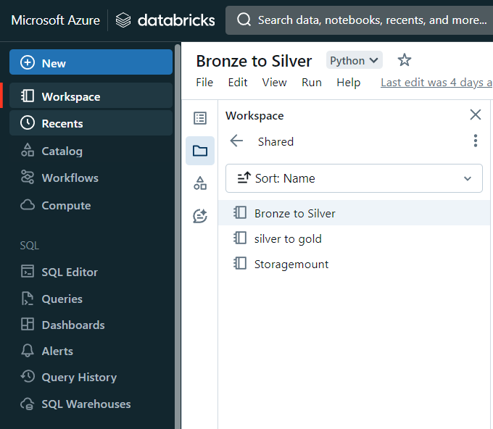
Create compute(cluster) Databricks.
Mount the data from ADLS gen 2.
Create notebooks using python to transform data from raw data(Bronze) to semi transformed(Silver) to fully transformed(Gold) data.

Slide 9
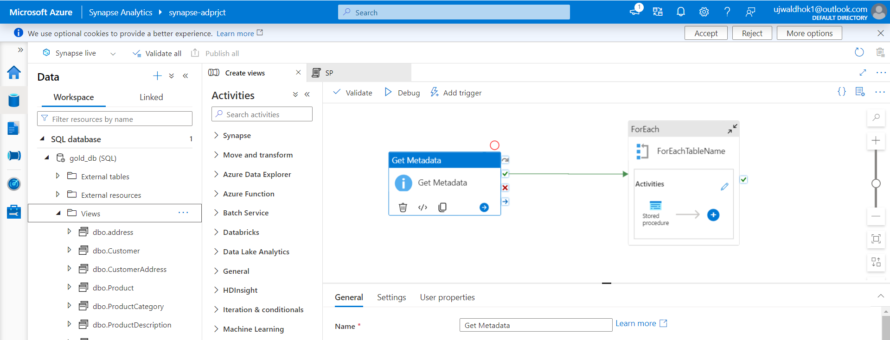
Create serverless SQL pool in Synapse Analytics.
Create Pipeline in synapse analytics to import the data in form of view (dynamically for all tables using stored procedure) from ADLS gen2 to serverless SQL pool.

Slide 10
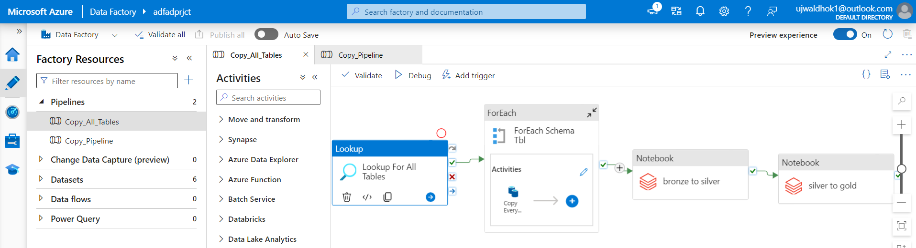
Create the pipeline in ADF to run notebook we create in Databricks .
Schedule the Pipeline.
Setting for Security and Governance. (Role ,Access Assignment )
Reporting

