Slide 1
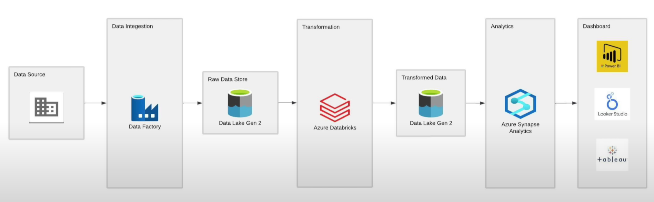

Azure Data Engineering End-to-End Project- Olympic_Tokyo
Project Overview- Architecture

Slide 2
Agenda
Environment Setup
Data Ingestion
Data Transformation
Data Loading
Data Reporting
End to End Pipeline Testing

Slide 3
Tools Used in this Project
Azure Data Factory
Synapse Analytics
Databricks
Data Lake Gen 2
GitHub Repository

Slide 4
Steps to create this project
Create resource group in Azure Portal and create tools required in the resource group (Synapse , ADF, DatLake , Databricks).
Store Data in GitHub Repository.
Create pipeline in Azure data factory to import data from GitHub repository to ADLS gen2.
Create compute(cluster) Databricks .
Mount the data from ADLS gen 2.

Slide 5
Steps to create this project
7. Create notebooks in Databricks using python to transform data from raw data to fully transformed data.
8. Create Lake Database in Synapse to store the data.
9. Create Pipeline in synapse analytics to import the data from ADLS gen2 to Lake Database .
10. Analyze the data in Synapse analytics by using SQL queries.
11. Schedule the Pipeline.
12. Setting for Security and Governance. (Role ,Access Assignment )
13. Reporting

Slide 6
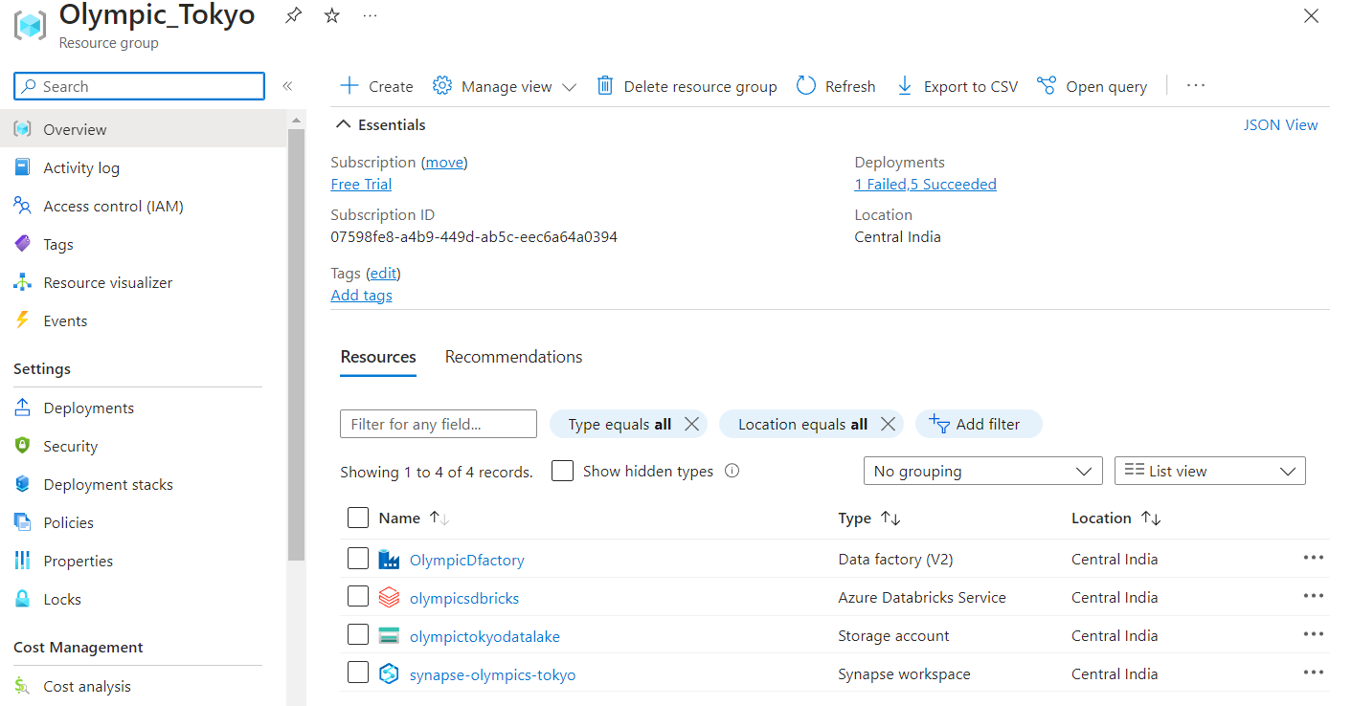
Create resource group in Azure Portal and create tools required in the resource group (Synapse,ADF,DatLake,Databricks,KeyVault) .
Store Data in GitHub Repository .
:Download the data from Kaggle and store in GitHub Repository

Slide 7
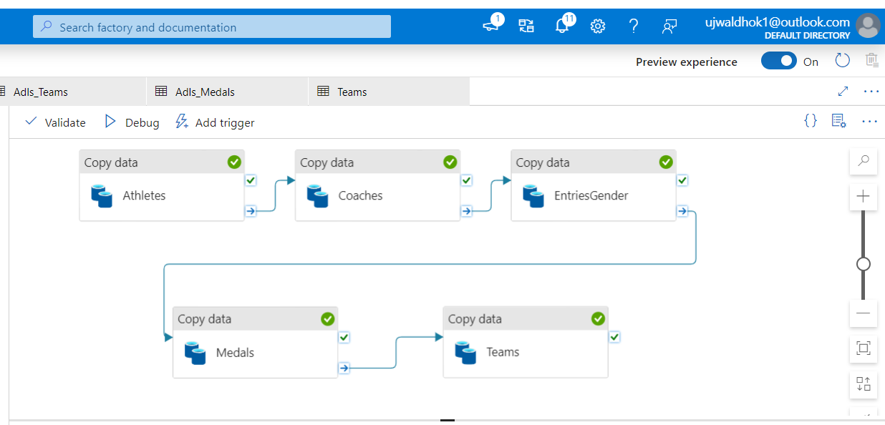
Create pipeline in Azure data factory to import data from GitHub repository to ADLS gen2.
Create compute(cluster) Databricks .
Mount the data from ADLS gen 2.

Slide 8
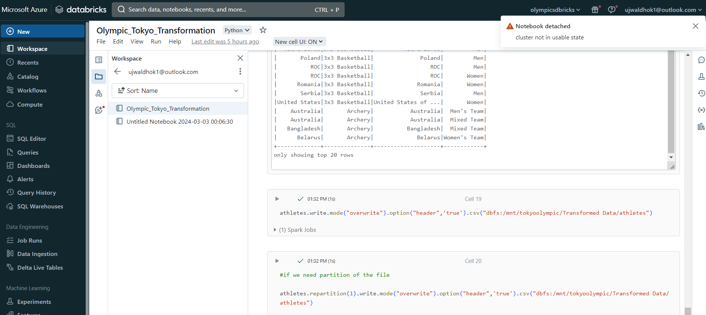
Create notebooks in Databricks using python to transform data from raw data to fully transformed data.
Create Lake Database in Synapse to store the data.

Slide 9
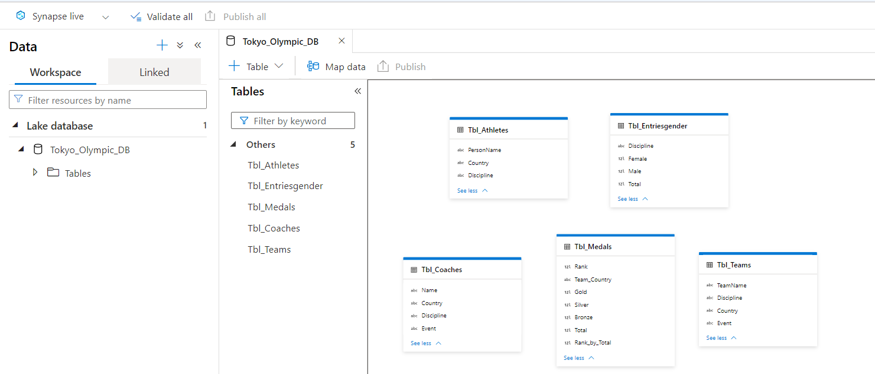
Create tables using synapse analytics and import the data from ADLS gen2 to Lake Database .

Slide 10
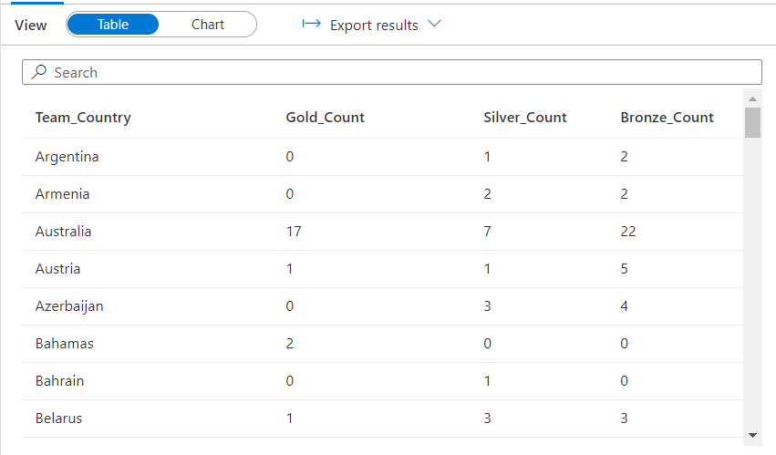
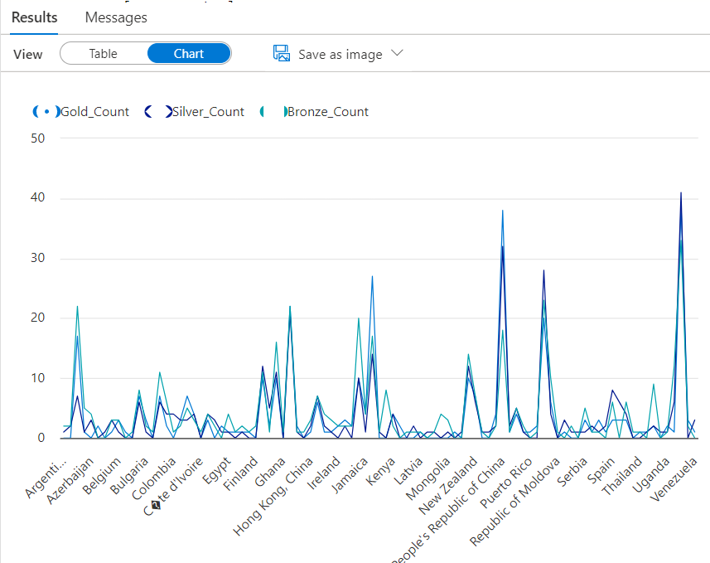
Analyze the data in Synapse analytics by using SQL queries.
Schedule the Pipeline.
Setting for Security and Governance. (Role ,Access Assignment )
Reporting

