Slide 1

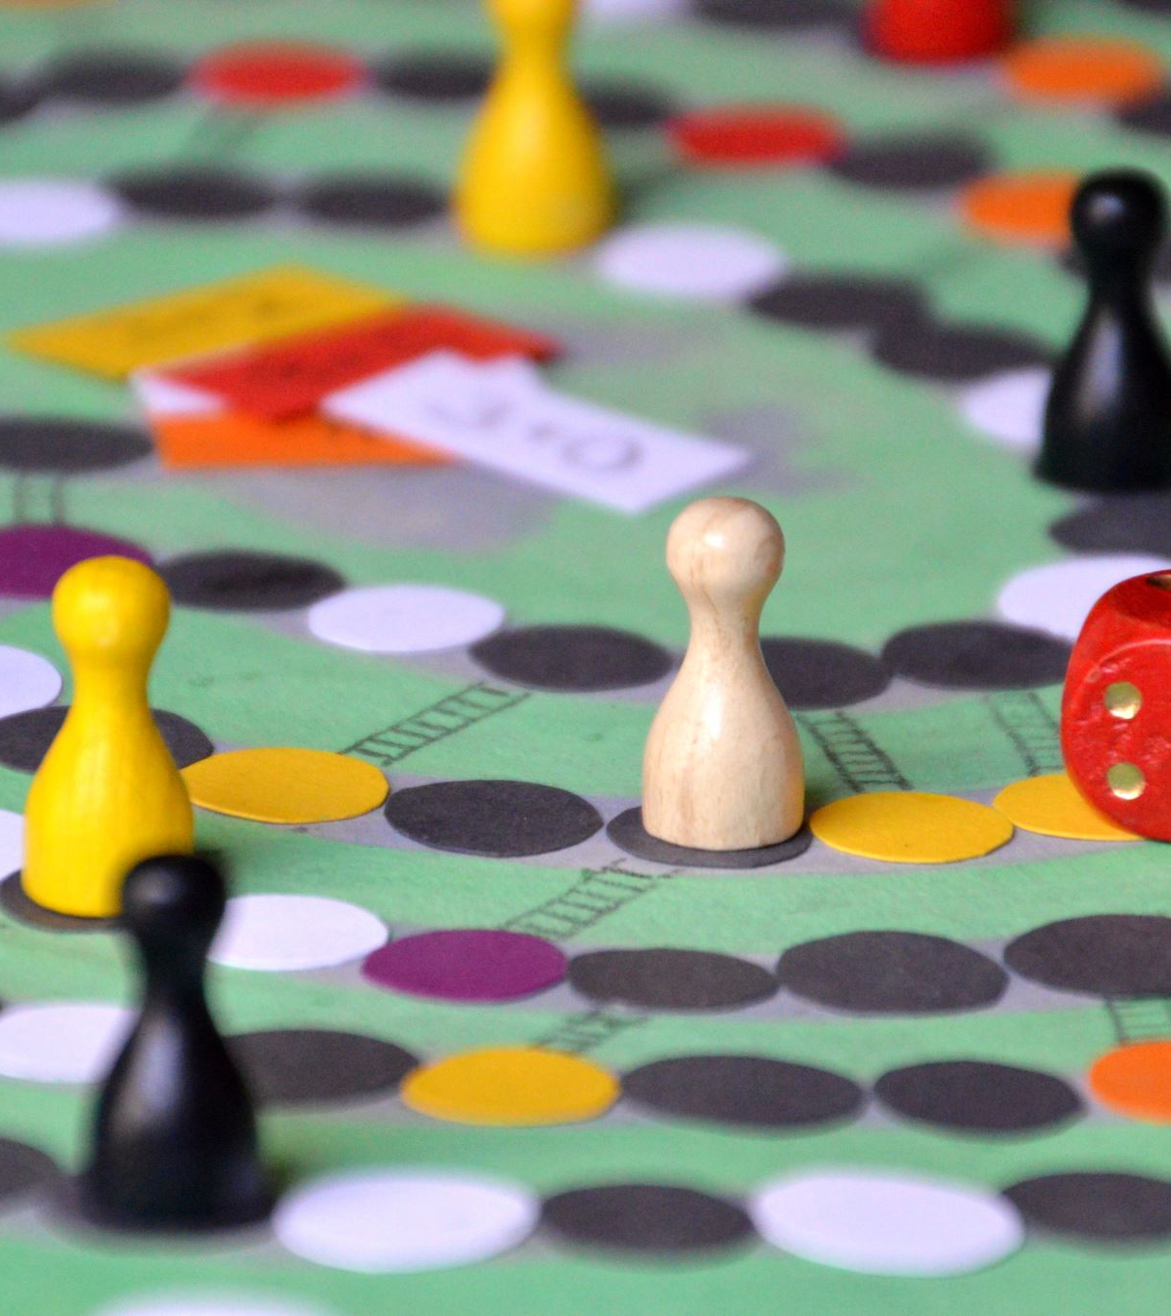
Picture Quiz Game
Interactive Multiple-Choice Game with Image-Based Answers

Slide 2

Content
Web Application for a Game
Project Overview
Features of the Web Application
Technical Challenge
Technical Challenge
Big Mistake
Big Mistake
Demo
Closing Slide

Slide 3
Introduction to the Project
What is the project?
The project is a Picture Quiz Game, an interactive multiple-choice game where the answers are represented by images instead of text.
Key Objectives:
To create a fun and engaging way to test knowledge on various topics.
To provide an educational tool that is visually appealing and easy to use.
Target Audience: Suitable for all ages, especially useful for young learners, trivia enthusiasts, and language learners.

Slide 4

Project Overview
Gameplay Workflow
Register an account or log in to save progress on the website.
When a user is ready, he can press the “Start”
The timer will begin after the “Start” button is pressed.
The player is presented with a question.
Multiple image options are displayed as possible answers.
The player selects the image they believe is correct.
Scores will be displayed when the timer ends.

Slide 5

The Purpose of the Website
Why did we choose this idea?
Motivation and Purpose
To create a fun and engaging tool for learners.
Personal Interest: Inspired by the need for interactive and visually engaging educational tools.
Market Need: Identified a gap in the availability of games that leverage images for learning and engagement.
Expected Impact: Aims to enhance learning experiences by making quizzes more interactive and enjoyable, particularly for visual learners.

Slide 6

Technical Challenge
Most Important Technical Challenge
Challenge: Ensuring the game is responsive and performs well across different devices and screen sizes.
Details: Managing image loading times and maintaining a smooth user experience, particularly on mobile devices.
Learning How to use GitHub: GitHub was a little difficult to understand at first and to work with.
Database Connection: The MongoDB was a little challenging and to connect it we had several issues.

Slide 7

Technical Challenge
Overcoming the Challenge
Approach and Methods Used
Optimization Techniques: Implemented lazy loading for images to reduce initial load time.
Responsive Design: Used flexible layouts and scalable images to ensure the game looks good on all devices.
Tools and Technologies: Leveraged HTML5, CSS3, and JavaScript frameworks like ES6 for dynamic rendering.
For GitHub: We managed to work with GitHub in the it became easy using GitHub Desktop.
The MongoDB: With each step it was getting easier to deal with and use.

Slide 8

Big Mistake
Biggest Mistake Made
Mistake: Initially underestimated the complexity of image optimization for various devices and network conditions. There was with each version a mistake or detail we forgot to add.
Consequences: Led to slow loading times and a suboptimal user experience in early versions. Also, it slowed our work and caused a loss in time left for the project due date.

Slide 9

Big Mistake
What Did You Learn?
Technical Insights: Gained a deeper understanding of performance optimization techniques for web applications.
User Experience Focus: Recognized the importance of thorough testing across different environments before deployment.
Preventive Measures: Established a more rigorous testing and feedback loop to catch performance issues early.

Slide 10

Demo
Link to your project: Picture Quiz Game Demo
Brief instructions: "Click the link to play the game and test your knowledge with our interactive picture-based quiz!"

Slide 11

Thank YOU
Project’s Name: Picture Quiz Game
Student’s Name and ID Number:
Khalid Helayhel 442017074
Abdulrahman Afit Askar Alanazi 441013506
Faisal Al-Kheryaf 442017139
Azzam Burkie Alotaibi 441013925

