Slide 1

Statements & Instructions
INTRODUCTION TO DATABASE
Elaboré par :
Dhouha Sagga
College year : 2022/2023

Slide 2

What is mongo db
Mongo DB is an open source No SQL database management program. No SQL (Not only SQL) is used as an alternative to traditional relational databases. No SQL databases are quite useful for working with large sets of distributed data. Mongo DB is a tool that can manage document-oriented information, store or retrieve information.

Slide 3
functionalities of Mongo DB
High availability: Mongo DB provides high availability through replica sets. In a replica set, multiple copies of the same data, called replicas, are distributed across different servers. If the primary replica fails, a new primary is automatically elected from the available replicas, ensuring that the system remains available even in the event of a failure.
Automatic shading: Mongo DB supports automatic shading, which is distributing data across multiple machines. This makes it possible to scale horizontally, meaning the system can handle large amounts of data by adding more machines

Slide 4
functionalities of Mongo DB
Flexible schema: Mongo DB allows for a flexible schema, which means that you can store data of different structures in the same collection. This makes handling data that does not fit into a traditional relational database structure possible.
Document-oriented: Mongo DB is a document-oriented database, meaning data is stored in documents rather than tables. Each document can have a different structure, and the data is stored in a format that is easy to access and manipulate.
Geospatial indexing: Mongo DB supports geospatial indexing, which means you can store and query geospatial data such as coordinates and shapes. This makes it possible to build applications that require location-based services, such as maps and location-based search.

Slide 5
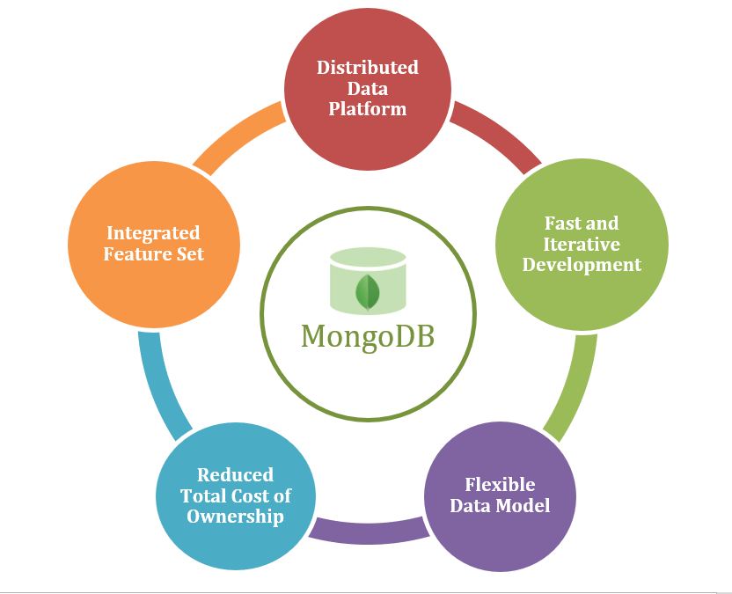
functionalities of Mongo DB

Slide 6

What is SQL
SQL: stands for Structured Query Language. SQL is used to communicate with a database. According to ANSI (American National Standards Institute), it is the standard language for relational database management systems.
SQL statements are used to perform tasks such as update data on a database, or retrieve data from a database. Some common relational database management systems that use SQL are: Oracle, Sybase, Microsoft SQL Server, Microsoft Access, Ingres, etc.

Slide 7
functionalities of SQL
The CASE clause:The CASE clause allows you to create conditional situations in your queries and return them as columns.
Aggregation functions:There are lots of really useful functions that you can perform in queries. They are pretty straight forward functions, it is often simply a matter of being aware that they exist. So know that things like MIN(), MAX(), SUM(), COUNT(), and AVG() are there for you to make your queries more productive. As a note, you will always need to pair these with a GROUP BY clause.
The WHERE and HAVING clauses: The WHERE and HAVING clauses are similar to each other because they both are simple methods for filtering based on criteria. The biggest difference to remember between the two is that HAVING will filter based on aggregated data columns and WHERE does not.

Slide 8
functionalities of SQL
The concatenation operator:This is a handy little trick for combining columns into one. For example, let’s say you have a table that contains employee names in two different columns, first name and last-named. Maybe you want to create a query that returns the names in the same column with the full name displayed.
Subqueries: Many people who are looking to grab information from two tables often immediately turn to joins. But subqueries are also a valid method to combine information from two sources and you may find that in some situations they are easier. Subqueries can be used within pretty much any of the clauses.

Slide 9
functionalities of SQL
The LIKE operator: Normally information in the database has to be searched exactly and is case sensitive. Maybe you have some entries that have been capitalized differently or have slight spelling variations. The LIKE operator is going to be your best friend here since it is how you search without needing exact spellings.
Prettifying Your Results: This last one is more of a collection of a few related tips for getting your results to display in neat, readable formats.

Slide 10
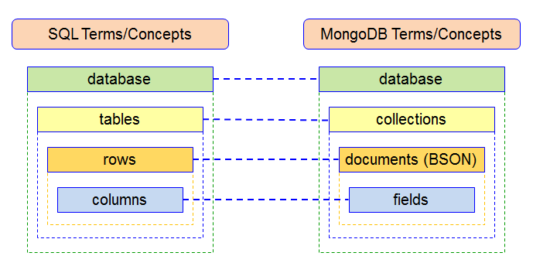
MONGO DB VS SQL
A SQL database processes SQL queries, whereas Mongo DB offers JSON querying. Mongo DB is a more dynamic and complicated choice that is appropriate for hierarchical data because of its fundamental properties, as opposed to a SQL Database, which is still more predetermined and appropriate for other types of data storage. Hence this is the reason Mongo DB outshines the SQL database.

Slide 11
Merci pour votre Attention
Thank your for your attention

