Slide 1

Sprocket Central Pty Ltd
Data analytics approach
By Dhriti Vohra

Slide 2
Agenda:
Introduction
Data Exploration
Model Development
Interpretation

Slide 3
Introduction:
Objective: Find Most Loyal and valuable customers for the company
Outline of Problem –
Sprocket Central Pty Ltd. specializes in high-quality bikes and accessible cycling accessories to riders.
The marketing team wants some useful customer insights which could help optimize resource allocation for targeted marketing.
We need to recommend high-value adding customers from 1000 new customers .
Data sets available to us are:
– Transactions data in the past 3 months
– Customer Demographics
– Customer Addresses
– New Customer List
– Correspondence, 2017 Postcode to 2016 Remoteness Area (Downloaded from ABS Site)

Slide 4
Introduction (1):
Data Analysis will be done by considering following features –
Age Distribution of the customers.
Geographic distribution of the customers.
Car Owners in each state.
Customers Distribution according to their wealth segment, job industry category and their tenure.
Brand preference of the customers.
Old and New Customers comparison to find out the valuable customers.

Slide 5
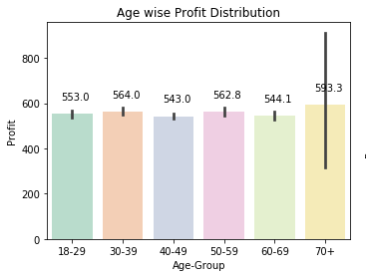
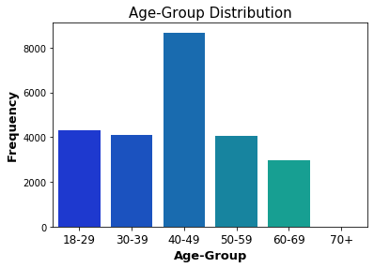
Age Distribution of the Old Customers:
Most of the customers belong to the age group of 40-49 years.
Most of the Profit comes from the age group of 30-39 years. Age-group of 70+ years is visible with maximum profit but this anomaly is only due to presence of some outliers.

Slide 6
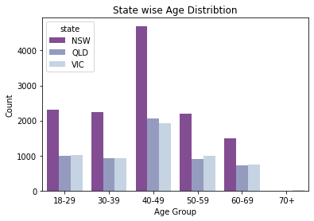
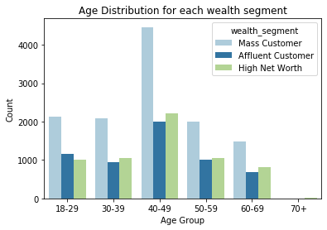
Maximum customers are from the state of New South Wales (NSW), Australia.
These mostly belong to 40-49 age group.
Maximum Bike purchases are done by Mass Customers and hence they are highly valuable for the company.

Slide 7
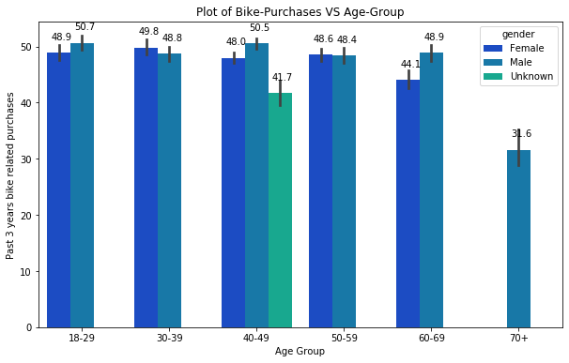
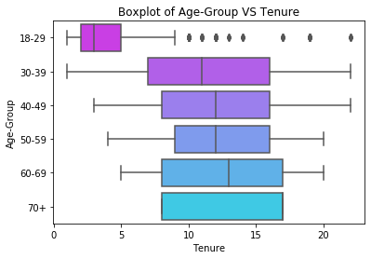
…contd.
Above plot clearly show that the independent variables, Age and Tenure are correlated i.e., people of the older brackets will have a longer tenure.
Maximum Bike purchases are from the category 18-29 followed by 30-39 , 40-49 age brackets and so on. Moreover, Males dominate the bike purchases.

Slide 8
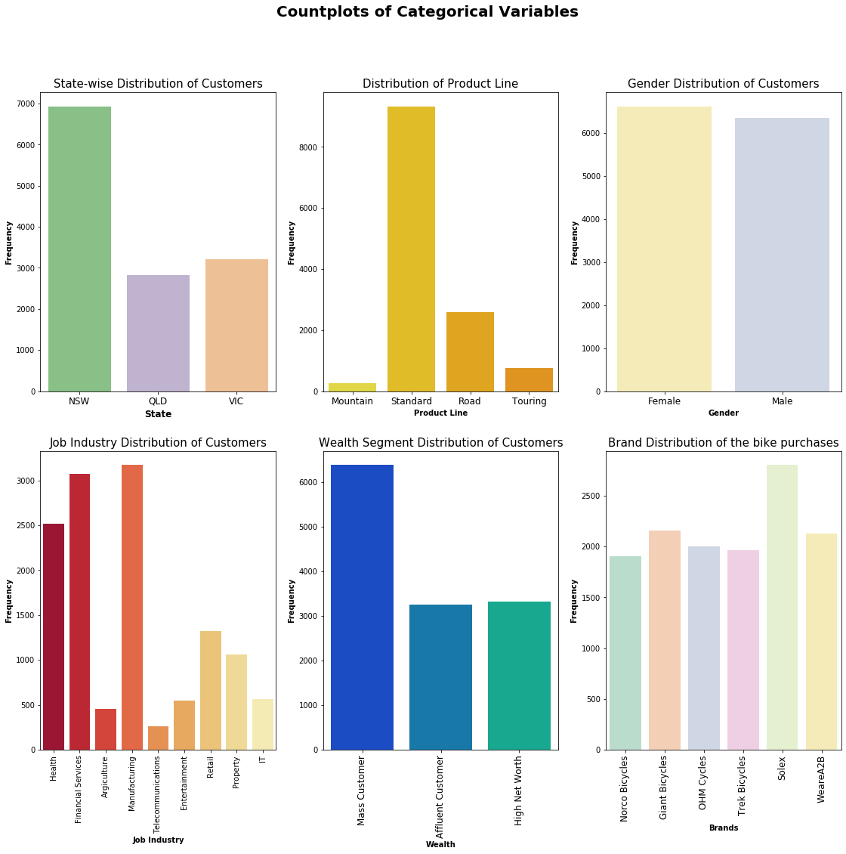
Geographical Distribution of Bike purchases:
New South Wales is the leading state in terms of bike or bike components related purchases from the company.

Slide 9
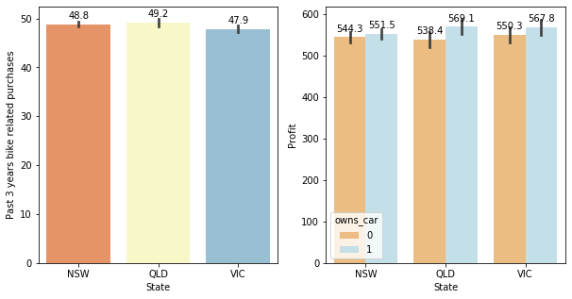
State-wise Bike Purchases and Profit distribution:
Above plot indicates that maximum bike related purchases are from the state of Queensland.
Maximum Profit contribution is by the state of Victoria.
Car owners contribute more to the profit of company as compared to those of non-car owners.

Slide 10
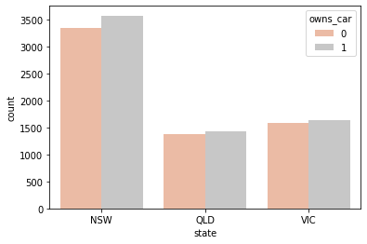
State wise distribution of Car Owners:
Maximum car owners belong to the state of New South Wales but it doesn’t affect their bike purchases at all.
New South Wales dominates the car ownership.
The population of New South Wales is high as compared to other states which leads to large height of bar of New South Wales.

Slide 11
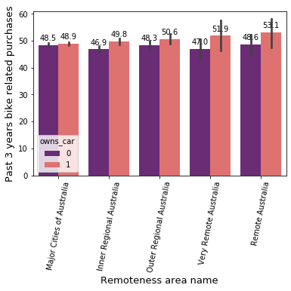
Remoteness are distribution of Car Owners:
These remoteness area names are given according to the remoteness of various postcodes of cities of Australia.
Maximum bike purchases are from Remote Australia.
Car owners are also highest in this region.

Slide 12
How Brand Influences the bike purchases?:
The Highest Sales are for brand, Solex followed by Giant Bicycles and WeareA2B having almost same number of sales.
More work should be done to increase the sales of the brand like Norco Bicycles to make profit from this brand.

Slide 13
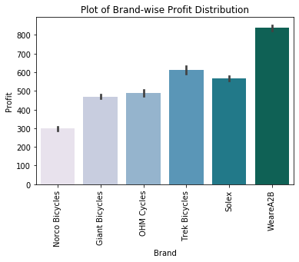
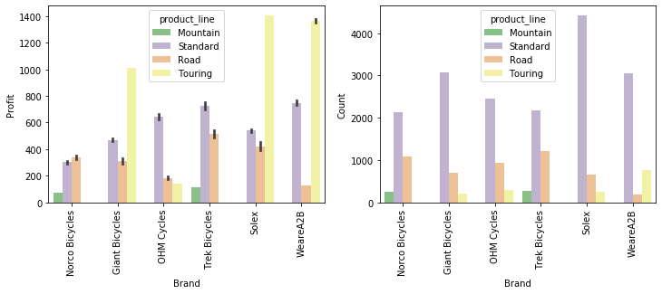
Although Solex brand has high sales but WeareA2B mostly contributes to the Profit of the company followed by Trek Bicycles.
Least profitable brand is Norco Bicycles also because it sales are lowest among all others
Maximum brand sales has been done for products transported via the standard line compared to the products being transported through road, mountain or touring lines.

Slide 14
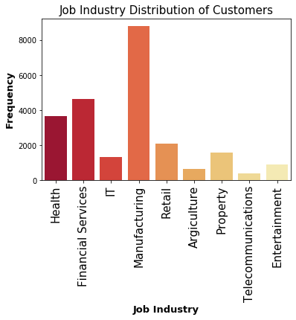
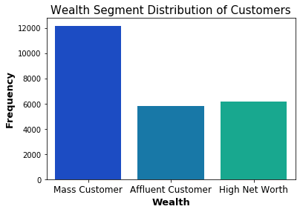
Customers’ wealth segment and Job Industry distribution:
Most of the customers belong to Manufacturing Job Industry followed by Financial Services and Health respectively.
Mass customers are the largest contributors for increasing sales of the bikes.

Slide 15
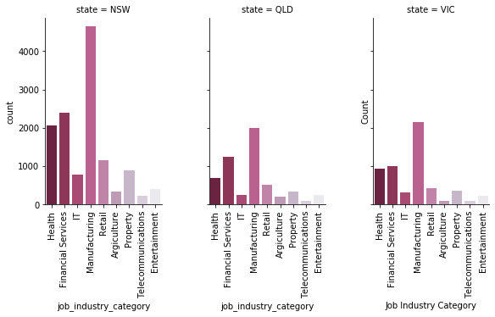
Customers’ Job Industry distribution:
Each state’s public is mostly employed in Manufacturing Industry followed by Financial Services.
Telecommunications is the industry which is least preferable.

Slide 16
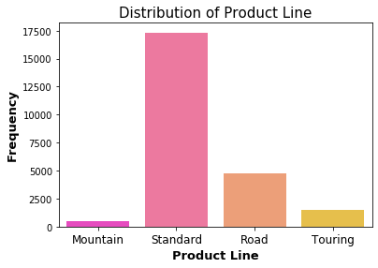
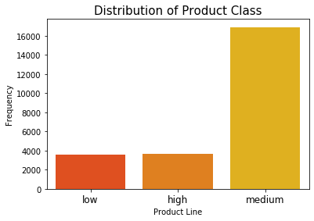
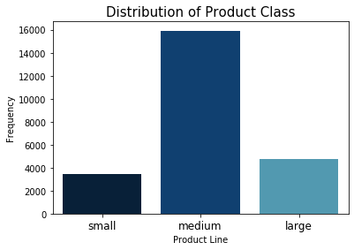
Distribution of the products according to their line of transport, class & size:
Maximum brand sales has been done for products transported via the standard line compared to the products being transported through road, mountain or touring lines.
Customers prefer to buy medium size product the most.
Sales of medium class product is high, followed by large and then, small product respectively.

Slide 17
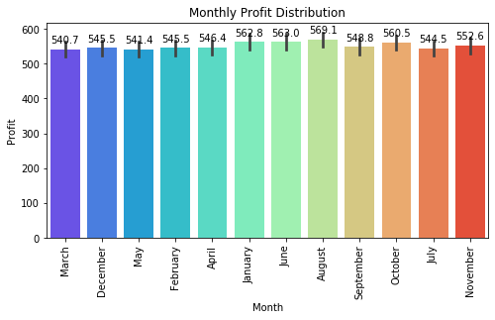
Monthly Profit Distribution of the Bike purchases:
Maximum Profit by the company is earned in the month of August followed by January.
Least profitable month is March.

Slide 18
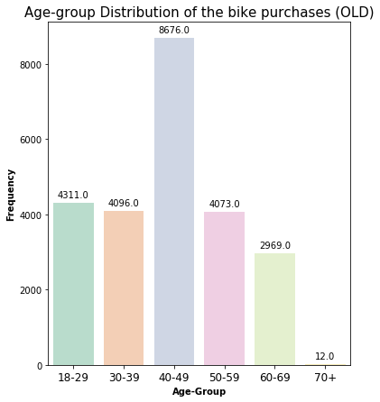
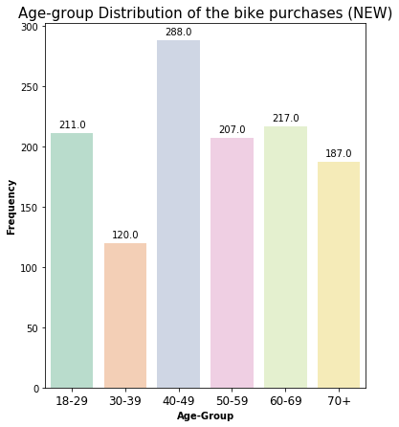
Old VS New Customers:
Old customers mainly constitute people of age group 40-49 with almost no buyer belonging from age group 70+ years.
New customers mostly belong to the age-group of 40-49 year age group followed by 50-59, 18-29 and 60-69 age-groups respectively.
There is an increase in the customers of age group 70+ years in New customers.

Slide 19
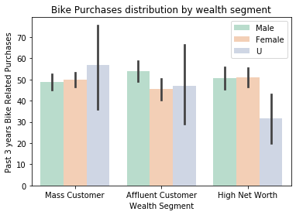
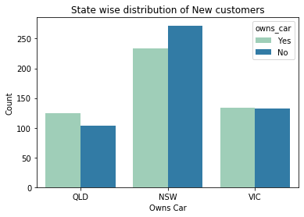
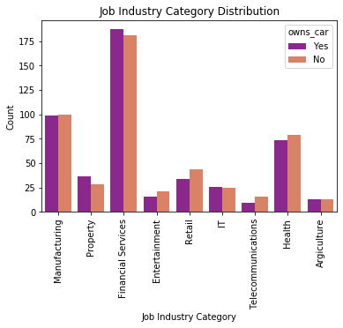
Some plots for New Customers data:
Maximum purchases are from the Mass customer segment of both New and Old customers.
Most of the customers belong to New South Wales just like the old customers.
New customers are mainly employed in Financial Services unlike old ones which were mainly employed in Manufacturing Industry.

Slide 20
Some points to remember after considering both Old and New Customers data:
Our customers mainly belong to the age-group 40-49 years from New South Wales.
Old customers mostly work in Manufacturing Industries while New ones in Financial Services.
The customers belonging to the Mass Customers wealth segment are the most valuable customers for the company which contributes to the maximum profit of the company.
The group of customers mostly constitutes of Car owners from New South Wales and they bring most of the profit to the company.
For old customers, Maximum bike purchases are done by people residing in Remote Australia which clearly shows that the address of people is also a factor in bike purchases.

Slide 21
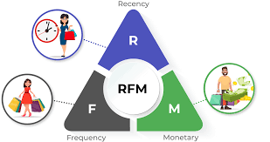
Model Development :
The problem here is of customer segmentation .
According to past data, we can develop a RFM Model (Recency-Frequency-Monetary Model).
In this model, the three terms have following meaning –
Recency : Number of days since the last purchase was made by the customer.
Frequency : The frequency of product purchases or no. of times a customer has made any transaction with the firm.
Monetary Value : Purchasing or the spending power of a particular customer. (i.e., Transaction value)

Slide 22
Classification of OLD Customers:
Platinum : Loyal Customers, they are the ones with highest score of RFM (i.e, 111) and very important for increasing the future sales. They have most recent purchases with high frequency and monetary value.
Gold : Customers having the potential to become Platinum customers. They recently shopped and their purchase frequency is quite good.
Silver : Customers who didn't purchased recently.
Lost : Customers who haven't contributed to the sales of the company for a long time.
Customer-Id | Recency | Frequency | Monetary-value | Loyalty | Cluster
1 | 7 | 11 | 2 | Gold | 0
2 | 128 | 3 | 2 | Gold | 2
4 | 195 | 4 | 1 | Platinum | 3
5 | 16 | 6 | 2 | Platinum | 0
6 | 64 | 10 | 4 | Bronze | 1

Slide 23
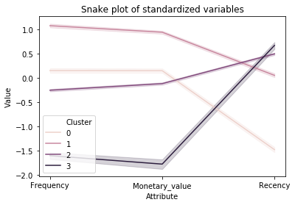
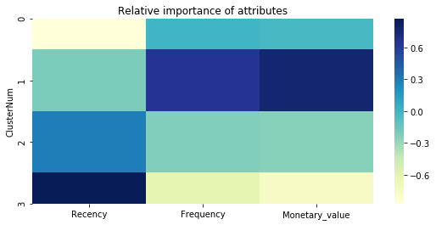
Recency, Frequency and Monetary values can be visualized based on each cluster by using a Snake plot and a Heatmap of Relative Importance of Attributes:
-0.87 | 0.00 | -0.02
-0.21 | 0.65 | 0.78
0.29 | -0.22 | -0.24
0.87 | -0.61 | -0.76

Slide 24
Observations that can be made from plot:
We observe that Cluster 1 is frequent, spend more, and they buy the product recently. Therefore, it could be the cluster of a Platinum Customer.
Cluster 0 is more frequent than Cluster 1, its Monetary Value is also very high but the purchases made here are not that much recent. They can be classified as Gold Customers.
Cluster 2 has the customers which are less frequent in purchases than both the Cluster 0 and Cluster 1, their transaction values are also low from those clusters. Also, they have not done any purchases recently. They are Silver Customers.
Cluster 3 has the customers whose purchases are very less frequent, they also spend very less. Moreover, they have made purchase long time ago. Therefore, it could be the cluster of Lost Customers.

Slide 25
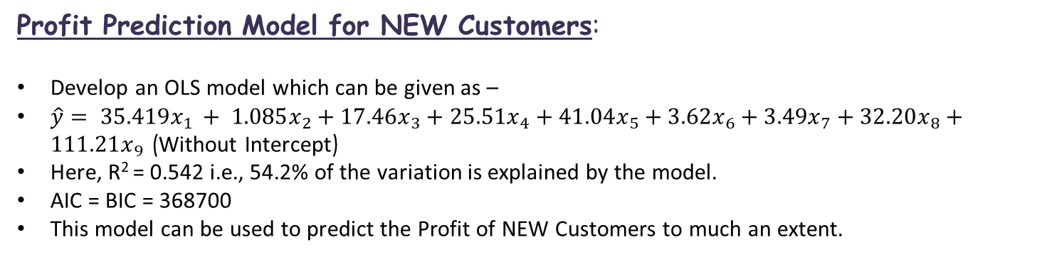
Profit Prediction Model for NEW Customers:
Develop an OLS model which can be given as –
$\hat{y}= 35.419x_{1 }+ 1.085x_{2}+17.46x_{3}+25.51x_{4}+41.04x_{5}+3.62x_{6}+3.49x_{7}+32.20x_{8}+111.21x_{9}$ (Without Intercept)
Here, R² = 0.542 i.e., 54.2% of the variation is explained by the model.
AIC = BIC = 368700
This model can be used to predict the Profit of NEW Customers to much an extent.
 | First name | Last name | Gender | Past 3 years bike related purchases | Job industry category | Wealth segment | Owns car | Age | RA CODE 2016 | RA NAME 2016 | RATIO | Profit
1225 | Datha | Fishburn | 0 | 15 | 7 | 2 | 0 | 31.0 | 20.0 | 2 | 1.000 | 547.2666
1226 | Melloney | Temby | 0 | 17 | 2 | 0 | 1 | 67.0 | 31.0 | 1 | 0.724 | 558.0027
1227 | Melloney | Temby | 0 | 17 | 2 | 0 | 1 | 67.0 | 32.0 | 1 | 0.174 | 500.3080
1228 | Melloney | Temby | 0 | 17 | 2 | 0 | 1 | 67.0 | 33.0 | 1 | 0.102 | 495.7952
1229 | Dickie | Cubbini | 1 | 30 | 2 | 2 | 1 | 69.0 | 30.0 | 1 | 1.000 | 692.9839

Slide 26
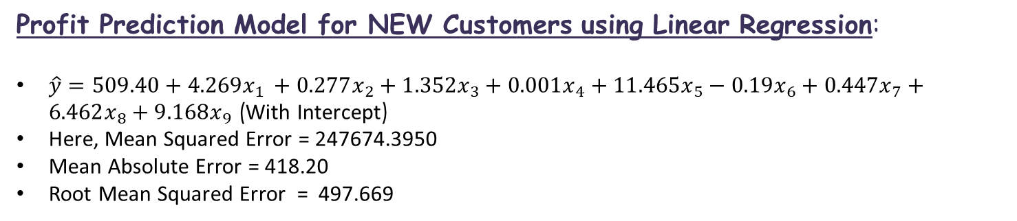
Profit Prediction Model for NEW Customers using Linear Regression:
$\hat{y}=509.40+4.269x_{1 }+0.277x_{2}+1.352x_{3}+0.001x_{4}+11.465x_{5}−0.19x_{6}+0.447x_{7}+6.462x_{8}+9.168x_{9}$ (With Intercept)
Here, Mean Squared Error = 247674.3950
Mean Absolute Error = 418.20
Root Mean Squared Error = 497.669
 | First name | Last name | Gender | Past 3 years bike related purchases | Job industry category | Wealth segment | Owns car | Age | RA CODE 2016 | RA NAME 2016 | RATIO | Profit
0 | Chickie | Brister | 1 | 86 | 5 | 2 | 1 | 64.0 | 30.0 | 1 | 1.0 | 572.519
1 | Peria | Rantoull | 0 | 3 | 2 | 2 | 0 | 46.0 | 30.0 | 1 | 1.0 | 533.244
2 | Madison | Lars | 1 | 11 | 3 | 2 | 0 | 55.0 | 30.0 | 1 | 1.0 | 539.339
3 | Andrea | Pendle | 0 | 86 | 2 | 1 | 1 | 83.0 | 30.0 | 1 | 1.0 | 560.516
4 | Philbert | Bangs | 1 | 67 | 4 | 2 | 1 | 56.0 | 30.0 | 1 | 1.0 | 567.456

Slide 27
Classification of NEW Customers:
Using KNN Algorithm –
 | First Name | Last Name | Gender | Past 3 yrs bike related purchases | Job IndustryCategory | Wealth-Segment | Owns- car | Age | RA CODE 2016 | Loyalty
0 | Chickie | Brister | 1 | 86 | 5 | 2 | 1 | 64.0 | 30.0 | 3
1 | Peria | Rantoull | 0 | 3 | 2 | 2 | 0 | 46.0 | 30.0 | 0
2 | Madison | Lars | 1 | 11 | 3 | 2 | 0 | 55.0 | 30.0 | 1
3 | Andrea | Pendle | 0 | 86 | 2 | 1 | 1 | 83.0 | 30.0 | 3
4 | Philbert | Bangs | 1 | 67 | 4 | 2 | 1 | 56.0 | 30.0 | 3
But this only has the accuracy of 0.437724. So, we will look at one more classification algorithm…..

Slide 28
(2) Decision Tree Algorithm –
 | First name | Last name | Gender | Past 3 years bike related purchases | Job industry category | Wealth segment | Owns car | Age | RA CODE 2016 | Loyalty
0 | Chickie | Brister | 1 | 86 | 5 | 2 | 1 | 64 | 30.0 | 3
1 | Peria | Rantoull | 0 | 3 | 2 | 2 | 0 | 46 | 30.0 | 2
2 | Madison | Lars | 1 | 11 | 3 | 2 | 0 | 55 | 30.0 | 3
3 | Andrea | Pendle | 0 | 86 | 2 | 1 | 1 | 83 | 30.0 | 2
4 | Philbert | Bangs | 1 | 67 | 4 | 2 | 1 | 56 | 30.0 | 1
This actually classifies with accuracy 0.98867 which is pretty good.

Slide 29
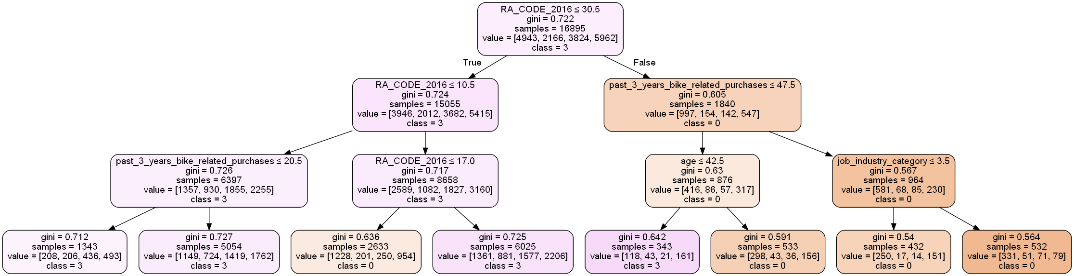
Portion of Decision Tree diagram:

Slide 30
Interpretation:
Most Loyal customers from the list of NEW Customers for the company are–
People with age below 50 years or 40-49 years.
Female customers.
Customers with median past bike purchases as 60.
People employed in Financial Services.
Mass Customers.
Non-Car Owners.
Remoteness Area Cide as 10.

