Slide 1
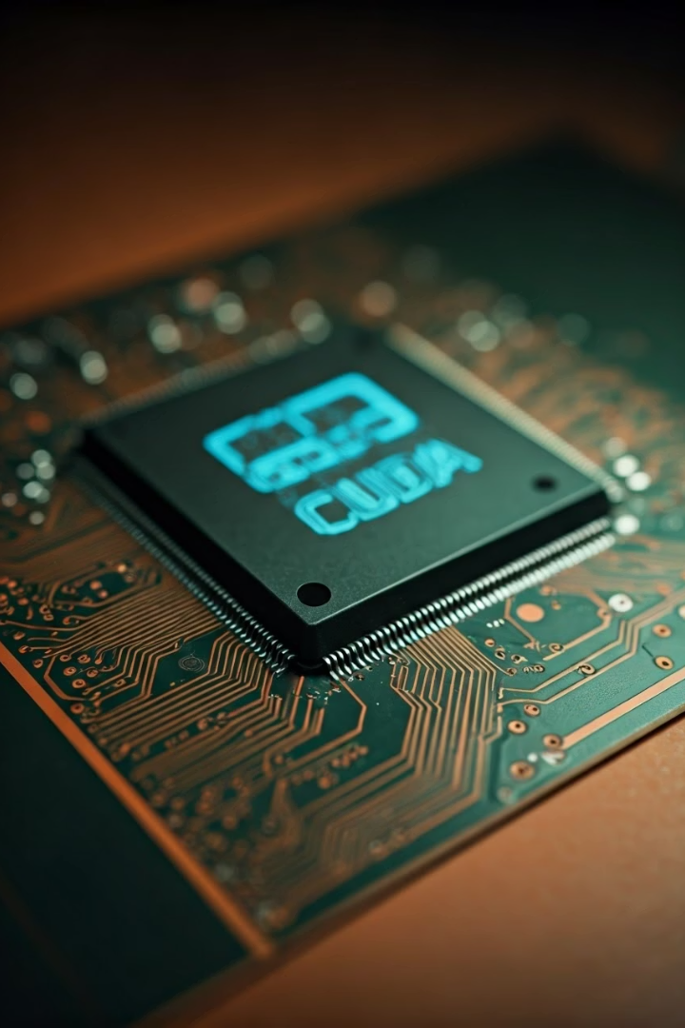

CUDA-Accelerated Stock Trading Model with Technical Indicator Analysis
Leveraging GPU Parallelism for Real-Time Decision-Making
Name: Arnav Gupta
Roll No.: 102203590
by Arnav

Slide 2

Introduction
Overview of Stock Trading Models
Need for Real-Time Analysis
Challenges of traditional models in high-frequency environments.
Why CUDA Acceleration?
Efficiency and speed improvements for decision-making.

Slide 3

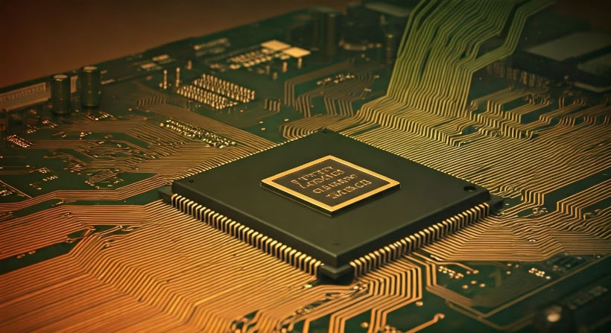
Problem Statement
The Trading Challenge
Objective
Traditional CPU-based methods are slow for real-time trading decisions.
Improve performance by parallelizing key technical indicators using CUDA.

Slide 4
Key Technical Indicators Used
SMA & EMA
RSI
MACD
Simple and Exponential Moving Averages track price trends over specific time periods.
Relative Strength Index measures the speed and change of price movements to identify overbought or oversold conditions.
Moving Average Convergence Divergence reveals changes in strength, direction, momentum, and duration of price trends.
Bollinger Bands
Stochastic Oscillator
Volatility bands placed above and below a moving average to identify potential price breakouts.
Momentum indicator comparing a particular closing price to a range of prices over a certain period.

Slide 5
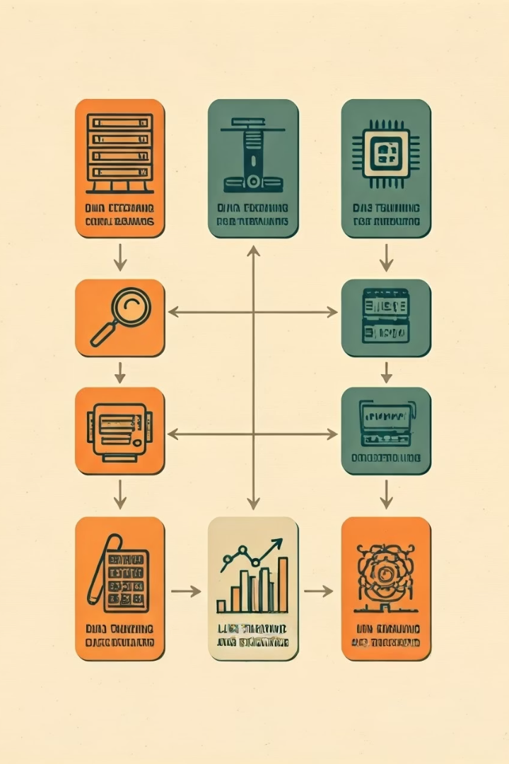
Methodology
Step 1: Data Fetching from Alpha Vantage API
Retrieving historical and real-time stock data through API calls.
Step 2: Technical Indicators Computed using CUDA Kernels
Parallel computation of indicators leveraging GPU architecture.
Step 3: Trade Decision Logic based on Indicators
Algorithmic decision-making using computed technical indicators.
Step 4: Visualization and Portfolio Management via Python
Displaying results and managing trading portfolio through Python interface.
Key Equations: Briefly show core equations like EMA, RSI, etc.

Slide 6





CUDA-Accelerated Logic
Stock Data Input
Historical prices loaded into GPU memory
CUDA Kernels
Parallel computation of indicators
Signal Generation
Buy/sell signals based on indicator values
Decision Output
Trading decisions returned to CPU
CUDA in Action: Parallel computation of technical indicators.
Benchmark Performance: CPU vs GPU execution times.
Diagram: High-level flow of data through CUDA kernels for indicator calculation.

Slide 7
Results and Discussion
Metric
CPU Performance
GPU Performance
Speedup Factor
SMA Calculation
3.4ms
0.6ms
6x
RSI Calculation
6.4ms
1.2ms
5.3x
Full Model Execution
50.7ms
15.3ms
3.3x
Performance: Speedup achieved with CUDA vs traditional CPU.
Trading Results: Log of trades, portfolio growth.
Resource Utilization: GPU load and potential for scalability.
Limitations: Single asset analysis, no real-time visualization, etc.
Future Work: Multi-stock handling, real-time broker integration.

Slide 8
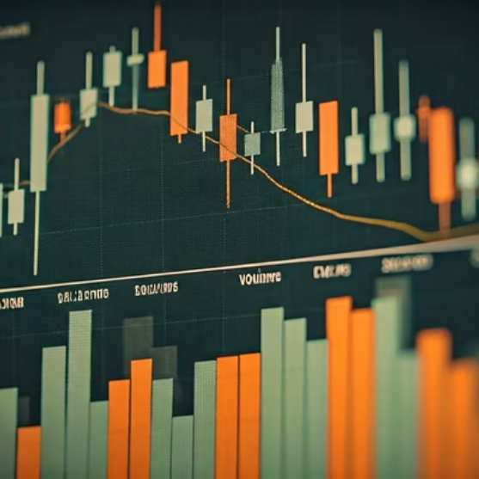
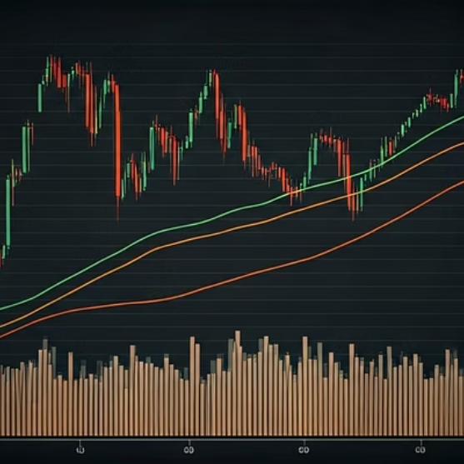
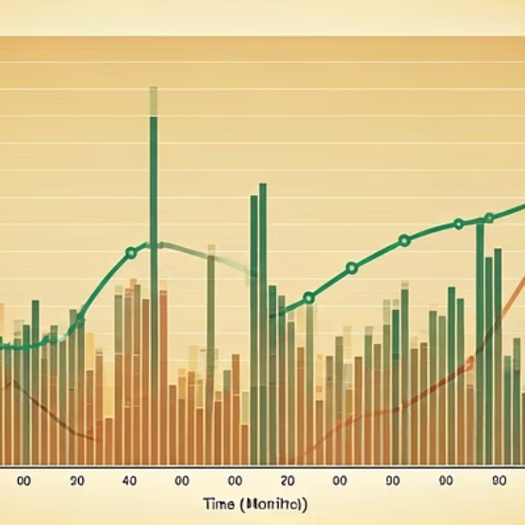
Visualization (Charts/Graphs)
Candlestick Chart: Show an example of price movement.
Indicator Plots: SMA, EMA, Bollinger Bands overlay on price chart.
Portfolio Value: Graph of portfolio value over time showing trade execution points.

Slide 9



Conclusion
Summary of Achievements
1
CUDA acceleration improves real-time decision-making efficiency.
Challenges & Limitations
2
Multi-asset support and real-time broker integration still pending.
Future Directions
3
Broader application to institutional trading or full broker API integration.

