Slide 1
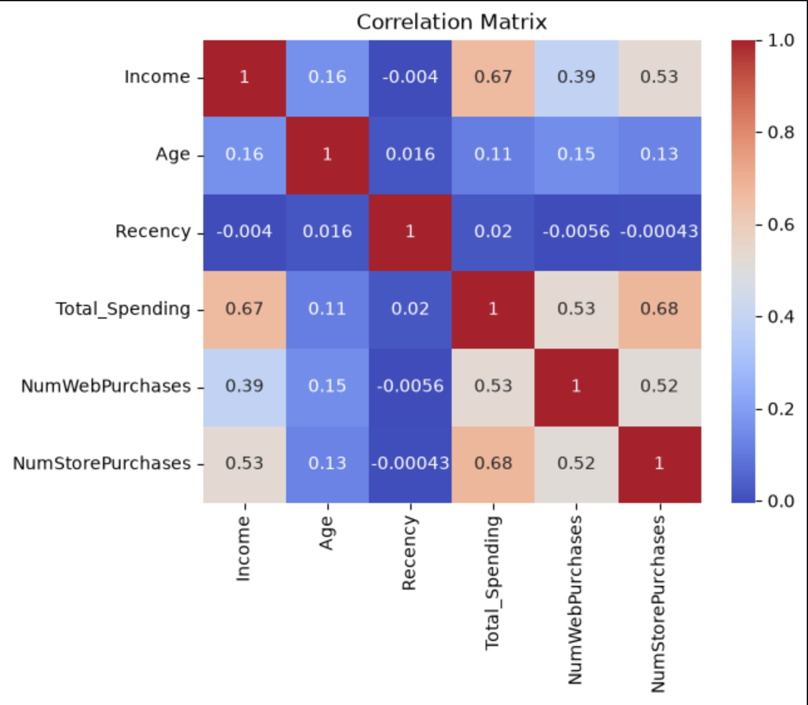
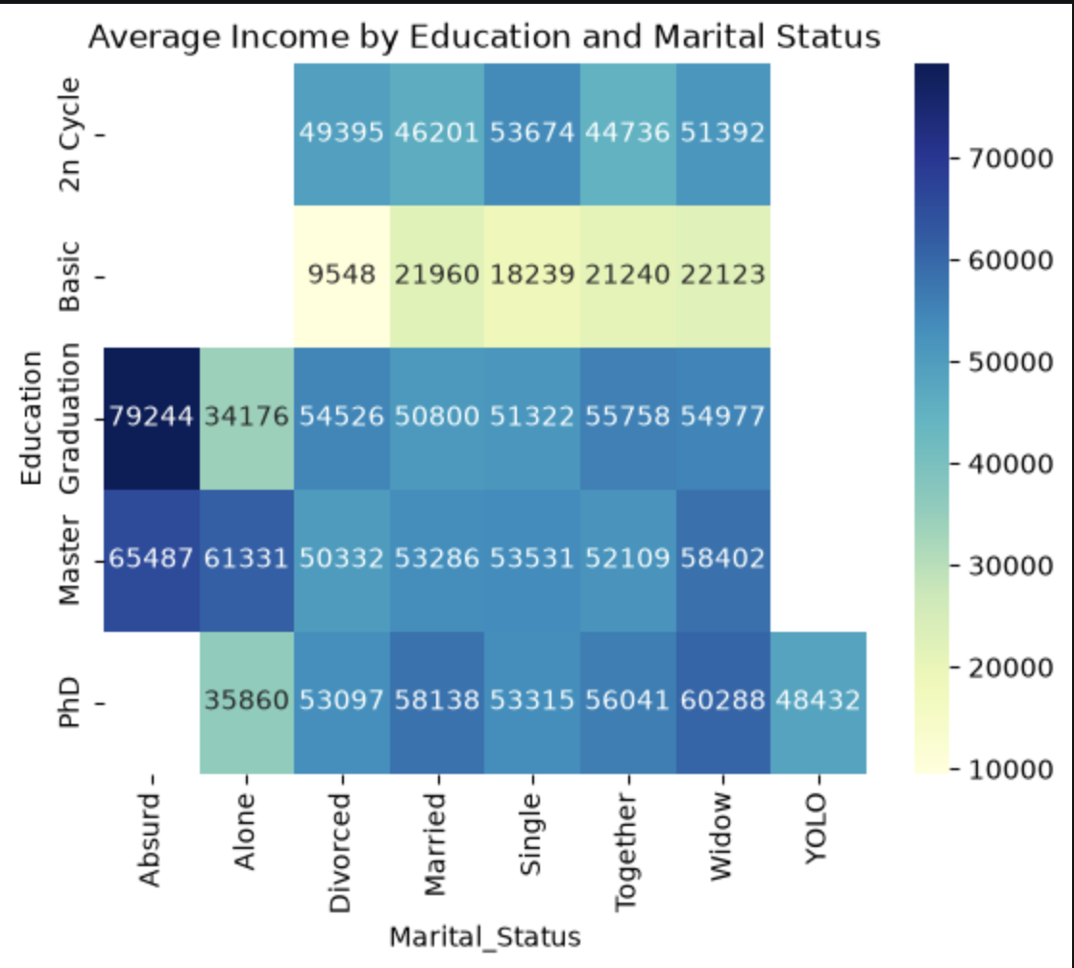
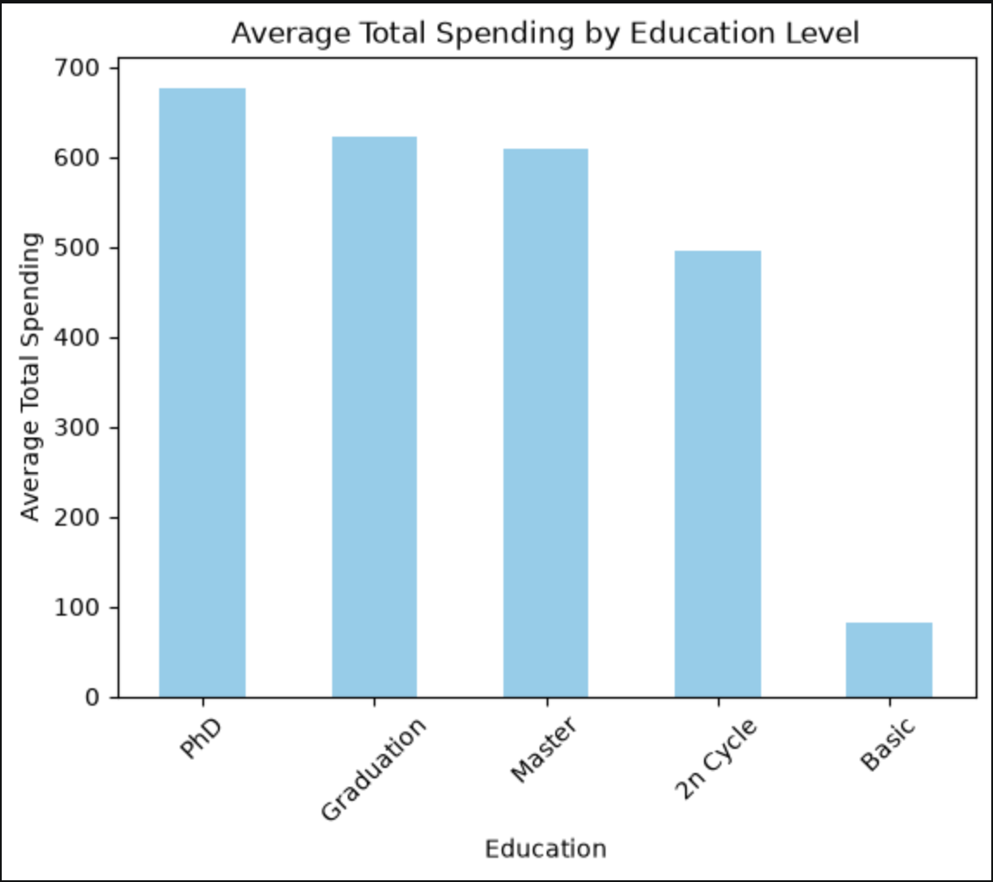
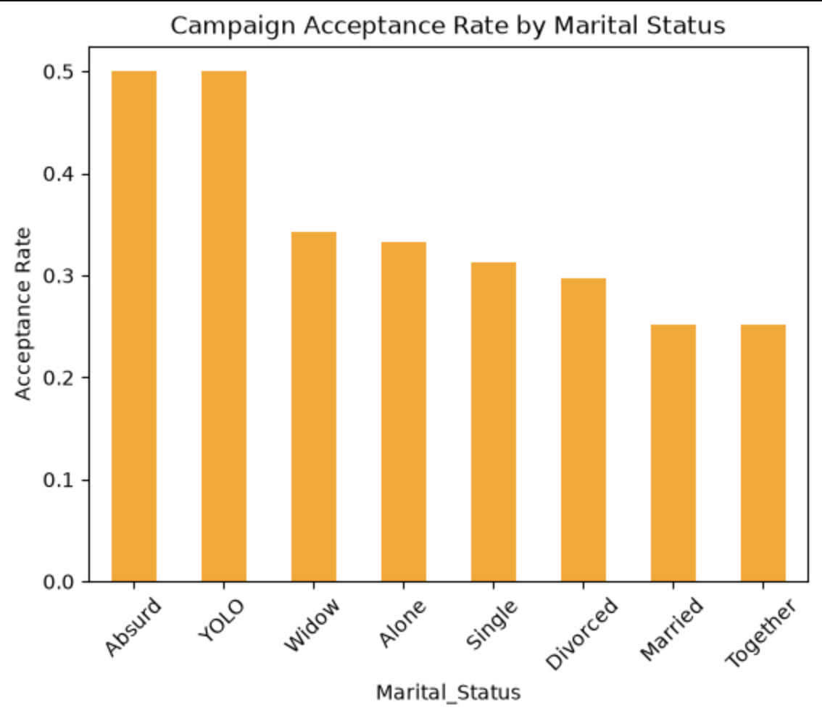
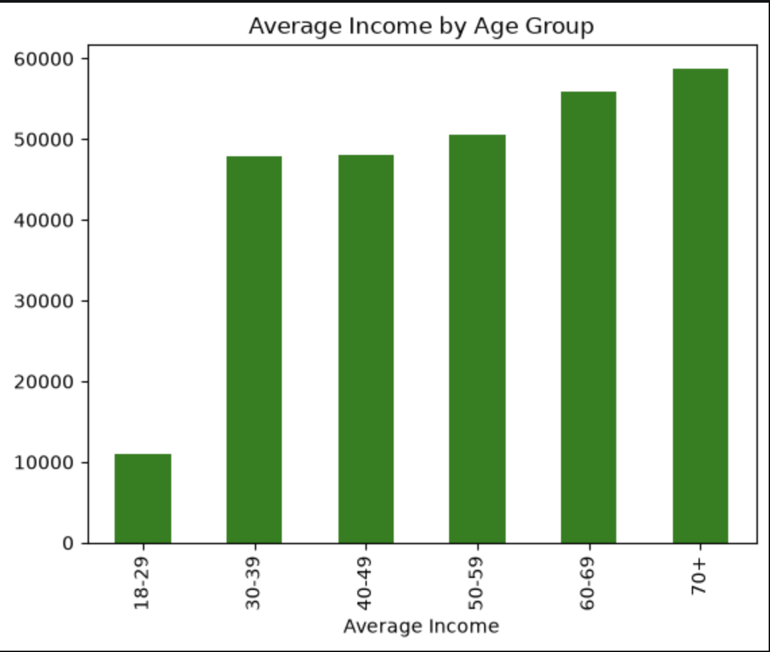
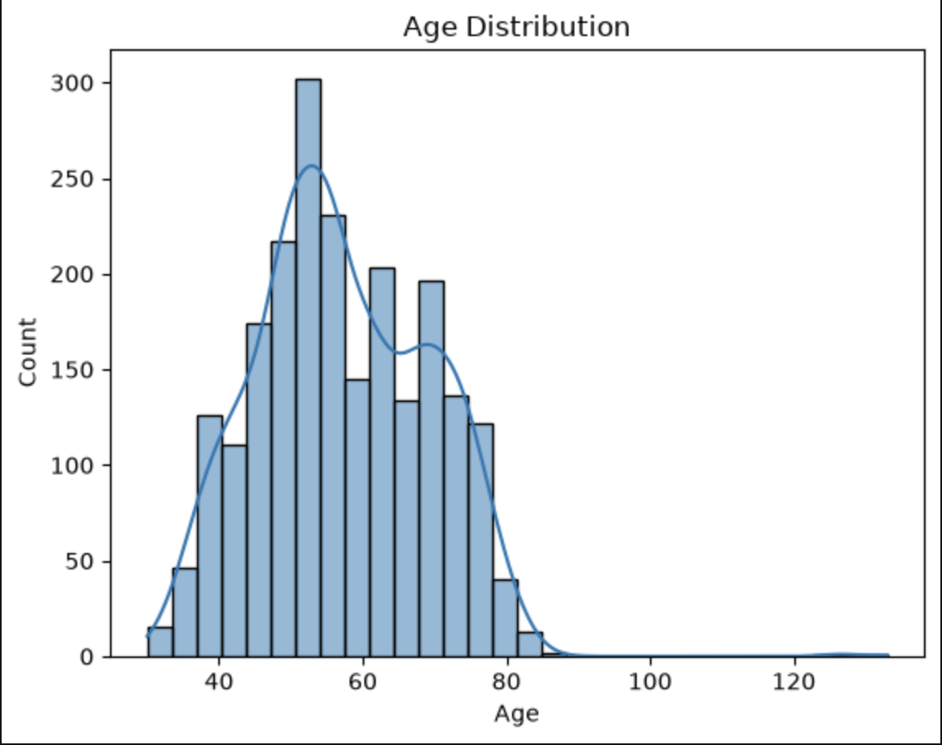
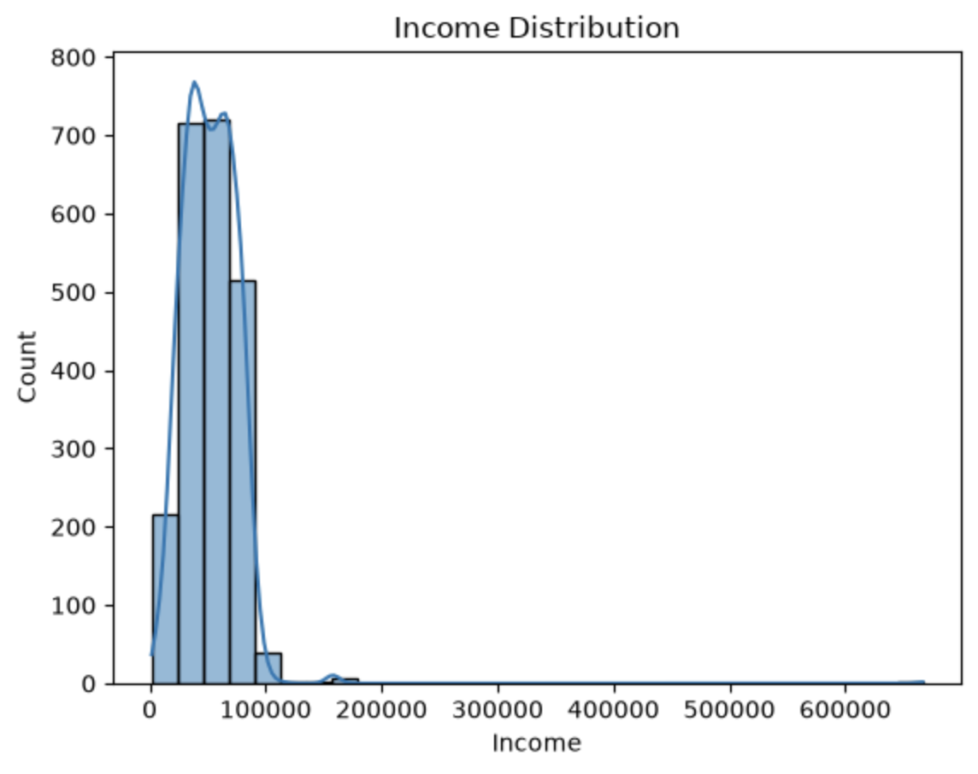
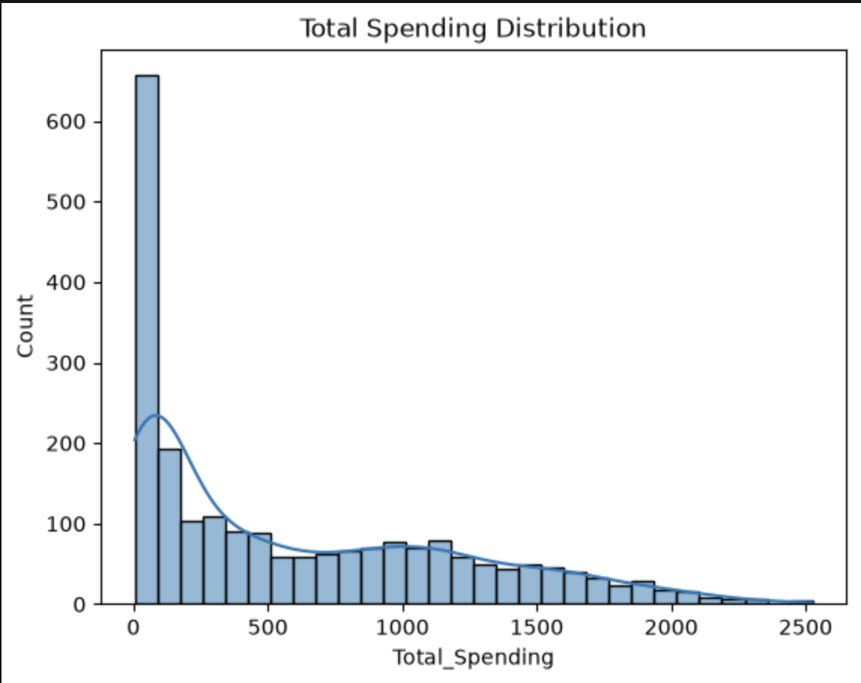
CREDIT RISK ANALYSIS × CUSTOMER SEGMENTATION
MACHINE LEARNING
An Explainable Machine-Learning Framework for Risk-Aware, Customer-Centric Banking Decisions
FINTECH / BANKING
GERMAN CREDIT RISK + CUSTOMER PERSONALITY ANALYSIS | DATA • EDA • ML • SEGMENTATION • DECISION SUPPORT
A3 • RESEARCH POSTER
01
ABSTRACT
06
SYSTEM ARCHITECTURE
10
EDA — RELATIONSHIP STRUCTURE
Financial institutions need both reliable credit-risk assessment and a detailed understanding of customer behaviour. This project integrates supervised credit-risk classification with unsupervised customer segmentation. The credit branch classifies applicants as Good/Bad risk; the segmentation branch identifies natural behavioural groups. Both outputs are connected to explainable, actionable banking recommendations and an interactive Streamlit decision-support layer.
RAW DATA → CLEANING → FEATURE ENGINEERING → MODELING → EXPLANATION → ACTION
DATA
CLEAN
FEATURES
MODELS
DECISION
CREDIT RISK
CUSTOMER SEGMENTATION
CORRELATION
INCOME / AGE
CAMPAIGN RATE
KEYWORDS
Credit Risk
Customer Segmentation
Decision Tree • Random Forest
Extra Trees • XGBoost
K-Means (primary)
Hierarchical • DBSCAN
02
PROBLEM STATEMENT & OBJECTIVES
EXPLAIN → PROFILE → RECOMMEND
11
WHAT THE EDA REVEALS
PROBLEM
• Manual decisions can be slow/inconsistent.
• Generic marketing ignores heterogeneous behaviour.
• High-risk applicants must be detected carefully.
OBJECTIVES
• Predict applicant risk.
• Discover customer groups.
• Predict future segment membership.
• Recommend targeted actions.
07
END-TO-END METHODOLOGY
• Income ↔ Total Spending: r ≈ 0.67
• Total Spending ↔ Store Purchases: r ≈ 0.68
• Total Spending ↔ Web Purchases: r ≈ 0.53
• Recency shows near-zero linear correlation with the selected value/purchase variables.
• Income and spending are strongly right-skewed; extreme observations need careful interpretation.
• Marital-status categories contain anomalies (e.g., Absurd / YOLO), highlighting the need for validation.
01
02
03
04
05
06
07
DATA
EDA
ENGINEER
SCALE
TRAIN
EVALUATE
DEPLOY
Risk evaluation prioritises high-risk recall; clustering evaluation focuses on compactness and separation.
03
DATASETS & FEATURE GROUPS
08
MODEL CONFIGURATION & EVALUATION
GERMAN CREDIT RISK
CUSTOMER PERSONALITY
CREDIT RISK
Decision Tree • Random Forest • Extra Trees • XGBoost
Metrics: Accuracy • Precision • Recall • F1 • Confusion Matrix • ROC-AUC
SEGMENTATION
K-Means • Hierarchical • DBSCAN
Validation: Elbow • Silhouette • Davies–Bouldin • PCA
12
SEGMENT PROFILING → BANKING STRATEGY
Age • Sex • Job • Housing
Credit Amount • Duration
Saving Account • Checking Account
Purpose • other relevant credit attributes
TARGET: Good = Low Risk | Bad = High Risk
Demographic: Age • Income • Education • Marital Status
Behaviour: Total Spending • Web/Store/Catalog/Deals Purchases
Engagement: Website Visits • Campaign Responses • Recency
Financial: product spending + purchase frequency + value
PREMIUM
High income + high spending
Wealth management • premium banking • investment
Select the best model using both statistical performance and business risk considerations.
GROWTH
Moderate income + increasing spending
Upselling • personalised offers
SEGMENTATION VALIDATION & ACTUAL RESULTS
DIGITAL
High web purchases + online engagement
Digital products • mobile campaigns
09
PRICE-SENSITIVE
Low spending + frequent deals
Discounts • budget products
AT-RISK
Low engagement + high recency
Retention • re-engagement
04
PREPROCESSING & FEATURE ENGINEERING
CLEAN
Missing values • duplicates • outliers
ENCODE
Categorical → numerical
SPLIT
Training / testing for supervised learning
ENGINEER
Age • Total Children • Total Spending
Customer Since • AcceptedAny • AgeGroup
TRANSFORM
Scaling / normalization / standardization
13
CUSTOMER SEGMENT PREDICTION & STREAMLIT
NEW CUSTOMER
Profile + spending + purchases + engagement
↓
Random Forest / XGBoost / LightGBM
↓
Predicted Segment
INTERACTIVE APPLICATION
Input → preprocessing → inference
→ segment/risk → profile → recommendation
Real-time decision support
ELBOW METHOD
PCA — K=6
WCSS falls rapidly as K increases and then shows diminishing improvement around K≈6–7. The implemented notebook uses K = 6.
05
EDA: EVIDENCE FROM THE ANALYSIS
ID
N
INCOME
RECENCY
SPEND
PROFILE
C0
298
44.7k
59
199
Older / low-spend
14
REAL-WORLD APPLICATIONS, LIMITATIONS & FUTURE WORK
C1
309
76.5k
24
1171
Premium / high-value
APPLICATIONS
• Automated loan processing
• Risk-aware credit limits
• Digital lending / credit cards
• Targeted marketing & product recommendation
• Retention and financial inclusion
PRODUCTION REQUIREMENTS
• SHAP explainability
• Bias / fairness testing
• Privacy & security
• Regulatory compliance
• Monitoring + retraining
• Add trained credit-risk metrics
C2
394
59.7k
46
894
Engaged / digital
C3
361
74.7k
71
1316
High-value / at-risk
AGE
INCOME
SPENDING
C4
474
34.1k
23
120
Budget / low-spend
C5
380
32.0k
75
106
Low-engagement / at-risk
TECHNOLOGY: Python • Pandas • NumPy • Scikit-learn • XGBoost • K-Means • Matplotlib • Seaborn • Plotly • Streamlit • SHAP
Cluster profiles are interpreted from the supplied notebook's actual cluster means.
FINAL OUTPUT: Risk Prediction + Customer Segments + Actionable Banking Decisions

