Slide 1
Minimum Mode Of 8086
When the minimum operation is selected,the 8086 provides all control signals needed to implement the memory and I/O interface.
The minimum mode signal can be divided into the following basic groups:address/data bus,status,control,control,interrupt and DMA

Slide 2
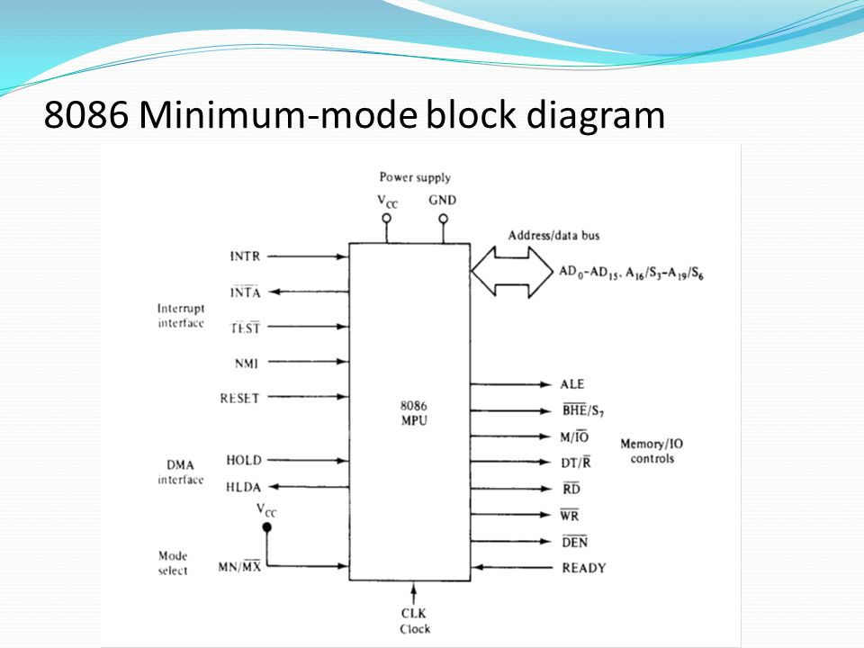

Slide 3
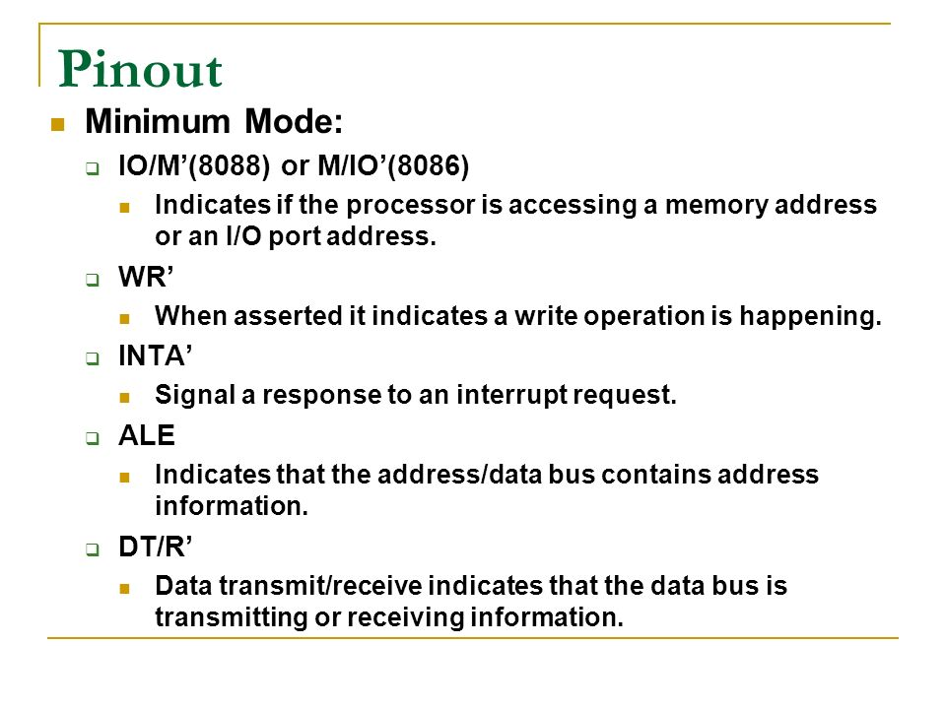

Slide 4
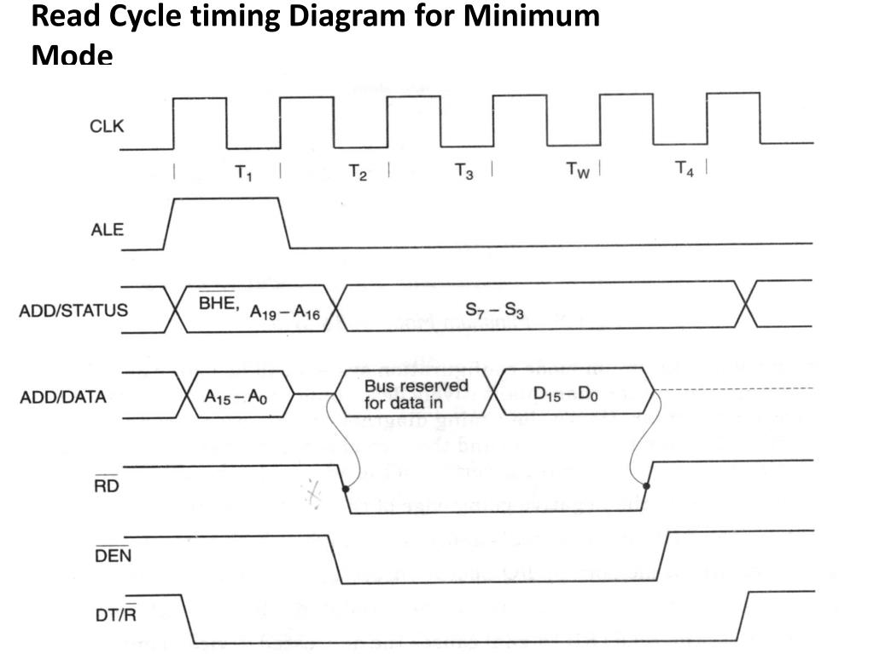

Slide 5
