Slide 1
Product Sales Analysis
Mid term project
By: Dhruvin and Abi
Aug 11, 2023

Slide 2
Goal: Try to predict the revenue generated over next year for an electronic store

Slide 3
Execution Process Steps
Data Import
Pre-processing & EDA
Visualization /
Insights
Dashboard Design
Conclusion & Recommendation
Import .csv files into Python & Tableau.
Cleaning, Merging, Formatting and Statistics.
Create charts including best selling products, revenue by product, demography etc.
Created dashboard to aid stakeholders make decisions.
Used insights and trends to give recommendations for business planning.

Slide 4
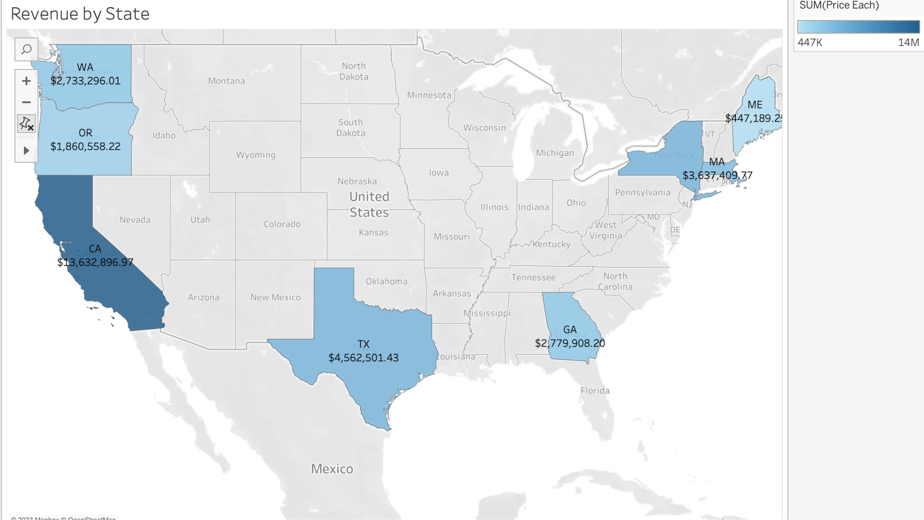

Slide 5
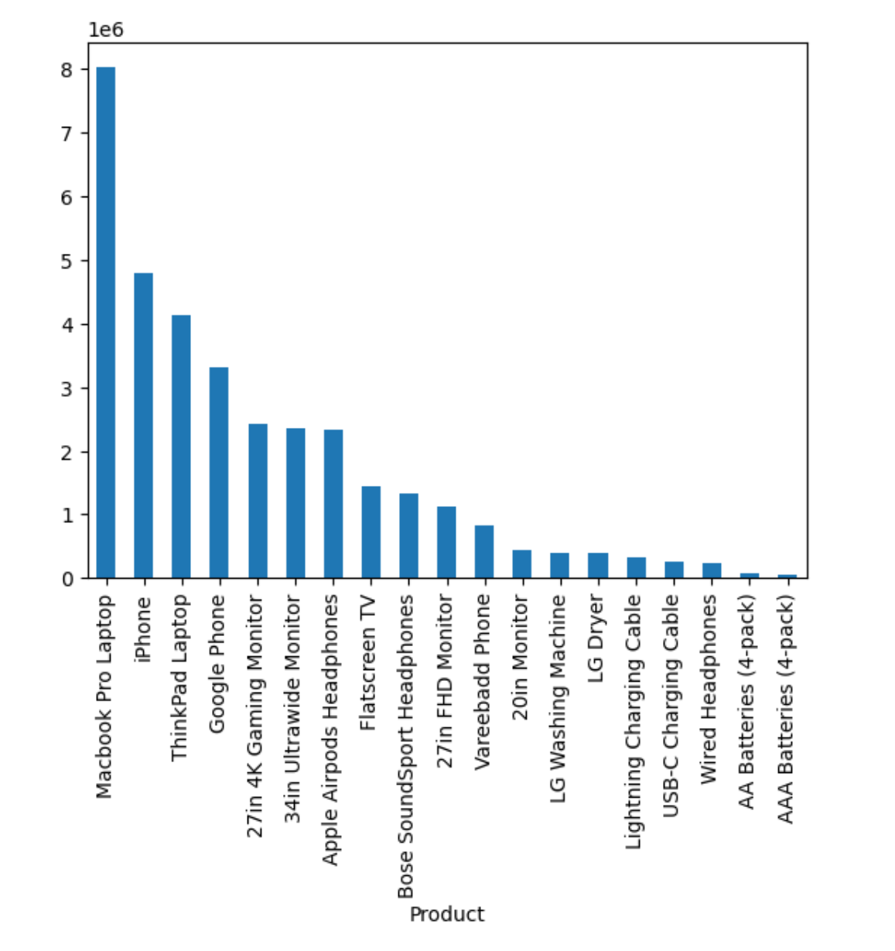
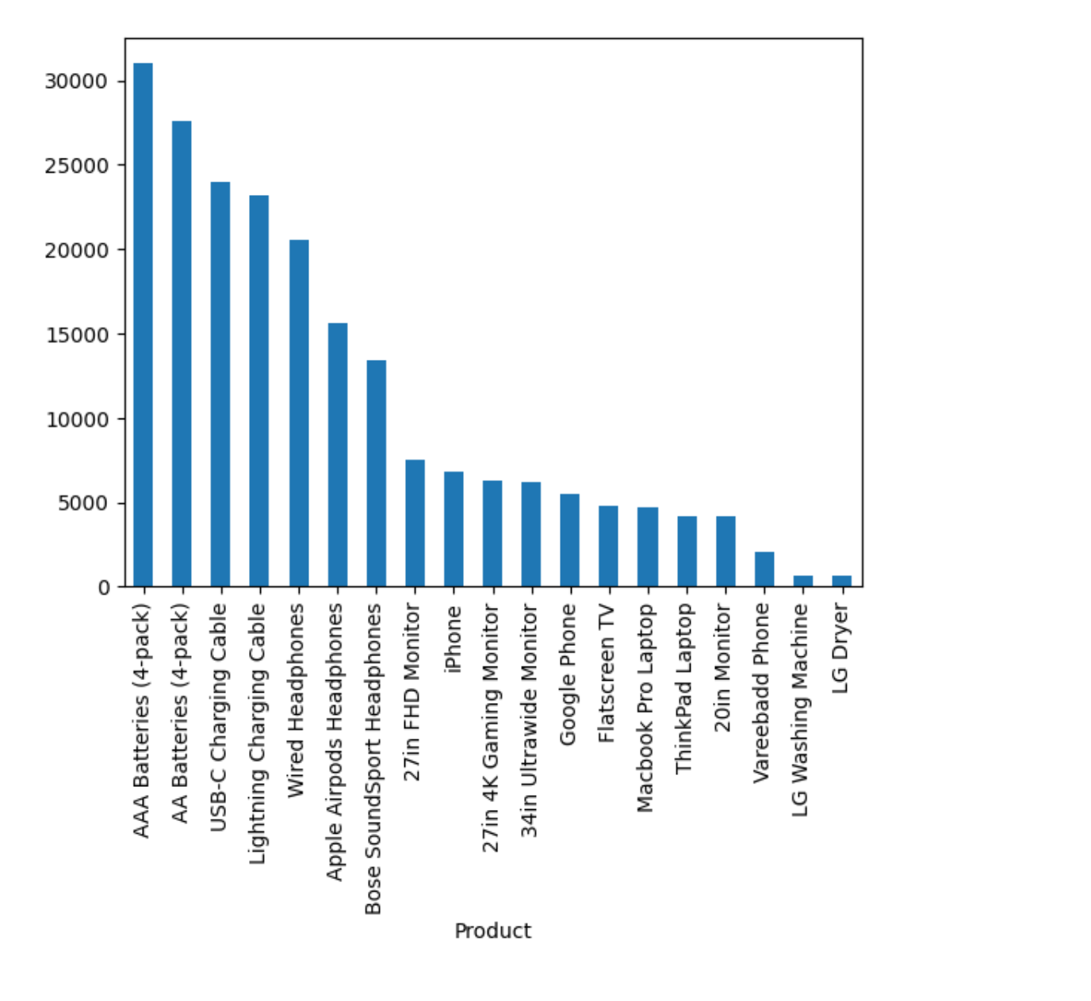
Revenue by Product
Quantity Ordered by Product
Revenue
Quantity Ordered

Slide 6
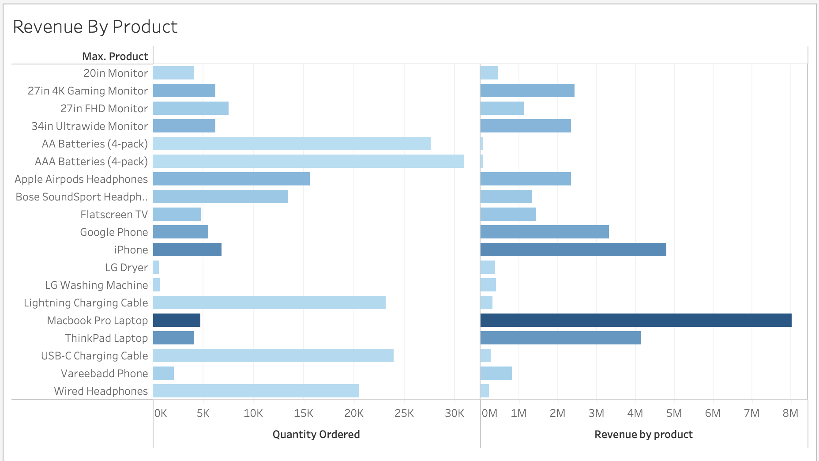

Slide 7
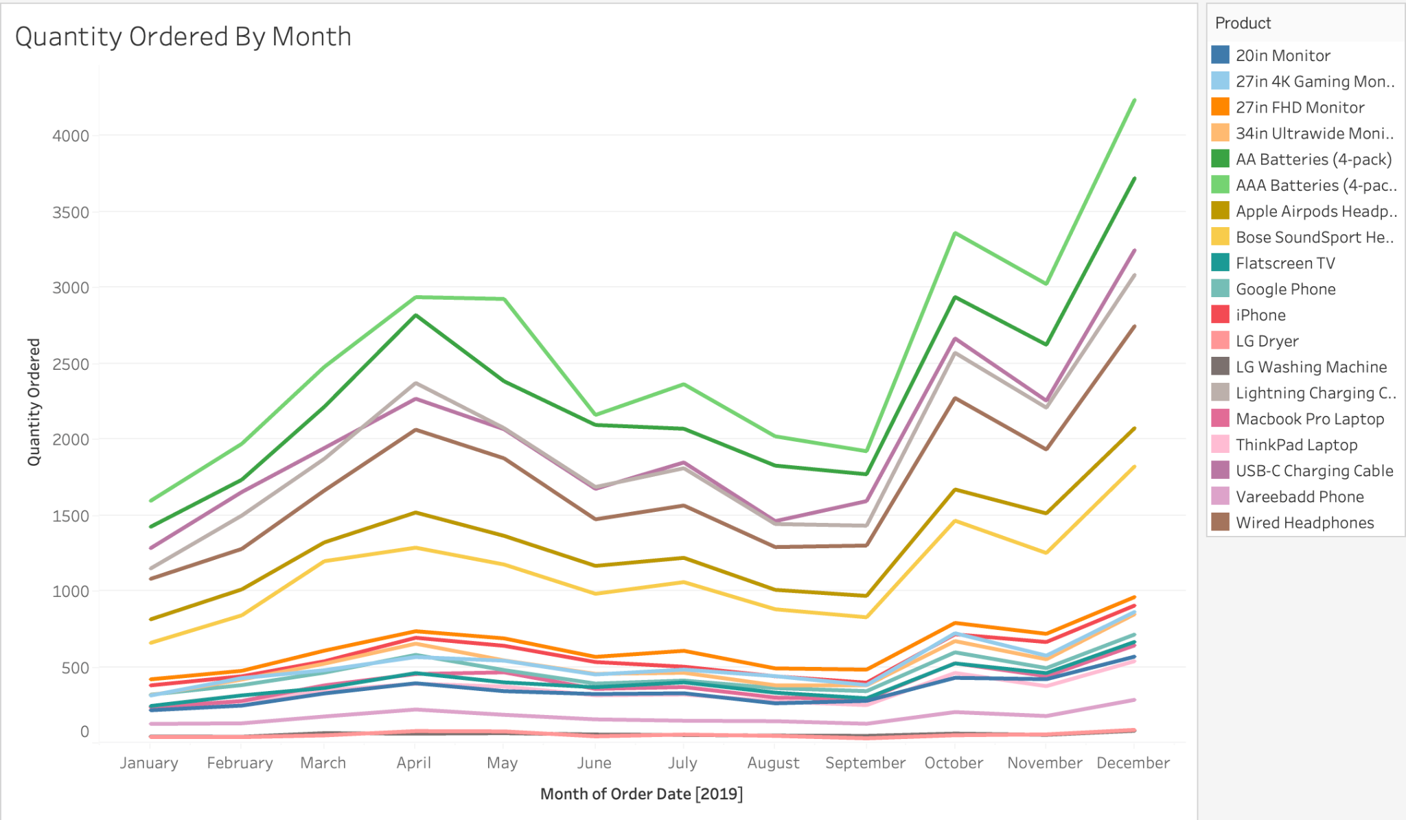

Slide 8
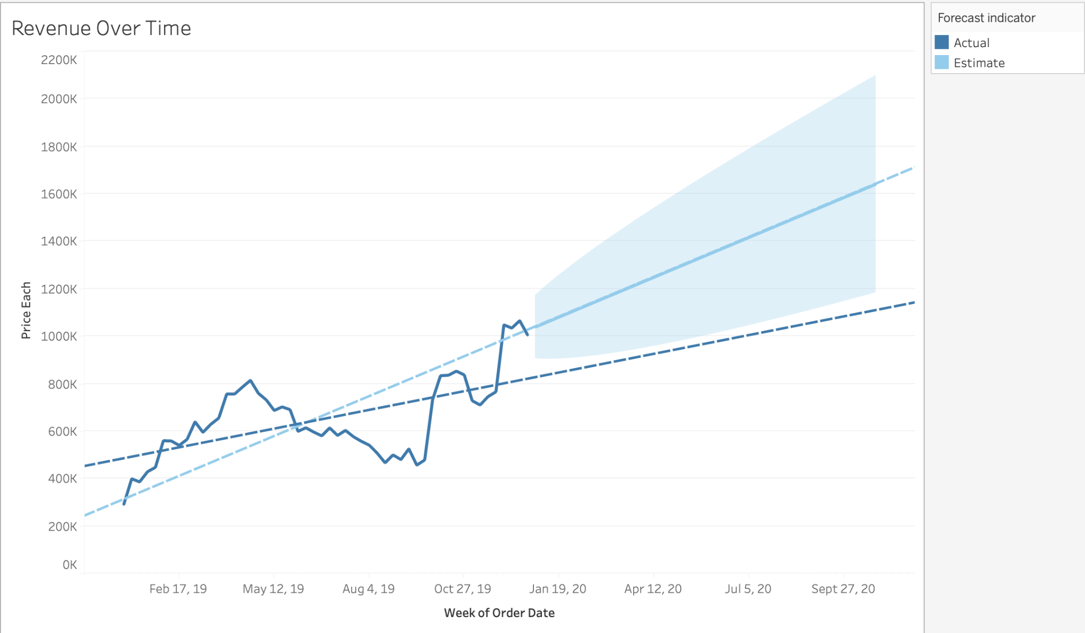
Trendlines

Slide 9
Challenges
Data loading and cleaning
Integrating results obtained from different tools
Time constraints

